Slide 1
Recent Advances in Dynamic Matching
Sayan Bhattacharya
(University of Warwick)

Slide 2
Disclaimer
I will often skip the strongest version of a known result, and present a more intuitive/weaker version.

Slide 3
Introduction

Slide 10
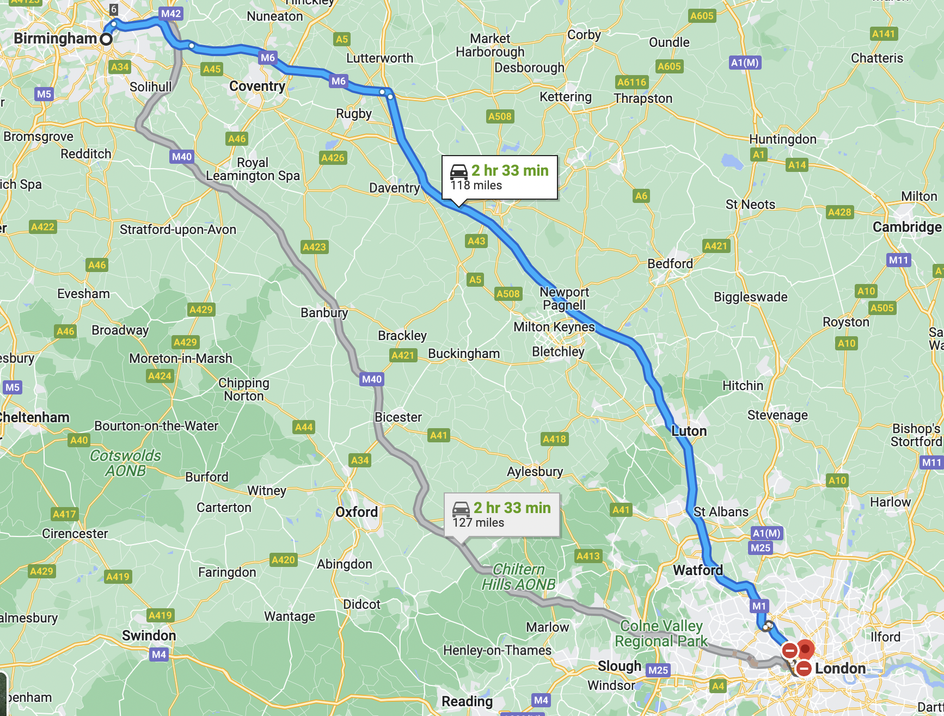

Slide 11


Slide 12


Slide 14
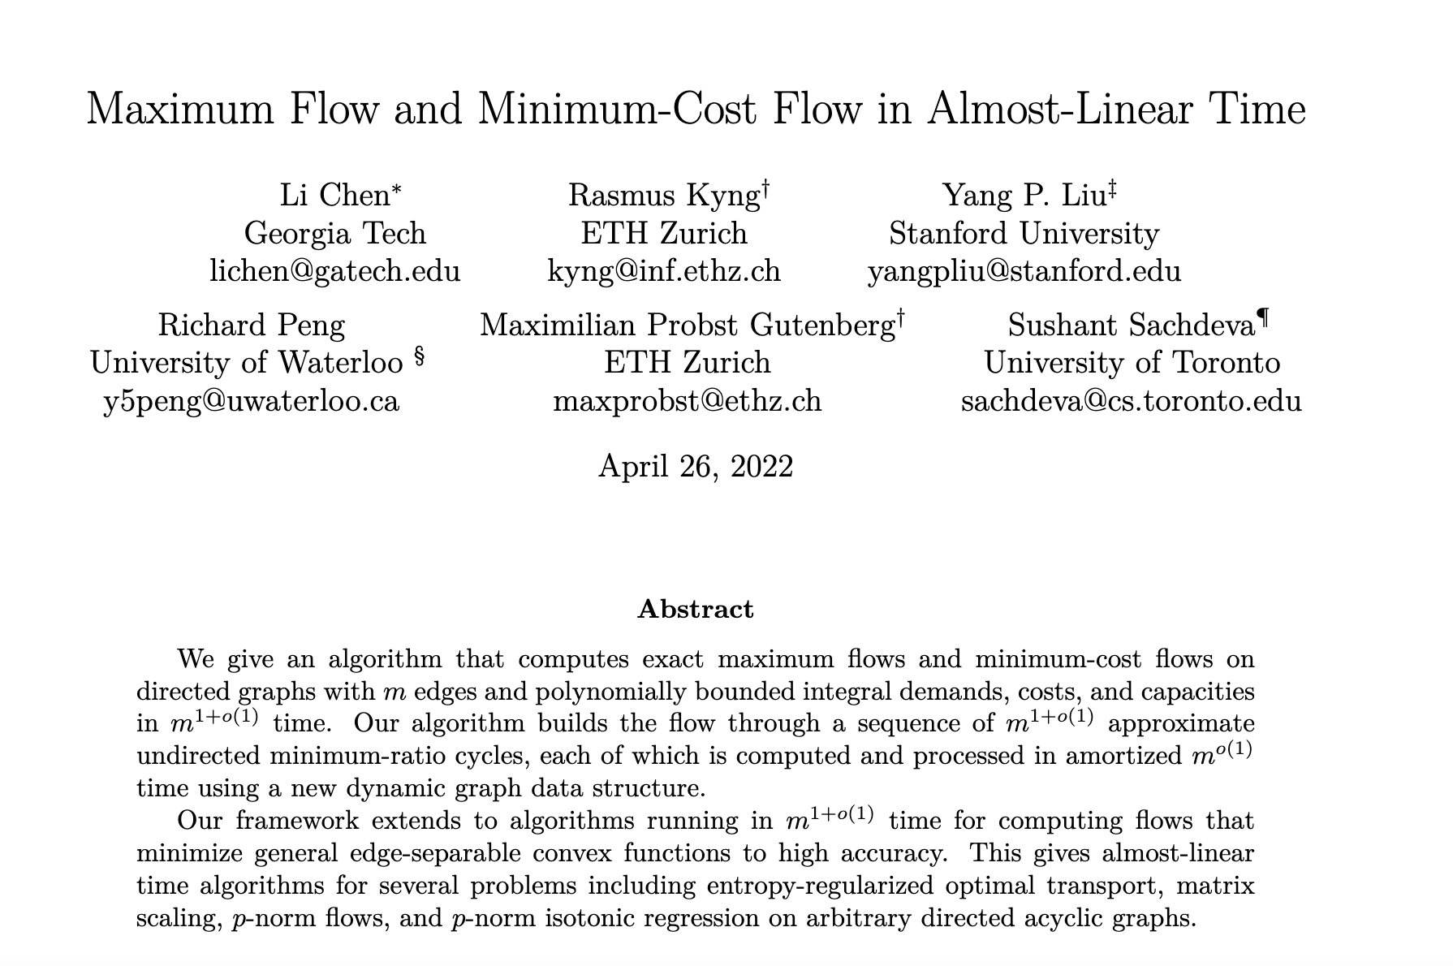

Slide 15


Slide 17
Dynamic Matching: Preliminaries

Slide 33
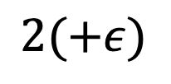

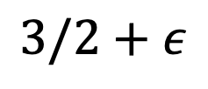


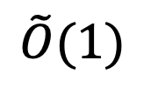
Update Time
$$n$$
$$\sqrt{n}$$
$$\tilde{O}(1)$$
Approximation
ratio
$$1+ε$$
$$3/2+ε$$
$$2(+ε)$$
Notes:
See also my tutorial @ dynamic algorithms workshop in STOC 22

Slide 34
Update Time
[GP13,
PS16,
S18]
$$n$$
$$\sqrt{n}$$
$$\tilde{O}(1)$$
Approximation
ratio
$$1+ε$$
$$3/2+ε$$
$$2(+ε)$$
Notes:
See also my tutorial @ dynamic algorithms workshop in STOC 22

Slide 35
Update Time
[GP13,
PS16,
S18]
$$n$$
$$\sqrt{n}$$
[BS15,16,K22,
GSSU22]
$$\tilde{O}(1)$$
Approximation
ratio
$$1+ε$$
$$3/2+ε$$
$$2(+ε)$$
Notes:
See also my tutorial @ dynamic algorithms workshop in STOC 22

Slide 36
Update Time
[GP13,
PS16,
S18]
$$n$$
$$\sqrt{n}$$
[BS15,16,K22,
GSSU22]
[BGS15, S16, BHN16, BHN17,
CS18, ACSSW18, CZ19, BDHSS19,
BFH19, BK19, W20, BK21, K22]
$$\tilde{O}(1)$$
Approximation
ratio
$$1+ε$$
$$3/2+ε$$
$$2(+ε)$$
Notes:
See also my tutorial @ dynamic algorithms workshop in STOC 22

Slide 37
Update Time
[GP13,
PS16,
S18]
$$n$$
More tradeoffs:
[BHN16, BŁM20, W20, BK21, BK22 , RSW20]
$$\sqrt{n}$$
[BS15,16,K22,
GSSU22]
[BGS15, S16, BHN16, BHN17,
CS18, ACSSW18, CZ19, BDHSS19,
BFH19, BK19, W20, BK21, K22]
$$\tilde{O}(1)$$
Approximation
ratio
$$1+ε$$
$$3/2+ε$$
$$2(+ε)$$
Notes:
See also my tutorial @ dynamic algorithms workshop in STOC 22

Slide 38
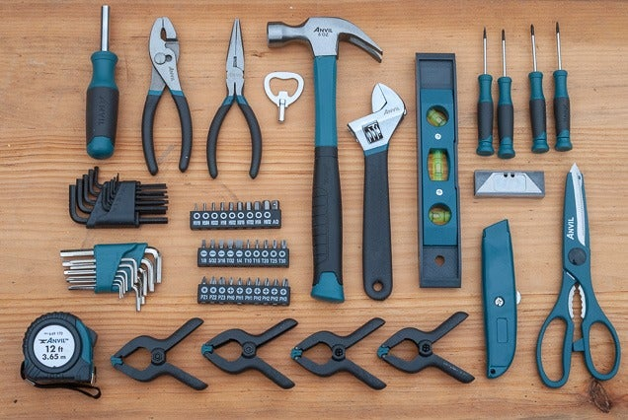
Update Time
[GP13,
PS16,
S18]
$$n$$
More tradeoffs:
[BHN16, BŁM20, W20, BK21, BK22 , RSW20]
$$\sqrt{n}$$
[BS15,16,K22,
GSSU22]
[BGS15, S16, BHN16, BHN17,
CS18, ACSSW18, CZ19, BDHSS19,
BFH19, BK19, W20, BK21, K22]
$$\tilde{O}(1)$$
Approximation
ratio
$$1+ε$$
$$3/2+ε$$
$$2(+ε)$$
Notes:
See also my tutorial @ dynamic algorithms workshop in STOC 22

Slide 39
Update Time
[GP13,
PS16,
S18]
$$n$$
More tradeoffs:
[BHN16, BŁM20, W20, BK21, BK22 , RSW20]
$$\sqrt{n}$$
[BS15,16,K22,
GSSU22]
[BGS15, S16, BHN16, BHN17,
CS18, ACSSW18, CZ19, BDHSS19,
BFH19, BK19, W20, BK21, K22]
$$\tilde{O}(1)$$
Approximation
ratio
$$1+ε$$
$$3/2+ε$$
$$2(+ε)$$
Notes:
See also my tutorial @ dynamic algorithms workshop in STOC 22

Slide 40
Update Time
[GP13,
PS16,
S18]
$$n$$
More tradeoffs:
[BHN16, BŁM20, W20, BK21, BK22 , RSW20]
$$\sqrt{n}$$
[BS15,16,K22,
GSSU22]
[BGS15, S16, BHN16, BHN17,
CS18, ACSSW18, CZ19, BDHSS19,
BFH19, BK19, W20, BK21, K22]
$$\tilde{O}(1)$$
Approximation
ratio
$$1+ε$$
$$3/2+ε$$
$$2(+ε)$$
Notes:
See also my tutorial @ dynamic algorithms workshop in STOC 22

Slide 41
Update Time
[GP13,
PS16,
S18]
$$n$$
More tradeoffs:
[BHN16, BŁM20, W20, BK21, BK22 , RSW20]
$$\sqrt{n}$$
[BS15,16,K22,
GSSU22]
[BGS15, S16, BHN16, BHN17,
CS18, ACSSW18, CZ19, BDHSS19,
BFH19, BK19, W20, BK21, K22]
$$\tilde{O}(1)$$
Approximation
ratio
$$1+ε$$
$$3/2+ε$$
$$2(+ε)$$
Notes:
See also my tutorial @ dynamic algorithms workshop in STOC 22

Slide 42
Update Time
$$n$$
More tradeoffs:
$$\sqrt{n}$$
$$\tilde{O}(1)$$
Approximation
ratio
$$1+ε$$
$$3/2+ε$$
$$2(+ε)$$
Notes:
See also my tutorial @ dynamic algorithms workshop in STOC 22

Slide 43
Update Time
$$n$$
More tradeoffs:
$$\sqrt{n}$$
$$\tilde{O}(1)$$
Approximation
ratio
$$1+ε$$
$$3/2+ε$$
$$2(+ε)$$
Notes:
See also my tutorial @ dynamic algorithms workshop in STOC 22

Slide 44
Update Time
$$n$$
More tradeoffs:
$$\sqrt{n}$$
$$\tilde{O}(1)$$
Approximation
ratio
$$1+ε$$
$$3/2+ε$$
$$2(+ε)$$
Notes:
See also my tutorial @ dynamic algorithms workshop in STOC 22

Slide 45
Update Time
$$n$$
More tradeoffs:
$$\sqrt{n}$$
$$\tilde{O}(1)$$
Approximation
ratio
$$1+ε$$
$$3/2+ε$$
$$2(+ε)$$
Notes:
See also my tutorial @ dynamic algorithms workshop in STOC 22

Slide 46
Take 1: Periodic Rebuilding [Gupta, Peng’13]
(an alternate proof using vertex sparsification)

Slide 61


Slide 70
Update Time
[GP13,
PS16,
S18]
$$n$$
More tradeoffs:
[BHN16, BŁM20, W20, BK21, BK22 , RSW20]
$$\sqrt{n}$$
[BS15,16,K22,
GSSU22]
[BGS15, S16, BHN16, BHN17,
CS18, ACSSW18, CZ19, BDHSS19,
BFH19, BK19, W20, BK21, K22]
$$\tilde{O}(1)$$
Approximation
ratio
$$1+ε$$
$$3/2+ε$$
$$2(+ε)$$
Notes:
See also my tutorial @ dynamic algorithms workshop in STOC 22

Slide 71

Update Time
[GP13,
PS16,
S18]
$$n$$
More tradeoffs:
[BHN16, BŁM20, W20, BK21, BK22 , RSW20]
$$\sqrt{n}$$
[BS15,16,K22,
GSSU22]
[BGS15, S16, BHN16, BHN17,
CS18, ACSSW18, CZ19, BDHSS19,
BFH19, BK19, W20, BK21, K22]
$$\tilde{O}(1)$$
Approximation
ratio
$$1+ε$$
$$3/2+ε$$
$$2(+ε)$$
Notes:
See also my tutorial @ dynamic algorithms workshop in STOC 22

Slide 72
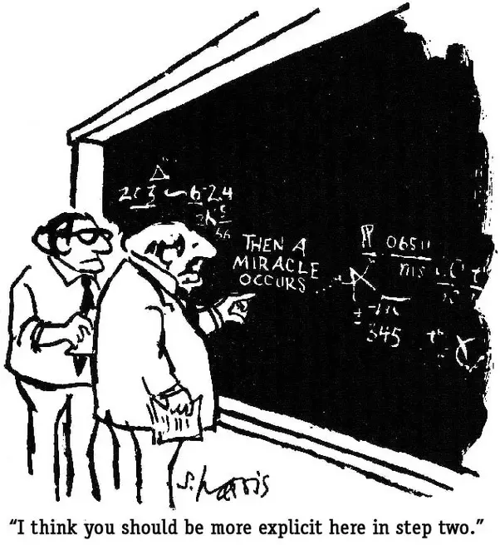
Update Time
[GP13,
PS16,
S18]
$$n$$
More tradeoffs:
[BHN16, BŁM20, W20, BK21, BK22 , RSW20]
$$\sqrt{n}$$
[BS15,16,K22,
GSSU22]
[BGS15, S16, BHN16, BHN17,
CS18, ACSSW18, CZ19, BDHSS19,
BFH19, BK19, W20, BK21, K22]
$$\tilde{O}(1)$$
Approximation
ratio
$$1+ε$$
$$3/2+ε$$
$$2(+ε)$$
Notes:
See also my tutorial @ dynamic algorithms workshop in STOC 22

Slide 73
Take 2: Dynamic Greedy

Slide 87
Take 2-(a): Randomized Greedy

Slide 98
Update Time
[GP13,
PS16,
S18]
$$n$$
More tradeoffs:
[BHN16, BŁM20, W20, BK21, BK22 , RSW20]
$$\sqrt{n}$$
[BS15,16,K22,
GSSU22]
[BGS15, S16, BHN16, BHN17,
CS18, ACSSW18, CZ19, BDHSS19,
BFH19, BK19, W20, BK21, K22]
$$\tilde{O}(1)$$
Approximation
ratio
$$1+ε$$
$$3/2+ε$$
$$2(+ε)$$
Notes:
See also my tutorial @ dynamic algorithms workshop in STOC 22

Slide 99
Dynamic Matching with Better-than-2 Approximation in Polylogarithmic Update Time
Joint work with Peter Kiss, Thatchaphol Saranurak and David Wajc.

Slide 101
Overview of Our Techniques
(bipartite graph, oblivious adversary, amortized update time, 1.99 approximation ratio)

Slide 104
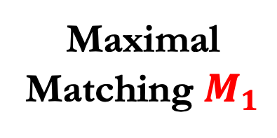
Maximal
Matching $M_{1}$

Slide 105
Maximal
Matching $M_{1}$

Slide 106
Maximal
Matching $M_{1}$
M’

Slide 107
Maximal
Matching $M_{1}$
M’

Slide 108
Maximal
Matching $M_{1}$
M’

Slide 109

Maximal
Matching $M_{1}$
M’

Slide 118
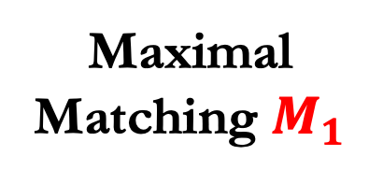
Maximal
Matching $M_{1}$

Slide 119



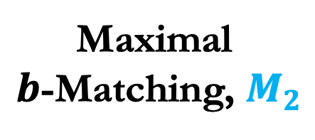
Maximal
Matching $M_{1}$
Maximal
$b$-Matching, $M_{2}$
$$+$$
$$≤1$$
match
$≤b$
match

Slide 120
Maximal
Matching $M_{1}$
Maximal
$b$-Matching, $M_{2}$
$$+$$
$$≤1$$
match
$≤b$
match

Slide 121
Maximal
Matching $M_{1}$
Maximal
$b$-Matching, $M_{2}$
$$+$$
$$≤1$$
match
$≤b$
match

Slide 122
Maximal
Matching $M_{1}$
Maximal
$b$-Matching, $M_{2}$
$$+$$
$$≤1$$
match
$≤b$
match

Slide 123
Maximal
Matching $M_{1}$
Maximal
$b$-Matching, $M_{2}$
$$+$$
$$≤1$$
match
$≤b$
match

Slide 124
Maximal
Matching $M_{1}$
Maximal
$b$-Matching, $M_{2}$
$$+$$
$$≤1$$
match
$≤b$
match

Slide 125
Maximal
Matching $M_{1}$
Maximal
$b$-Matching, $M_{2}$
$$+$$
$$≤1$$
match
$≤b$
match

Slide 126
Maximal
Matching $M_{1}$
Maximal
$b$-Matching, $M_{2}$
$$+$$
$$≤1$$
match
$≤b$
match

Slide 127
Maximal
Matching $M_{1}$
Maximal
$b$-Matching, $M_{2}$
$$+$$
$$≤1$$
match
$≤b$
match

Slide 128
Maximal
Matching $M_{1}$
Maximal
$b$-Matching, $M_{2}$
$$+$$
$$≤1$$
match
$≤b$
match

Slide 129
Maximal
Matching $M_{1}$
Maximal
$b$-Matching, $M_{2}$
$$+$$
$$≤1$$
match
$≤b$
match

Slide 130
Maximal
Matching $M_{1}$
Maximal
$b$-Matching, $M_{2}$
$$+$$
$$≤1$$
match
$≤b$
match

Slide 131
Maximal
Matching $M_{1}$
Maximal
$b$-Matching, $M_{2}$
$$+$$
$$≤1$$
match
$≤b$
match

Slide 132
Maximal
Matching $M_{1}$
Maximal
$b$-Matching, $M_{2}$
$$+$$
$$≤1$$
match
$≤b$
match

Slide 133
Maximal
Matching $M_{1}$
Maximal
$b$-Matching, $M_{2}$
$$+$$
$$≤1$$
match
$≤b$
match

Slide 134
Maximal
Matching $M_{1}$
Maximal
$b$-Matching, $M_{2}$
$$+$$
$$≤1$$
match
$≤b$
match

Slide 135
Maximal
Matching $M_{1}$
Maximal
$b$-Matching, $M_{2}$
$$+$$
$$≤1$$
match
$≤b$
match

Slide 136
Maximal
Matching $M_{1}$
Maximal
$b$-Matching, $M_{2}$
$$+$$
$$≤1$$
match
$≤b$
match

Slide 137
Maximal
Matching $M_{1}$
Maximal
$b$-Matching, $M_{2}$
$$+$$
$$≤1$$
match
$≤b$
match

Slide 138
Maximal
Matching $M_{1}$
Maximal
$b$-Matching, $M_{2}$
$$+$$
$$≤1$$
match
$≤b$
match

Slide 139

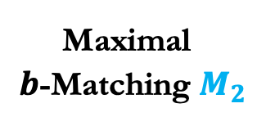


Maximal
Matching $M_{1}$
Maximal
$b$-Matching $M_{2}$
$$≤1$$
match
$≤b$
match

Slide 140
Maximal
Matching $M_{1}$
Maximal
$b$-Matching $M_{2}$
$$≤1$$
match
$≤b$
match

Slide 141
Maximal
Matching $M_{1}$
Maximal
$b$-Matching $M_{2}$
$$≤1$$
match
$≤b$
match

Slide 142
Maximal
Matching $M_{1}$
Maximal
$b$-Matching $M_{2}$
$$≤1$$
match
$≤b$
match

Slide 143
Maximal
Matching $M_{1}$
Maximal
$b$-Matching $M_{2}$
$$≤1$$
match
$≤b$
match

Slide 144
Maximal
Matching $M_{1}$
Maximal
$b$-Matching $M_{2}$
$$≤1$$
match
$≤b$
match

Slide 145
Maximal
Matching $M_{1}$
Maximal
$b$-Matching $M_{2}$
$$≤1$$
match
$≤b$
match

Slide 146
Maximal
Matching $M_{1}$
Maximal
$b$-Matching $M_{2}$
$$≤1$$
match
$≤b$
match

Slide 147
Maximal
Matching $M_{1}$
Maximal
$b$-Matching $M_{2}$
$$≤1$$
match
$≤b$
match

Slide 148
Maximal
Matching $M_{1}$
Maximal
$b$-Matching $M_{2}$
$$≤1$$
match
$≤b$
match

Slide 149
Maximal
Matching $M_{1}$
Maximal
$b$-Matching $M_{2}$
$$≤1$$
match
$≤b$
match

Slide 150
Open Questions

Slide 151
Update Time
[GP13,
PS16,
S18]
$$n$$
More tradeoffs:
[BHN16, BŁM20, W20, BK21, BK22 , RSW20]
$$\sqrt{n}$$
[BS15,16,K22,
GSSU22]
[BGS15, S16, BHN16, BHN17,
CS18, ACSSW18, CZ19, BDHSS19,
BFH19, BK19, W20, BK21, K22]
$$\tilde{O}(1)$$
Approximation
ratio
$$1+ε$$
$$3/2+ε$$
$$2(+ε)$$
Notes:
See also my tutorial @ dynamic algorithms workshop in STOC 22

Slide 152
Update Time
$$n$$
More tradeoffs:
$$\sqrt{n}$$
$$\tilde{O}(1)$$
Approximation
ratio
$$1+ε$$
$$3/2+ε$$
$$2(+ε)$$
Notes:
See also my tutorial @ dynamic algorithms workshop in STOC 22

Slide 153
Update Time
$$n$$
More tradeoffs:
$$\sqrt{n}$$
$$\tilde{O}(1)$$
Approximation
ratio
$$1+ε$$
$$3/2+ε$$
$$2(+ε)$$
Notes:
See also my tutorial @ dynamic algorithms workshop in STOC 22

Slide 154
Thank you!

