Slide 1
Vital edges and sensitivity oracles for (s,t)-mincuts
Surender Baswana
Department of CSE, IIT Kanpur
Joint work with Koustav Bhanja
Research supported by Tapas Mishra Memorial Chair

Slide 2









($s$,$t$)-cut
$A⊂V$, with
$s∈A$, $t∈\overline{A}$
$$s$$
$$t$$
$$A$$
$$\overline{A}$$
$G$=($V,E$)
$n=|V|$, $m=|E|$
$c\left(e\right)≥0$ for each $e∈E$.

Slide 3




($s$,$t$)-cut
$A⊂V$, with
$s∈A$, $t∈\overline{A}$
$Cut(A,\overline{A})$=
{$\left(x,y\right)∈E$ |$x∈A,y∈\overline{A}$ or $y∈A,x∈\overline{A}$}
Capacity of a cut:
$c(A,\overline{A})$=
$$\sum_{\left(u,v\right)∈E,u∈A, v∈\overline{A}}{c(u,v)}$$
($s$,$t$)-mincut : a ($s$,$t$)-cut with least capacity
$$f^{∗}$$
$$s$$
$$t$$
$$A$$
$$\overline{A}$$
$G$=($V,E$)
Fastest algorithm to compute ($s$,$t$)-mincut:
$$O(mn)$$
Orlin [2013]

Slide 4



















($s$,$t$)-mincut
$E_{min}$ : set of edges that appear in at least 1 ($s$,$t$)-mincut
$$2$$
$$1$$
$$2$$
$$2$$
$$2$$
$$2$$
$$1$$
$$s$$
$$t$$
$$1$$
$$1$$
$$1$$
$$1$$
$$1$$
$$1$$
$$1$$
$$1$$

Slide 5












($s$,$t$)-maxflow
Capacity constraint
Conservation constraint
$$2$$
$$1$$
$$1$$
$$1$$
$$2$$
$$2$$
$$2$$
$$2$$
$$2$$
$$1$$
$$1$$
$$2$$
$$1$$
$$s$$
$$1$$
$$t$$
$$1$$
$$1$$
$$1$$
$$1$$
$$1$$
$$1$$
$$1$$
$$1$$
$$1$$
$$1$$
$$1$$
$$1$$

Slide 6

Ford Fulkerson Algorithm [1956]
1st algorithm to compute ($s$,$t$)-maxflow
($s$,$t$)-maxflow = ($s$,$t$)-mincut
Residual Network $G_{f}$

Slide 7









Mincut for an edge
Let $e=(u,v)$ be an edge in $G$.
Definition:
A ($s,t$)-cut of least capacity that keeps $u$ on side of $s$ and $v$ on side of $t$.
$$∞$$
$$s$$
$$u$$
$$e$$
$$v$$
$$t$$
$$∞$$
$$G$$

Slide 8







FlowCut Property
$$e∈E_{min}$$
$A$ is mincut for $e$ if and only if
For each ($s,t$)-maxflow $f$,
Every outgoing edge of $A$ is fully saturated.
Every incoming edge carries 0 flow.
$$e$$
$$s$$
$$t$$
$$A$$
$$\overline{A}$$
$$G$$

Slide 9

Part I
$\left(s,t\right)$-mincuts:
Compact Structures,
Combinatorial Results
Picard and Queyranne [1980]

Slide 10




Closed under intersection and union
$$A′$$
Let $A$ and $A$’ define any two ($s,t$)-mincuts.
$A∩A′$ is a ($s,t$)-mincut.
$A∪A′$ is a ($s,t$)-mincut.
$$s$$
$$t$$
$$A$$

Slide 11
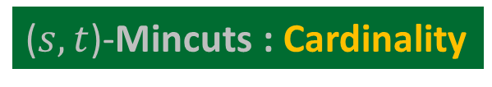

($s,t$)-Mincuts : Cardinality
source
sink
$n$ nodes

Slide 12

($s,t$)-Mincuts : Cardinality
$2^{n}$ Mincuts
source
sink
$n$ nodes

Slide 13





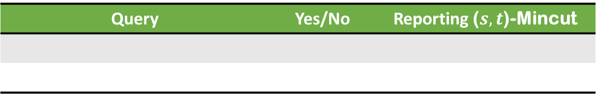



Data Structure for ($s,t$)-Mincuts
$$s$$
$$e$$
$$t$$
$$G$$
Query | Yes/No | Reporting ($s,t$)-Mincut
$O\left(mn\right)$ size
EdgeQuery($e$)
$$O(1)$$
$$O(n)$$

Slide 14










Data Structure for ($s,t$)-Mincuts
$$y$$
$$s$$
$$t$$
$$x$$
$$∞$$
$$G$$
Query | Yes/No | Reporting ($s,t$)-Mincut
$O\left(mn\right)$ size
EdgeQuery($e$)
$$O(1)$$
$$O(n)$$
$O\left(n^{3}\right)$ size
VertexQuery($x$,$y$)
$$O(1)$$
$$O(n)$$
$O\left(n\right)$ size

Slide 15











A simplifying assumption about $G$
For each $x$in $G$, $s⇝x$
➔
Every vertex $x$has a path to $s$ in $G_{f}$
Every vertex $x$has a path from $t$ in $G_{f}$
$⇝t$
$f$ : any ($s,t$)-flow of non-zero value in $G$
$$s$$
$$t$$
$$s$$
$$t$$
$$x$$
$$x$$
$$G_{f}$$
$$G$$

Slide 16










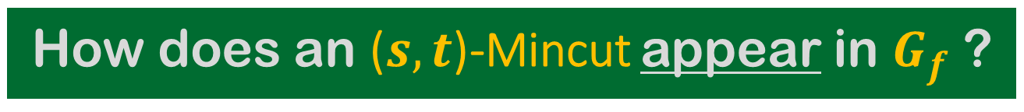



How does an ($s,t$)-Mincut appear in $G_{f}$ ?
$f$ : a ($s,t$)-maxflow in $G$
$f_{out}\left(A\right)−f_{in}\left(A\right)=f^{∗}$
$f_{out}\left(A\right)≤cap(A,\overline{A})$
➔ $f_{out}\left(A\right)=cap(A,\overline{A})$
$$s$$
$$t$$
$$s$$
$$t$$
$$A$$
$$\overline{A}$$
$$A$$
$$\overline{A}$$
$$G_{f}$$
$$G$$
$$=cap(A,\overline{A})$$
and $f_{in}\left(A\right)=0$
$A$ is an ($s,t$)-Mincut in $G$
No outgoing edges from $A$ in $G_{f}$

Slide 17




How does an ($s,t$)-cut $A$appear in $G$ ?
$f_{out}\left(A\right)=cap(A,\overline{A})$
$f_{out}\left(A\right)−f_{in}\left(A\right)=f^{∗}$
➔ $cap(A,\overline{A})$ $=f^{∗}$
$$s$$
$$t$$
$$s$$
$$t$$
$$A$$
$$\overline{A}$$
$$A$$
$$\overline{A}$$
$$G_{f}$$
$$G$$
and $f_{in}\left(A\right)=0$
$A$ is an ($s,t$)-Mincut in $G$
No outgoing edges from $A$ in $G_{f}$

Slide 18








Focussing on $G_{f}$ only.
$A$: ($s,t$)-Mincut and $x∈A$.
$R(x)$ : set of vertices reachable from $x$ in $G_{f}$.
$R\left(x\right)$ is an ($s,t$)-Mincut
$R\left(x\right)$ is the smallest ($s,t$)-Mincut that keeps $x$ on the side of $s$.
Lemma :
There is an ($s,t$)-Mincut to which edge $e=(u,v)$ contributes
Iff $v∉R(u)$
$$s$$
$$t$$
$$x$$
$$R(x)$$
$$A$$
$$\overline{A}$$
$$G_{f}$$
EdgeQuery($e$) in $O(m)$ time

Slide 19



Answering VertexQuery
$A$: ($s,t$)-Mincut and $x∈A$ and $y∈\overline{A}$
$$y∉R(x)$$
$$s$$
$$y$$
$$t$$
$$x$$
$$R(x)$$
$$A$$
$$\overline{A}$$
$$G_{f}$$

Slide 20


Answering VertexQuery
➔ $t∉R(x)$
➔ $R\left(x\right)$ is an ($s,t$)-Mincut.
$$y∉R(x)$$
There exists a ($s,t$)-Mincut $A$such that $x∈A$ and $y∈\overline{A}$
$$s$$
$$y$$
$$t$$
$$x$$
$$R(x)$$
$$G_{f}$$

Slide 21



Answering VertexQuery
Lemma :
There exists a ($s,t$)-Mincut $A$such that $x∈A$ and $y∈\overline{A}$
iff $y∉R(x)$ in $G_{f}$
Corollary:
$x$ and $y$ are not separated by any ($s,t$)-Mincut
Iff $y∈R(x)$ and $x∈R(y)$ in $G_{f}$.
VertexQuery($x,y$) in $O(m)$ time
$$s$$
$$y$$
$$t$$
$$x$$
$$R(x)$$
$$G_{f}$$
$x$ and $y$ are strongly connected

Slide 22












A compact data structure
$$G_{f}$$
Mapping $π:V→V′$
$τ$: a topological ordering of $D$
Let $e=(u,v)$
If $e$ contributes to any ($s,t$)-Mincut
EdgeQuery($e$) ?
in $O(n)$ time
Compress each strongly connected component into a node
A Directed Acyclic Graph $D$ = ($V′,E′)$
… $3 2 1$
$$s$$
$$u$$
$$v$$
$$t$$
$$τ\left(v\right)<τ(u)$$
$$\left(v,u\right)∈D$$

Slide 23


Mincut Cover for $E_{min}$
Definition:
Smallest set of ($s,t$)-Mincuts such that for each $e∈E_{min}$,
at least 1 mincut for $e$ is present in the set.
$$s$$
$$t$$
$$G$$

Slide 24


A compact data structure
$$G_{f}$$
Mapping $π:V→V′$
$τ$: a topological ordering of $D$
Compress each strongly connected component into a node
A Directed Acyclic Graph $D$ = ($V′,E′)$
… $3 2 1$
$$s$$
$$t$$
MincutCover for $E_{min}$ with size $≤(n−1)$

Slide 25


A structure to characterize all ($s,t$)-Mincuts
A compact data structure
$$G_{f}$$
$D$ preserves all ($s,t$)-Mincuts.
Any ($s,t$)-cut $A$ is a ($s,t$)-Mincut iff $R\left(A\right)=A$ in $G_{f}$.
Compress each strongly connected component into a node
A Directed Acyclic Graph $D$ = ($V′,E′)$
$A$is transversal in $G_{f}$

Slide 26






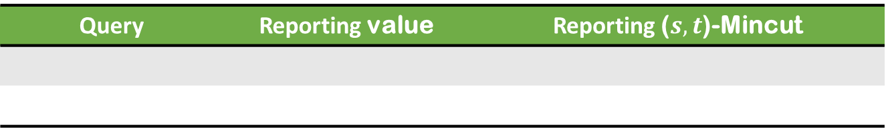



Exercise
$$s$$
$$e$$
$$t$$
Unweighted graph
$$e$$
$$G$$
Query | Reporting value | Reporting ($s,t$)-Mincut
Deletion($e$)
$$O(1)$$
$$O(n)$$
Insertion($e$)
$$O(1)$$
$$O(n)$$
$O\left(n\right)$ size Data Structure

Slide 27

Part II
Vital Edges,
Sensitivity Oracle for $\left(s,t\right)$-mincuts

Slide 28

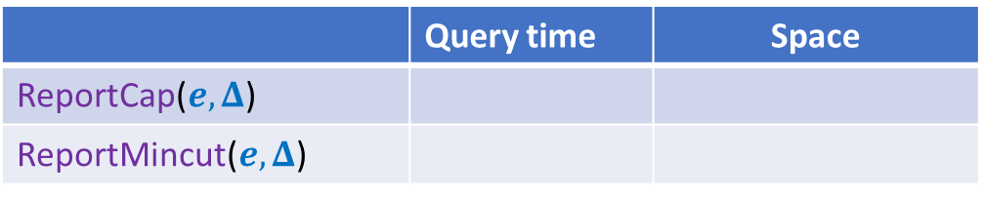





Sensitivity oracles for (s,t)-mincuts
Let $G$=($V,E$) be a directed graph with source $s$ and sink $t$ such that
$n=|V|$, $m=|E|$,
$c\left(e\right)≥0$ for each $e∈E$.
Aim: To build a compact data structure:
ReportMinCut($e, Δ$) : Report the (s,t)-mincut after $c\left(e\right)$ changes to $c\left(e\right)+Δ$
ReportCap($e, Δ$) : Report cap. of (s,t)-mincut after $c\left(e\right)$ changes to $c\left(e\right)+Δ$
 | Query time | Space
ReportCap($e, Δ$)
ReportMincut($e, Δ$)
$$O(1)$$
$$O(n)$$
$$O(n)$$
$$O(n^{2})$$
$Ω\left(n^{2}\right)$ Lower bound

Slide 29


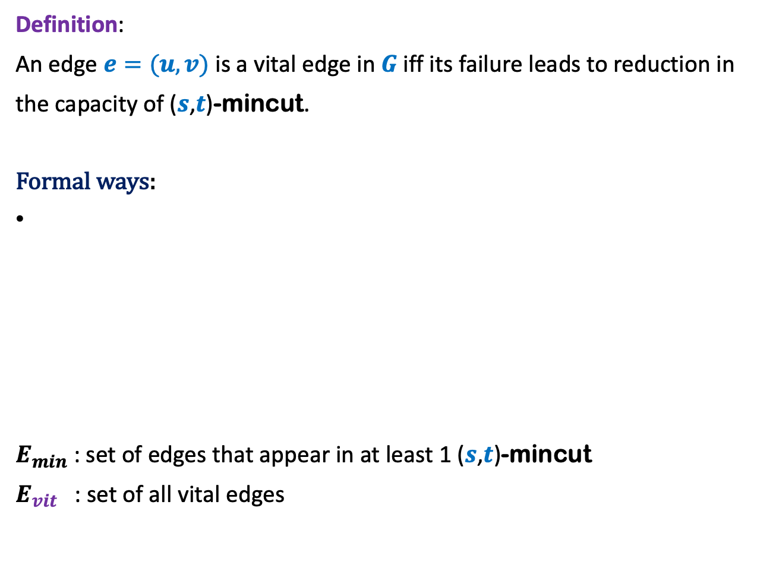



Vital edge
Definition:
An edge $e=(u,v)$ is a vital edge in $G$ iff its failure leads to reduction in
the capacity of ($s$,$t$)-mincut.
Formal ways:
$E_{min}$ : set of edges that appear in at least 1 ($s$,$t$)-mincut
$E_{vit}$ : set of all vital edges
Capacity of Mincut for $e$
$$− c(e)$$
$$<f^{∗}$$
$e$carries nonzero flow in each ($s$,$t$)-maxflow.
$$c_{min}(e)$$

Slide 30

























An Example
Mincut($u$, $x$)
$E_{min}$ :
Least value of flow through ($u$, $x$) in a ($s$,$t$)-maxflow
$E_{vit}$ :
$$x$$
$$9$$
$$11$$
$$9$$
$$9$$
$$s$$
$$10$$
$$3$$
$$10$$
$$t$$
$$10$$
$$u$$
$$1$$
$$v$$
$$10$$
$$4$$
$$1$$
$$1$$
$$3$$
$$y$$
{($s$, $u$), ($v$, $t$)}
$$=4$$
$$c_{min}((u,x))$$
{($s$, $u$), ($u$, $x$), ($x$, $v$), ($v$, $t$)}

Slide 31



Main Objectives
Sensitivity Oracles for weighted graphs
Mincut Cover for $E_{vit}$
Compact structure for mincuts for $E_{vit}$
$E_{vit}$
$E_{min}$

Slide 32










An Example
Mincut($e$)
Consider $e=(u,x)$
Outgoing edges are not fully saturated.
Incoming edges are carrying flow.
$$x$$
$$9$$
$$6$$
$$11$$
$$6$$
$$s$$
$$10$$
$$9$$
$$10$$
$$t$$
$$10$$
$$u$$
$$6$$
$$v$$
$$10$$
$$3$$
$$2$$
$$2$$
$$3$$
$$y$$

Slide 33



GenFlowCut Property
$$e∈E_{vit}$$
$$c_{min}(e)$$
$A$ is mincut for $e$ if and only if
There exists a ($s,t$)-maxflow $f$,
Every outgoing edge of $A$, except $e$, is fully saturated.
$f\left(e\right)=c_{min}(e)$
Every incoming edge carries 0 flow.
$$e$$
$$s$$
$$t$$
$$A$$
$$\overline{A}$$
$$G$$

Slide 34

GenFlowCut Property
$$e∈E_{vit}$$
Reduce the capacity of $e$ from $c(e)$ to $c_{min}\left(e\right)$
Increase the capacity back to $w(e)$.
$$e$$
$$s$$
$$t$$
$$A$$
$$\overline{A}$$
$$G$$

Slide 35

Mincut of a vital edge
$$e∈E_{vit}$$
Property:
Let $A$ be Mincut for a vital edge $e$.
There cannot exist a vital edge that goes from $\overline{A}$ to $A$.
$$e$$
$$s$$
$$t$$
$$A$$
$$\overline{A}$$

Slide 36






Key insight
$$A$$
$$s$$
$$e$$
$$t$$
$$4$$
$$3$$
$$2$$

Slide 37




Key insight
$$A$$
$$s$$
$$e$$
$$t$$
Pick $A$
$$3$$
$$4$$
$$2$$

Slide 38
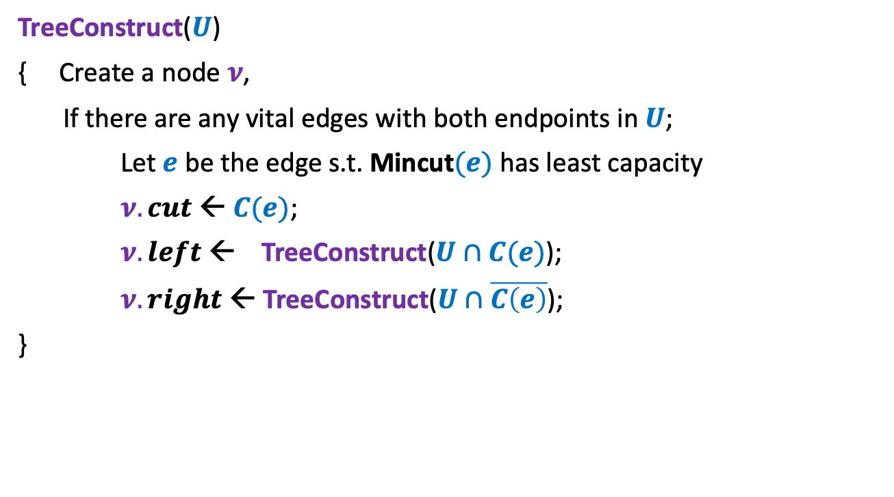

$$U⊆V$$
TreeConstruct($U$)
{ Create a node $ν$,
If there are any vital edges with both endpoints in $U$;
Let $e$ be the edge s.t. Mincut$(e)$ has least capacity
$ν.cut$ ← $C(e)$;
$ν.left$ ← TreeConstruct($U∩C(e)$);
$ν.right$ ← TreeConstruct($U∩\overline{C\left(e\right)}$);
}

Slide 39


MincutCover for $E_{vit}$
size $≤(n−1)$

Slide 40




Sensitivity Oracle
ReportCap($e, Δ$)
$e=(u,v)$ : a vital edge
$$u$$
$$v$$
Each internal node stores only the capacity of the cut.

Slide 41


Sensitivity Oracle
ReportCap($e, Δ$)
$$v$$
$$u$$
Each internal node stores only the capacity of the cut.

Slide 42

Main Questions
Sensitivity Oracles for weighted graphs
Mincut Cover for $E_{vit}$
Compact structure for mincuts for $E_{vit}$
$E_{vit}$
$E_{min}$
$O(n)$ DAGs
Characterization: 1-Transversal cuts

Slide 43
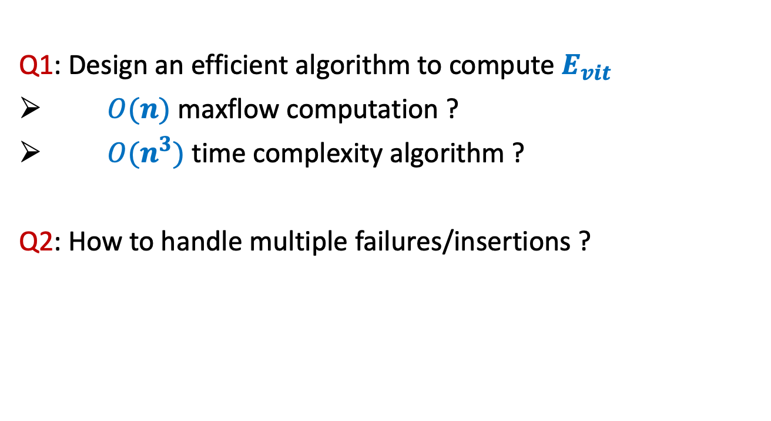
Open Questions
Q1: Design an efficient algorithm to compute $E_{vit}$
$O(n)$maxflow computation ?
$O(n^{3})$time complexity algorithm ?
Q2: How to handle multiple failures/insertions ?
Thank you

