Slide 1
Online Algorithms
With Recourse
Ravishankar Krishnaswamy
Microsoft Research India
Based on joint works Anupam Gupta, Varun Gupta, Amit Kumar, Janardhan Kulkarni, Debmalya Panigrahi, Sai Sandeep

Slide 2
PART I: ONLINE SET COVER

Slide 3
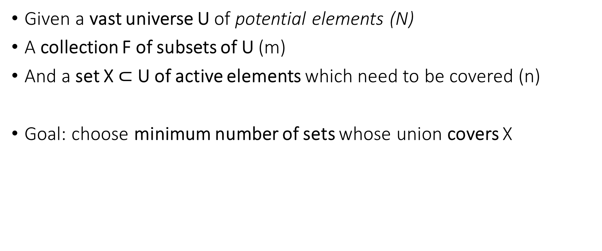
The Set Cover Problem
Given a vast universe U of potential elements (N)
A collection F of subsets of U (m)
And a set X $⊂$U of active elements which need to be covered (n)
Goal: choose minimum number of sets whose union covers X

Slide 4
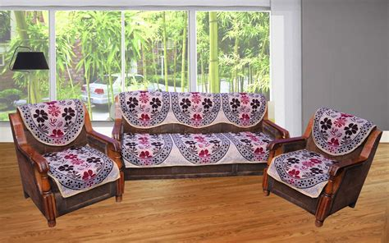
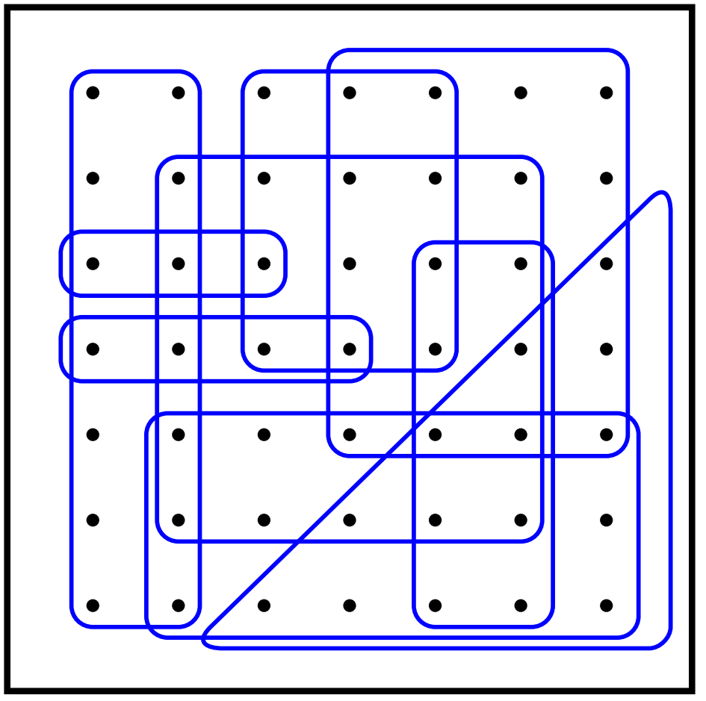
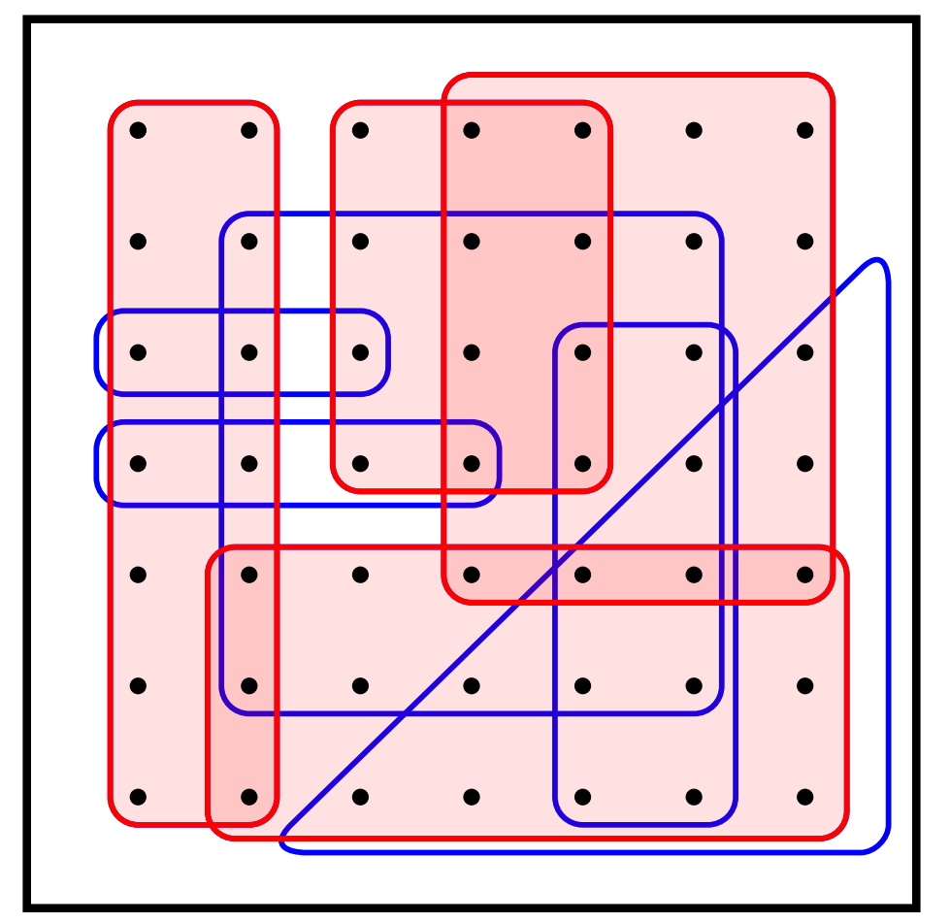
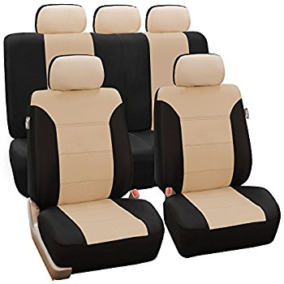
Toy Example (from Google and Bing)
In general, no geometric structure needed. Purely combinatorial set system

Slide 5
Classical Problem, Well Understood!
NP-Complete
Greedy algorithm is ln n approximation (independent of m!)
NP-hard to improve upon ln n approximation result in general
Often, greedy algorithm is much better in practice

Slide 6
Online Set Cover
Given a vast universe U of potential elements (N)
A collection F of subsets of U, each possibly with a cost (m)
A set X of active elements arrives online, one by one
Goal: dynamically choose low cost sub-collection which collectively covers all the active elements
Decisions are irrevocable (once a set is included, can’t undo later)

Slide 7
How to measure quality of algorithm?
COMPETITIVE RATIO
Algo Cost (I)
  max over all input sequences I
Optimal Cost(I)

Slide 8
Irrevocability hurts!
Fix parameter t; universe of potential elements = {1, 2, …, t²}
Sets are all t-sized subsets of the universe
Adversarial sequence:
  first active element is 1; say your algorithm picks set {1, 2, …, t}
  second active element is t+1; say your algorithm picks set {t+1, …, 2t}
  third active element is 2t+1; say your algorithm picks set {2t+1, …, 3t}
  and so on
  Finally, Alg has picked t sets, while hindsight OPT is just 1 set!! gap of t ☹
Can’t hope to get O(log n)-type guarantees here!

Slide 9
Online Set Cover
Despite the bad example, Alon et al. [2005] developed a beautiful framework based on the multiplicative weights framework
O(ln n ln m)-competitive deterministic algorithm
Matching* lower bound for deterministic algos [Alon et al. 2005]
Matching* NP-hardness for randomized algos [Feige Korman 2005]
Can we overcome this dependence on m in the approximation ratio?
Can we devise algorithms which are greedy-like and yet work in the online model?

Slide 10
Online Set Cover with Recourse
Allow a few changes to the set cover solution!
Can add and remove some sets in solution upon element each arrival
Goal 1: ensure good competitive ratio
Goal 2: with bounded recourse
  Either amortized or worst-case recourse
Trivial: ln n approximation with m changes each time
Trivial: O(ln m ln n) approximation with no deletions and 1 addition

Slide 11
Focus of today’s talk
Can maintain O(ln n)-approximate set cover with O(log n)-amortized updates per element arrival
By-product: Actually implementable fast (i.e., update time is O(f log n) per element arrival or departure)
Bonus: can improve recourse to O(1) amortized, can arbitrary handle set costs, and also handle element arrivals and departures (see our paper)
But for today’s talk, assume only element arrivals, all sets have unit cost, and we’ll show O(log n) recourse bound

Slide 12
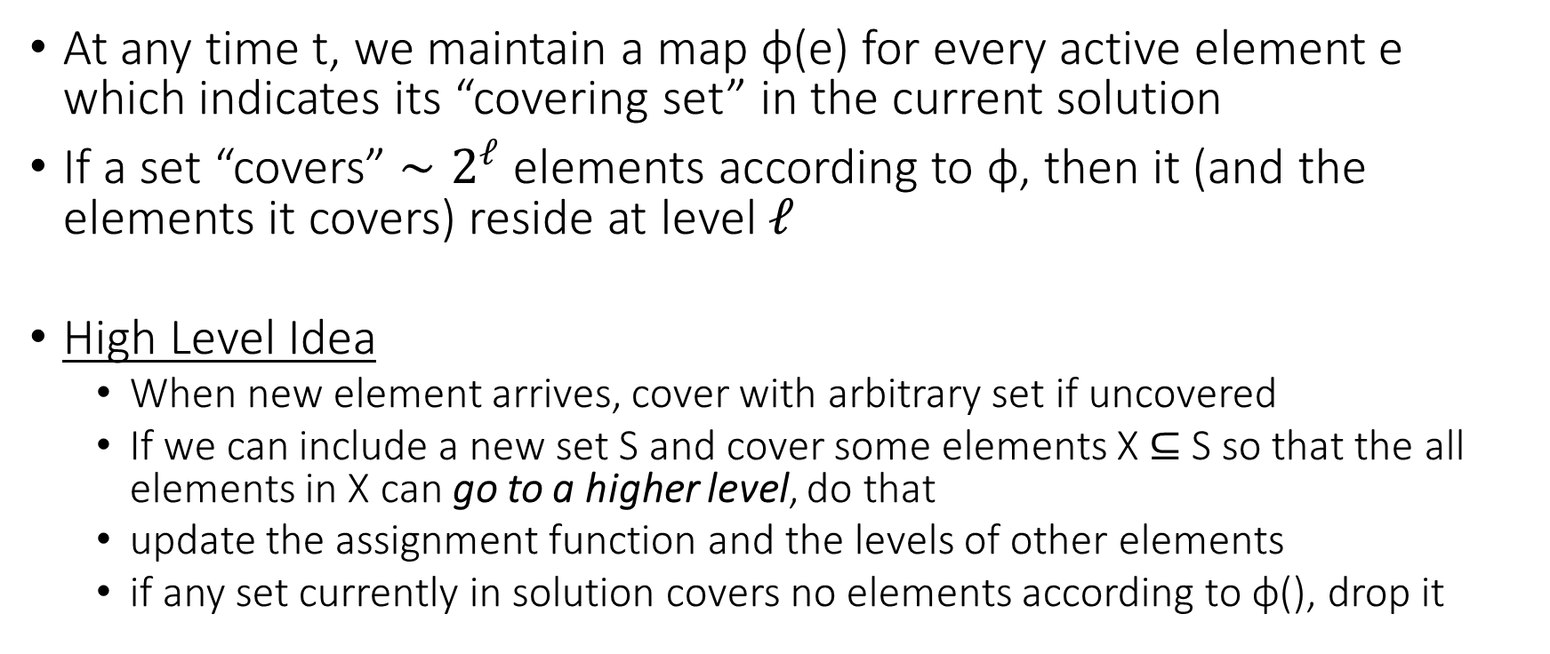
Dynamic Greedy Framework
At any time t, we maintain a map φ(e) for every active element e which indicates its “covering set” in the current solution
If a set “covers” $∼2^{ℓ}$ elements according to φ, then it (and the elements it covers) reside at level $ℓ$
High Level Idea
  When new element arrives, cover with arbitrary set if uncovered
  If we can include a new set S and cover some elements X $⊆$S so that the all elements in X can go to a higher level, do that
  update the assignment function and the levels of other elements
  if any set currently in solution covers no elements according to φ(), drop it

Slide 13
Toy Example
Element | Density / Level
1
2
3
4
5
6
1
3
4
6
2
5

Slide 14
Toy Example
Element | Density / Level
1 | 1
2
3
4
5
6
1
3
4
6
2
5

Slide 15
Toy Example
Element | Density / Level
1 | 1
2 | 1
3
4
5
6
1
3
4
6
2
5

Slide 16
Toy Example
Element | Density / Level
1 | 1
2 | 1
3 | 1
4
5
6
1
3
4
6
2
5

Slide 17
Toy Example
Element | Density / Level
1 | 1
2 | 2
3 | 2
4
5
6
1
3
4
6
2
5

Slide 18
Toy Example
Element | Density / Level
1 | 1
2 | 2
3 | 2
4 | 1
5
6
1
3
4
6
2
5

Slide 19
Toy Example
Element | Density / Level
1 | 2
2 | 2
3 | 2
4 | 2
5
6
1
3
4
6
2
5

Slide 20
Toy Example
Element | Density / Level
1 | 2
2 | 2
3 | 2
4 | 2
5 | 1
6
1
3
4
6
2
5

Slide 21
Toy Example
Element | Density / Level
1 | 2
2 | 2
3 | 2
4 | 2
5 | 1
6 | 1
1
3
4
6
2
5

Slide 22
Toy Example
Element | Density / Level
1 | 4
2 | 1
3 | 4
4 | 4
5 | 1
6 | 4
1
3
4
6
2
5

Slide 23
Toy Example
Element | Density / Level
1 | 4
2 | 2
3 | 4
4 | 4
5 | 2
6 | 4
1
3
4
6
2
5

Slide 24
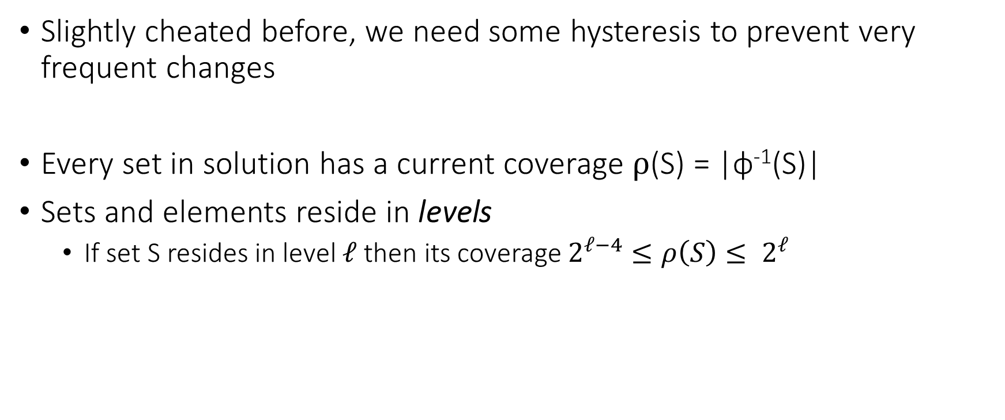
Dynamic Greedy Algorithm
Slightly cheated before, we need some hysteresis to prevent very frequent changes
Every set in solution has a current coverage $ρ$(S) = |φ⁻¹(S)|
Sets and elements reside in levels
  If set S resides in level $ℓ$ then its coverage $2^{ℓ−4}≤ρ\left(S\right)≤ 2^{ℓ}$

Slide 25
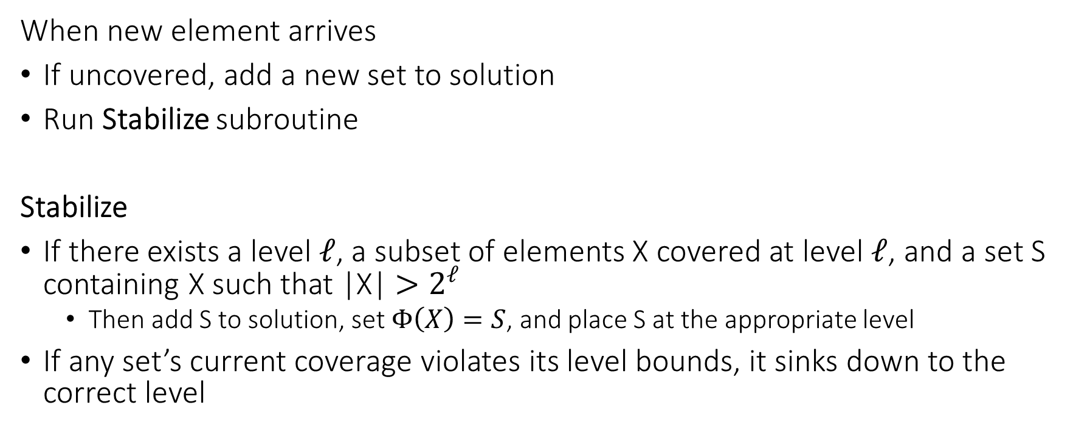
Overall Algorithm
When new element arrives
If uncovered, add a new set to solution
Run Stabilize subroutine
Stabilize
If there exists a level $ℓ$, a subset of elements X covered at level $ℓ$, and a set S containing X such that |X| $>2^{ℓ}$
  Then add S to solution, set $Φ\left(X\right)=S$, and place S at the appropriate level
If any set’s current coverage violates its level bounds, it sinks down to the correct level

Slide 26
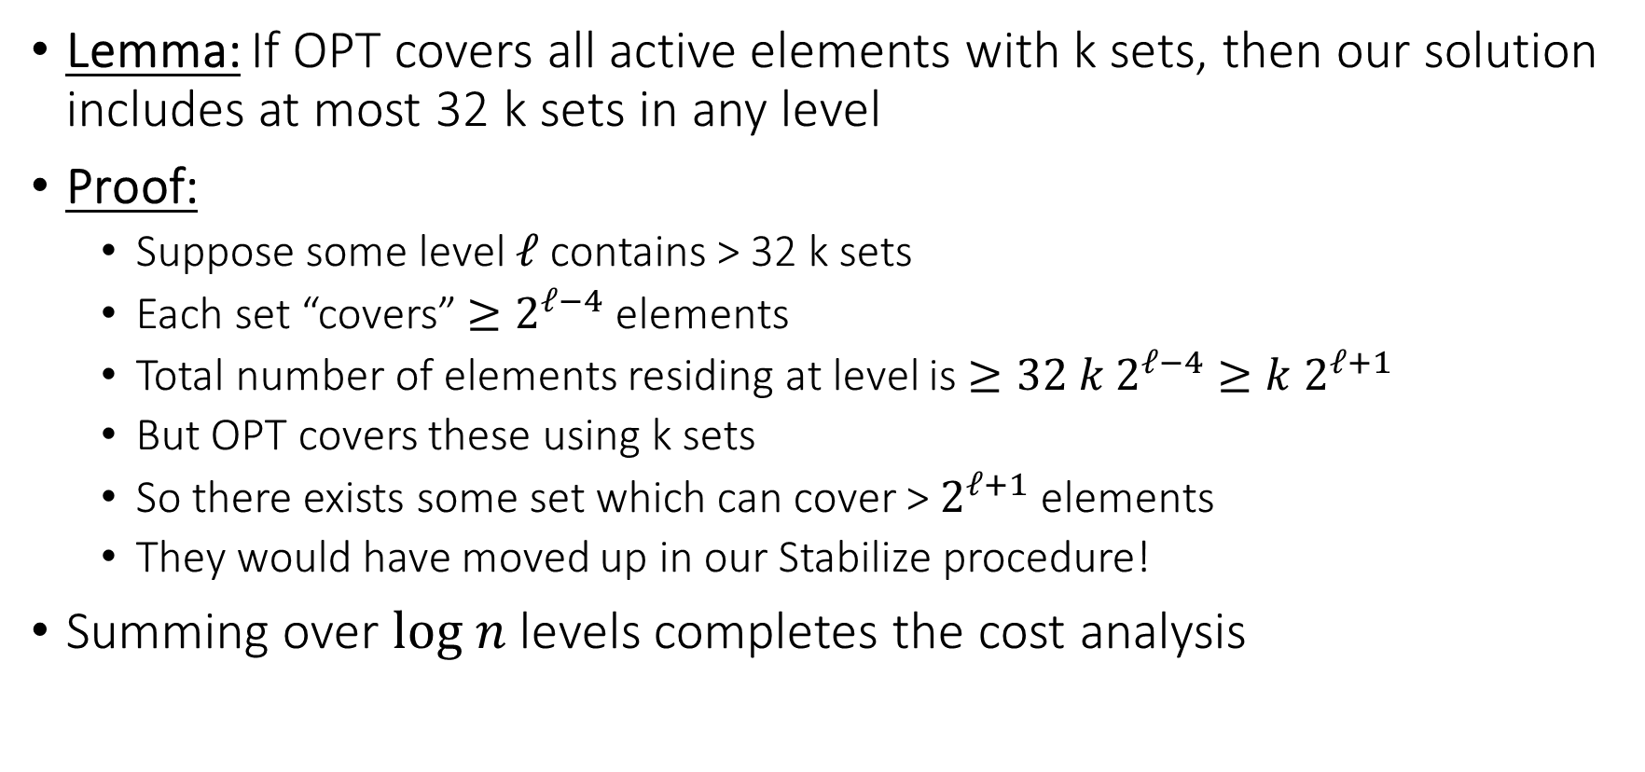
Cost Analysis
Lemma: If OPT covers all active elements with k sets, then our solution includes at most 32 k sets in any level
Proof:
  Suppose some level $ℓ$ contains > 32 k sets
  Each set “covers” $≥2^{ℓ−4}$ elements
  Total number of elements residing at level is $≥32 k 2^{ℓ−4}≥k 2^{ℓ+1}$
  But OPT covers these using k sets
  So there exists some set which can cover > $2^{ℓ+1}$ elements
  They would have moved up in our Stabilize procedure!
Summing over $log n$ levels completes the cost analysis

Slide 27
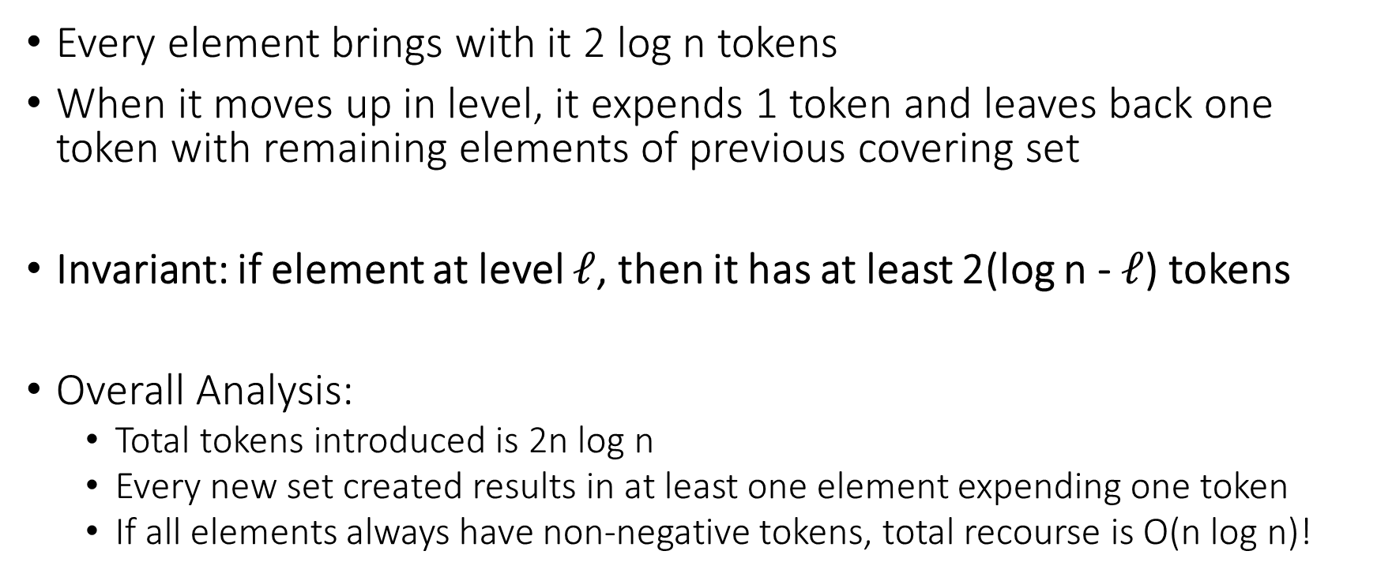
Recourse Analysis via Tokens
Every element brings with it 2 log n tokens
When it moves up in level, it expends 1 token and leaves back one token with remaining elements of previous covering set
Invariant: if element at level $ℓ$, then it has at least 2(log n - $ℓ$) tokens
Overall Analysis:
  Total tokens introduced is 2n log n
  Every new set created results in at least one element expending one token
  If all elements always have non-negative tokens, total recourse is O(n log n)!

Slide 28

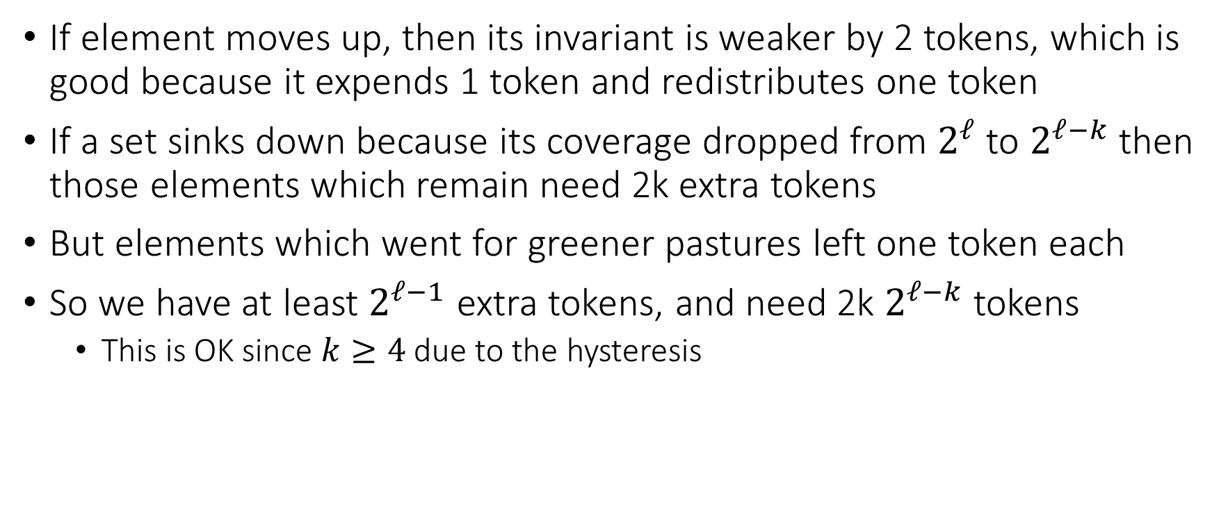
Proof of Invariant
If element moves up, then its invariant is weaker by 2 tokens, which is good because it expends 1 token and redistributes one token
If a set sinks down because its coverage dropped from $2^{ℓ}$ to $2^{ℓ−k}$ then those elements which remain need 2k extra tokens
But elements which went for greener pastures left one token each
So we have at least $2^{ℓ−1}$ extra tokens, and need 2k $2^{ℓ−k}$ tokens
  This is OK since $k≥4$ due to the hysteresis

Slide 29
PART II: ONLINE BIPARTITE MATCHING

Slide 30


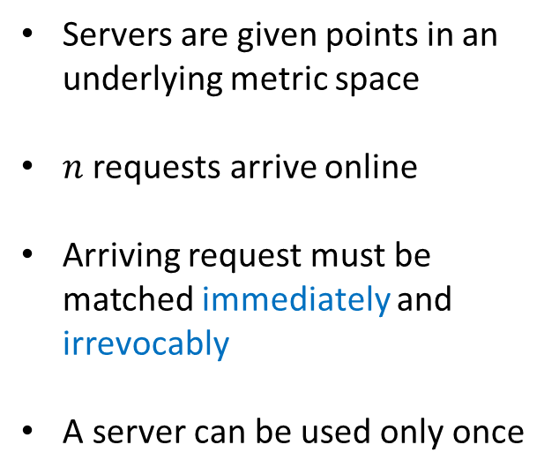
Online Bipartite (Metric) Matching
Servers are given points in an underlying metric space
$n$ requests arrive online
Arriving request must be matched immediately and irrevocably
A server can be used only once
Recall Competitive Ratio : $\max_{instances I}{\frac{Cost\left(Online matching\right)}{Cost(Optimal in hindsight matching)}}$
Notes:
Example: think of fulfillment for shipment orders from inventory; or sending fire trucks to handle fires

Slide 31
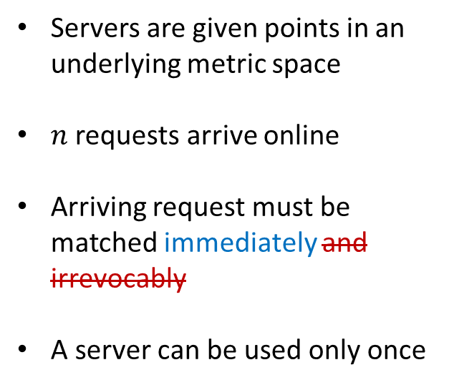
Online Bipartite (Metric) Matching with Recourse
Servers are given points in an underlying metric space
$n$ requests arrive online
Arriving request must be matched immediately and irrevocably
A server can be used only once
Notes:
Example: think of fulfillment for shipment orders from inventory; or sending fire trucks to handle fires

Slide 32

Online Bipartite (Metric) Matching with Recourse
Servers are given points in an underlying metric space
$n$ requests arrive online
Arriving request must be matched immediately and irrevocably
A server can be used only once
Amortized Recourse Metric: $\frac{\# rematches by algorithm}{\# clients in the instance}$

Slide 33
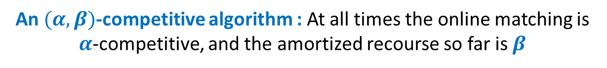
Online Bipartite (Metric) Matching with Recourse
Servers are given points in an underlying metric space
$n$ requests arrive online
Arriving request must be matched immediately and irrevocably
A server can be used only once
An $(α,β)$-competitive algorithm : At all times the online matching is $α$-competitive, and the amortized recourse so far is $β$
Notes:
Example: think of fulfillment for shipment orders from inventory; or sending fire trucks to handle fires

Slide 34

Background: Matching without Recourse
Greedy is $Ω\left(2^{n}\right)$ competitive
Optimal cost = (1+ε) + ε + ε + ε + .. = 1+nε
Greedy cost = (1-ε)+(2-ε)+(4-ε)+(8-ε)+… = $Ω\left(2^{n}\right)$
Servers
Clients
1+ε
2+ε
4+ε
8+ε
16+ε
0
2
4
8
16

Slide 35
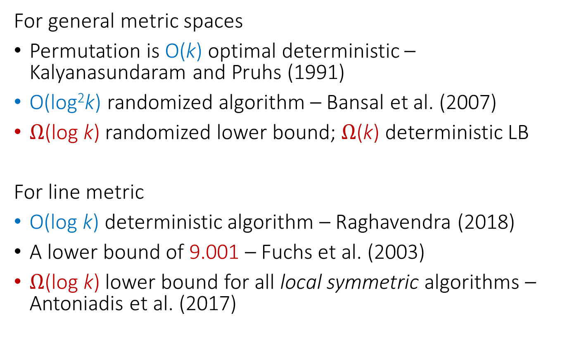
Background: Matching without Recourse
For general metric spaces
Permutation is O(k) optimal deterministic – Kalyanasundaram and Pruhs (1991)
O(log²k) randomized algorithm – Bansal et al. (2007)
$Ω$(log k) randomized lower bound; $Ω$(k) deterministic LB
For line metric
O(log k) deterministic algorithm – Raghavendra (2018)
A lower bound of 9.001 – Fuchs et al. (2003)
$Ω$(log k) lower bound for all local symmetric algorithms – Antoniadis et al. (2017)

Slide 36
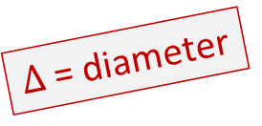
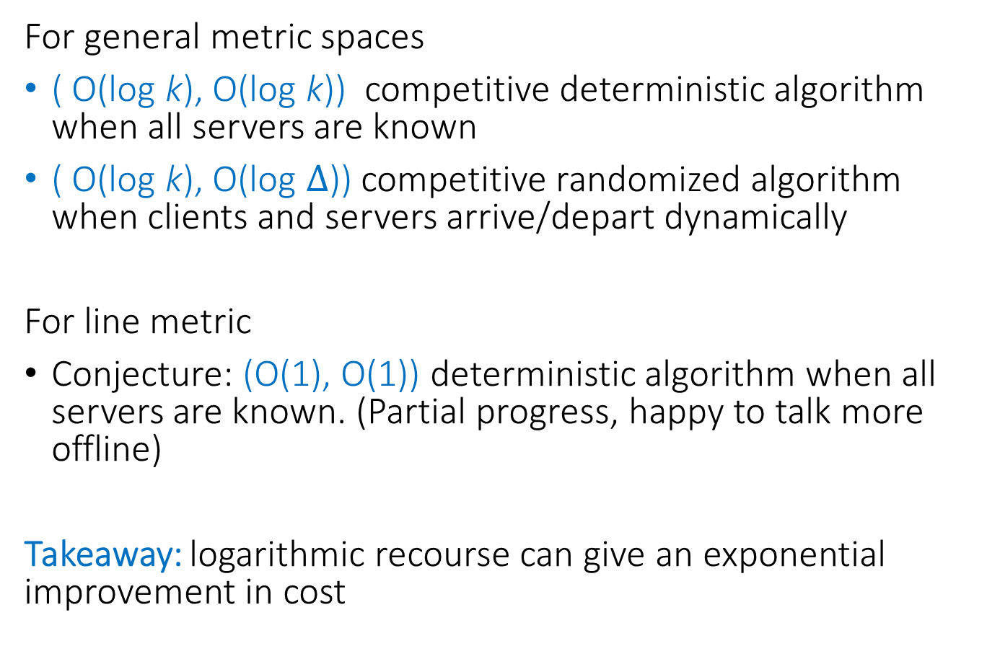
Our Results: Matching with Recourse
For general metric spaces
( O(log k), O(log k)) competitive deterministic algorithm when all servers are known
( O(log k), O(log $Δ$)) competitive randomized algorithm when clients and servers arrive/depart dynamically
For line metric
Conjecture: (O(1), O(1)) deterministic algorithm when all servers are known. (Partial progress, happy to talk more offline)
Takeaway: logarithmic recourse can give an exponential improvement in cost
$Δ$= diameter

Slide 37
Background: Matching without Recourse
Permutation Algorithm: Kalyanasundaram and Pruhs (1991)
c₁
Compute optimal matching for c₁
M₁ = (c₁, s₁)
Servers
Clients

Slide 38
Background: Matching without Recourse
Permutation Algorithm: Kalyanasundaram and Pruhs (1991)
c₁
Compute optimal matching for c₁
M₁ = (c₁, s₁)
Match c₁ to s₁
s₁
Servers
Clients

Slide 39
Background: Matching without Recourse
Permutation Algorithm: Kalyanasundaram and Pruhs (1991)
c₁
Compute optimal matching for c_{1,} c₂
say: M₂ = ( (c₁, s₂), (c₂, s₁)) )
c₂
s₁
Servers
Clients

Slide 40
Background: Matching without Recourse
Permutation Algorithm: Kalyanasundaram and Pruhs (1991)
s₂
c₁
Compute optimal matching for c₁
say: M₂ = ( (c₁, s₂), (c₂, s₁)) )
c₂
s₁
Servers
Clients

Slide 41
Background: Matching without Recourse
Permutation Algorithm: Kalyanasundaram and Pruhs (1991)
s₂
c₁
Compute optimal matching for c₁
say: M₂ = ( (c₁, s₂), (c₂, s₁)) )
Match c₂ to s₂
c₂
s₁
Servers
Clients

Slide 42
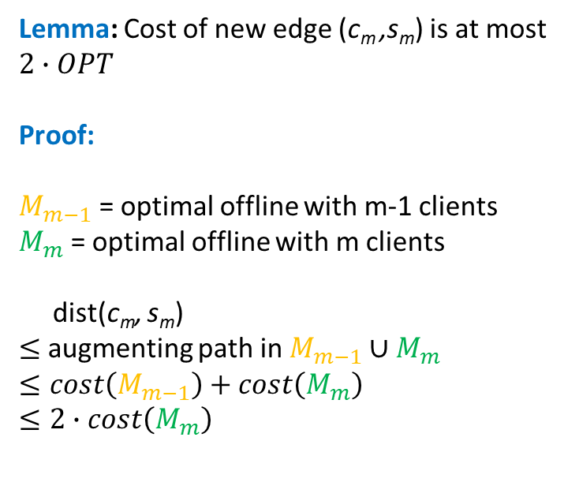
Background: Matching without Recourse
Permutation Algorithm: Kalyanasundaram and Pruhs (1991)
Lemma: Cost of new edge (c_{m} ,s_{m}) is at most $2∙OPT$
Proof:
$M_{m−1}$ = optimal offline with m-1 clients
$M_{m}$ = optimal offline with m clients
dist(c_{m}, s_{m})
$≤$ augmenting path in $M_{m−1}∪M_{m}$
$$≤cost\left(M_{m−1}\right)+cost\left(M_{m}\right)$$
$$≤2∙cost\left(M_{m}\right)$$
c_{m}
s_{m}
Servers
Clients

Slide 43
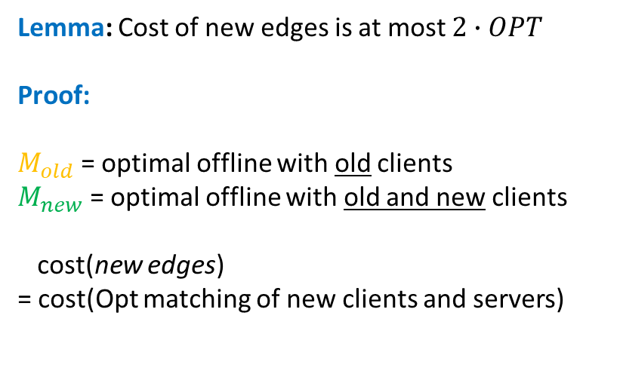
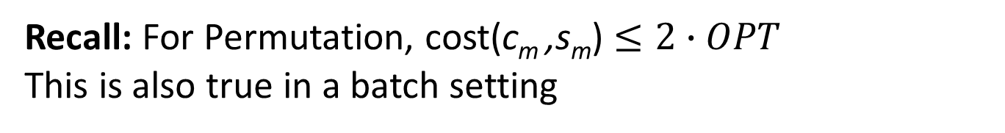
Result 1: (O(log n), O(log n)) competitive algorithm
Recall: For Permutation, cost(c_{m} ,s_{m}) $≤2∙OPT$
This is also true in a batch setting
Lemma: Cost of new edges is at most $2∙OPT$
Proof:
$M_{old}$ = optimal offline with old clients
$M_{new}$ = optimal offline with old and new clients
cost(new edges)
= cost(Opt matching of new clients and servers)
New
clients
New
servers
Servers
Clients

Slide 44
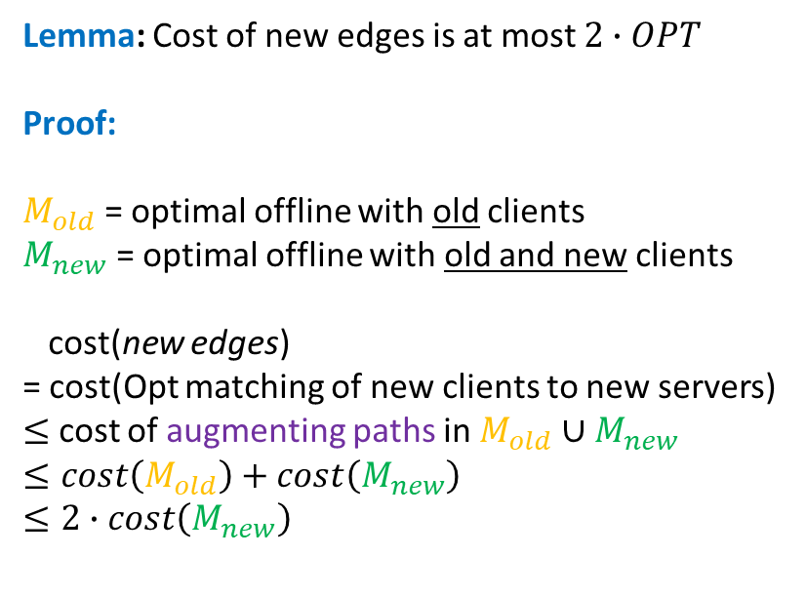
Result 1: (O(log n), O(log n)) competitive algorithm
Recall: For Permutation, cost(c_{m} ,s_{m}) $≤2∙OPT$
This is also true in a batch setting
Lemma: Cost of new edges is at most $2∙OPT$
Proof:
$M_{old}$ = optimal offline with old clients
$M_{new}$ = optimal offline with old and new clients
cost(new edges)
= cost(Opt matching of new clients to new servers)
$≤$ cost of augmenting paths in $M_{old}∪M_{new}$
$$≤cost\left(M_{old}\right)+cost\left(M_{new}\right)$$
$$≤2∙cost\left(M_{new}\right)$$
New
clients
New
servers
Servers
Clients

Slide 45
Result 1: (O(log n), O(log n)) competitive algorithm
Attempt 1: Use Permutation, and then correct by batch reoptimization
Insert using permutation
Servers
Clients

Slide 46
Result 1: (O(log n), O(log n)) competitive algorithm
Attempt 1: Use Permutation, and then correct by batch reoptimization
Insert using permutation
Servers
Clients

Slide 47
Result 1: (O(log n), O(log n)) competitive algorithm
Attempt 1: Use Permutation, and then correct by batch reoptimization
Recompute optimal matching
Servers
Clients

Slide 48
Result 1: (O(log n), O(log n)) competitive algorithm
Attempt 1: Use Permutation, and then correct by batch reoptimization
Insert using permutation
Servers
Clients

Slide 49
Result 1: (O(log n), O(log n)) competitive algorithm
Attempt 1: Use Permutation, and then correct by batch reoptimization
Insert using permutation
Servers
Clients

Slide 50
Result 1: (O(log n), O(log n)) competitive algorithm
Attempt 1: Use Permutation, and then correct by batch reoptimization
Recompute optimal matching
Servers
Clients

Slide 51
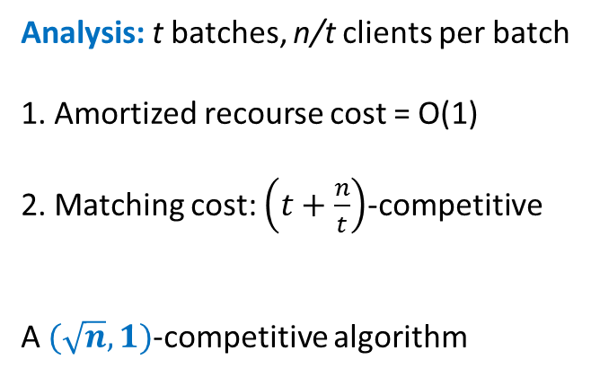
Result 1: (O(log n), O(log n)) competitive algorithm
Attempt 1: Use Permutation, and then correct by batch reoptimization
Analysis: t batches, n/t clients per batch
1. Amortized recourse cost = O(1)
2. Matching cost: $\left(t+\frac{n}{t}\right)$-competitive
A $(\sqrt{n},1)$-competitive algorithm
Batch 1
Batch 2
Servers
Clients

Slide 52
Result 1: (O(log n), O(log n)) competitive algorithm
Attempt 2: Multi-scale batch re-optimization
Servers
Clients

Slide 53
Result 1: (O(log n), O(log n)) competitive algorithm
Attempt 2: Multi-scale batch re-optimization
Insert using
permutation
Servers
Clients

Slide 54
Result 1: (O(log n), O(log n)) competitive algorithm
Attempt 2: Multi-scale batch re-optimization
Insert using
permutation
Servers
Clients

Slide 55
Result 1: (O(log n), O(log n)) competitive algorithm
Attempt 2: Multi-scale batch re-optimization
Reoptimize
subtree
Servers
Clients

Slide 56
Result 1: (O(log n), O(log n)) competitive algorithm
Attempt 2: Multi-scale batch re-optimization
Insert using
permutation
Servers
Clients

Slide 57
Result 1: (O(log n), O(log n)) competitive algorithm
Attempt 2: Multi-scale batch re-optimization
Insert using
permutation
Servers
Clients

Slide 58
Result 1: (O(log n), O(log n)) competitive algorithm
Attempt 2: Multi-scale batch re-optimization
Reoptimize
subtree
Servers
Clients

Slide 59
Result 1: (O(log n), O(log n)) competitive algorithm
Attempt 2: Multi-scale batch re-optimization
Insert using
permutation
Servers
Clients

Slide 60
Result 1: (O(log n), O(log n)) competitive algorithm
Attempt 2: Multi-scale batch re-optimization
Reoptimize
subtree
Servers
Clients

Slide 61
Result 1: (O(log n), O(log n)) competitive algorithm
Attempt 2: Multi-scale batch re-optimization
Insert using
permutation
Servers
Clients

Slide 62
Result 1: (O(log n), O(log n)) competitive algorithm
Attempt 2: Multi-scale batch re-optimization
Reoptimize
subtree
Servers
Clients

Slide 63
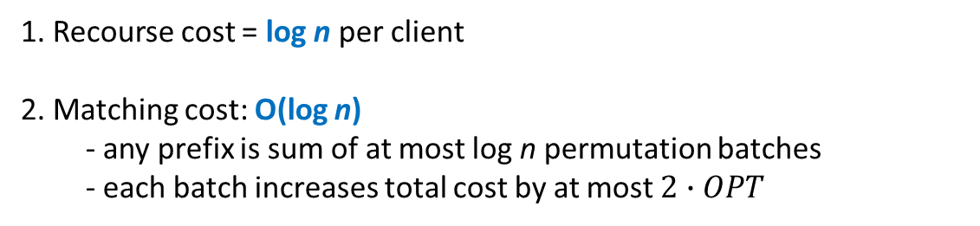
Result 1: (O(log n), O(log n)) competitive algorithm
Attempt 2: Multi-scale batch re-optimization
1. Recourse cost = log n per client
2. Matching cost: O(log n)
  - any prefix is sum of at most log n permutation batches
  - each batch increases total cost by at most $2∙OPT$
Servers
Clients

Slide 64
Summary
Exhibited power of small recourse in online algorithms
Get algorithms which match “offline” solution quality in online world
Allows us to model arrivals and departures
Other problems? online scheduling, online clustering, online LPs?
Your favorite problem!

Slide 65
THANK YOU!

