Slide 1

Parametric Shortest Paths in Planar Graphs
Kshitij Gajjar
Tata Institute of Fundamental Research, Mumbai

Slide 2
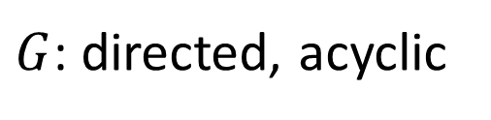









Shortest Paths
$G$: directed, acyclic
$$SP\left(G\right)= ???$$
$$t$$
$$P_{1}$$
$$P_{4}$$
$$P_{2}$$
$$P_{5}$$
$$s$$
$$P_{3}$$
$$P_{6}$$

Slide 3



Shortest Paths
$$G$$
$$SP\left(G\right)= ???$$
$$P_{1}$$
$$P_{4}$$
$$P_{2}$$
$$P_{5}$$
$$P_{3}$$
$$P_{6}$$

Slide 4






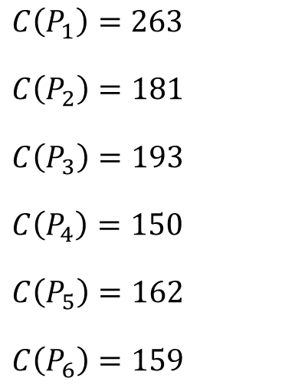







Shortest Paths
$$G$$
$$SP\left(G\right)=P_{4}$$
$$42$$
$$58$$
$$P_{1}$$
$$P_{4}$$
$$C\left(P_{1}\right)=263$$
$$C\left(P_{2}\right)=181$$
$$C\left(P_{3}\right)=193$$
$$C\left(P_{4}\right)=150$$
$$C\left(P_{5}\right)=162$$
$$C\left(P_{6}\right)=159$$
$$16$$
$$27$$
$$99$$
$$34$$
$$17$$
$$P_{2}$$
$$P_{5}$$
$$43$$
$$5$$
$$31$$
$$60$$
$$73$$
$$P_{3}$$
$$P_{6}$$

Slide 5













Parametric Shortest Paths
$$G$$
$$SP\left(G\right)= ???! ! !$$
$$2λ−5$$
$$λ+8$$
$$P_{1}$$
$$P_{4}$$
$$7λ−1$$
$$−λ+7$$
$$6λ−2$$
$$5λ$$
$$−4$$
$$P_{2}$$
$$P_{5}$$
$$4λ+3$$
$$λ−9$$
$$−2λ−4$$
$$−2λ−1$$
$$−5λ+6$$
$$P_{3}$$
$$P_{6}$$

Slide 6
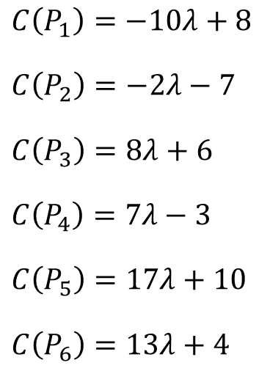
Parametric Shortest Paths
$$G$$
$$SP\left(G\right)= ???! ! !$$
$$2λ−5$$
$$λ+8$$
$$P_{1}$$
$$P_{4}$$
$$7λ−1$$
$$−λ+7$$
$$C\left(P_{1}\right)=−10λ+8$$
$$C\left(P_{2}\right)=−2λ−7$$
$$C\left(P_{3}\right)=8λ+6$$
$$C\left(P_{4}\right)=7λ−3$$
$$C\left(P_{5}\right)=17λ+10$$
$$C\left(P_{6}\right)=13λ+4$$
$$6λ−2$$
$$5λ$$
$$−4$$
$$P_{2}$$
$$P_{5}$$
$$4λ+3$$
$$λ−9$$
$$−2λ−4$$
$$−2λ−1$$
$$−5λ+6$$
$$P_{3}$$
$$P_{6}$$

Slide 7

Parametric Shortest Paths
$$G$$
$$SP\left(G\left(λ\right)\right)$$
$$2λ−5$$
$$λ+8$$
$$P_{1}$$
$$P_{4}$$
$$7λ−1$$
$$−λ+7$$
$$C\left(P_{1}\right)=−10λ+8$$
$$C\left(P_{2}\right)=−2λ−7$$
$$C\left(P_{3}\right)=8λ+6$$
$$C\left(P_{4}\right)=7λ−3$$
$$C\left(P_{5}\right)=17λ+10$$
$$C\left(P_{6}\right)=13λ+4$$
$$6λ−2$$
$$5λ$$
$$−4$$
$$P_{2}$$
$$P_{5}$$
$$4λ+3$$
$$λ−9$$
$$−2λ−4$$
$$−2λ−1$$
$$−5λ+6$$
$$P_{3}$$
$$P_{6}$$

Slide 8

Parametric Shortest Paths
$$G$$
$$SP\left(G\left(0\right)\right)=P_{2}$$
$$2λ−5$$
$$λ+8$$
$$P_{1}$$
$$P_{4}$$
$$7λ−1$$
$$−λ+7$$
$$C\left(P_{1}\right)=−10λ+8$$
$$C\left(P_{2}\right)=−2λ−7$$
$$C\left(P_{3}\right)=8λ+6$$
$$C\left(P_{4}\right)=7λ−3$$
$$C\left(P_{5}\right)=17λ+10$$
$$C\left(P_{6}\right)=13λ+4$$
$$6λ−2$$
$$5λ$$
$$−4$$
$$P_{2}$$
$$P_{5}$$
$$4λ+3$$
$$λ−9$$
$$−2λ−4$$
$$−2λ−1$$
$$−5λ+6$$
$$P_{3}$$
$$P_{6}$$

Slide 9

Parametric Shortest Paths
$$G$$
$$SP\left(G\left(1\right)\right)=P_{2}$$
$$2λ−5$$
$$λ+8$$
$$P_{1}$$
$$P_{4}$$
$$7λ−1$$
$$−λ+7$$
$$C\left(P_{1}\right)=−10λ+8$$
$$C\left(P_{2}\right)=−2λ−7$$
$$C\left(P_{3}\right)=8λ+6$$
$$C\left(P_{4}\right)=7λ−3$$
$$C\left(P_{5}\right)=17λ+10$$
$$C\left(P_{6}\right)=13λ+4$$
$$6λ−2$$
$$5λ$$
$$−4$$
$$P_{2}$$
$$P_{5}$$
$$4λ+3$$
$$λ−9$$
$$−2λ−4$$
$$−2λ−1$$
$$−5λ+6$$
$$P_{3}$$
$$P_{6}$$

Slide 10

Parametric Shortest Paths
$$G$$
$$SP\left(G\left(2\right)\right)=P_{1}$$
$$2λ−5$$
$$λ+8$$
$$P_{1}$$
$$P_{4}$$
$$7λ−1$$
$$−λ+7$$
$$C\left(P_{1}\right)=−10λ+8$$
$$C\left(P_{2}\right)=−2λ−7$$
$$C\left(P_{3}\right)=8λ+6$$
$$C\left(P_{4}\right)=7λ−3$$
$$C\left(P_{5}\right)=17λ+10$$
$$C\left(P_{6}\right)=13λ+4$$
$$6λ−2$$
$$5λ$$
$$−4$$
$$P_{2}$$
$$P_{5}$$
$$4λ+3$$
$$λ−9$$
$$−2λ−4$$
$$−2λ−1$$
$$−5λ+6$$
$$P_{3}$$
$$P_{6}$$

Slide 11
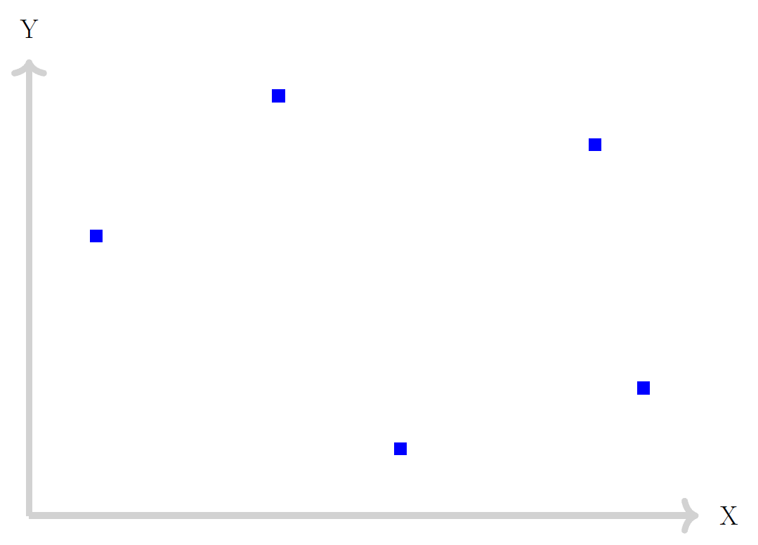








Cost of Path
The shortest path sequence is $Δ(G)=(P_{1},P_{2},P_{3},P_{5},P_{6})$.
This is a piece-wise linear concave function.
We are interested in the number of break points, or, the number of times the shortest path changes.
This is formally captured by $Φ$.
$$P_{6}$$
$$P_{4}$$
$$P_{5}$$
$$P_{3}$$
$$P_{2}$$
Break Points
$$P_{1}$$
$$λ$$

Slide 12
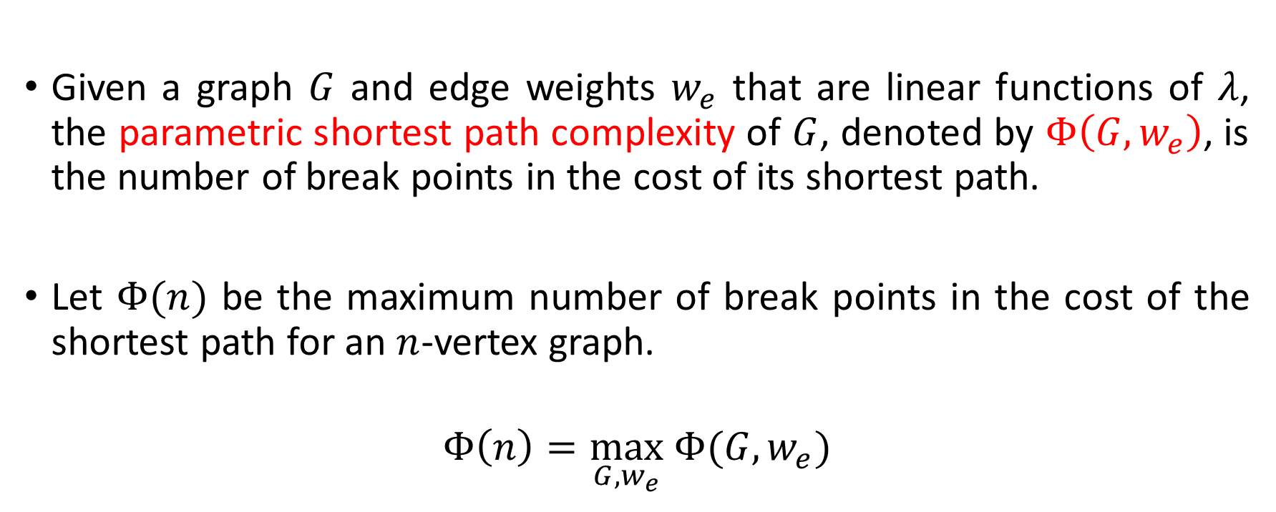
Definition
Given a graph $G$ and edge weights $w_{e}$ that are linear functions of $λ$, the parametric shortest path complexity of $G$, denoted by $Φ\left(G,w_{e}\right)$, is the number of break points in the cost of its shortest path.
Let $Φ(n)$ be the maximum number of break points in the cost of the shortest path for an $n$-vertex graph.
$$Φ\left(n\right)=\max_{G,w_{e}} Φ(G,w_{e})$$

Slide 13
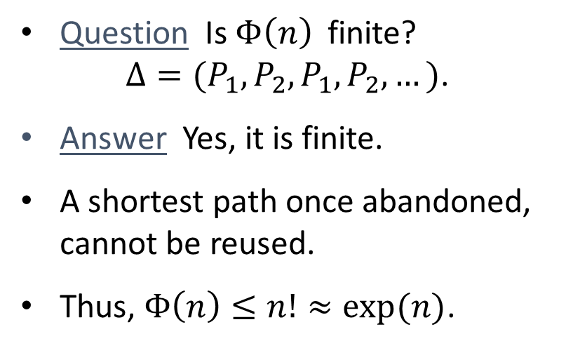
Question Is $Φ\left(n\right)$finite? $Δ=(P_{1},P_{2},P_{1},P_{2},…)$.
Answer Yes, it is finite.
A shortest path once abandoned, cannot be reused.
Thus, $Φ\left(n\right)≤n!≈exp(n)$.
$$P_{6}$$
$$P_{4}$$
$$P_{5}$$
$$P_{3}$$
$$P_{2}$$
Break Points
$$P_{1}$$
$$λ$$

Slide 14


An Upper Bound for $Φ(n)$
A shortest path once abandoned, cannot be reused.
The same holds true for subpaths as well (alternation-free property).
Theorem [Gusfield, 1980] $Φ(n)≤n^{log n+O(1)}$.

Slide 15
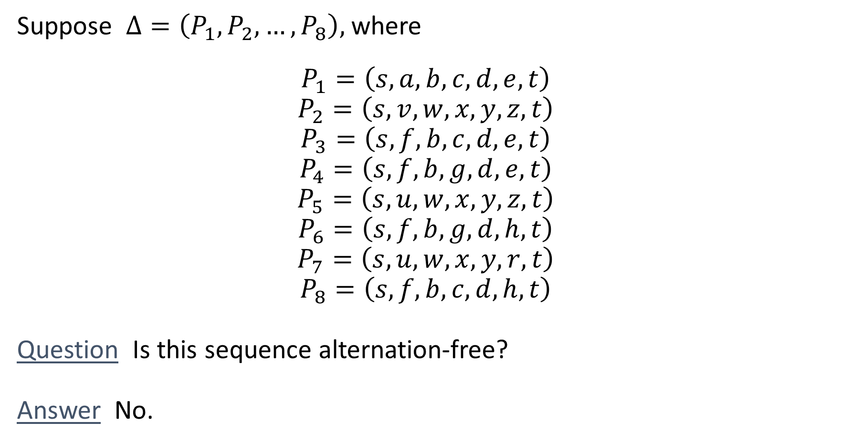
Alternation-free Sequences of Paths
Suppose $Δ=\left(P_{1},P_{2},…,P_{8}\right),$ where
$$P_{1}=\left(s,a,b,c,d,e,t\right)$$
$$P_{2}=\left(s,v,w,x,y,z,t\right)$$
$$P_{3}=\left(s,f,b,c,d,e,t\right)$$
$$P_{4}=\left(s,f,b,g,d,e,t\right)$$
$$P_{5}=\left(s,u,w,x,y,z,t\right)$$
$$P_{6}=\left(s,f,b,g,d,h,t\right)$$
$$P_{7}=\left(s,u,w,x,y,r,t\right)$$
$$P_{8}=\left(s,f,b,c,d,h,t\right)$$
Question Is this sequence alternation-free?
Answer No.
A shortest path once abandoned, cannot be reused.

Slide 16
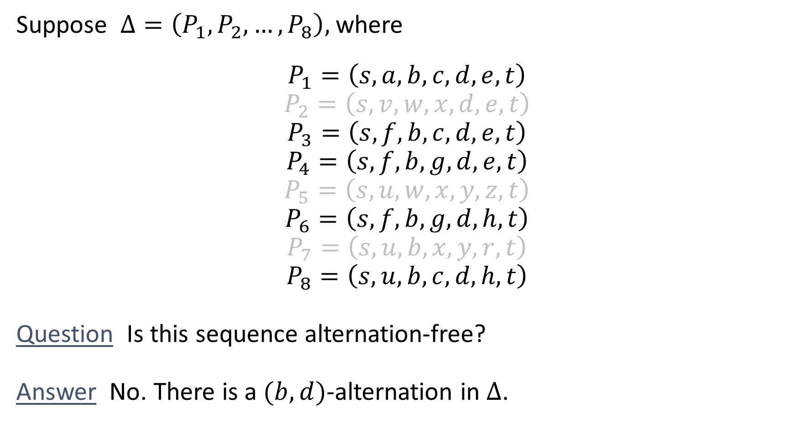
Alternation-free Sequences of Paths
Suppose $Δ=\left(P_{1},P_{2},…,P_{8}\right),$ where
$$P_{1}=\left(s,a,b,c,d,e,t\right)$$
$$P_{2}=\left(s,v,w,x,d,e,t\right)$$
$$P_{3}=\left(s,f,b,c,d,e,t\right)$$
$$P_{4}=\left(s,f,b,g,d,e,t\right)$$
$$P_{5}=\left(s,u,w,x,y,z,t\right)$$
$$P_{6}=\left(s,f,b,g,d,h,t\right)$$
$$P_{7}=\left(s,u,b,x,y,r,t\right)$$
$$P_{8}=\left(s,u,b,c,d,h,t\right)$$
Question Is this sequence alternation-free?
Answer No. There is a $(b,d)$-alternation in $Δ$.
A shortest path once abandoned, cannot be reused.

Slide 17
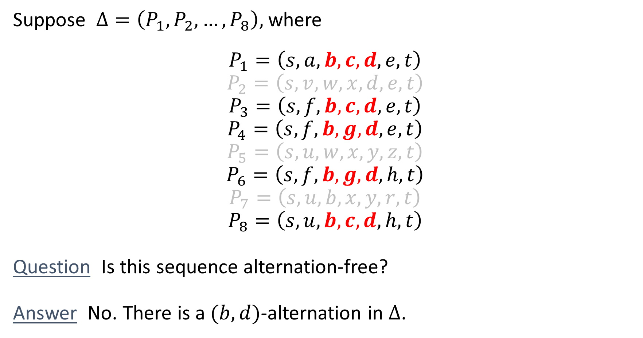
Alternation-free Sequences of Paths
Suppose $Δ=\left(P_{1},P_{2},…,P_{8}\right),$ where
$$P_{1}=\left(s,a,b,c,d,e,t\right)$$
$$P_{2}=\left(s,v,w,x,d,e,t\right)$$
$$P_{3}=\left(s,f,b,c,d,e,t\right)$$
$$P_{4}=\left(s,f,b,g,d,e,t\right)$$
$$P_{5}=\left(s,u,w,x,y,z,t\right)$$
$$P_{6}=\left(s,f,b,g,d,h,t\right)$$
$$P_{7}=\left(s,u,b,x,y,r,t\right)$$
$$P_{8}=\left(s,u,b,c,d,h,t\right)$$
Question Is this sequence alternation-free?
Answer No. There is a $(b,d)$-alternation in $Δ$.
A shortest path once abandoned, cannot be reused.
✓
✓
✓
✓
✗

Slide 18
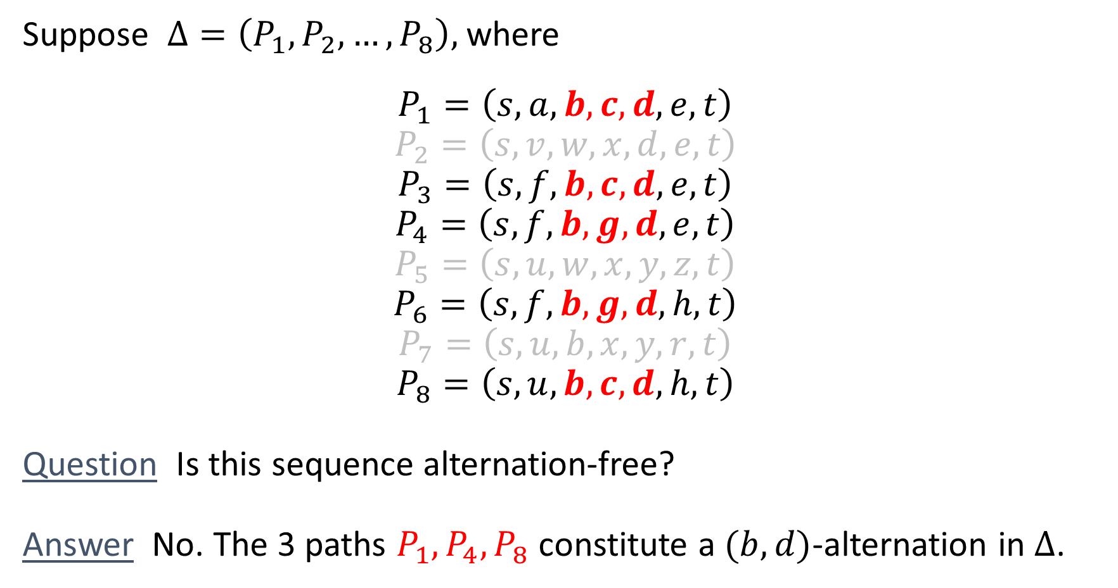
Alternation-free Sequences of Paths
Suppose $Δ=\left(P_{1},P_{2},…,P_{8}\right),$ where
$$P_{1}=\left(s,a,b,c,d,e,t\right)$$
$$P_{2}=\left(s,v,w,x,d,e,t\right)$$
$$P_{3}=\left(s,f,b,c,d,e,t\right)$$
$$P_{4}=\left(s,f,b,g,d,e,t\right)$$
$$P_{5}=\left(s,u,w,x,y,z,t\right)$$
$$P_{6}=\left(s,f,b,g,d,h,t\right)$$
$$P_{7}=\left(s,u,b,x,y,r,t\right)$$
$$P_{8}=\left(s,u,b,c,d,h,t\right)$$
Question Is this sequence alternation-free?
Answer No. The 3 paths $P_{1},P_{4}, P_{8}$ constitute a $(b,d)$-alternation in $Δ$.
A shortest path once abandoned, cannot be reused.
✓
✓
✓
✓
✗

Slide 19
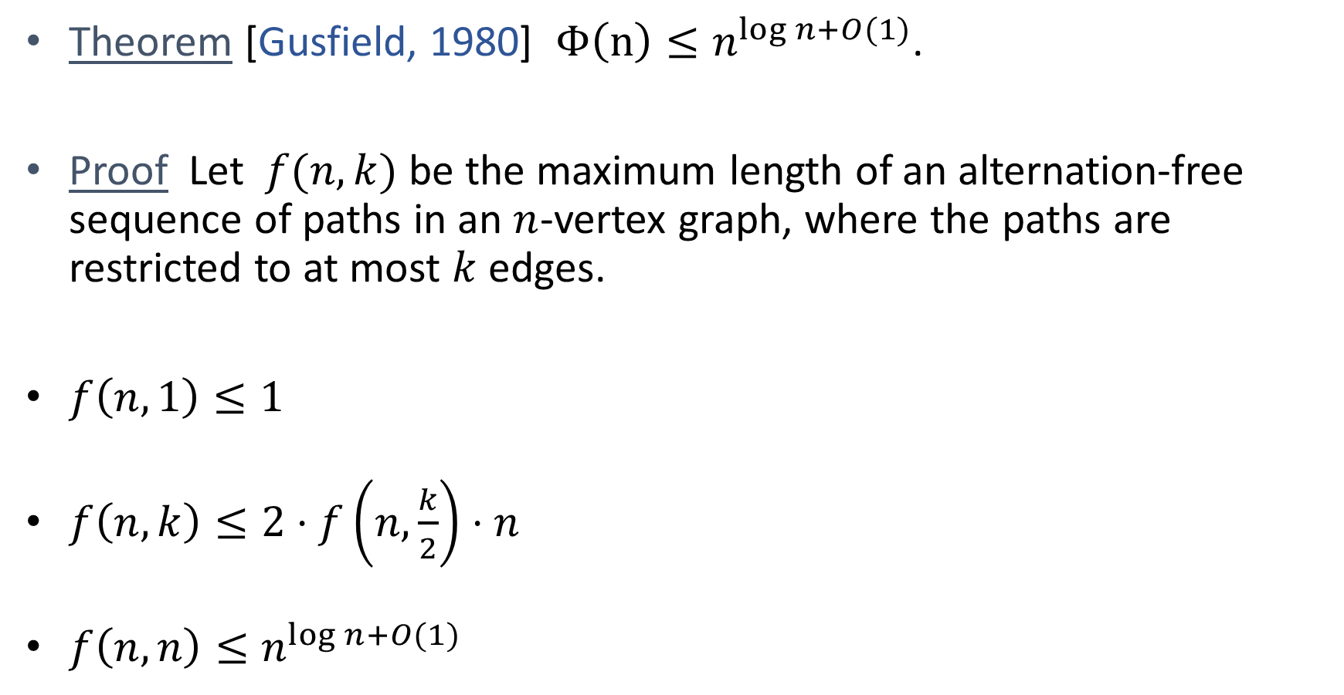
An Upper Bound for $Φ(n)$
Theorem [Gusfield, 1980] $Φ\left(n\right)≤n^{log n+O(1)}$.
Proof Let $f(n,k)$ be the maximum length of an alternation-free sequence of paths in an $n$-vertex graph, where the paths are restricted to at most $k$ edges.
$f\left(n,1\right)≤1$
$f\left(n,k\right)≤2⋅f\left.\left(n,\frac{k}{2}\right.\right)⋅n$
$f\left(n,n\right)≤n^{log n+O(1)}$

Slide 20
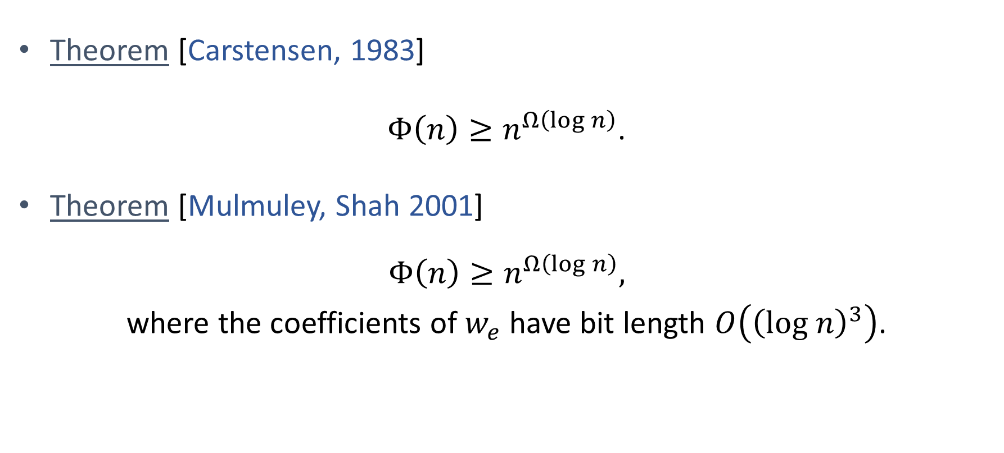

A Lower Bound for $Φ(n)$
Theorem [Carstensen, 1983]
$Φ\left(n\right)≥n^{Ω\left(log n\right)}$.
Theorem [Mulmuley, Shah 2001]
$$Φ\left(n\right)≥n^{Ω\left(log n\right)},$$
where the coefficients of $w_{e}$ have bit length $O\left({\left(log n\right)}^{3}\right)$.

Slide 21

Planar Graphs
Theorem [Nikolova, Kelner, Brand, Mitzenmacher 2006]
$$Φ^{pl}\left(n\right)≥Ω(n)\text{.}$$
Theorem [Correa, Harks, Kreuzen, Matuschke 2017]
$$Φ^{sp}\left(n\right)≤O\left(n\right).$$

Slide 22

Planar Graphs
Conjecture [Nikolova 2009]
$$Φ^{pl}\left(n\right)≤n^{O\left(1\right)}.$$
Theorem [G, Radhakrishnan 2019]
$$Φ^{pl}\left(n\right)≥n^{Ω\left(log n\right)},$$
where the coefficients of $w_{e}$ have bit length $O\left({\left(log n\right)}^{3}\right)$.

Slide 23
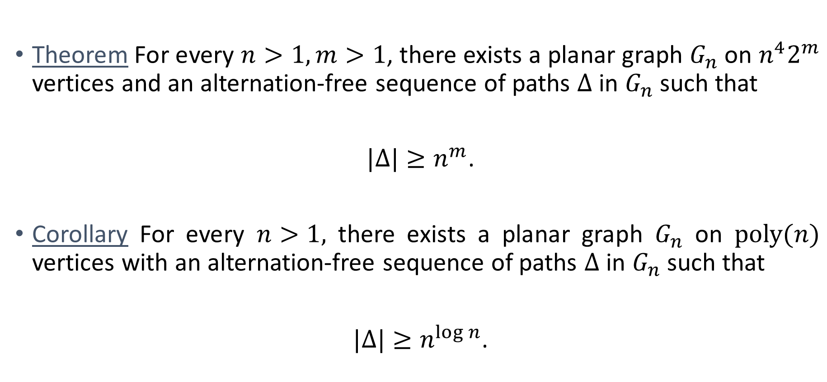
Planar Graphs
Theorem For every $n>1, m>1$, there exists a planar graph $G_{n}$ on $n^{4}2^{m}$ vertices and an alternation-free sequence of paths $Δ$ in $G_{n}$ such that
$|Δ|≥n^{m}$.
Corollary For every $n>1,$ there exists a planar graph $G_{n}$ on $poly(n)$ vertices with an alternation-free sequence of paths $Δ$ in $G_{n}$ such that
$|Δ|≥n^{log n}$.

Slide 24











Planar Graphs
Consider all the $m$-digit base-$n$ numbers in increasing order.
$$P_{1}=$$
$$P_{2}=$$
.
.
.
$${ P}_{64}=$$
Each number corresponds to $n$ vertex-disjoint paths.
Total $n^{m}$ numbers $⇒ \left|Δ\right|=n^{m+1}$.
$$0$$
$$0$$
$$0$$
$$0$$
$$0$$
$$1$$
$$n=4$$
$$m=3$$
$$3$$
$$3$$
$$3$$

Slide 25


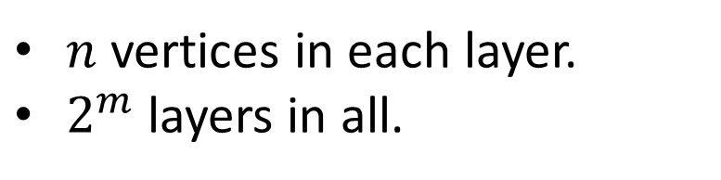
The Layered Graph on a Cylinder
$n$ vertices in each layer.
$2^{m}$ layers in all.
$$n=4$$
$$m=3$$
$$s$$
$$t$$

Slide 26
The Layered Graph on a Cylinder
$n$ vertices in each layer.
$2^{m}$ layers in all.
$$n=4$$
$$m=3$$
$$s$$
$$t$$

Slide 27
The Layered Graph on a Cylinder
$$s$$
$$t$$

Slide 28
The Layered Graph on a Cylinder
$$s$$
$$t$$

Slide 29
The Layered Graph on a Cylinder
$$s$$
$$t$$

Slide 30
Paths on a Cylinder
planarize

Slide 31
Alternation-free Sequences of Paths in Planar Graphs
planarize

Slide 32
Alternation-free Sequences of Paths in Planar Graphs
planarize

Slide 33
Alternation-free Sequences of Paths in Planar Graphs
planarize

Slide 34
Alternation-free Sequences of Paths in Planar Graphs
planarize

Slide 35




$$1$$
$$0$$
$$2$$
$$2$$
$$s$$
$$t$$

Slide 36


$$1$$
$$0$$
$$2$$
$$0$$
$$2$$
$$s$$
$$t$$

Slide 37
$$1$$
$$0$$
$$2$$
$$0$$
$$2$$
$$s$$
$$t$$

Slide 38

$$1$$
$$0$$
$$2$$
$$0$$
$$0$$
$$2$$
$$s$$
$$t$$

Slide 39

$$1$$
$$0$$
$$2$$
$$0$$
$$2$$
$$0$$
$$s$$
$$t$$

Slide 40


$$1$$
$$0$$
$$2$$
$$1$$
$$0$$
$$2$$
$$0$$
$$s$$
$$t$$

Slide 41

$$1$$
$$0$$
$$2$$
$$1$$
$$1$$
$$0$$
$$2$$
$$0$$
$$s$$
$$t$$

Slide 42

$$1$$
$$0$$
$$2$$
$$1$$
$$1$$
$$0$$
$$1$$
$$2$$
$$0$$
$$s$$
$$t$$

Slide 43


$$1$$
$$0$$
$$2$$
$$1$$
$$1$$
$$0$$
$$1$$
$$2$$
$$1$$
$$0$$
$$s$$
$$t$$

Slide 44




$$1$$
$$0$$
$$2$$
$$1$$
$$0$$
$$1$$
$$2$$
$$1$$
$$0$$
$$1$$
$$s$$
$$t$$

Slide 45



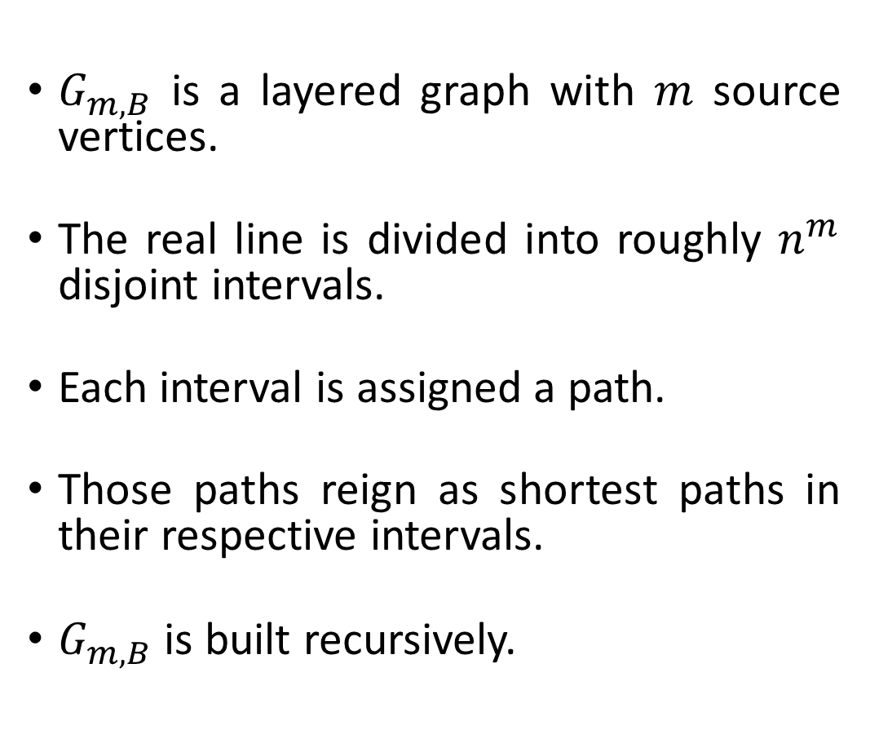







The Carstensen and Mulmuley-Shah framework
$G_{m,B}$ is a layered graph with $m$ source vertices.
The real line is divided into roughly $n^{m}$ disjoint intervals.
Each interval is assigned a path.
Those paths reign as shortest paths in their respective intervals.
$G_{m,B}$ is built recursively.
$$t_{M}$$
$$M≈2^{m}B$$
.
.
.
$$s_{B}$$
$$G_{m,B}$$
.
.
.
$$s_{3}$$
$$t_{3}$$
$$s_{2}$$
$$t_{2}$$
$$s_{1}$$
$$t_{1}$$

Slide 46












The decomposition of $G_{m,B}$
$${s′}_{B+n}$$
.
.
.
.
.
.
$$G_{m−1,B+n}$$
$$s_{B}$$
$$G_{m−1,B}$$
$$G_{m−1,B}^{rev}$$
.
.
.
.
.
.
Link Gadget
$$s_{3}$$
$${s′}_{3}$$
$$s_{2}$$
$${s′}_{2}$$
$$s_{1}$$
$${s′}_{1}$$

Slide 47
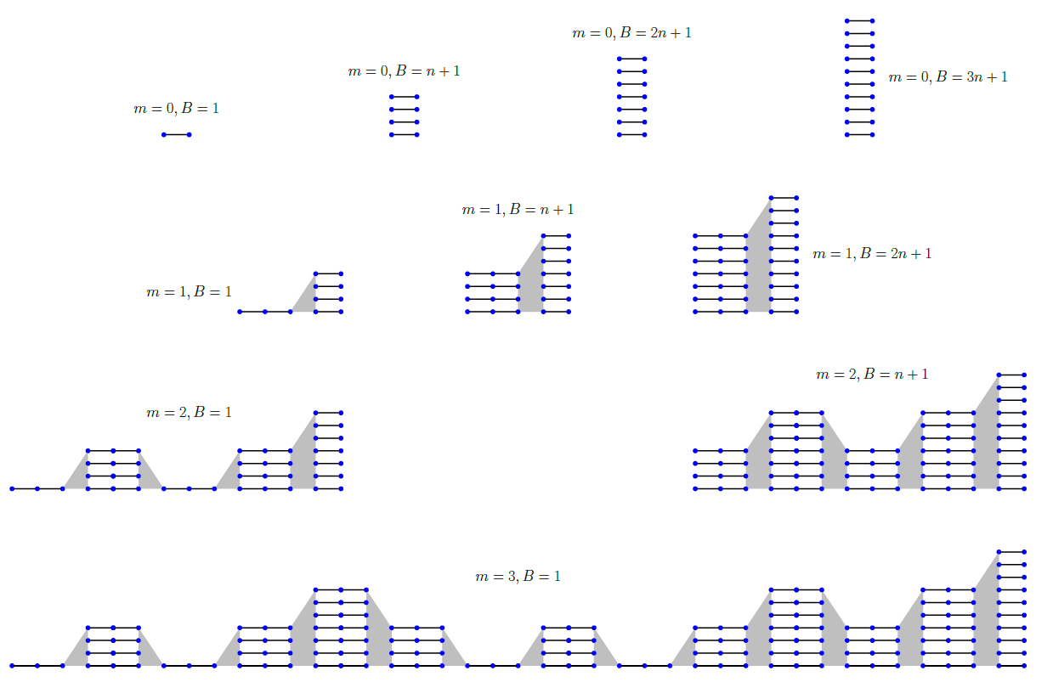
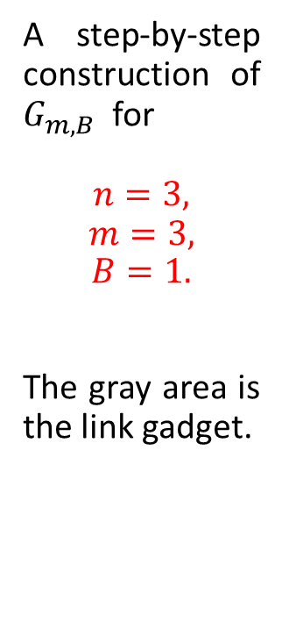
A step-by-step construction of $G_{m,B}$ for
$$n=3,$$
$$m=3,$$
$$B=1.$$
The gray area is the link gadget.

Slide 48
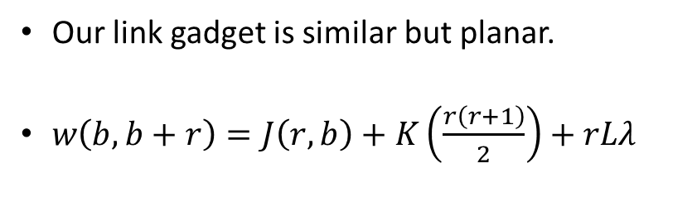
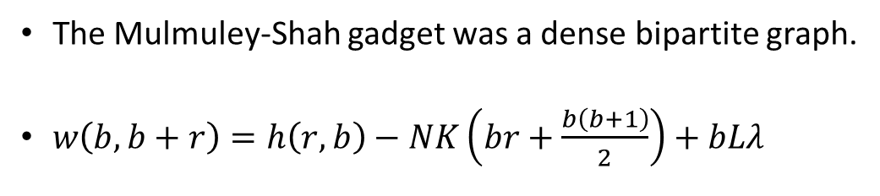
The Link Gadget
planarize
1 unit
The Mulmuley-Shah gadget was a dense bipartite graph.
$w\left(b,b+r\right)=h\left(r,b\right)−NK\left(br+\frac{b\left(b+1\right)}{2}\right)+bLλ$
Our link gadget is similar but planar.
$w\left(b,b+r\right)=J\left(r,b\right)+K\left(\frac{r\left(r+1\right)}{2}\right)+rLλ$

Slide 49
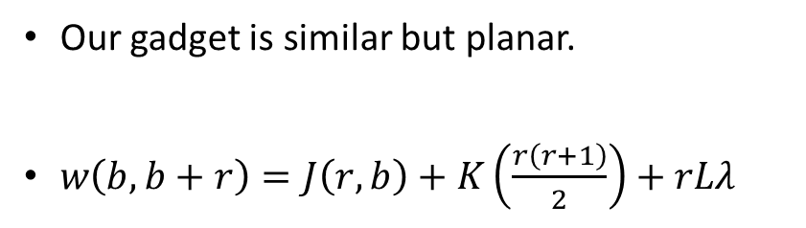
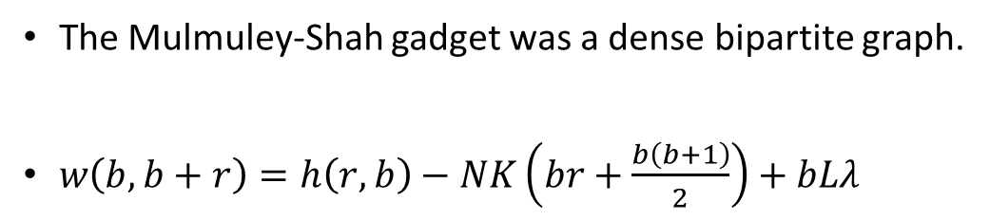
The Link Gadget
planarize
1 unit
The Mulmuley-Shah gadget was a dense bipartite graph.
$w\left(b,b+r\right)=h\left(r,b\right)−NK\left(br+\frac{b\left(b+1\right)}{2}\right)+bLλ$
Our gadget is similar but planar.
$w\left(b,b+r\right)=J\left(r,b\right)+K\left(\frac{r\left(r+1\right)}{2}\right)+rLλ$

Slide 50
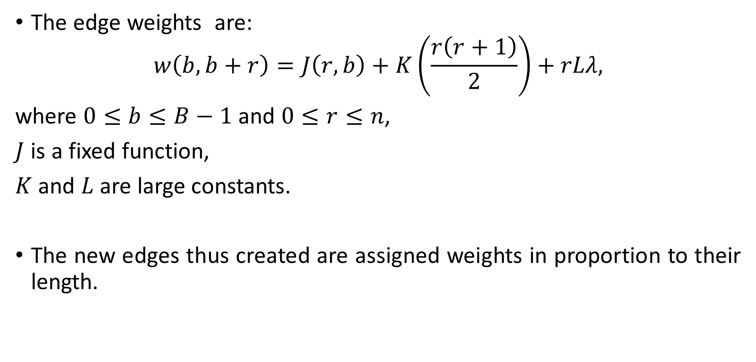
Properties of the Link Gadget
The edge weights are:
$$w\left(b,b+r\right)=J\left(r,b\right)+K\left(\frac{r\left(r+1\right)}{2}\right)+rLλ,$$
where $0≤b≤B−1$ and $0≤r≤n$,
$J$ is a fixed function,
$K$ and $L$ are large constants.
The new edges thus created are assigned weights in proportion to their length.

Slide 51
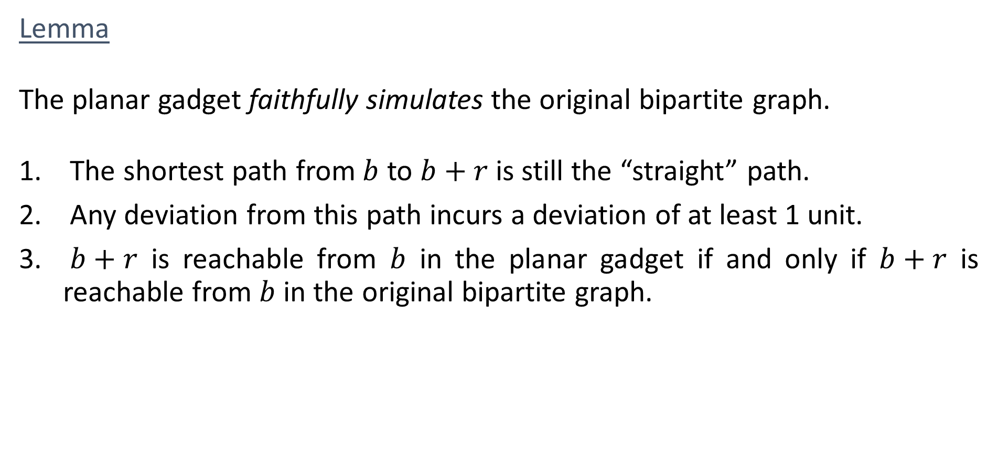
Properties of the Link Gadget
Lemma
The planar gadget faithfully simulates the original bipartite graph.
The shortest path from $b$ to $b+r$ is still the “straight” path.
Any deviation from this path incurs a deviation of at least 1 unit.
$b+r$ is reachable from $b$ in the planar gadget if and only if $b+r$ is reachable from $b$ in the original bipartite graph.

Slide 52
The decomposition of $G_{m,B}$
$${s′}_{B+n}$$
.
.
.
.
.
.
$$G_{m−1,B+n}$$
$$s_{B}$$
$$G_{m−1,B}$$
$$G_{m−1,B}^{rev}$$
.
.
.
.
.
.
Link Gadget
$$s_{3}$$
$${s′}_{3}$$
$$s_{2}$$
$${s′}_{2}$$
$$s_{1}$$
$${s′}_{1}$$
Planar
Planar
Planar
Planar

Slide 53
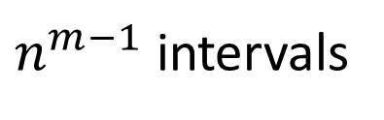

Cost of Path
$n^{m−1}$ intervals
$$G_{m−1,B}$$
$$λ$$

Slide 54
Cost of Path
$n^{m−1}$ intervals
$$G_{m−1,B}$$
$$λ$$

Slide 55

Cost of Path
$$G_{m−1,B+n}$$
$n^{m−1}$ intervals
$$λ$$

Slide 56
Cost of Path
$$G_{m−1,B+n}$$
$n^{m−1}$ intervals
$$λ$$

Slide 57
Cost of Path
$$G_{m−1,B+n}$$
$n^{m−1}$ intervals
$$G_{m−1,B}$$
$$λ$$

Slide 58
Cost of Path
$$G_{m−1,B+n}$$
$n^{m−1}$ intervals
$$G_{m−1,B}$$
$$λ$$

Slide 59
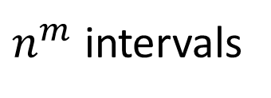
Cost of Path
$$G_{m−1,B+n}$$
$n^{m}$ intervals
Link gadget
$$G_{m−1,B}$$
$$λ$$

Slide 60
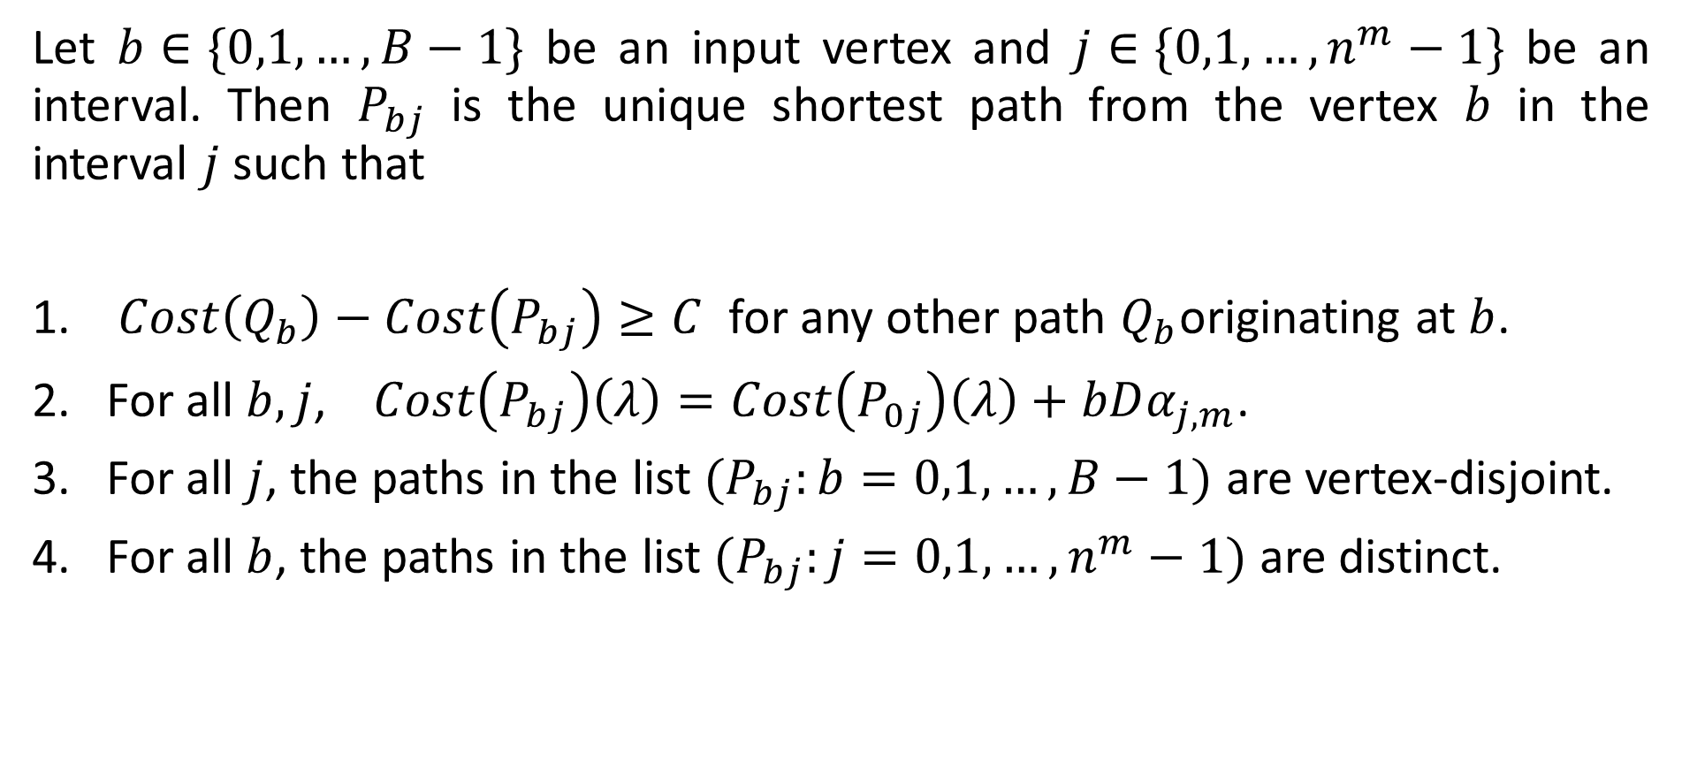
Induction Hypothesis
Let $b∈\{0,1,…,B−1\}$ be an input vertex and $j∈\{0,1,…,n^{m}−1\}$ be an interval. Then $P_{bj}$ is the unique shortest path from the vertex $b$ in the interval $j$ such that
$Cost\left(Q_{b}\right)−Cost\left(P_{bj}\right)≥C$ for any other path $Q_{b}$originating at $b$.
For all $b,j$, $Cost\left(P_{bj}\right)\left(λ\right)=Cost\left(P_{0j}\right)\left(λ\right)+bDα_{j,m}$.
For all $j$, the paths in the list $(P_{bj}:b=0,1,…, B−1)$ are vertex-disjoint.
For all $b$, the paths in the list $(P_{bj}:j=0,1,…, n^{m}−1)$ are distinct.

Slide 61
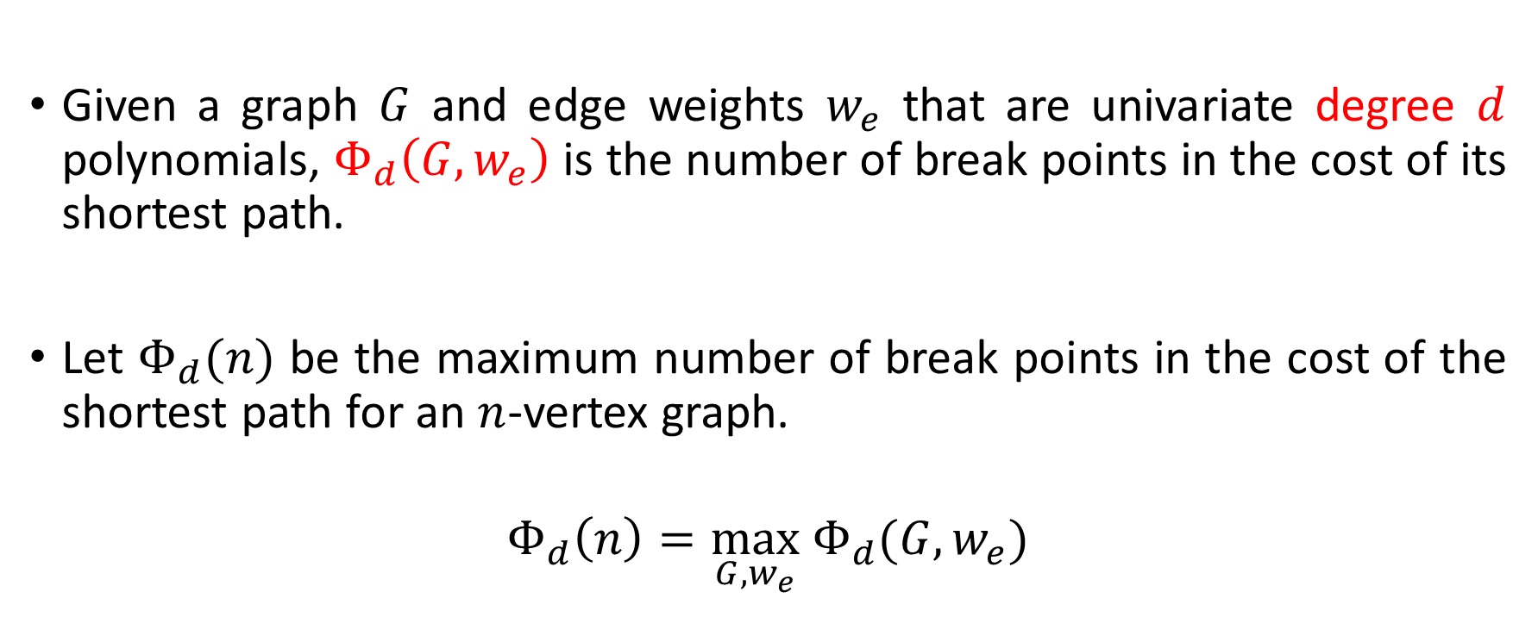

What about degree $d$ polynomials in $λ ?$
Given a graph $G$ and edge weights $w_{e}$ that are univariate degree $d$ polynomials, $Φ_{d}\left(G,w_{e}\right)$ is the number of break points in the cost of its shortest path.
Let $Φ_{d}(n)$ be the maximum number of break points in the cost of the shortest path for an $n$-vertex graph.
$$Φ_{d}\left(n\right)=\max_{G,w_{e}} Φ_{d}(G,w_{e})$$

Slide 62
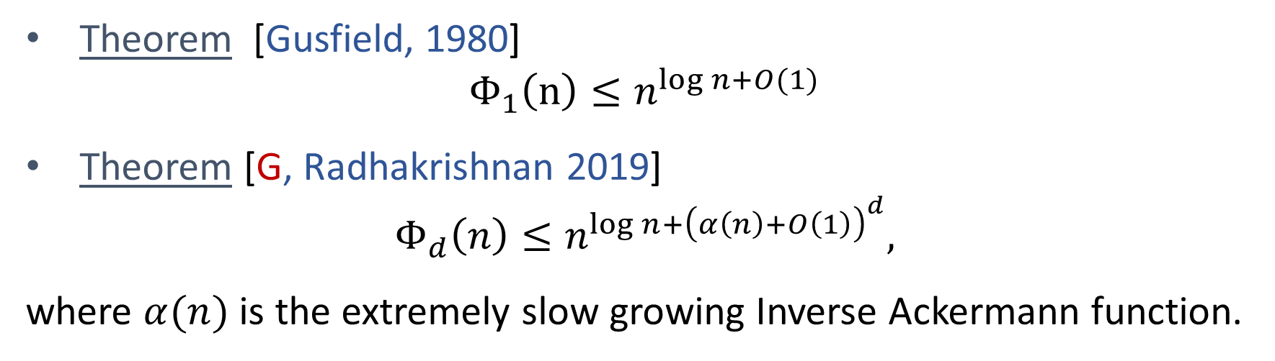
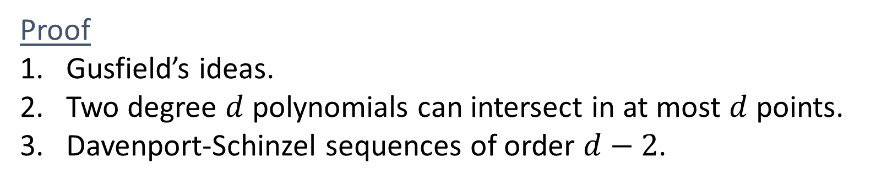
What about degree $d$ polynomials in $λ ?$
Theorem [Gusfield, 1980]
$$Φ_{1}\left(n\right)≤n^{log n+O(1)}$$
Theorem [G, Radhakrishnan 2019]
$$Φ_{d}\left(n\right)≤n^{log n+{\left(α\left(n\right)+O\left(1\right)\right)}^{d}},$$
where $α(n)$ is the extremely slow growing Inverse Ackermann function.
Proof
Gusfield’s ideas.
Two degree $d$ polynomials can intersect in at most $d$ points.
Davenport-Schinzel sequences of order $d−2$.

Slide 63

Thank you!

