Slide 1
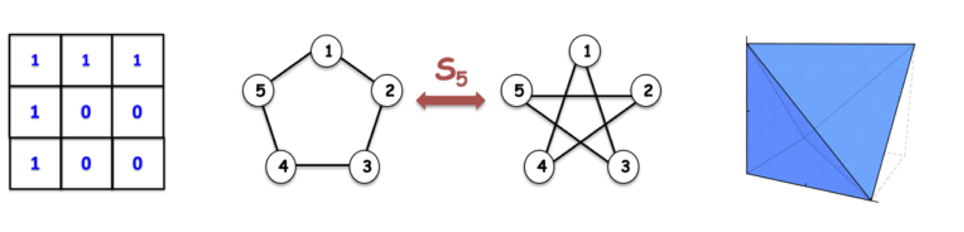
Panorama of scaling problems and algorithms
Ankit Garg
Microsoft Research India
Recent trends in algorithms, February 7, 2019

Slide 2
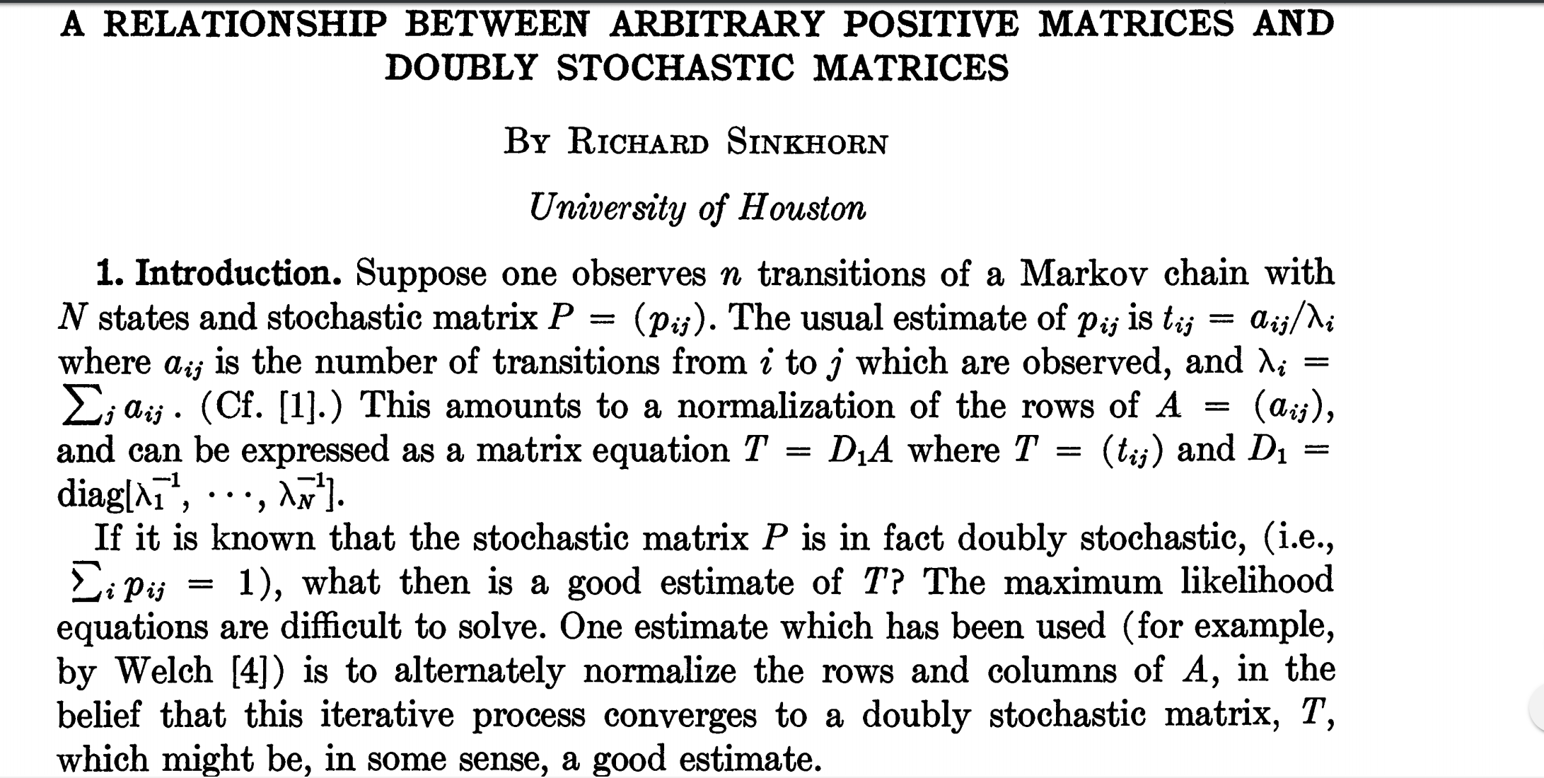
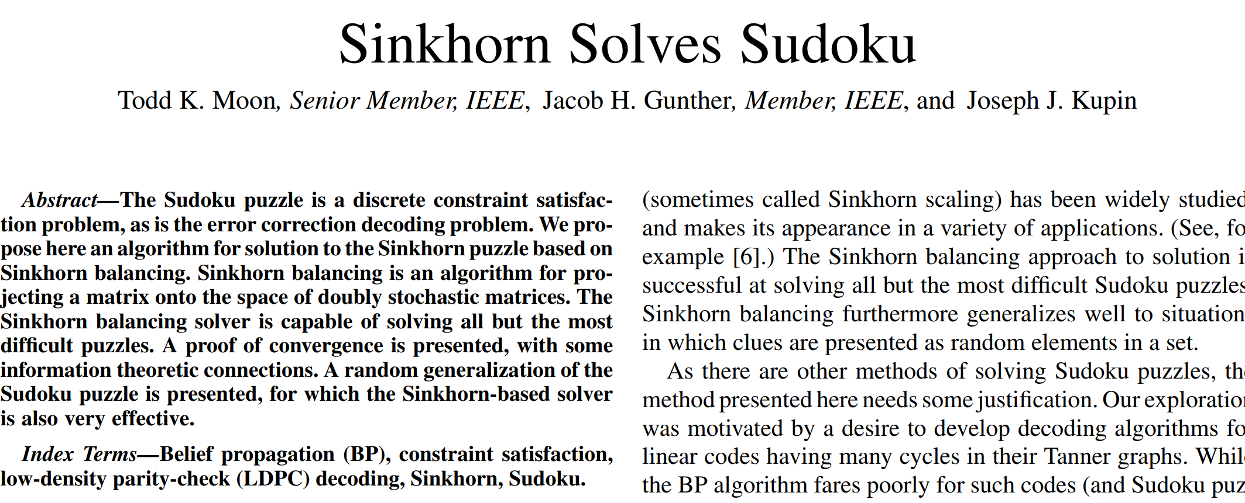
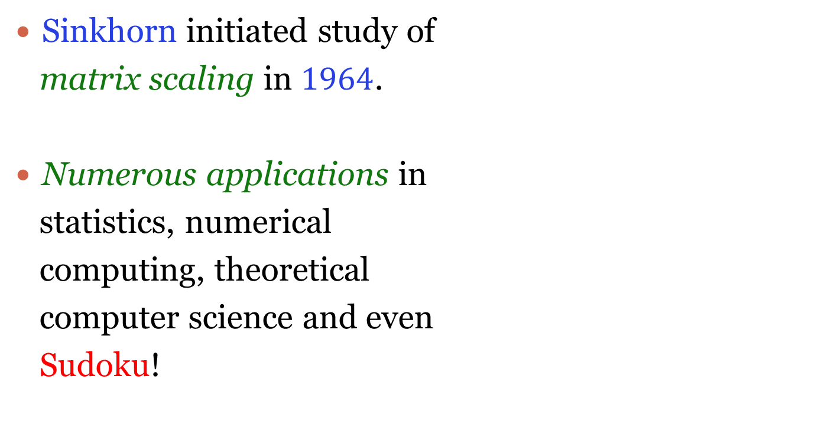
Overview
Sinkhorn initiated study of
matrix scaling in $1964$.
Numerous applications in
statistics, numerical
computing, theoretical
computer science and even
Sudoku!

Slide 3
Overview
Generalized in several unexpected directions with multiple themes.
Analytic approaches for algebraic problems.
Special cases of polynomial identity testing (PIT).
Isomorphism related problems: Null cone, orbit intersection, orbit-closure intersection.
Provable fast convergence of alternating minimization algorithms in problems with symmetries.
Tractable polytopes with exponentially many vertices and facets. Brascamp-Lieb polytopes, moment polytopes etc.

Slide 4
Outline
Matrix scaling
Operator scaling
Unified source of scaling problems
Even more scaling problems

Slide 5
Matrix scaling: Sinkhorn’s algorithm, analysis and an application

Slide 6
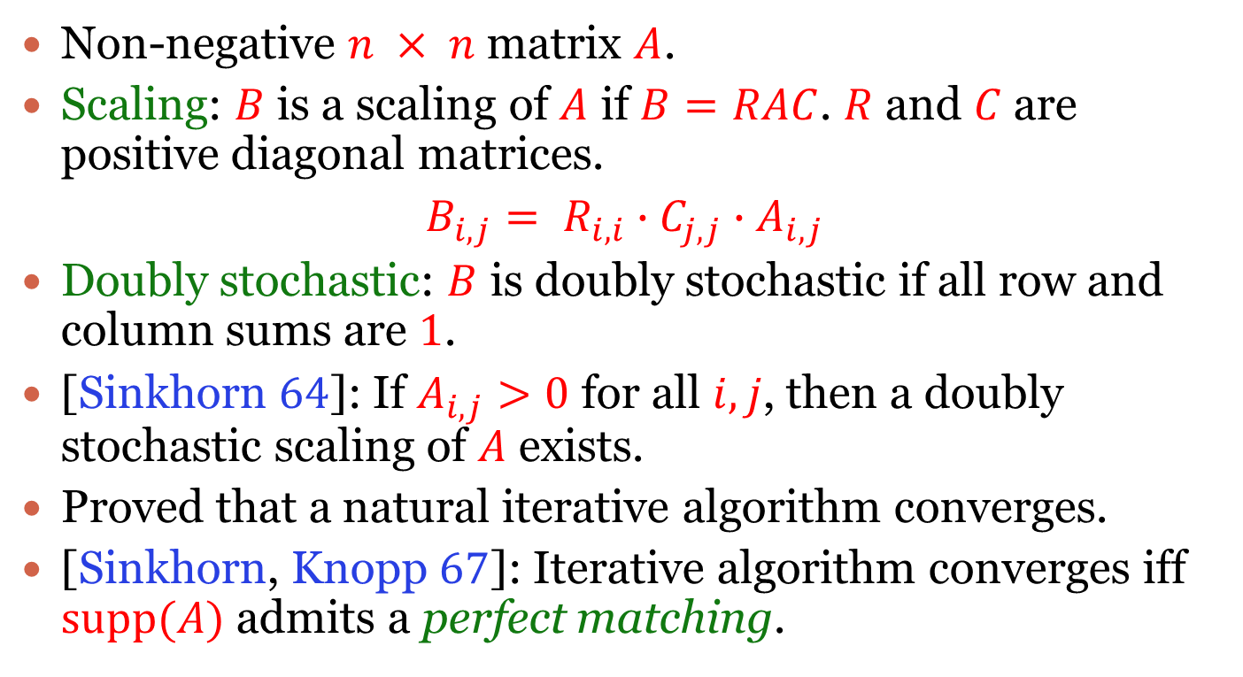
Matrix Scaling
Non-negative $n × n$ matrix $A$.
Scaling: $B$ is a scaling of $A$ if $B=RAC$. $R$ and $C$ are positive diagonal matrices.
$B_{i,j}= R_{i,i}∙C_{j,j}∙A_{i,j}$
Doubly stochastic: $B$ is doubly stochastic if all row and column sums are $1$.
[Sinkhorn $64$]: If $A_{i,j}>0$ for all $i,j$, then a doubly stochastic scaling of $A$ exists.
Proved that a natural iterative algorithm converges.
[Sinkhorn, Knopp $67$]: Iterative algorithm converges iff $supp(A)$ admits a perfect matching.

Slide 7









Matrix scaling: Example $1$
[Sinkhorn $64$]: Alternately normalize rows
and columns.
$$G$$
$$1$$
$$1$$
$$1$$
$$1$$
$$0$$
$$0$$
$$1$$
$$0$$
$$1$$

Slide 8





Matrix scaling: Example $1$
[Sinkhorn $64$]: Alternately normalize rows
and columns.
$$G$$
$$1/3$$
$$1/3$$
$$1/3$$
$$1$$
$$0$$
$$0$$
$$1/2$$
$$0$$
$$1/2$$

Slide 9





Matrix scaling: Example $1$
[Sinkhorn $64$]: Alternately normalize rows
and columns.
$$G$$
$$2/11$$
$$1$$
$$2/5$$
$$6/11$$
$$0$$
$$0$$
$$3/11$$
$$0$$
$$3/5$$

Slide 10





Matrix scaling: Example $1$
[Sinkhorn $64$]: Alternately normalize rows
and columns.
$$G$$
$$10/87$$
$$55/87$$
$$22/87$$
$$1$$
$$0$$
$$0$$
$$5/16$$
$$0$$
$$11/16$$

Slide 11








Matrix scaling: Example $1$
[Sinkhorn $64$]: Alternately normalize rows
and columns.
$$G$$
$$0$$
$$1$$
$$0$$
$$1$$
$$0$$
$$0$$
$$0$$
$$0$$
$$1$$

Slide 12






Matrix scaling: Example $2$
[Sinkhorn $64$]: Alternately normalize rows
and columns.
$$G$$
$$1$$
$$1$$
$$1$$
$$1$$
$$0$$
$$0$$
$$1$$
$$0$$
$$0$$

Slide 13


Matrix scaling: Example $2$
[Sinkhorn $64$]: Alternately normalize rows
and columns.
$$G$$
$$1/3$$
$$1/3$$
$$1/3$$
$$1$$
$$0$$
$$0$$
$$1$$
$$0$$
$$0$$

Slide 14



Matrix scaling: Example $2$
[Sinkhorn $64$]: Alternately normalize rows
and columns.
$$G$$
$$1/7$$
$$1$$
$$1$$
$$3/7$$
$$0$$
$$0$$
$$3/7$$
$$0$$
$$0$$

Slide 15


Matrix scaling: Example $2$
[Sinkhorn $64$]: Alternately normalize rows
and columns.
$$G$$
$$1/15$$
$$7/15$$
$$7/15$$
$$1$$
$$0$$
$$0$$
$$1$$
$$0$$
$$0$$

Slide 16




Matrix scaling: Example $2$
[Sinkhorn $64$]: Alternately normalize rows
and columns.
$$G$$
$$0$$
$$1$$
$$1$$
$$1/2$$
$$0$$
$$0$$
$$1/2$$
$$0$$
$$0$$

Slide 17



Matrix scaling: Example $2$
[Sinkhorn $64$]: Alternately normalize rows
and columns.
$$G$$
$$0$$
$$1/2$$
$$1/2$$
$$1$$
$$0$$
$$0$$
$$1$$
$$0$$
$$0$$

Slide 18
Matrix scaling: Example $2$
[Sinkhorn $64$]: Alternately normalize rows
and columns.
$$G$$
$$0$$
$$1$$
$$1$$
$$1/2$$
$$0$$
$$0$$
$$1/2$$
$$0$$
$$0$$

Slide 19
Matrix scaling: Example $2$
[Sinkhorn $64$]: Alternately normalize rows
and columns.
$$G$$
$$0$$
$$1/2$$
$$1/2$$
$$1$$
$$0$$
$$0$$
$$1$$
$$0$$
$$0$$

Slide 20
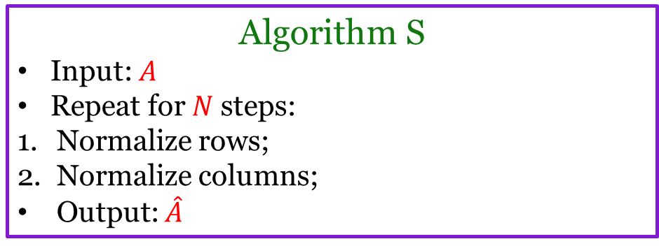
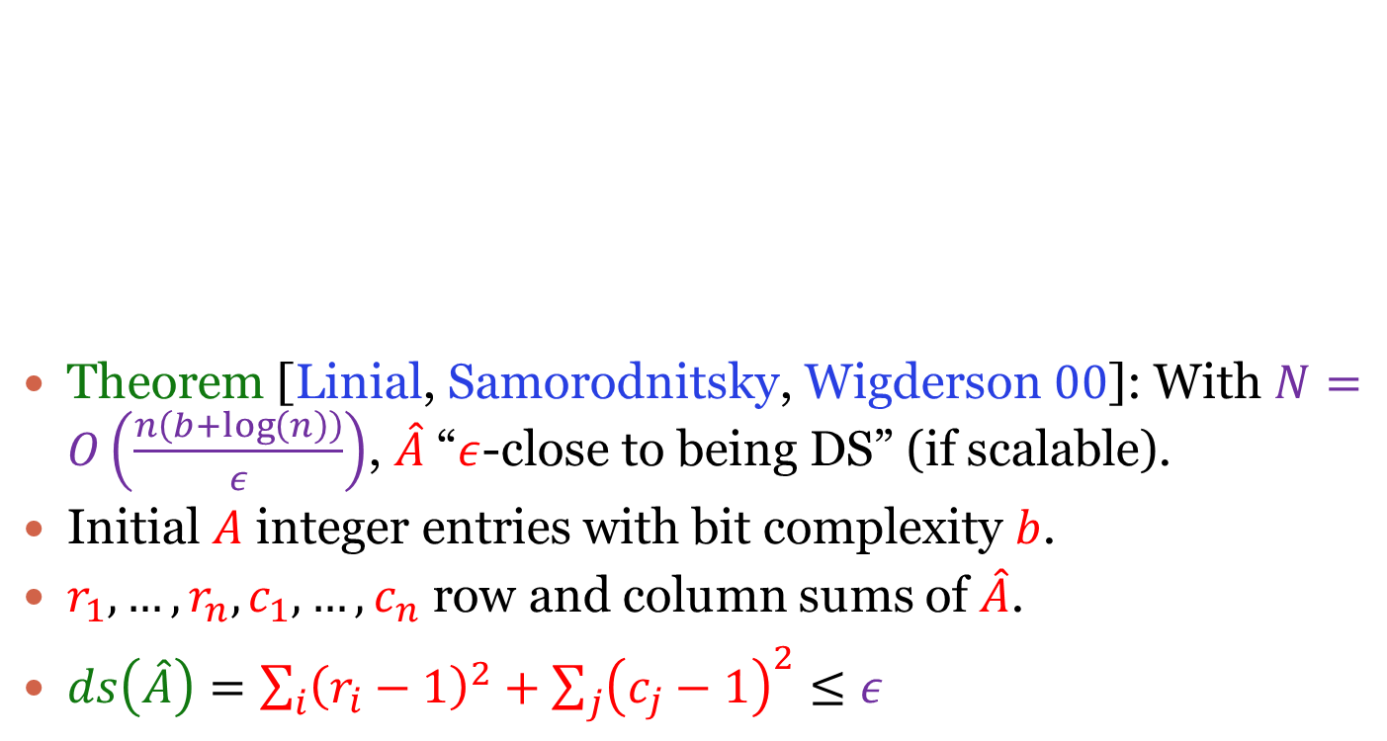
Analysis
Theorem [Linial, Samorodnitsky, Wigderson $00$]: With $N=O\left(\frac{n\left(b+\log\left(n\right)\right)}{ε}\right)$, $\hat{A}$ “$ε$-close to being DS” (if scalable).
Initial $A$ integer entries with bit complexity $b$.
$r_{1},…,r_{n},c_{1},…,c_{n}$ row and column sums of $\hat{A}$.
$ds\left(\hat{A}\right)=\sum_{i}{{\left(r_{i}−1\right)}^{2}}+\sum_{j}{{\left(c_{j}−1\right)}^{2}≤ε}$
Algorithm S
Input: $A$
Repeat for $N$ steps:
Normalize rows;
Normalize columns;
Output: $\hat{A}$

Slide 21
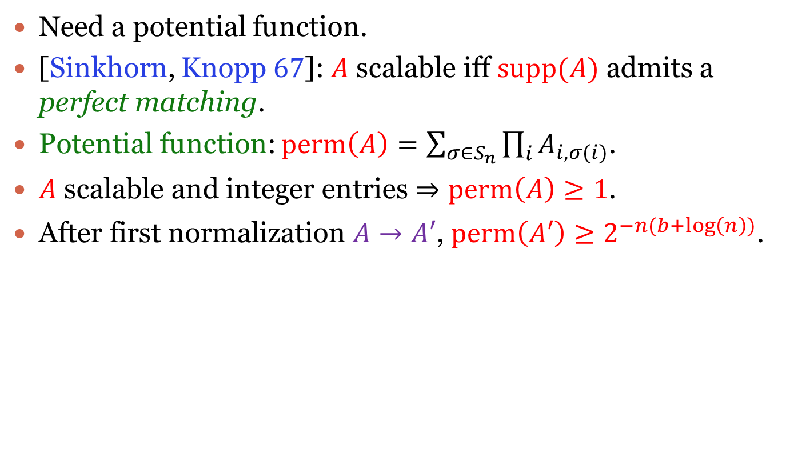
Analysis
Need a potential function.
[Sinkhorn, Knopp $67$]: $A$ scalable iff $supp(A)$ admits a perfect matching.
Potential function: $perm\left(A\right)=\sum_{σ∈S_{n}}{\prod_{i}{A_{i,σ(i)}}}$.
$A$ scalable and integer entries $⇒perm\left(A\right)≥1$.
After first normalization $A→A′$, $perm\left(A′\right)≥2^{−n(b+\log\left(n\right))}$.

Slide 22


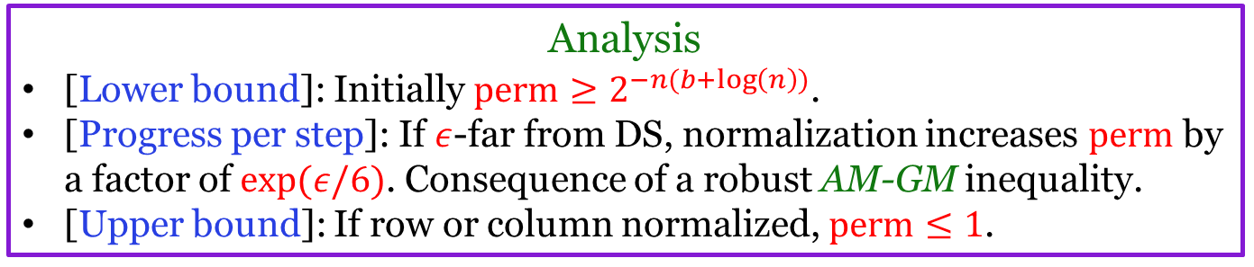
$3$-step analysis
Therefore get $ε$-close to DS in $O\left(\frac{n\left(b+\log\left(n\right)\right)}{ε}\right)$steps.
Crucial property of permanent:
$perm\left(R A C\right)=∏_{i}R_{i,i}{ ∏}_{j}C_{j,j} perm(A)$
($R,C$ diagonal). Permanent invariant under action of diagonal matrices (with determinant $1$).
Analysis
[Lower bound]: Initially $perm≥2^{−n(b+\log\left(n\right))}$.
[Progress per step]: If $ε$-far from DS, normalization increases $perm$ by a factor of $exp⁡(ε/6)$. Consequence of a robust AM-GM inequality.
[Upper bound]: If row or column normalized, $perm≤1$.

Slide 23
Much faster scaling
[Allen-Zhu, Li, Oliveira, Wigderson 17]; [Cohen, Madry, Tsipras, Vladu 17]: Near linear time matrix scaling.
Box constrained Newton’s method.
Laplacian linear system solvers.

Slide 24


Application: Bipartite matching
[Sinkhorn, Knopp $67$]: Iterative algorithm converges iff $supp(A)$ admits a perfect matching.
[Linial, Samorodnitsky, Wigderson $00$]: Only need to check $1/n$ close to DS.
Algorithm
Input $A_{G}$
Repeat for $O(n^{2}\log\left(n\right))$ steps:
Normalize rows;
Normalize columns;
Output $\hat{A}$
Test if $ds\left(\hat{A}\right)<1/n$,
Yes: PM in $G$.
No: No PM in $G$.
Notes:
Alternate algorithm for bipartite matching albeit slower. And does not even find the perfect matching.

Slide 25

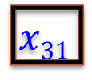


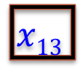



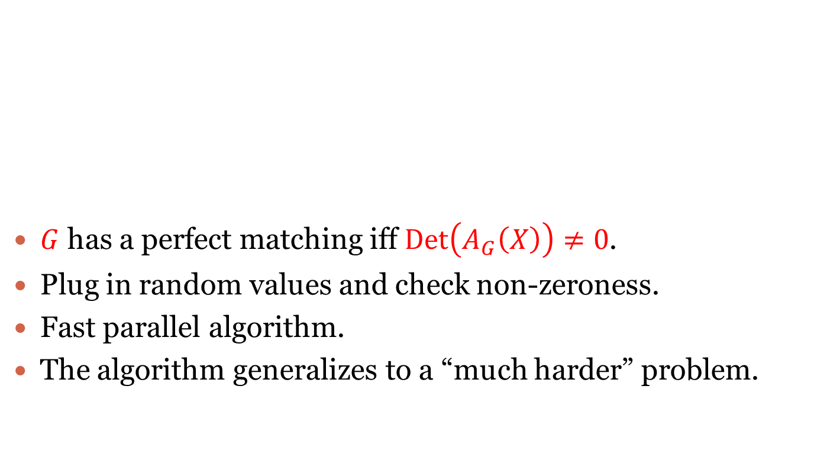
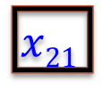
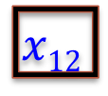





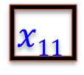




Another algorithm: Matching
$G$ has a perfect matching iff $Det\left(A_{G}\left(X\right)\right)≠0$.
Plug in random values and check non-zeroness.
Fast parallel algorithm.
The algorithm generalizes to a “much harder” problem.
$$1$$
$$1$$
$$1$$
$$x11$$
$$x12$$
$$x13$$
$$1$$
$$0$$
$$0$$
$$x21$$
$$0$$
$$0$$
$$1$$
$$0$$
$$1$$
$$x31$$
$$0$$
$$x_{33}$$
$$G$$
$$AG$$
$$AG(X)$$

Slide 26










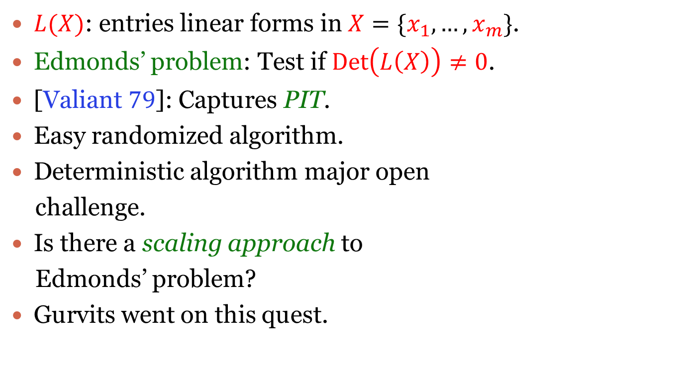


Edmonds’ problem [$1967$]
$$L11$$
$$L12$$
$$L13$$
$L(X)$: entries linear forms in $X=\{x_{1},…,x_{m}\}$.
Edmonds’ problem: Test if $Det\left(L\left(X\right)\right)≠0$.
[Valiant $79$]: Captures PIT.
Easy randomized algorithm.
Deterministic algorithm major open
challenge.
Is there a scaling approach to
Edmonds’ problem?
Gurvits went on this quest.
$$L21$$
$$L22$$
$$L23$$
$$L31$$
$$L32$$
$$L33$$
$$L(X)$$
Notes:
Probably not – seems bizarre to ask such a question. Gurvits asked this question and went on this quest in 2004.

Slide 27
Operator scaling: Gurvits’ algorithm and an application

Slide 28
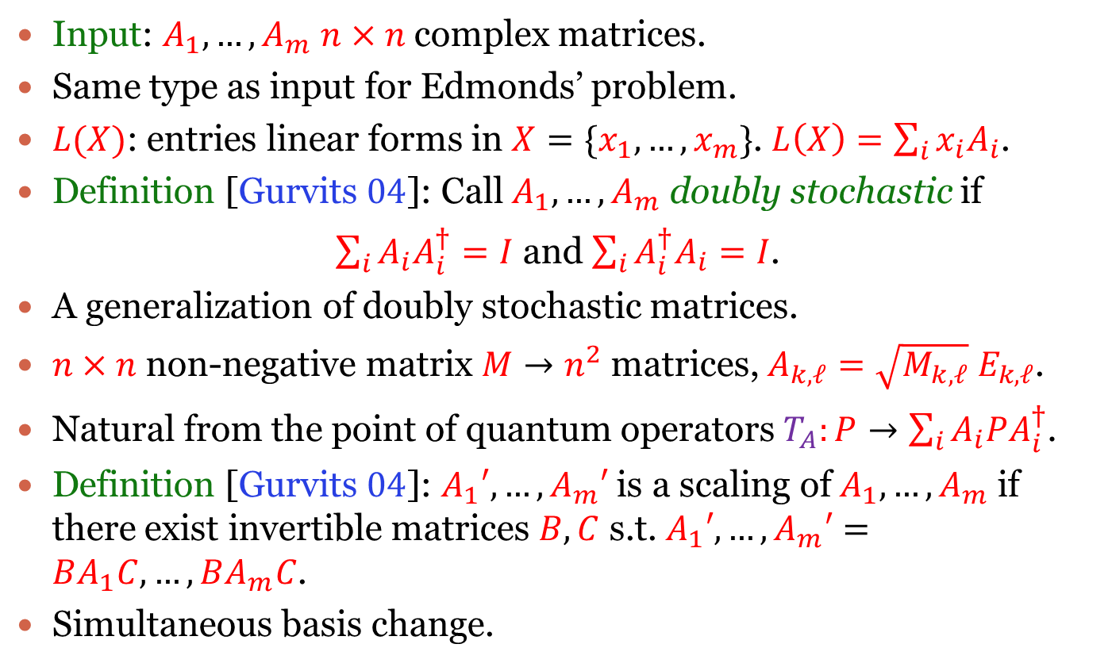
Operator scaling
Input: $A_{1},…,A_{m}$ $n×n$ complex matrices.
Same type as input for Edmonds’ problem.
$L(X)$: entries linear forms in $X=\{x_{1},…,x_{m}\}$. $L\left(X\right)=\sum_{i}{x_{i}A_{i}}$.
Definition [Gurvits $04$]: Call $A_{1},…,A_{m}$ doubly stochastic if
$\sum_{i}{A_{i}A_{i}^{†}=I}$ and $\sum_{i}{A_{i}^{†}A_{i}}=I$.
A generalization of doubly stochastic matrices.
$n×n$ non-negative matrix $M→n^{2}$ matrices, $A_{k,ℓ}=\sqrt{M_{k,ℓ}} E_{k,ℓ}$.
Natural from the point of quantum operators $T_{A}:P→\sum_{i}{A_{i}PA_{i}^{†}}$.
Definition [Gurvits $04$]: $A_{1}′,…,A_{m}′$ is a scaling of $A_{1},…,A_{m}$ if there exist invertible matrices $B,C$ s.t. $A_{1}′,…,A_{m}′=BA_{1}C,…, BA_{m}C$.
Simultaneous basis change.

Slide 29

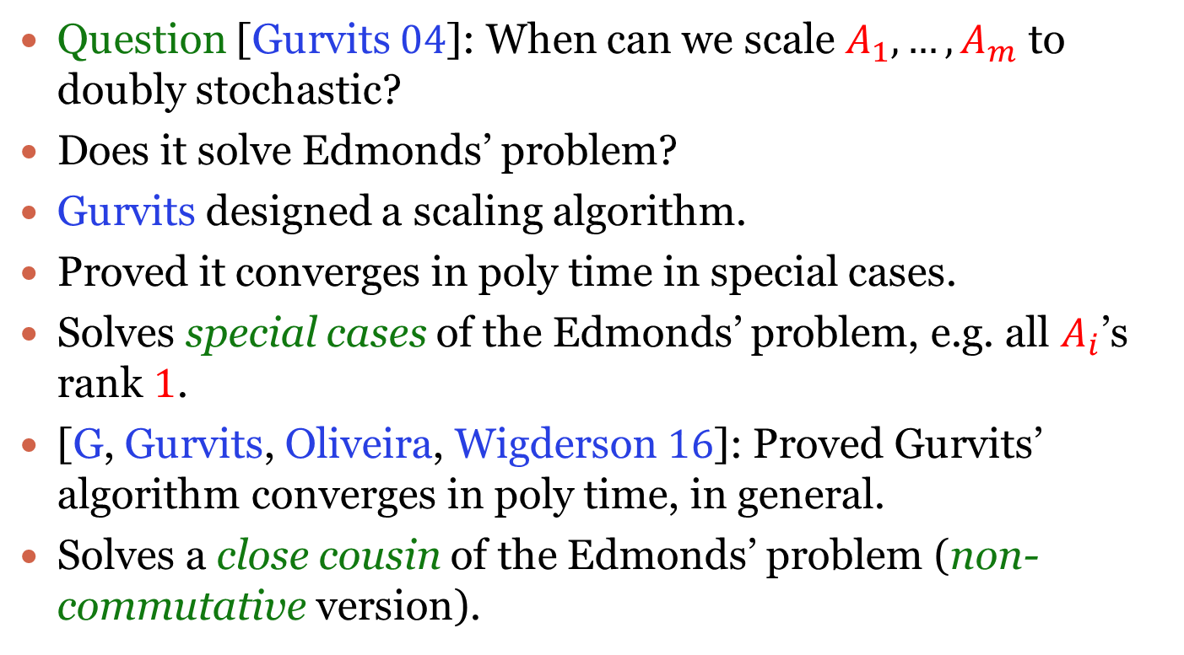
Operator scaling
Question [Gurvits $04$]: When can we scale $A_{1},…,A_{m}$ to doubly stochastic?
Does it solve Edmonds’ problem?
Gurvits designed a scaling algorithm.
Proved it converges in poly time in special cases.
Solves special cases of the Edmonds’ problem, e.g. all $A_{i}$’s rank $1$.
[G, Gurvits, Oliveira, Wigderson $16$]: Proved Gurvits’ algorithm converges in poly time, in general.
Solves a close cousin of the Edmonds’ problem (non-commutative version).
Notes:
What is the connection of this weird analytic question to Edmonds’ problem? Why to even expect such a connection? Just because matrix scaling solves a special case of Edmonds’ problem and operator scaling is a generalization with the same input type as the general case of the Edmonds’ problem. Gurvits made this amazing leap of faith.
Have to give it to Gurvits for trying this radical approach to PIT. Of course, I haven’t even talked his proof of the Van Der Waerden conjecture using these ideas.

Slide 30
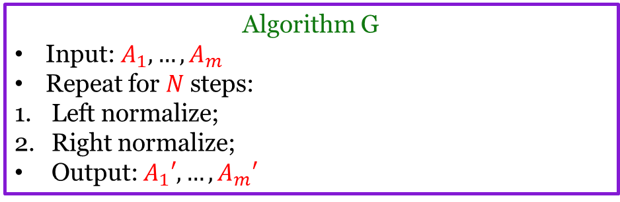

Gurvits’ algorithm
Goal: Transform $A_{1},…,A_{m}$ to satisfy
$\sum_{i}{A_{i}A_{i}^{T}=I}$ and $\sum_{i}{A_{i}^{T}A_{i}}=I$.
Left normalize: $A_{1},…,A_{m}→{\left(\sum_{i}{A_{i}A_{i}^{T}}\right)}^{−1/2} A_{1},…,{\left(\sum_{i}{A_{i}A_{i}^{T}}\right)}^{−1/2}A_{m}$.
Ensures $\sum_{i}{A_{i}A_{i}^{T}}=I$.
Right normalize: $A_{1},…,A_{m}→$ $A_{1}{\left(\sum_{i}{A_{i}^{T}A_{i}}\right)}^{−1/2},…,A_{m}{\left(\sum_{i}{A_{i}^{T}A_{i}}\right)}^{−1/2}$.
Ensures $\sum_{i}{A_{i}^{T}A_{i}}=I$.
Algorithm G
Input: $A_{1},…,A_{m}$
Repeat for $N$ steps:
Left normalize;
Right normalize;
Output: $A_{1}′,…,A_{m}′$

Slide 31

Gurvits’ algorithm
Theorem [G, Gurvits, Oliveira, Wigderson $16$]: With $N=O\left(\frac{n\left(b+\log\left(n\right)\right)}{ε}\right)$, $A_{1}′,…,A_{m}′$ “$ε$-close to being DS” (if scalable).
$b$: bit complexity of input.
Need the right potential function.

Slide 32

Non-commutative singularity
Symbolic matrices: $L= \sum_{i=1}^{m}{x_{i}A_{i}}.$
$A_{1},…,A_{m}$ are $n×n$ complex matrices.
Edmonds’ problem: Test if $Det\left(L\left(X\right)\right)≠0$.
Or is $L\left(X\right)$ non-singular?
Implicitly assume $x_{i}′$s commute.
NC-SING: $L\left(X\right)$ non-singular when $x_{i}′$s
non-commuting?
Highly non-trivial to define.
Work by Cohn and others in $70$’s.
$$L11$$
$$L12$$
$$L13$$
$$L21$$
$$L22$$
$$L23$$
$$L31$$
$$L32$$
$$L33$$
$$L(X)$$

Slide 33

Non-commutative singularity
Easiest definition: $L= \sum_{i=1}^{m}{x_{i}A_{i}}$ NC-SING if
$Det\left(\sum_{i=1}^{m}{X_{i}{⊗A}_{i}}\right)=0$,
for all $d$, $X_{i}$ are $d×d$ generic matrices (entries distinct
formal commutative variables).
Theorem [G, Gurvits, Oliveira, Wigderson $16$]: Deterministic poly time algorithm for NC-SING.
[Ivanyos, Qiao, Subrahmanyam 16; Derksen, Makam 16]: Algebraic algorithms. Work over other fields.
Strongest PIT result in non-commutative algebraic complexity.

Slide 34



Analysis
Wlog assume $A_{1},…,A_{m}$ integer matrices.
If $A_{1},…,A_{m}$ NC-SING, then know won’t converge. No way to transform and satisfy both $\sum_{i}{A_{i}A_{i}^{T}≈I}$, $\sum_{i}{A_{i}^{T}A_{i}}≈I$ ($∗$).
Goal: If $A_{1},…,A_{m}$ not NC-SING, then converge in $n^{2}$ iterations.
Need a potential function.
Know: There exists $d$ and $d×d$ $B_{1},…,B_{m}$ s.t. $Det\left(\sum_{i=1}^{m}{B_{i}{⊗A}_{i}}\right)≠0$.
Potential function: $|Det\left(\sum_{i=1}^{m}{B_{i}{⊗A}_{i}}\right)|$ for a nice choice of $B_{1},…,B_{m}$.
Niceness conditions can be satisfied by using Alon’s combinatorial nullstellansatz. Schwarz-Zippel lemma not enough.
Analysis
[Lower bound]: Initially $\left|Det\left(\sum_{i=1}^{m}{B_{i}{⊗A}_{i}}\right)\right|≥1$. Need $B_{1},…,B_{m}$ to be integer matrices.
[Progress per step]: If $1/n$-far from satisfying ($∗$), normalization increases $\left|Det\left(\sum_{i=1}^{m}{B_{i}{⊗A}_{i}}\right)\right|$ by a factor of $exp⁡(d/12n)$. Consequence of a robust AM-GM inequality. Holds for all $B_{1},…,B_{m}$ .
[Upper bound]: If $A_{1},…,A_{m}$ left or right normalized, $\left|Det\left(\sum_{i=1}^{m}{B_{i}{⊗A}_{i}}\right)\right|≤exp⁡(dn log(n))$. Need $B_{1},…,B_{m}$ to have “small” entries.
Notes:
Will look at the analysis and see what niceness properties we need.
Cheating: not mentioning the decrease in the first normalization step.
Gives convergence in n^2 log(n) iterations. Sorry was hiding log factors all along.

Slide 35
Analysis for algebra: source of scaling

Slide 36



Linear actions of groups
Group $G$ acts linearly on vector space $V$.
$π:G→GL(V)$ group homomorphism.
$π\left(g\right):V→V$ invertible linear map $∀ g∈G$.
$π\left(g_{1}g_{2}\right)=π\left(g_{1}\right)∘π(g_{2})$ and $π\left(id\right)=id$.
Example $1$
$G=S_{n}$ acts on $V=C^{n}$ by permuting coordinates.
$σ⋅\left(x_{1},…, x_{n}\right)→\left(x_{σ(1)},…,x_{σ(n)}\right)$.
Example $2$
$G=GL_{n}\left(C\right)$ acts on $V=M_{n}(C)$ by conjugation.
$A⋅X=AXA^{−1}$.

Slide 37



Orbits and orbit-closures
Group $G$ acts linearly on vector space $V$.
Objects of study
Orbits: Orbit of vector $v$, $O_{v}$ $= \left\{g⋅v :g∈G\right\}$.
Orbit-closures: Orbits may not be closed. Take their closures.
Orbit-closure of vector $v ,\overline{O_{v}} =cl \left\{g⋅v :g∈G\right\}$.
Example $1$
$G=S_{n}$ acts on $V=C^{n}$ by permuting coordinates.
$σ⋅\left(x_{1},…, x_{n}\right)→\left(x_{σ(1)},…,x_{σ(n)}\right)$.
$x$, $y$ in same orbit iff they are of same type. $∀c∈C, \left|\left\{i:x_{i}=c\right\}\right|=\left|\left\{i:y_{i}=c\right\}\right|$.
Orbit-closures same as orbits.

Slide 38


Orbits and orbit-closures
Capture several interesting problems in theoretical computer science.
Graph isomorphism: Whether orbits of two graphs the same. Group action: permuting the vertices.
Arithmetic circuits: The $VP$ vs $VNP$ question. Whether permanent lies in the orbit-closure of the determinant. Group action: Action of ${GL}_{n^{2}}(C)$ on polynomials induced by action on variables.
Tensor rank: Whether a tensor lies in the orbit-closure of the diagonal unit tensor. Group action: Natural action of $GL_{n}\left(C\right)×GL_{n}\left(C\right)×GL_{n}\left(C\right)$.
Example $2$
$G=GL_{n}\left(C\right)$ acts on $V=M_{n}(C)$ by conjugation.
$A⋅X=AXA^{−1}$.
Orbit of $X$: $Y$ with same Jordan normal form as $X$.
If $X$ not diagonalizable, orbit and orbit-closure differ.
Orbit-closures of $X$ and $Y$ intersect iff same eigenvalues.

Slide 39






Connection to scaling
$$\overline{O_{v}}$$
Scaling: finding minimal norm elements
in orbit-closures!
Group $G$ acts linearly on vector space $V$.
$NC\left(v\right)=\inf_{g∈G}{{\left\|g⋅v\right\|}_{2}^{2}}$.
Null cone: $v$ s.t. $NC\left(v\right)=0$, i.e. $0∈\overline{O_{v}}$.
Determines scalability.
$v$ scalable iff not in null cone.
Null cone membership fundamental problem in invariant theory.
Scaling: natural analytic approach.
$$v′$$
Notes:
In case you are wondering about this shady patchwork – I stole this image from Michael’s thesis and had to patch it up to convert from quantum to classical language.
The optimization problem is non-convex in the Euclidean space but satisfies a different notion of convexity called geodesic convexity. More in Michael’s talk and Rafael’s talk in the afternoon.

Slide 40



Example $1$: Matrix scaling
Given non-negative $n×n$ matrix $A$, find non-negative diagonal matrices $R,C$ s.t. $RAC$ doubly stochastic.
What is the group action?
Defined by the problem itself!
Vector space | $n×n$ complex matrices. (Minor translation: $M∈V→A$ : $A_{i,j}={\left|M_{i,j}\right|}^{2}$.)
Group action | Left-right multiplication by diagonal matrices.
Annoying technicality | Need determinant $1$ constraint.
Why doubly stochastic? | Critical point (KKT) condition.
Optimization problem | Gurvits’ capacity for matrices.
Null cone | Bipartite matching.

Slide 41


Example $2$: Operator scaling
Vector space | Tuple of $n×n$ complex matrices.
Group action | Simultaneous left-right multiplication.
Annoying technicality | Need determinant $1$ constraint.
Why doubly stochastic? | Critical point (KKT) condition.
Optimization problem | Gurvits’ capacity for operators.
Null cone | Non-commutative singularity.

Slide 42


Example $3$: Geometric programming
Vector space | Polynomials in $n$ variables $x_{1},…,x_{n}$.
Group action | Scaling of variables. $x_{i}→α_{i}x_{i}$.
Annoying technicality | Need Laurent polynomials. Polynomials in $x_{1},…,x_{n}$, $x_{1}^{−1},…, x_{n}^{−1}$. Or determinant $1$ constraint.
Optimization problem | Unconstrained Geometric programming. Or Gurvits’ capacity for polynomials.
Null cone | Linear programming.

Slide 43
Conclusion and open problems
Scaling problems: natural optimization problems with symmetries.
Analytic tools for algebraic problems.
Scaling problems involving commutative groups: convex optimization. Near linear time algorithms?
Non-commutative groups: geodesically convex optimization. Polynomial time algorithms?
More applications?

Slide 44

Thank You
IAS workshop videos:
https://www.math.ias.edu/ocit2018
Avi’s CCC $2017$ tutorial:
http://computationalcomplexity.org/Archive/2017/tutorial.php

Slide 45
More scaling problems: interesting polytopes

Slide 46




Non-uniform matrix scaling
$$c_{1} … …{ c}_{n}$$
$\left(r,c\right):$ probability distributions over $\{1,…,n\}$.
Non-negative $n × n$ matrix $A$.
Scaling of $A$ with row sums $r_{1},…,r_{n}$
and column sums $c_{1},…,c_{n}$?
$P_{A}=\{such \left(r,c\right)\}$.
[$…$; Rothblum, Schneider $89$]: $P_{A}$ convex polytope!
$P_{A}$ = $\{\left(r,c\right):∃ Q, supp\left(Q\right)⊆supp\left(A\right), Q marginals (r,c)\}$.
Commutative group actions: classical marginal problems.
Computing maximum entropy distributions: Nisheeth’s talk.
$$r_{1}$$
$$⋮$$
$$⋮$$
$$r_{n}$$
$$B=RAC$$
Notes:
Several algorithms known.

Slide 47


Quantum marginals
Pure quantum state ${|ψ⟩}_{S_{1},…,S_{d}}$ ($d$ quantum systems).
Characterize marginals $ρ_{S_{1}},…,ρ_{S_{d}}$ (marginal states on systems)?
Only the spectra matter (local rotations for free).
Collection of such spectra convex polytope!
Follows from theory of moment polytopes.
Efficient algorithms via non-uniform tensor
scaling [BFGOWW 18].
Underlying group action: Products of $GL$’s on tensors.
Other interesting moment polytopes: Schur-Horn, Horn, Brascamp-Lieb polytopes.

