Slide 1

Interplay between core and corona from small to large systems
Y. Kanakubo et al., Phys. Rev. C 105 (2022) 2, 024905
Y. Kanakubo et al., Phys. Rev. C 106 (2022) 5, 054908
Yuuka Kanakubo^{1,2}
¹ University of Jyväskylä, Centre of Excellence in Quark Matter
Collaborators: Yasuki Tachibana³, Tetsufumi Hirano²
² Sophia University, ³Akita International University

Slide 2

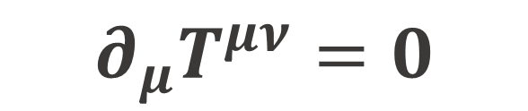

QGP study with relativistic hydrodynamics
many body system of quarks and gluons under local equilibrium
$$∂_{μ}T^{μν}=0$$
$$P=P\left(e\right)$$
Energy-momentum conservation
Equation of state (EoS)
$η/s(T)$ $, ζ/s(T)$…
-- Basic information of matter --
A lots of developments on hydro theory…
How should we apply them on QGP study?

Slide 3
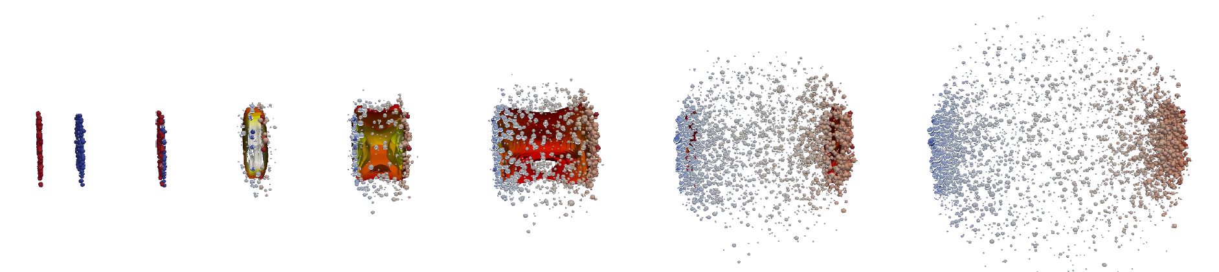
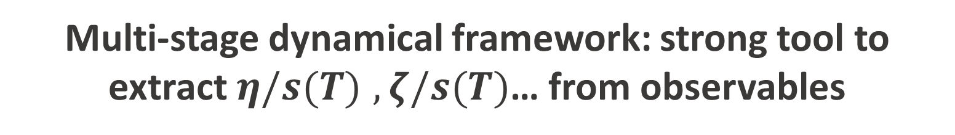
Describing relativistic heavy-ion collisions
QGP
Hadrons
J. E. Bernhard, 1804.06469
Initial state
Hydro evolution
Hadronic afterburner
Description of the multi-stage process
➔ Rewinding the process to “see” QGP properties
Multi-stage dynamical framework: strong tool to extract $η/s(T)$ $, ζ/s(T)$… from observables

Slide 4
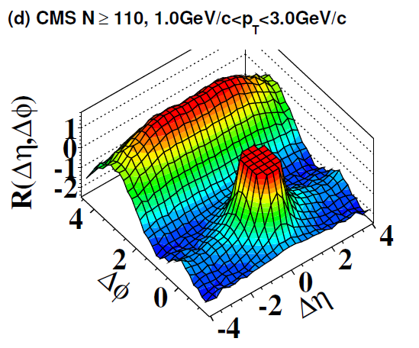
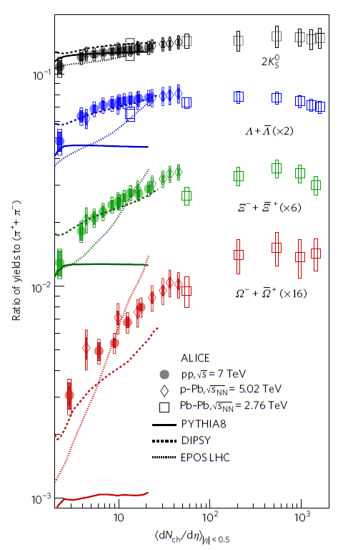


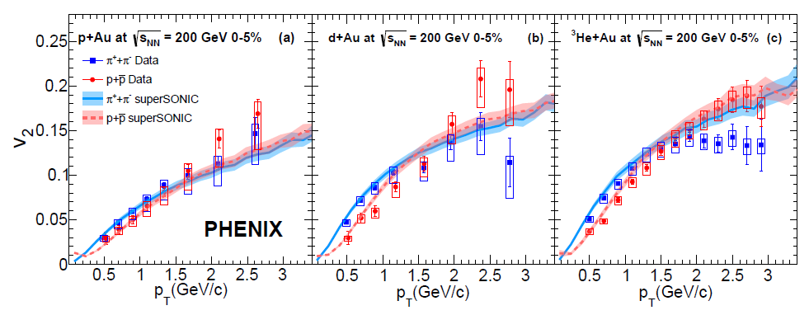
QGP signals in small colliding systems
In high-multiplicity small systems…
Thermal strange hadron productions
Hydro-like collectivity
Long range correlation
JHEP 09 091 (2010)
Strangeness enhancement
Our interest:
Nature Phys. 13 535-539 (2017)
Challenge to interpret the universal behavior from pp to AA
… within a single dynamical framework
Flow harmonics
Phys. Rev. C 97, 064904 (2018)

Slide 5

Dynamical Core-Corona Initialization framework
pp
AA
Y. Kanakubo et al., PTEP 2018 12, 121D01 (2018);
Y. Kanakubo et al., Phys. Rev. C 101 2, 024912 (2020);
Y. Kanakubo et al., Phys. Rev. C 105 (2022) 2, 024905
Core: fluids (equilibrated matter)
➔ Hydrodynamics
Corona: non-equilibrated partons
➔ String fragmentation
Core-corona: K. Werner, Phys. Rev. Lett. 98 (2007) 152301
Understanding universal behavior from pp to AA based on hydrodynamics

Slide 6
Dynamical Core-Corona Initialization model
2
Y. Kanakubo et al., Phys. Rev. C 105 (2022) 2, 024905

Slide 7

Model flowchart of DCCI2
Y. Kanakubo et al., Phys. Rev. C 105 (2022) 2, 024905
Initial partons:
PYTHIA8/PYTHIA8 Angantyr
T. Sjöstrand et al., Comput. Phys. Commun. 191, 159 (2015)
C. Bierlich et al., JHEP 1610 139 (2016)
Dynamical initialization of QGP fluids based on core-corona
Equilibrated matter (core)
(3+1)-D hydro with source terms
Non-equilibrated partons (corona)
Y. Tachibana et al., Phys. Rev. C 90, 021902 (2014)
PYTHIA8 (string fragmentation)
iS3D (thermal hadron sampling)
M. McNelis et al., Comput. Phys.Commun.258, 107604 (2021)
Hadronic afterburner: JAM
Y. Nara et al., Phys. Rev. C61, 024901 (2000)

Slide 8

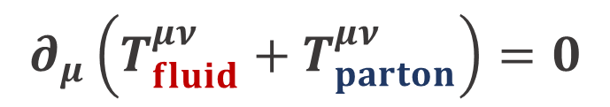
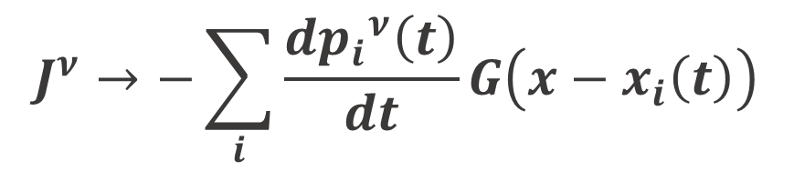
Dynamical initialization framework
New framework to dynamically generate initial condition
M. Okai et al., Phys.Rev.C 95 (2017) 5, 054914
C. Shen and B. Schenke, Phys.Rev.C 97 (2018) 2, 024907
Continuum eq. for fluids + partons
Energy-momentum conservation
$$∂_{μ}\left(T_{fluid}^{μν}+T_{parton}^{μν}\right)=0$$
Hydrodynamic eq. with source term
$∂_{μ}T_{fluid}^{μν}=J^{ν}$
“Sources of fluids”
= “energy-momentum of partons”
$$J^{ν}→−\sum_{i}{\frac{d{p_{i}}^{ν}\left(t\right)}{dt}}G\left(x−x_{i}\left(t\right)\right)$$
Core-corona picture

Slide 9

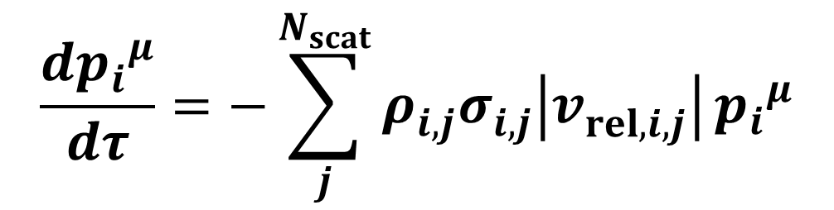


Dynamical core-corona picture
Multiple scatterings among partons ➔ partial equilibration
$$\frac{d{p_{i}}^{μ}}{dτ}=−\sum_{j}^{N_{scat}}{ρ_{i,j}^{}σ_{i,j}^{}\left|v_{rel, i,j}^{}\right|}{p_{i}}^{μ}$$
Defined at a co-moving frame with $η_{s, i}$
Energy-momentum deposition
➔ # of scatterings with partons (non-equilibrated and equilibrated)
Low $p_{T}$ and/or dense region
Core (fluids)
High $p_{T}$ and/or dilute region
Corona (non-equilibrated partons)

Slide 10
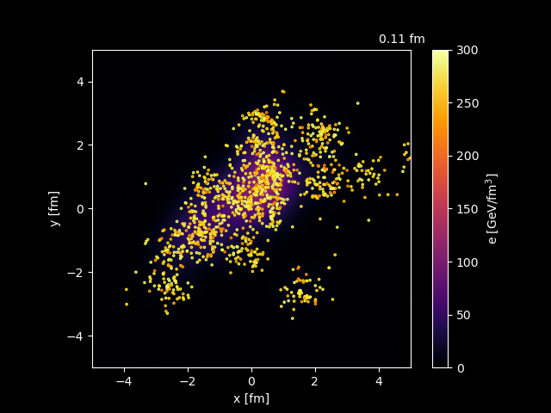
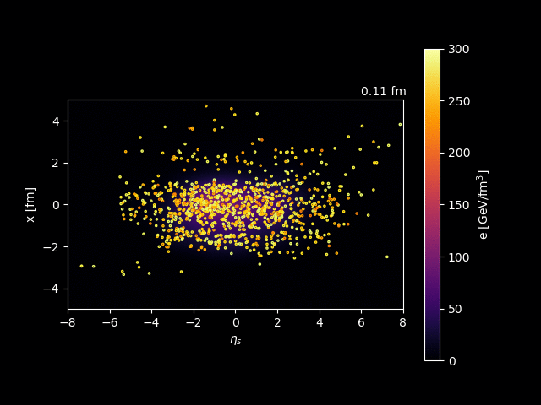
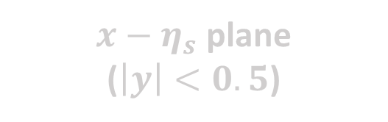
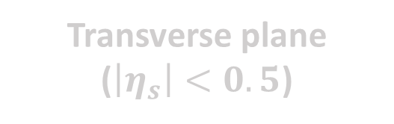
Dynamical core-corona initialization
PbPb 2.76 TeV
Transverse plane
($\left|η_{s}\right|<0.5$)
$x−η_{s}$ plane
($\left|y\right|<0.5$)
Dynamical separation into core and corona
➔ Jet quenching like picture

Slide 11
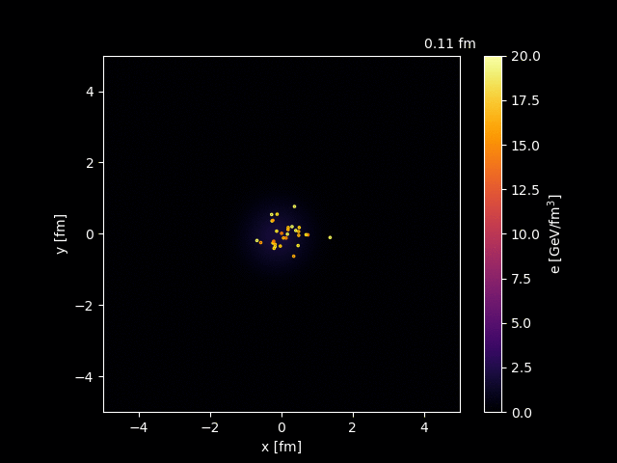
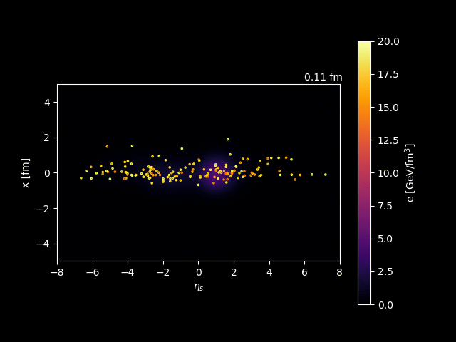
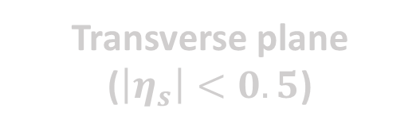
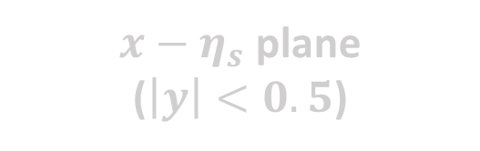
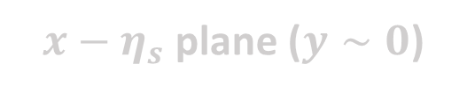
Dynamical core-corona initialization
pp 7 TeV
Transverse plane
($\left|η_{s}\right|<0.5$)
$x−η_{s}$ plane
($\left|y\right|<0.5$)
$x−η_{s}$ plane ($y∼0$)

Slide 12

Result 1
Need both core and corona
in both pp and AA!
Y. Kanakubo et al., Phys. Rev. C 105 (2022) 2, 024905

Slide 13
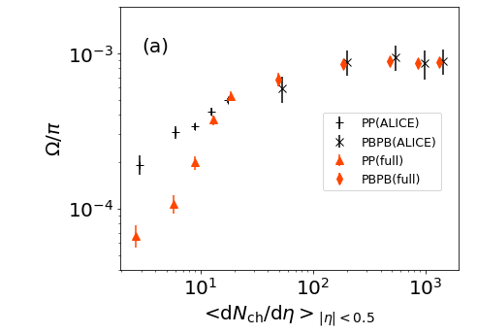


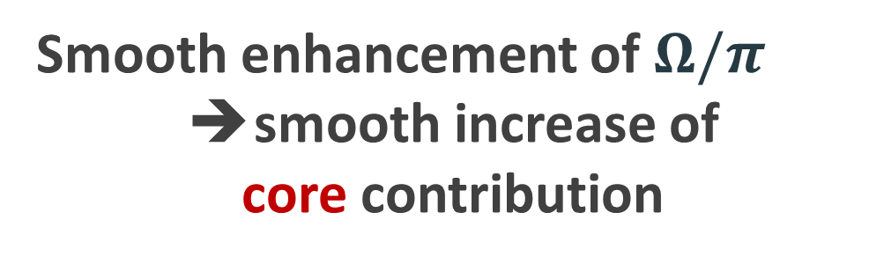
$Ω/π$ ratio from pp to PbPb
Fixing parameters to control fraction of core/corona
Core
Smooth enhancement of $Ω/π$
smooth increase of
core contribution
B. Abelev et al. (ALICE Collaboration), Phys. Lett. B 728, 216-227 (2014); erratum 734, 409-410 (2014)
J. Adam et al., (ALICE Collaboration), Nature Phys. 13 535-539 (2017)
Starting point
Corona
Describe composition of matter

Slide 14
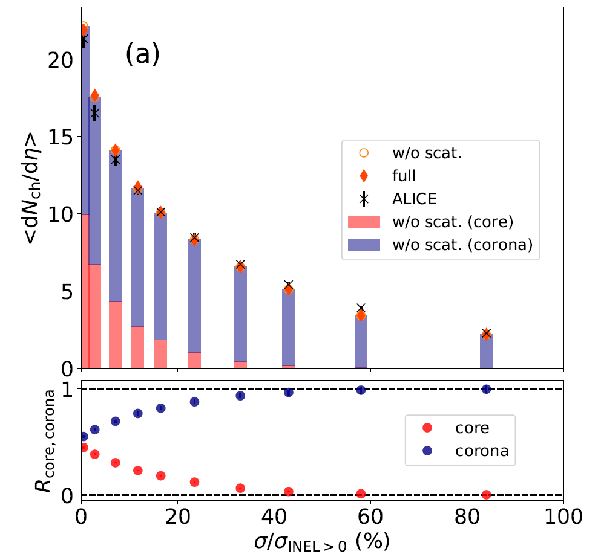
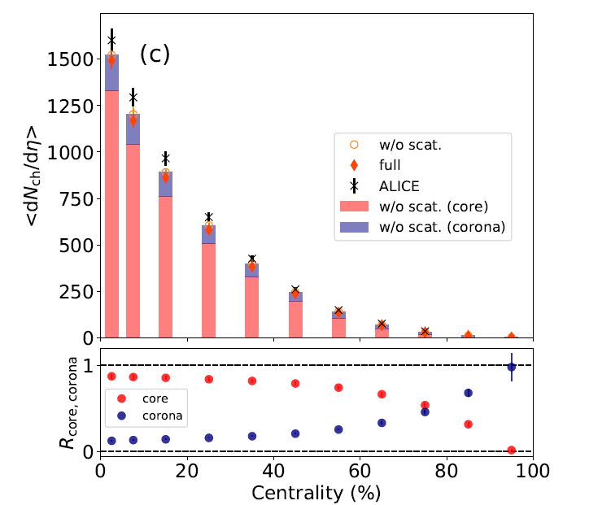
Fraction of core and corona in pp and PbPb
pp 7 TeV
PbPb 2.76 TeV
Corona
J. Adam et al., (ALICE Collaboration), Nature Phys. 13 535-539 (2017)
Core
K. Aamodt et al., (ALICE Collaboration), Phys. Rev. Lett. 106 032301 (2011)
pp: core/corona $∼50\%$ at the highest multiplicity class (0-0.95%)
PbPb: corona $∼20\%$ at intermediate centralities (40-60%)

Slide 15
Fraction of core and corona in pp and PbPb
pp 7 TeV
PbPb 2.76 TeV
Corona
J. Adam et al., (ALICE Collaboration), Nature Phys. 13 535-539 (2017)
Core
K. Aamodt et al., (ALICE Collaboration), Phys. Rev. Lett. 106 032301 (2011)
➔ Need both equilibrated and non-equilibrated matter
in both pp and AA

Slide 16

Result 2
Be careful with corona correction at low $p_{T}$ in AA!
Y. Kanakubo et al., Phys. Rev. C 106 (2022) 5, 054908

Slide 17
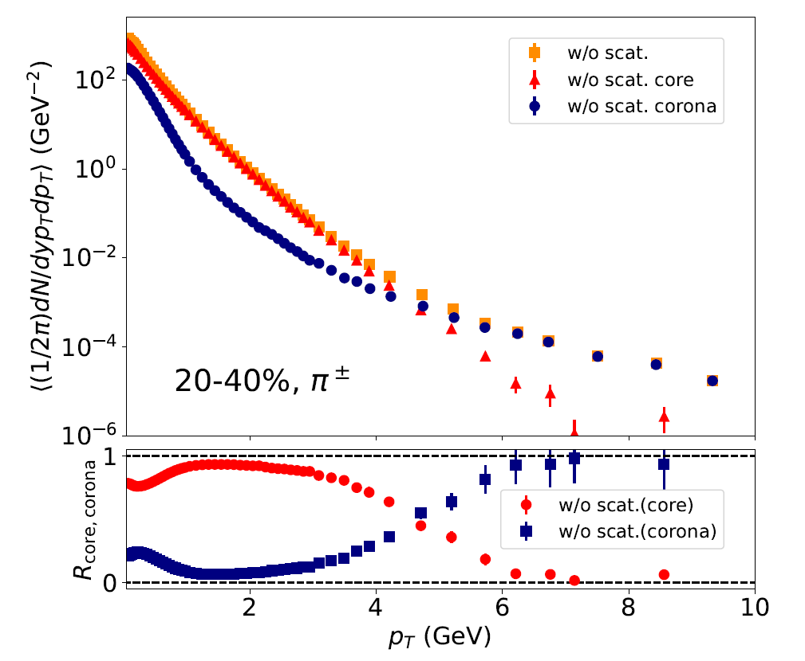

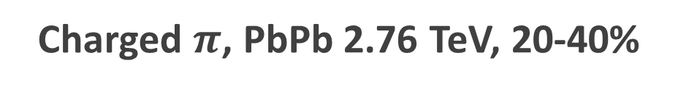



Fraction of core and corona vs. $p_{T}$
Charged $π$, PbPb 2.76 TeV, 20-40%
Core
Low $p_{T}$: core dominance
high$p_{T}$: corona dominance
Corona
Core-corona picture
➔ From low to high $p_{T}$ within one framework
$$p_{T} (GeV)$$

Slide 18
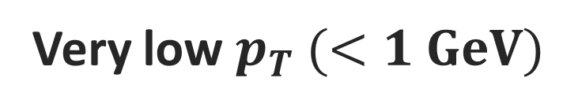
Fraction of core and corona vs. $p_{T}$
Charged $π$, PbPb 2.76 TeV, 20-40%
Core
Very low $p_{T} (<1 GeV)$
Slight enhancement of corona components
Corona
Non-equilibrium corrections to core (equilibrium)
$$p_{T} (GeV)$$

Slide 19
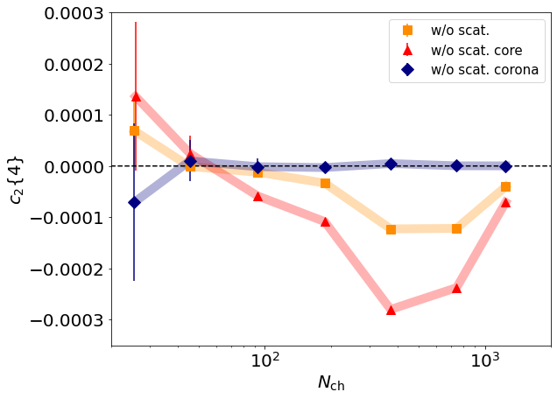
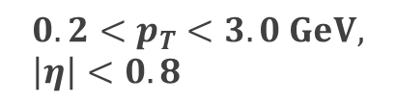
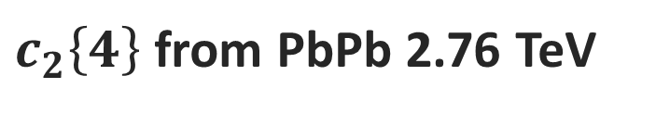



Corona corrections to flow
$c_{2}\left\{4\right\}$ from PbPb 2.76 TeV
$$c_{2}{\left\{4\right\}}_{core}≠c_{2}{\left\{4\right\}}_{tot}$$
$$0.2<p_{T}<3.0 GeV, \left|η\right|<0.8$$
➔ Diluted by corona
Conventional Hydro model
$c_{2}\left\{4\right\}$
Comparison
Experiment
Be careful with
corona correction even in AA!
$$N_{ch}$$

Slide 20

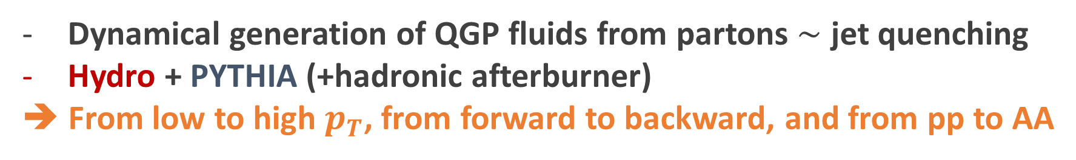
Summary
Dynamical core-corona initialization (DCCI2)
Dynamical generation of QGP fluids from partons $∼$ jet quenching
Hydro + PYTHIA (+hadronic afterburner)
➔ From low to high $p_{T}$, from forward to backward, and from pp to AA
Proper extraction of QGP properties from experiment?
Need both equilibrated and non-equilibrated matter in both pp and AA
Sophistication on hydro model,
e.g., viscous corrections, conserved current etc.
Next step?

Slide 21
Thank you!

Slide 22
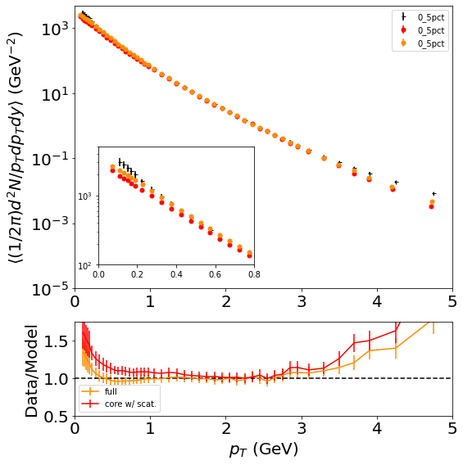
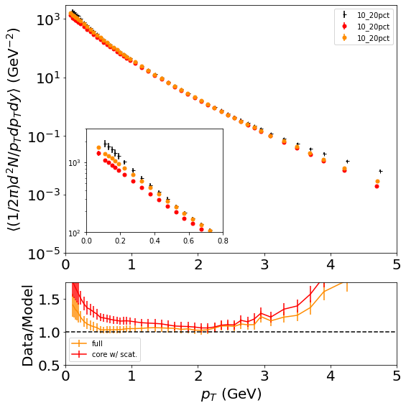
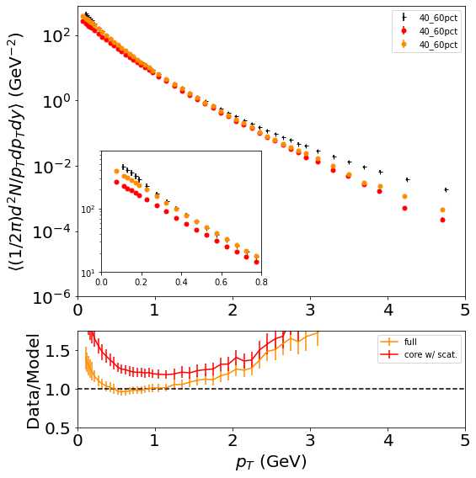
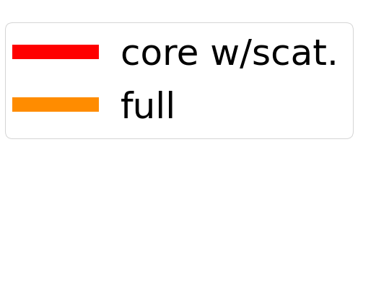
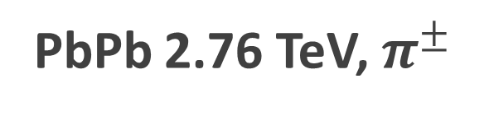
Comparison with exp. data
PbPb 2.76 TeV, $π^{±}$
0-5%
10-20%
40-50%
ALICE Collaboration, Phys. Rev. C 93 (2016) 3, 034913
Corona at very low $p_{T}$: possible compensation of yield

Slide 23
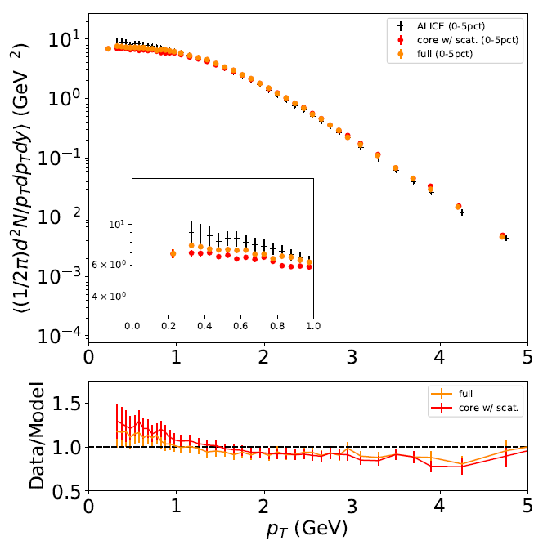
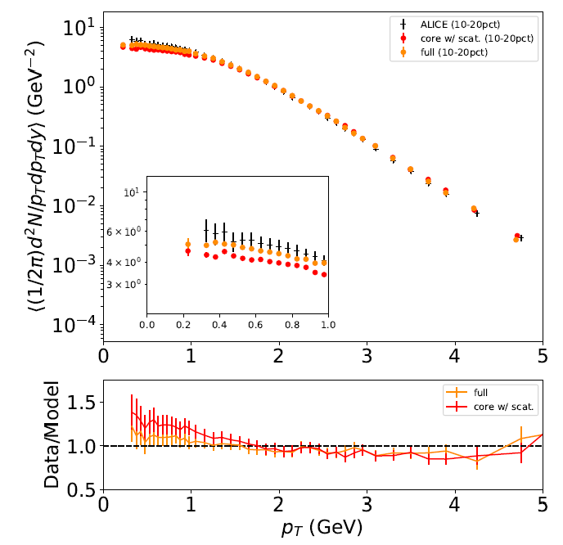
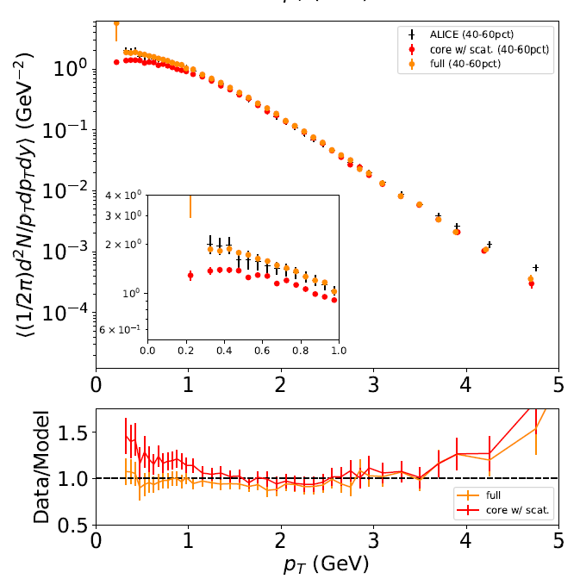
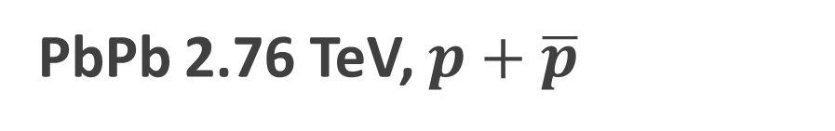
Comparison with exp. data
PbPb 2.76 TeV, $p+\overline{p}$
0-5%
10-20%
40-50%
ALICE Collaboration, Phys. Rev. C 93 (2016) 3, 034913
Corona at very low $p_{T}$: possible compensation of yield

Slide 24
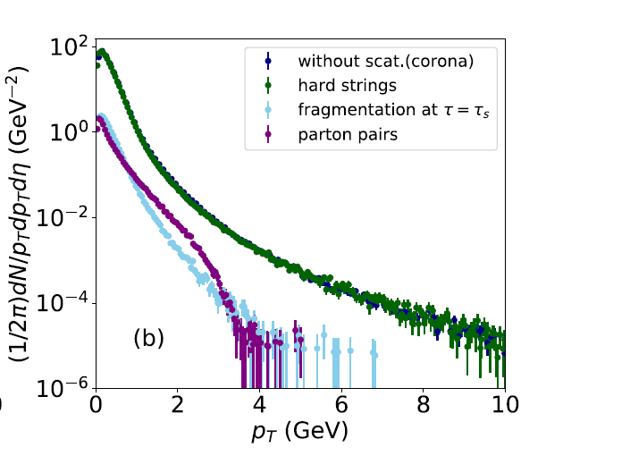
Origin of corona contribution
PbPb 2.76 TeV

Slide 25
Problems in DCCI2

Slide 26
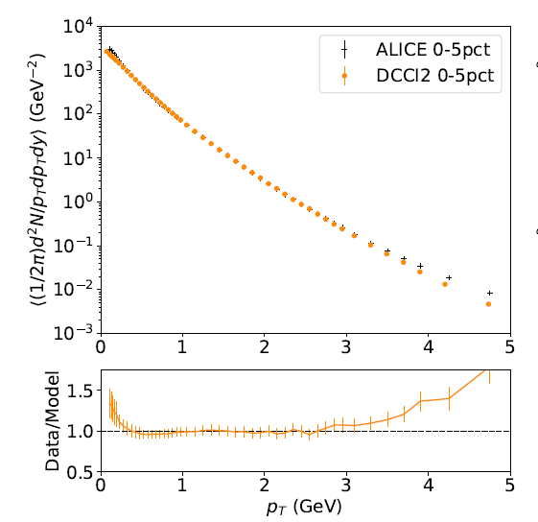
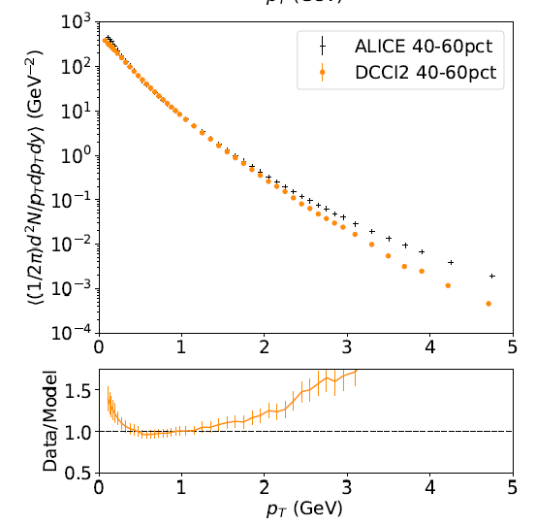


1. Yields at high $p_{T}$
PbPb 2.76 TeV, $π^{±}$
0-5%
40-60%
ALICE Collaboration, Phys. Rev. C 93 (2016) 3, 034913
Need to sophisticate jet quenching in DCCI2
Deviation from exp. data above $p_{T}∼3 GeV$. Lack of high $p_{T}$ yields (corona)
+ Need $N_{coll}$ scaling at high $p_{T}$?

Slide 27
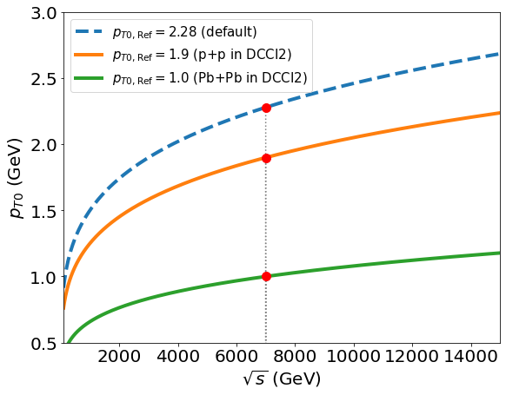
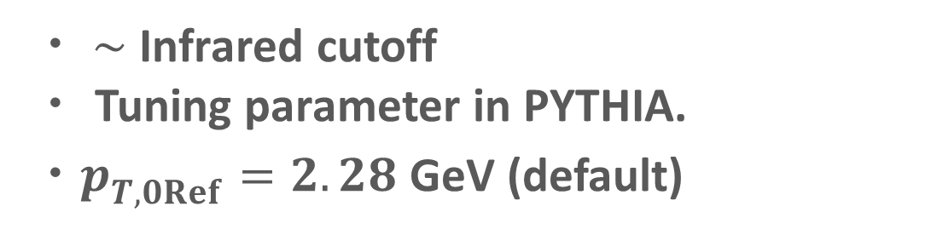
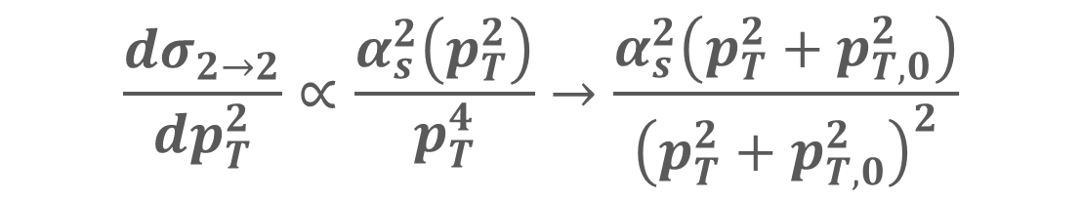

2. Multiplicity distribution in pPB
Multiplicity in DCCI2 ➔ controlled at initial parton generations
$$\frac{dσ_{2→2}}{dp_{T}^{2}}∝\frac{α_{s}^{2}\left(p_{T}^{2}\right)}{p_{T}^{4}}→\frac{α_{s}^{2}\left(p_{T}^{2}+p_{T,0}^{2}\right)}{{\left(p_{T}^{2}+p_{T,0}^{2}\right)}^{2}}$$
pPb?
・ $∼$ Infrared cutoff
・ Tuning parameter in PYTHIA.
・$p_{T,0Ref}^{}=2.28$ GeV (default)
Smaller $p_{T,0Ref}^{}$ ➔ More MPI ➔ More partonic productions at mid-rapidity

Slide 28
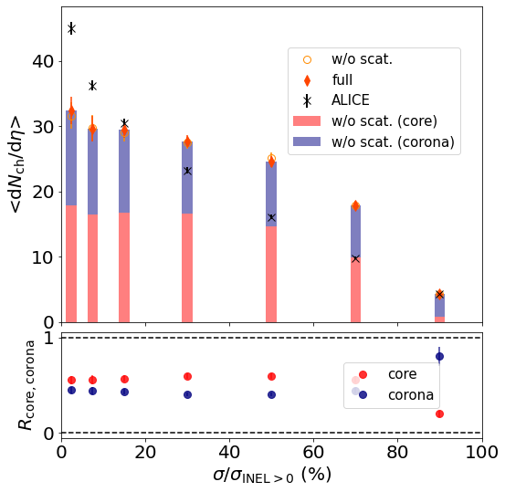
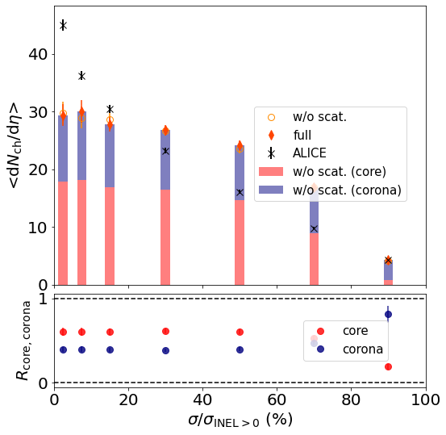
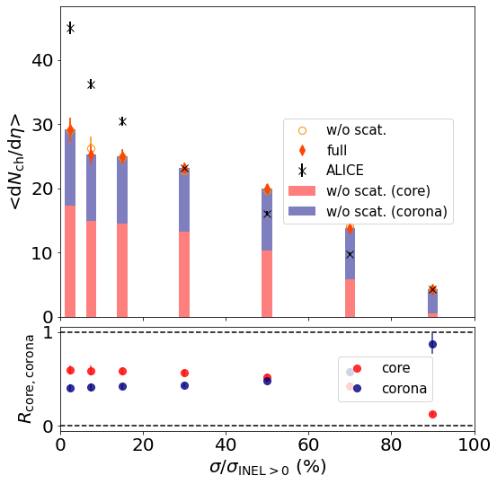



Parameter $p_{T0Ref}$dependence in DCCI2
$$p_{T0Ref}=0.8 GeV$$
$$p_{T0Ref}=1.0 GeV$$
$p_{T0Ref}=1.4 GeV$
Insensitive to the parameter…
Difficult to describe event distribution
Difficulty ➔ interplay of two different particle production mechanisms within a given total collision energy

Slide 29
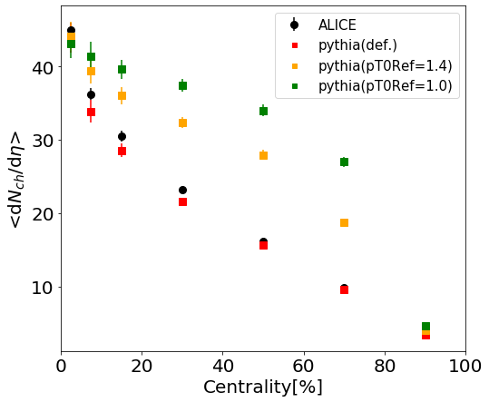
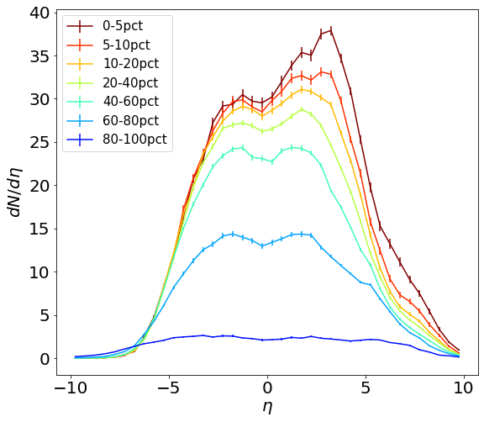
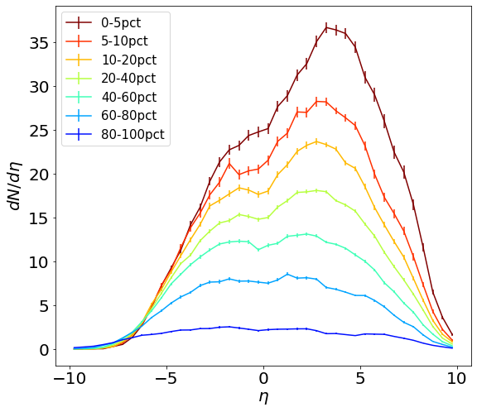


Parameter $p_{T0Ref}$dependence in default PYTHIA
$$p_{T0Ref}=1.0 GeV$$
Default ($p_{T0Ref}=2.28 GeV$)
Maximum multiplicity ➔ saturated

Slide 30



Multiplicity distribution in pPB default PYTHIA
Any dependence on some parameters related to 2nd absorptive collisions?
pPB 5020 GeV
$$σ_{diff} σ_{abs}$$
➔ No significant enhancement?
Difficulty: reproduction of multiplicity distribution given a fixed collision energy

Slide 31
Backup

Slide 32



Energy budget in dynamical core-corona initialization
Dynamical energy conversion from initial partons (corona) to fluids (core)
PbPb
pp
Starting from vacuum $T^{μν}=0$ for fluids
Energy & momentum conservation as total system
Dynamical separation into core and corona
➔ Jet quenching like picture

Slide 33



Onset $\left\langle dN_{ch}/dη\right\rangle$ of core dominance
Core
Clear scaling with multiplicity
Onset of
core dominance at $\left\langle dN_{ch}/dη\right\rangle ∼20$
Corona
PbPb
pp

Slide 34




Longstanding problem in hydro
$p_{T}$ spectra
Lack of very low $p_{T}$ hadron yields from hydro
G. Nijs et al., Phys. Rev. C 103 (2021) 5, 054909
J. Zimanyi et al., Phys. Rev. Lett. 43, 1705 (1979);
M. Kataja and P. V. Ruuskanen, Phys. Lett. B 243, 181 (1990);
J. Sollfrank et al., Z. Phys. C 52, 593 (1991);
U. Ornik and R. M. Weiner, Phys. Lett. B 263, 503 (1991);
V. Begun et al., Phys. Rev. C 90, 014906 (2014); Phys. Rev. C 90, 054912 (2014); Phys. Rev. C 91, 054909 (2015);
P. Huovinen et al., Phys. Lett. B 769, 509 (2017);
E. Grossi et al., Phys. Rev. D 104, 034025 (2021)
$$p_{T} (GeV)$$
➔ Non-hydro components？

Slide 35


Hydro-based multi-stage dynamical model
$$t$$
QGP is a transient state in HIC!
Different stage needs different picture
Detector
Hadronic transport
Hadron gas
Fluids ➔ particles
Relativistic hydrodynamics
QGP
$$z$$
Collision
Initial condition
Space-time evolution of HIC
Standard model in HIC

Slide 36


Where doesn’t hydro work?
1. In peripheral AA, small systems
2. At high $p_{T}$ (and very low $p_{T}$)
Trajectum
Phys. Rev. C 103 (2021) 5, 054909
ALICE Collaboration, Nature Phys. 13 535-539 (2017)
hydro
X Picture of local equilibrium
Need to extend applicability of dynamical frameworks

Slide 37
Model flowchart of DCCI2
Y. Kanakubo et al., Phys. Rev. C 105 (2022) 2, 024905
Initial partons:
PYTHIA8/PYTHIA8 Angantyr
T. Sjöstrand et al., Comput. Phys. Commun. 191, 159 (2015)
C. Bierlich et al., JHEP 1610 139 (2016)
Dynamical initialization of QGP fluids based on core-corona
Equilibrated matter (core)
(3+1)-D hydro with source terms
Non-equilibrated partons (corona)
Y. Tachibana et al., Phys. Rev. C 90, 021902 (2014)
PYTHIA8 (string fragmentation)
iS3D (thermal hadron sampling)
M. McNelis et al., Comput. Phys.Commun.258, 107604 (2021)
Hadronic afterburner: JAM
Y. Nara et al.,Phys. Rev. C61, 024901 (2000)

Slide 38
DCCI2: combination of hydro and PYTHIA
DCCI2
Hydro (and hadronic) afterburner on PYTHIA
From HIC community’s point of view
From high-energy physics community’s point of view
Corona (non-equilibrium) correction on hydro

Slide 39
Parameter fixing in DCCI2

Slide 40





Parameter set for PYTHIA part: almost Monash Tune
How far can we go as a naive combination of hydro and PYTHIA
PYTHIA
…with simple starting point
Default parameter values except $p_{T0Ref}$ in initial parton generation
Hydro with dynamical core-corona
$$\frac{dσ_{2→2}}{dp_{T}^{2}}∝\frac{α_{s}^{2}\left(p_{T}^{2}\right)}{p_{T}^{4}}→\frac{α_{s}^{2}\left(p_{T}^{2}+p_{T,0}^{2}\right)}{{\left(p_{T}^{2}+p_{T,0}^{2}\right)}^{2}}$$
$p_{T0}∼$ Infrared cutoff for 2→2 cross section

Slide 41




Difference of $E_{T}$ evolution between hydro and string frag.
PbPb (MB)
Hydro: $E_{T}$ decrease due to $pdV$ work in longitudinal direction
String fragmentation:
$E_{T}$ enhance
More multi-parton interaction is required in DCCI compared to PYTHIA
(with smaller $p_{T0}$ to enhance partonic productions at midrapidity)
Different dynamics in later stage
➔ Require different initial energy profile

Slide 42




Hadron vertices model in PYTHIA
S. Ferreres-Solé and T. Sjöstrand, Eur. Phys. J., vol. C78, no. 11, p. 983, 2018.
The production vertex of the hadron is taken to be the average of the two break-up vertices producing it.
t
z
The vertex of the hadron with mass $m_{i}$
Option
flag Fragmentation:setVertices = on
Information of production vertices
event[i].xProd(), event[i].yProd(), event[i].zProd(), event[i].tProd()

Slide 43





Space-time distribution of direct hadrons
PbPb 2.76 TeV
1 sampled event
Probability distribution ($\left|η\right|<0.5$)
$$P(r)$$
$$P(t)$$
Double peaks of hadron vertices from core and corona before hadronic rescatterings

Slide 44



Space-time distribution of direct hadrons
pp 7 TeV
1 sampled event
Probability distribution ($\left|η\right|<0.5$)
$$P(r)$$
$$P(t)$$
Short lifetime of hydro ($∼1 fm$) in pp
Direct hadrons from core and corona
➔ closely produced in space-time coordinate

Slide 45






Fraction of core and corona vs. $p_{T}$ with PID
Core
$$π$$
$$p$$
Corona
$$p_{T} (GeV)$$
$$p_{T} (GeV)$$
Core dominance up to higher $p_{T}$ for heavier hadrons
T. Hirano and Y. Nara, Phys. Rev. C 69, 034908 (2004).
Core/corona fraction $∼50\%$ at $p_{T}→0$ GeV in proton spectra

Slide 46
















Corona components from string modification
$$τ_{s}=0.3 fm$$
$$τ_{s}<τ<τ_{fo}$$
String cutting
Parton-pairing
String modification caused by ..
Discard dead partons
Find hypersurface boundaries $T_{sw}$
Sample partons & boost with $v_{fluid}$ at the boundary (recreation of color singlet )
・Spatial overlap of strings and medium
・Completely fluidized partons

Slide 47


Corona components from string modification (cont’d)
$$τ_{s}=0.3 fm$$
$$τ_{s}<τ<τ_{fo}$$
String cutting
Parton-pairing
4. Surviving partons traverse medium
5. Make a pair for a parton coming out from medium
Non-thermal & thermal
➔ Contributes as corona components
*$p_{T, cut}$: threshold to/not to modify a string

Slide 48


Corona corrections to flow
$c_{2}\left\{4\right\}$ from PbPb 2.76 TeV
$$0.2<p_{T}<3.0 GeV, \left|η\right|<0.8$$
$c_{2}\left\{4\right\}$
$$N_{ch}$$

Slide 49



$Ω$ yields from $e^{+}e^{−}$ with Monash Tune
P. Skands et al., Eur.Phys.J.C 74 (2014) 8, 3024

Slide 50
Dynamical core-corona picture
$∼$ EoM with a drag force due to secondary scatterings
$$\frac{d{p_{i}}^{μ}}{dτ}=−\sum_{j}^{N_{scat}}{ρ_{i,j}^{}σ_{i,j}^{}\left|v_{rel, i,j}^{}\right|}{p_{i}}^{μ}$$
Defined at a co-moving frame with $η_{s, i}$
*Note: Instant equilibration of deposited energy and momentum
- Collision criterion
- Parametrized cross-section
- Density of partons
$$b_{i,j}≤\sqrt{\frac{σ_{i,j}}{π}}$$
$σ_{i,j}=\frac{σ_{0}}{s_{i,j}/[GeV^{2}]}$
$$ρ_{i,j}=G(x_{i}−x_{j})$$
$G$: Gaussian
# of (non-equilibrated and equilibrated) partons scattered with ith parton
Low $p_{T}$ and/or dense region
Core (fluids)
High $p_{T}$ and/or dilute region
Corona (non-equilibrated partons)

Slide 51

Effects of hadronic rescatterings
Significant suppression of yield ratios at central PbPb
✓Captured with dissociation/annihilation of hadrons in late stage
Visible hadronic rescattering effects even in pp collisions

Slide 52





Corona correction in PbPb
$$∼5−11 \%$$
$$∼15−38 \%$$
- Mean $p_{T}$ and momentum anisotropy
➔ non-negligible effect of corona
- Pure hydro calculation can bring misinterpretation of exp. data even in PBPB

Slide 53


Collision with constituent partons of QGP fluids
$$\frac{d{p_{i}}^{μ}}{dτ}=−\sum_{j}^{N_{scat}}{ρ_{i,j}^{}σ_{i,j}^{}\left|v_{rel, i,j}^{}\right|}{p_{i}}^{μ}$$
➔ Applied to both core (QGP fluids) and corona (non-equilibrated partons)
Sampling of equilibrated partons at each time step
*with mass-less ideal gas approximation

Slide 54


Quark gluon plasma (QGP)
A state of quarks and gluons under thermal & chemical equilibrium
Gluon
Quark
- Extremely high temperature ($T∼2 \text{trillion} \text{degrees}$)
$$T$$
- Early universe
Hadron
QGP
Goal: Revealing the properties of the primordial matter
Only way to create QGP on the earth…
High energy heavy-ion collisions

Slide 55

High-energy heavy-ion collisions
QGP
Hadrons
J. E. Bernhard, 1804.06469
How can we access the properties of QGP from HIC experimental data?
Dynamics of locally equilibrated matter
Relativistic hydrodynamics
Press release on 2005/04/18
https://www.bnl.gov/newsroom/news.php?a=110303

Slide 56




QGP study with relativistic hydrodynamics
Energy-momentum tensor $T^{μν}$ ➔decomposed with
four velocity of fluids $u^{μ}\left(x\right)$
Energy-momentum conservation
$$∂_{μ}T^{μν}=0$$
Lattice EoS (high T)
Hadronic resonance gas EoS (low T)
Equation of state (EoS)
$$P=P\left(e\right)$$
Many-body system of quarks and gluons
$$u^{μ}\left(x\right)$$
Dynamics of locally-equilibrated patches
➔ Local equilibration

