Slide 1
Relativistic spin-hydrodynamics from entropy current analysis and Kubo relations:
Sourav Dey
National Institute of Science Education and Research
In collaboration with:
Rajesh Biswas, Samapan Bhadury, Amaresh Jaiswal
4th Feb,2023
Emergent Topics in Relativistic Hydrodynamics, Chirality,
Vorticity and Magnetic Field

Slide 2
Relativistic hydrodynamics provides an incredibly successful description of the macroscopic dynamics of interacting relativistic many-body systems.
Applicability of this description ranges from very small systems to very large systems.
QGP in the heavy-ion collision to the expanding universe.
Paul Romatschke Et al. :RELATIVISTIC FLUID DYNAMICS IN AND OUT OF EQUILIBRIUM
Fluid Mechanics, Landau & Lifsitz,Volume 6, S.Weinberg:Gravitation and Cosmology, Sean Hartnoll,A.Lucas,S.Sachdev :Holographic quantum matter

Slide 3
Relativistic hydrodynamics provides an incredibly successful description of the macroscopic dynamics of interacting relativistic many-body systems.
Applicability of this description ranges from very small systems to very large systems.
QGP in the heavy-ion collision to the expanding universe.
Relativistic hydrodynamics is an effective field theory to describe low energy exitacion or collective dynamics of the systems.
Need to understand which degrees of freedom will participates in this effective dynamics.
Need equation of motion which gives the dynamical evolution of the coarse grained variables.
Paul Romatschke Et al. :RELATIVISTIC FLUID DYNAMICS IN AND OUT OF EQUILIBRIUM
Fluid Mechanics, Landau & Lifsitz,Volume 6, S.Weinberg:Gravitation and Cosmology, Sean Hartnoll,A.Lucas,S.Sachdev :Holographic quantum matter

Slide 4
Relativistic hydrodynamics provides an incredibly successful description of the macroscopic dynamics of interacting relativistic many-body systems.
Applicability of this description ranges from very small systems to very large systems.
QGP in the heavy-ion collision to the expanding universe.
Relativistic hydrodynamics is an effective field theory to describe low energy exitacion or collective dynamics of the systems.
Need to understand which degrees of freedom will participates in this effective dynamics.
Need equation of motion which gives the dynamical evolution of the coarse grained variables.
Hydrodynamic equations are dictated by the symmetries of the microscopic Hamiltonian:
But not by the precise nature of the short distance d.o.f .
Now microscopic dynamics exhibits-
1.Lorentz symmetry,
2.U(1) symmetry,
3. Could have other symmetries.
Paul Romatschke Et al. :RELATIVISTIC FLUID DYNAMICS IN AND OUT OF EQUILIBRIUM
Fluid Mechanics, Landau & Lifsitz,Volume 6, S.Weinberg:Gravitation and Cosmology, Sean Hartnoll,A.Lucas,S.Sachdev :Holographic quantum matter

Slide 5
Hydrodynamics framework with spin degrees of freedom:
Equation of motion :

Slide 6
Ambiguity of the spin current
F.J. Belinfante, Physica 6, 887 (1939)
F.J. Belinfante, Physica 7, 449 (1940)
L. Rosenfeld, Mém. Acad. Roy. Belg. 18, 1 (1940)
Total angular momentum:
Enrico Speranza Et al.;Spin tensor and pseudo-gauges: from nuclear collisions to gravitational physics;Enrico Speranza
Conservation law:
W.Florkowski Et al;[1811.04409 [nucl-th]]

Slide 7
Ambiguity of the spin current
F.J. Belinfante, Physica 6, 887 (1939)
F.J. Belinfante, Physica 7, 449 (1940)
L. Rosenfeld, Mém. Acad. Roy. Belg. 18, 1 (1940)
Total angular momentum:
Enrico Speranza Et al.;Spin tensor and pseudo-gauges: from nuclear collisions to gravitational physics;Enrico Speranza
Conservation law:
W.Florkowski Et al;[1811.04409 [nucl-th]]
Preserved by:

Slide 8
Ambiguity of the spin current
Conservation law:
Slide 42: Canonical definition:

Slide 9
Ambiguity of the spin current
Conservation law:
One can make symmetric energy momentum tensor:
where
Slide 42: Canonical definition:

Slide 10
Ambiguity of the spin current
Conservation law:
One can make symmetric energy momentum tensor:
where
Slide 42: Canonical definition:

Slide 11
Hydrodynamics with the GLW(de Groot-van Leeuwen-van Weert) choice:
At the equilibrium:
S. Bhadury, W. Florkowski, A. Jaiswal, A. Kumar,
and R. Ryblewski, Phys. Rev. D 103, 014030 (2021),
arXiv:2008.10976 [nucl-th]
W. Florkowski, A. Kumar, and R. Ry-
blewski, Prog. Part. Nucl. Phys. 108, 103709 (2019),
arXiv:1811.04409 [nucl-th].

Slide 12
Entropy Current in GLW :
Even at equilibrium, entropy flux is present:

Slide 13
Entropy Current in GLW approach :
Even at equilibrium, entropy flux is present:

Slide 14
Off-equilibrium entropy production:
Off-equilibrium contribution:

Slide 15
Off-equilibrium entropy production:
Off-equilibrium contribution:
Off-equilibrium entropy contribution:

Slide 16
Off-equilibrium entropy production:
Off-equilibrium contribution:
Off-equilibrium entropy contribution:

Slide 17
Off-equilibrium entropy production:
Off-equilibrium contribution:
Landau conditions
Off-equilibrium entropy contribution:

Slide 18
Positivity of entropy production:
Paul Romatschke [0906.4787]
Second law of thermodynamics:
Sayantani Bhattacharyya [ 1201.4654 [hep-th] ]
Slide 43: Positivity of entropy production:

Slide 19
Positivity of entropy production:
Paul Romatschke [0906.4787]
Second law of thermodynamics:
Sayantani Bhattacharyya [ 1201.4654 [hep-th] ]
Slide 43: Positivity of entropy production:

Slide 20
Conditions on transport coefficients:
Landau & Lifshitz,Statistical mechanics Volume:4,5;
Slide 43: Positivity of entropy production:

Slide 21
Conditions on transport coefficients:
Landau & Lifshitz,Statistical mechanics Volume:4,5;
Condition due to LL frame or matching condition:
Slide 43: Positivity of entropy production:

Slide 22
Conditions on transport coefficients:
Landau & Lifshitz,Statistical mechanics Volume:4,5;
Condition due to LL frame or matching condition:
Condition due to Onsager’s symmetry principle:
Slide 43: Positivity of entropy production:

Slide 23
Conditions on transport coefficients:
Landau & Lifshitz,Statistical mechanics Volume:4,5;
Condition due to LL frame or matching condition:
Condition due to Onsager’s symmetry principle:
Koichi Hattori Et al.,New developments in relativistic magnetohydrodynamics [arXiv:2207.12794v1 [hep-th]
In presence of axial and vector fields, the kinetic coefficient has to satisfy :
X.-G. Huang, A. Sedrakian and D. H. Rischke, Kubo formulas for relativistic fluids in strong magnetic fields, Annals of Physics 326 (2011) 3075–3094, [1108.0602].
Slide 43: Positivity of entropy production:

Slide 24
Conditions on spin transport coefficients:

Slide 25
Conditions on spin transport coefficients:
Condition due to LL frame or matching condition:

Slide 26
Conditions on spin transport coefficients:
Condition due to LL frame or matching condition:
Condition due to Onsager’s symmetry principle:
In presence of axial and polar vector fields, the kinetic coefficient has to satisfy :

Slide 27
Entropy production from different components:

Slide 28
Entropy production due to spin diffusion:
If there are no cross transportation

Slide 29
Entropy production due to spin diffusion:

Slide 30
List of possible tensor structures:( for Frenkel condition )

Slide 31
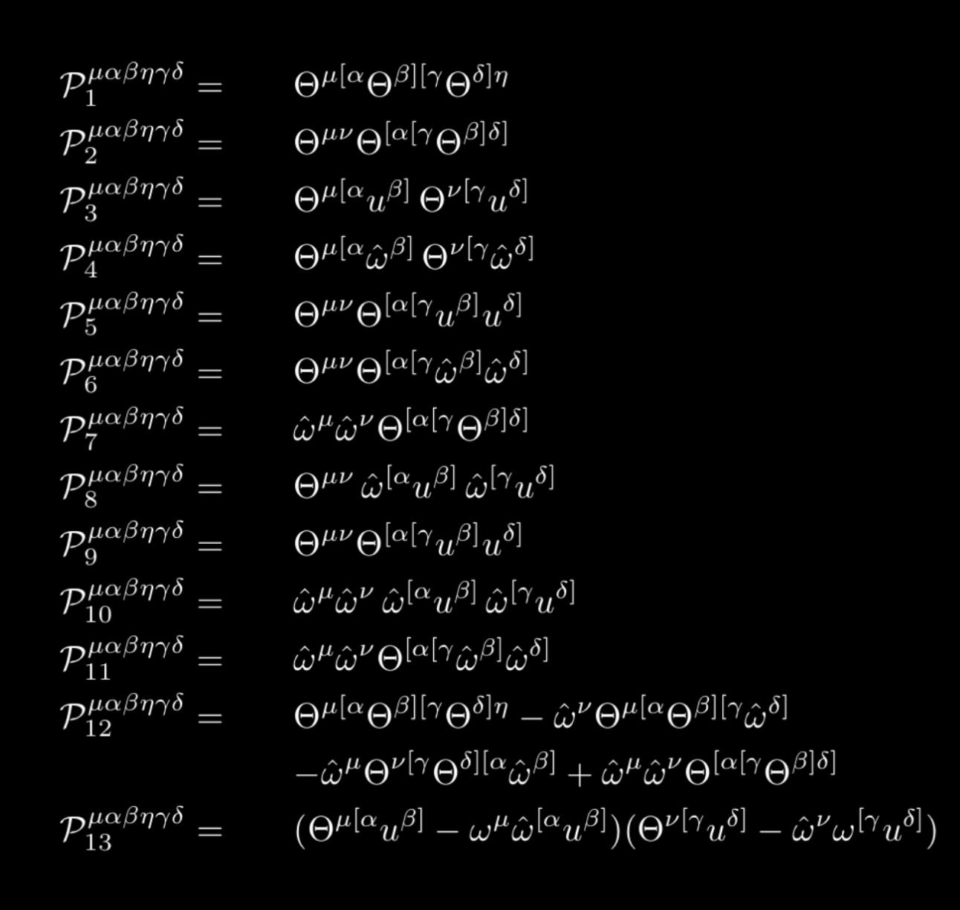
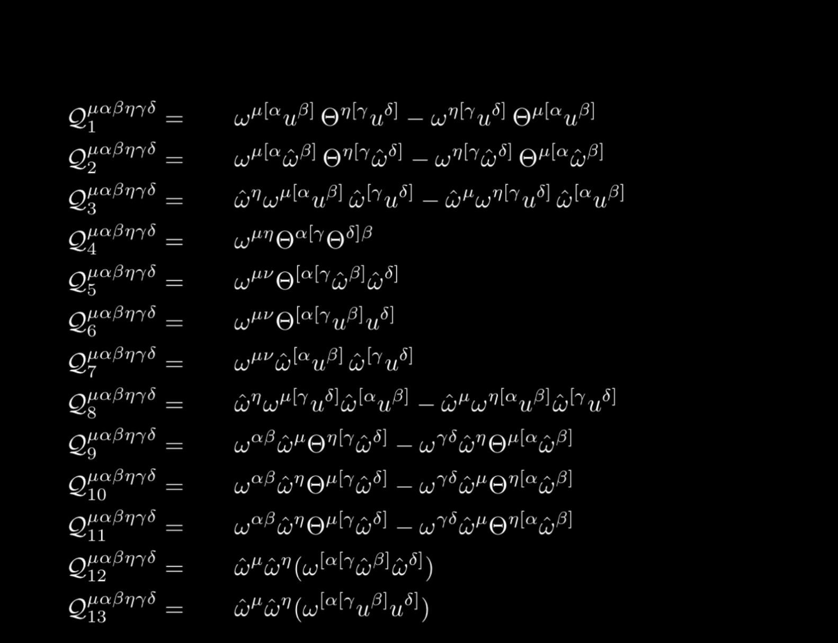
List of possible tensor structures:( for Frenkel condition )

Slide 32
List of possible tensor structures:( for Frenkel condition )

Slide 33
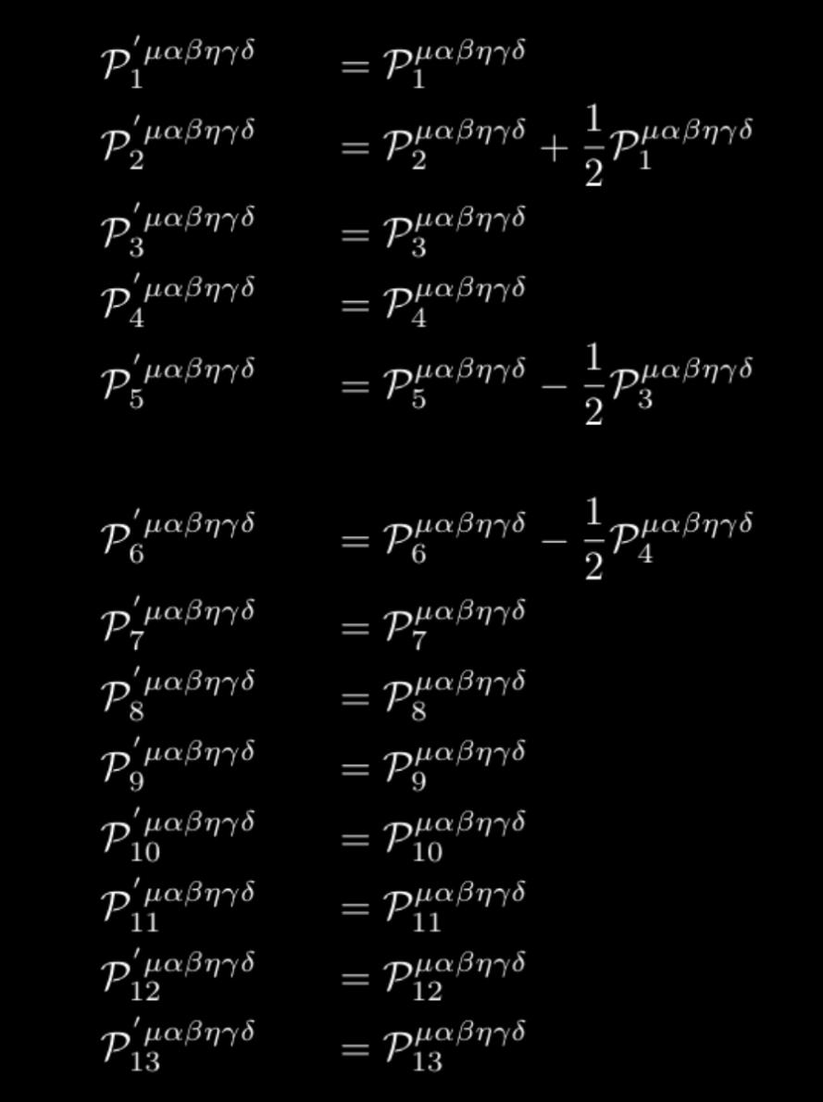
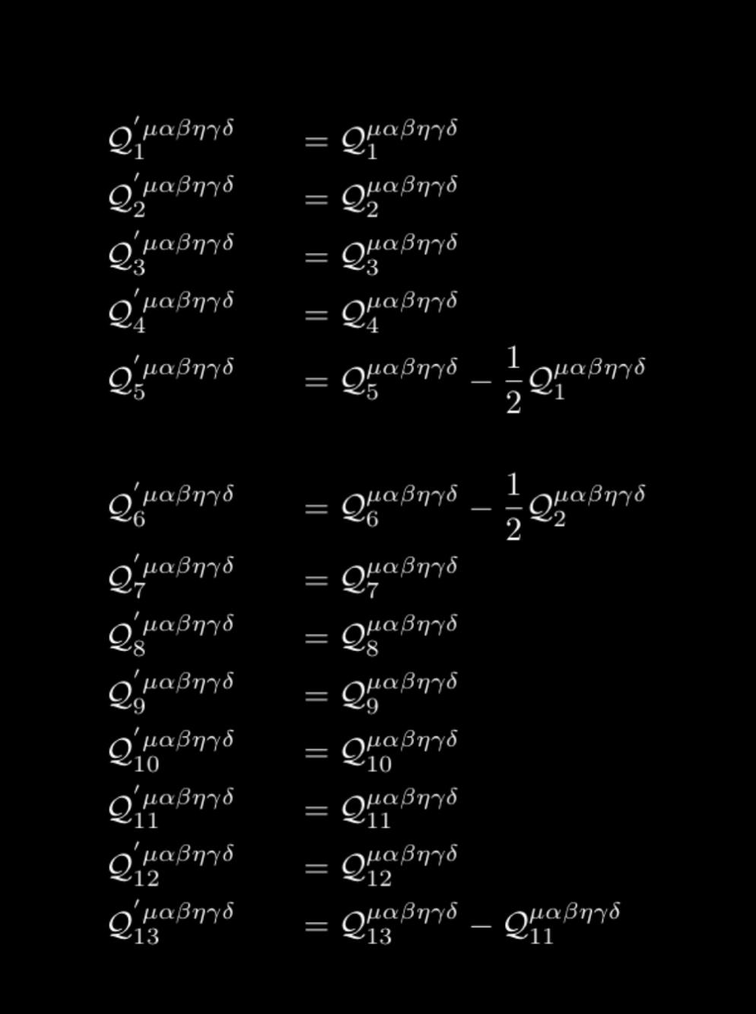
Orthogonal linearly independent basis :
Using Gram-Schmidt process to construct orthogonal basis sets:

Slide 34
Decomposition of :

Slide 35
Squarable and non-squarable terms :

Slide 36
Squarable and non-squarable terms :

Slide 37
Squarable and non-squarable terms :

Slide 38
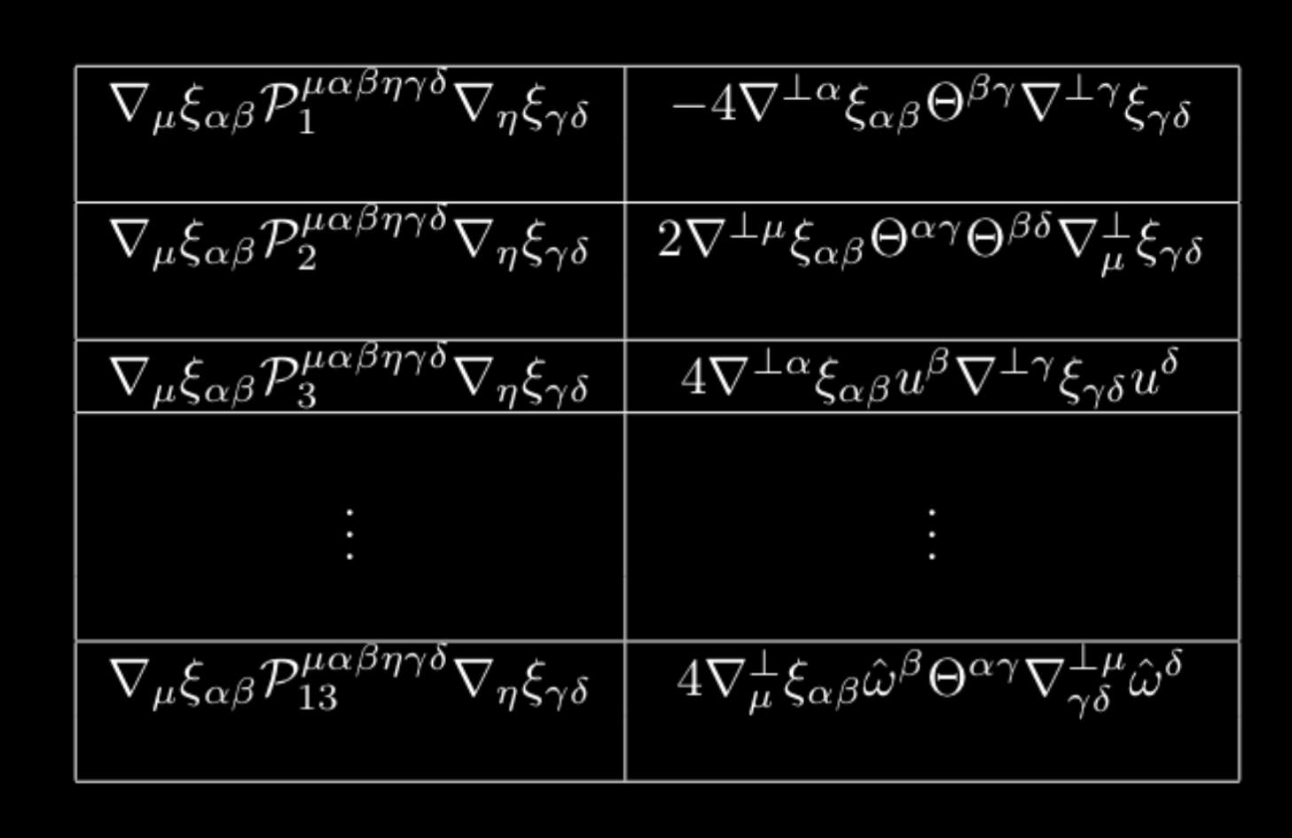
Squarable and non-squarable terms :

Slide 39
Off equilibrium spin diffusion :
where,

Slide 40
Off equilibrium spin diffusion :
where,
Needs a microscopic descriptions .

Slide 41
NESO methods :
D. Zubarev, V. Morozov and G. R ̈opke, Statistical Mechanics of Nonequilibrium Processes. John Wiley & Sons, 1997C
In this section we describe Zubarev nonequilibrium statistical operator (NESO) formalism for a generic quantum system which is in the hydrodynamic regime.
Slide 45: Microscopic approach:(B1)

Slide 42
NESO methods :
D. Zubarev, V. Morozov and G. R ̈opke, Statistical Mechanics of Nonequilibrium Processes. John Wiley & Sons, 1997C
In this section we describe Zubarev nonequilibrium statistical operator (NESO) formalism for a generic quantum system which is in the hydrodynamic regime.
Slide 45: Microscopic approach:(B1)

Slide 43
Microscopic approach:
Non-equilibrium statistical operator:
where

Slide 44
Microscopic approach:
Non-equilibrium statistical operator:
where

Slide 45
Microscopic approach:
Non-equilibrium statistical operator:
with
where
By applying conservation equations

Slide 46
Microscopic approach:
Non-equilibrium statistical operator:

Slide 47
Microscopic approach:
Non-equilibrium statistical operator:

Slide 48
Microscopic approach:
Non-equilibrium statistical operator:

Slide 49
Microscopic approach:
Non-equilibrium statistical operator:

Slide 50
Microscopic approach:
Non-equilibrium statistical operator:

Slide 51
Microscopic approach:
Non-equilibrium statistical operator:

Slide 52
Microscopic approach:
Non-equilibrium statistical operator:

Slide 53
Microscopic approach:
Upto the linear order of i.e., first order gradient of thermodynamic variable the NESO can be written as :
where,
The deviation of the statistical average of any arbitrary tensor operator from its equilibrium value as :
Slide 50: Microscopic approach:(B6)

Slide 54
Response from the system:
The deviation of the statistical average of any arbitrary tensor operator from its equilibrium value as :

Slide 55
Response from the system:
The deviation of the statistical average of any arbitrary tensor operator from its equilibrium value as :
For energy-momentum tensor, deviation with respect to its equilibrium value :
For charge current, deviation with respect to its equilibrium value :
X.-G. Huang, A. Sedrakian and D. H. Rischke, Kubo formulas for relativistic fluids in strong magnetic fields, Annals of Physics 326 (2011) 3075–3094, [1108.0602].

Slide 56
Response from the system:
The deviation of the statistical average of any arbitrary tensor operator from its equilibrium value as :
For spin angular momentum density, deviation with respect to its equilibrium value :
X.-G. Huang, A. Sedrakian and D. H. Rischke, Kubo formulas for relativistic fluids in strong magnetic fields, Annals of Physics 326 (2011) 3075–3094, [1108.0602].

Slide 57
Driven by gradient force ( ) :
By imposing the Landau matching conditions:

Slide 58
Driven by gradient force ( ) :
By imposing the Landau matching conditions:

Slide 59
Driven by gradient force ( ) :
By imposing the Landau matching conditions:
where,
and

Slide 60
Driven by gradient force ( ) :
By imposing the Landau matching conditions:
where,
and
For spin part:
With the condition

Slide 61
Linear Response Theory :
Transportation coefficients are contained in retarted green function as a linear response of the systems :

Slide 62
Linear Response Theory :
Transportation coefficients are contained in retarted green function as a linear response of the systems :

Slide 63
Linear Response Theory :
Transportation coefficients are contained in retarted green function as a linear response of the systems :
where,

Slide 64
Linear Response Theory :
Transportation coefficients are contained in retarted green function as a linear response of the systems :
where,

Slide 65
Decomposition of :
Due to Landau matching conditions has independent elements.

Slide 66
Decomposition of :
Due to Landau matching conditions has independent elements.

Slide 67
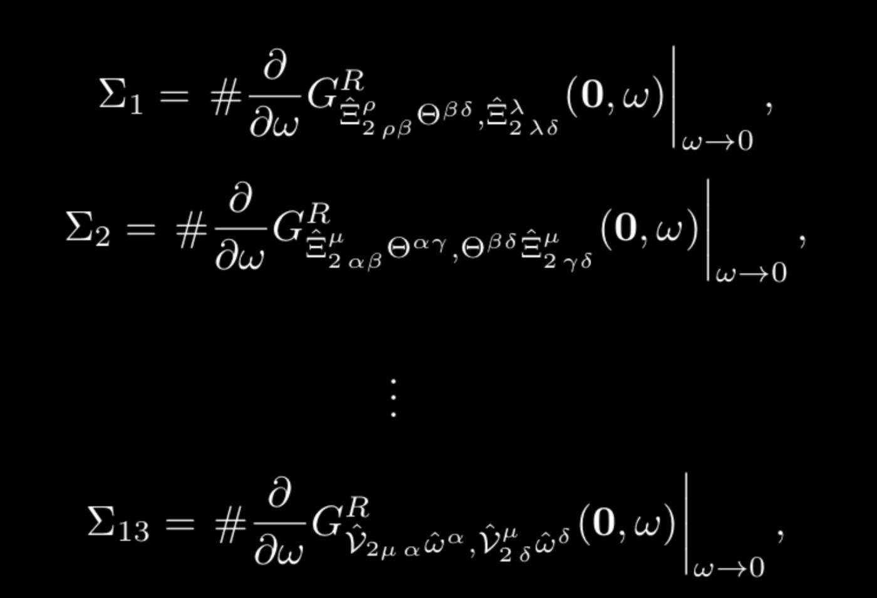
Kubo relations:

Slide 68
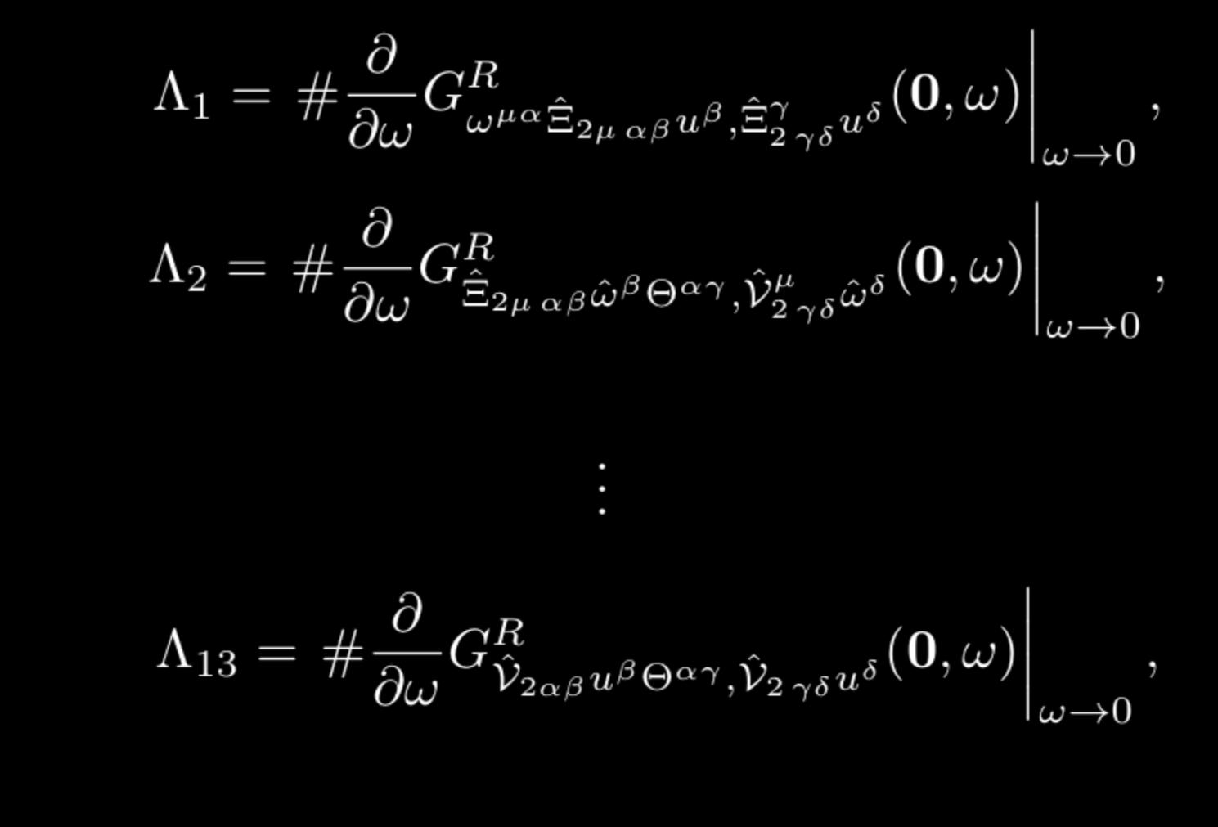
Kubo relations:

Slide 69
Potential future directions:
Linear mode analysis of spin diffusion.
Extends this works in presence of static and dynamical magnetic fields.
How does pseudo gauge transformations connect spin diffusion modes to rotational viscosity.
Estimate the values of the spin diffusion transport coefficients from effective field theories.

Slide 70
Potential future directions:
Linear mode analysis of spin diffusion.
Extends this works in presence of static and dynamical magnetic fields.
How does pseudo gauge transformations connect spin diffusion modes to rotational viscosity.
Estimate the values of the spin diffusion transport coefficients from effective field theories.
Thank you

Slide 71
Canonical definition:
Slide 9: Ambiguity of the spin current

Slide 72
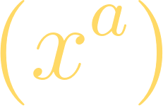
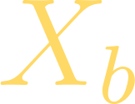
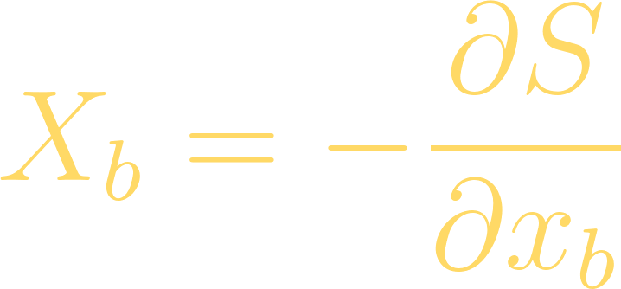
Positivity of entropy production:
Landau & Lifshitz,Statistical mechanics Volume:4,5;
Departure from equilibrium of thermodynamic quantities :
where is thermodynamic conjugate force, expressed as derivative of entropy:
Imposing Onsager’s principle
The rate of change of entropy of the system is given by:
In presence of axial and vector fields, the kinetic coefficient has to satisfy :

Slide 73
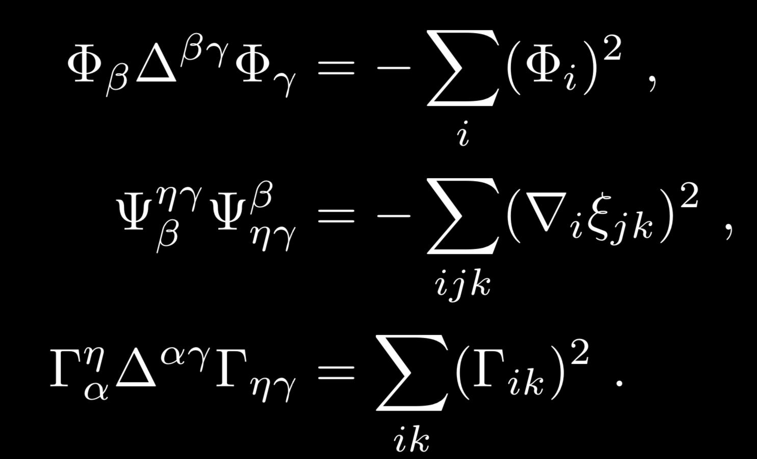
Sign of tensor structures
In LRF the quantities becomes

Slide 74
Microscopic approach:(B1)
In this section we describe Zubarev non-equilibrium statistical operator (NESO) formalism for a generic quantum system which is in the hydrodynamic regime
Knowledge of the statistical operator allows one to compute the thermal expectation value of any quantum operator.
Density matrix:
where,

Slide 75
Microscopic approach:(B2)
In the absence of global equilibrium, we still can ascribe local equilibrium thermodynamic parameters at each small patch of the full systems.
where,
Definition of energy and charge density operator in comoving frame:
and

Slide 76
Microscopic approach:(B3)
In the absence of global equilibrium, we still can ascribe local equilibrium thermodynamic parameters at each small patch of the full systems.
where,
Definition of energy and charge density operator in comoving frame:
and

Slide 77
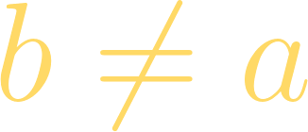
Microscopic approach:(B4)
In the absence of global equilibrium, we still can ascribe local equilibrium thermodynamic parameters at each small patch of the full systems.
Hydrodynamic parameters as local equilibrium function :
and
Define frame of fluid velocity :
Eckart frame:
, where

Slide 78
Microscopic approach:(B5)
Non-equilibrium statistical operator:
and

Slide 79
Microscopic approach:(B6)
Upto the linear order of i.e., first order gradient of thermodynamic variable the NESO can be written as :
where,
The deviation of the statistical average of any arbitrary tensor operator from its equilibrium value as :

Slide 80
Microscopic approach:(B7)
The deviation of the statistical average of any arbitrary tensor operator from its equilibrium value as :
where,

Slide 82
Ambiguity of the spin current
F.J. Belinfante, Physica 6, 887 (1939)
F.J. Belinfante, Physica 7, 449 (1940)
L. Rosenfeld, Mém. Acad. Roy. Belg. 18, 1 (1940)
Total angular momentum:
Enrico Speranza Et al.;Spin tensor and pseudo-gauges: from nuclear collisions to gravitational physics;Enrico Speranza
Conservation law:
W.Florkowski Et al;[1811.04409 [nucl-th]]
Preserved by:

Slide 83
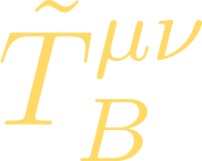
Ambiguity of the spin current
F.J. Belinfante, Physica 6, 887 (1939)
F.J. Belinfante, Physica 7, 449 (1940)
L. Rosenfeld, Mém. Acad. Roy. Belg. 18, 1 (1940)
Total angular momentum:
Enrico Speranza Et al.;Spin tensor and pseudo-gauges: from nuclear collisions to gravitational physics;Enrico Speranza
Conservation law:
W.Florkowski Et al;[1811.04409 [nucl-th]]
Preserved by:

Slide 84
Hydrodynamics framework with spin degrees of freedom:
Equation of motion :
General decomposition:
and

Slide 85
Microscopic approach:
Upto the linear order of i.e., first order gradient of thermodynamic variable the NESO can be written as :
where,
The deviation of the statistical average of any arbitrary tensor operator from its equilibrium value as :
where,
Slide 50: Microscopic approach:(B6)

Slide 86
Response from the system:
The deviation of the statistical average of any arbitrary tensor operator from its equilibrium value as :
For energy-momentum tensor, deviation with respect to its equilibrium value :
X.-G. Huang, A. Sedrakian and D. H. Rischke, Kubo formulas for relativistic fluids in strong magnetic fields, Annals of Physics 326 (2011) 3075–3094, [1108.0602].
For charge current, deviation with respect to its equilibrium value :
For charge current, deviation with respect to its equilibrium value :

Slide 87
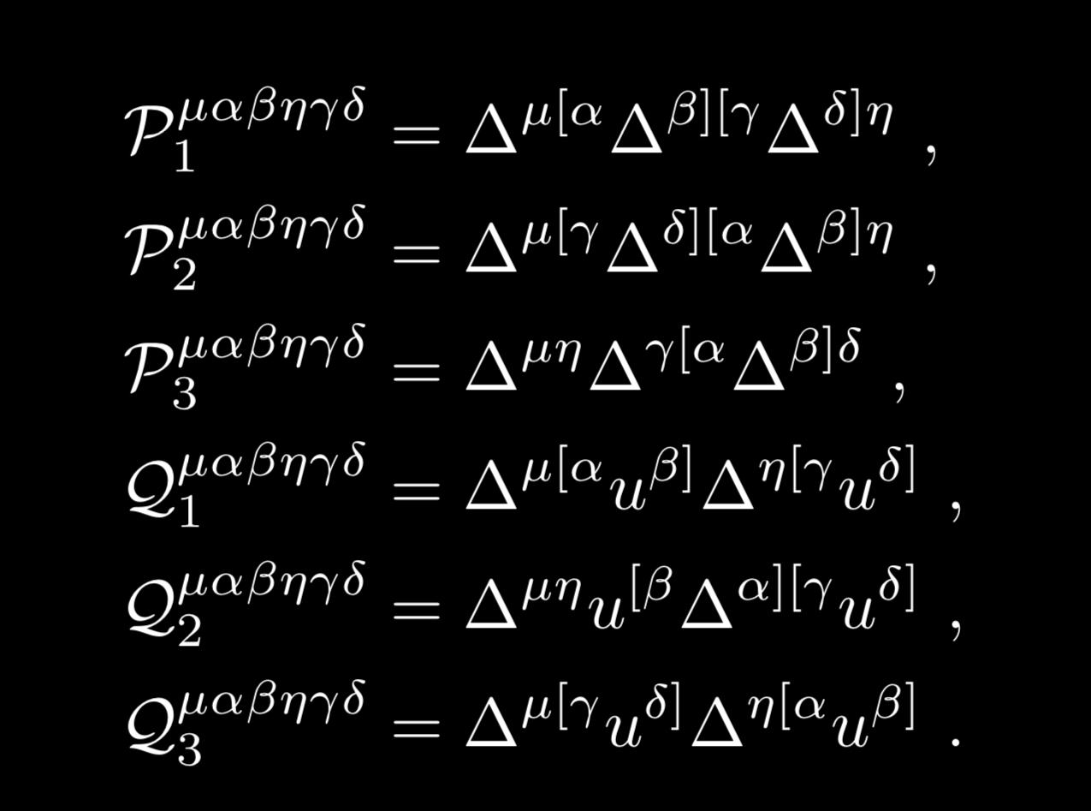
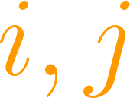
Entropy production due to spin diffusion:
Now if we consider small spin polarization limit, such that system maintains degeneracy at transportation coefficients.
for all

Slide 88
Entropy production due to spin diffusion:
Now if we consider small spin polarization limit, such that system maintains degeneracy at transportation coefficients.

Slide 89
Decomposition of :
Due to Landau matching conditions has independent elements.

Slide 90
Decomposition of :
Due to Landau matching conditions has independent elements.

Slide 91
Spin diffusion modes and corresponding Green functions:

Slide 92
Spin diffusion modes and corresponding Green functions:

Slide 93
Spin diffusion modes and corresponding Green functions:

Slide 94
Spin diffusion modes and corresponding Green functions:

Slide 95
Spin diffusion modes and corresponding Green functions:

Slide 96
Spin diffusion modes and corresponding Green functions:

Slide 97
Spin diffusion modes and corresponding Green functions:

Slide 98
Spin diffusion modes and corresponding Green functions:

Slide 99
:

Slide 100
:

Slide 101
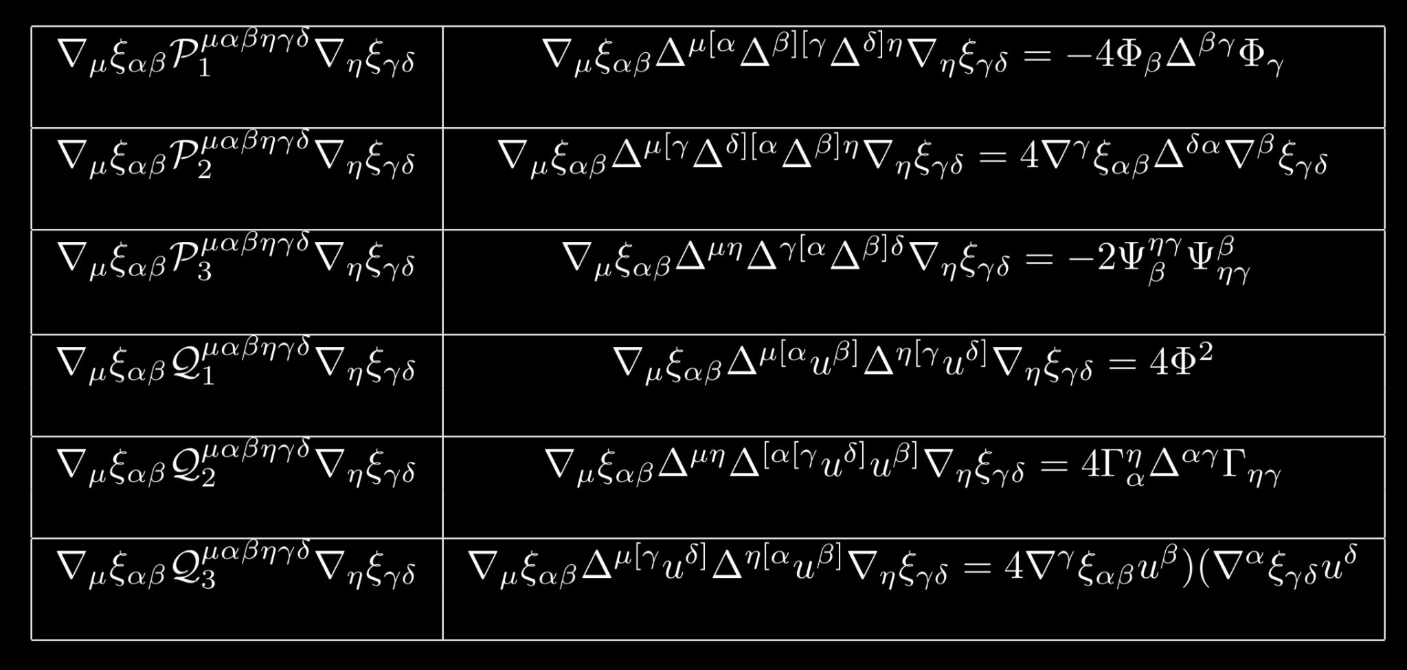
Squarable and non-squarable terms :
where,
2.
3.
4.

Slide 102
Squarable and non-squarable terms :

Slide 103
Squarable and non-squarable terms :
Slide 44: Sign of tensor structures

Slide 104
Squarable and non-squarable terms :
Coefficients of non-squarable terms needs to be zero:
and
Slide 44: Sign of tensor structures

Slide 105
Squarable and non-squarable terms :
Coefficients of non-squarable terms needs to be zero:
and
Sign of the square completed terms gives constrain over transport coefficients :(Go to comoving frame of fluid)
and
Slide 44: Sign of tensor structures

Slide 106
Mode splitting for spin polarization:

Slide 107
Mode splitting for spin polarization:
where,

Slide 108
Mode splitting for spin polarization:
where,
where,

Slide 109
Hydrodynamics with the GLW choice
At the equilibrium:
and

Slide 110
Hydrodynamics with the GLW choice
At the equilibrium:
and

Slide 111
Entropy Current in GLW approach :
Even at equilibrium, entropy flux is present:
First law of thermodynamics:
Gibbs-Duhem thermodynamics relation :

Slide 112
Off equilibrium spin diffusion :

Slide 113
Off equilibrium spin diffusion :
Needs a microscopic descriptions of this spin transports.

