Slide 1


Slide 2
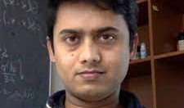
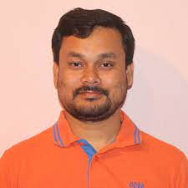

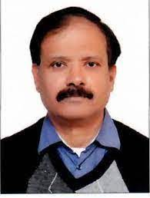
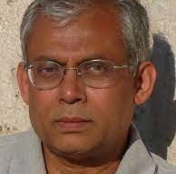
Decided to organize it as we have a group at NISER deeply interested in the topic

Slide 3

























Also received interest from various participants
60

Slide 4
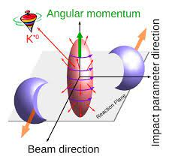
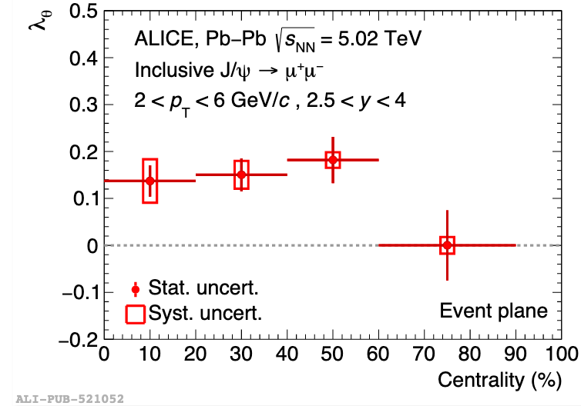
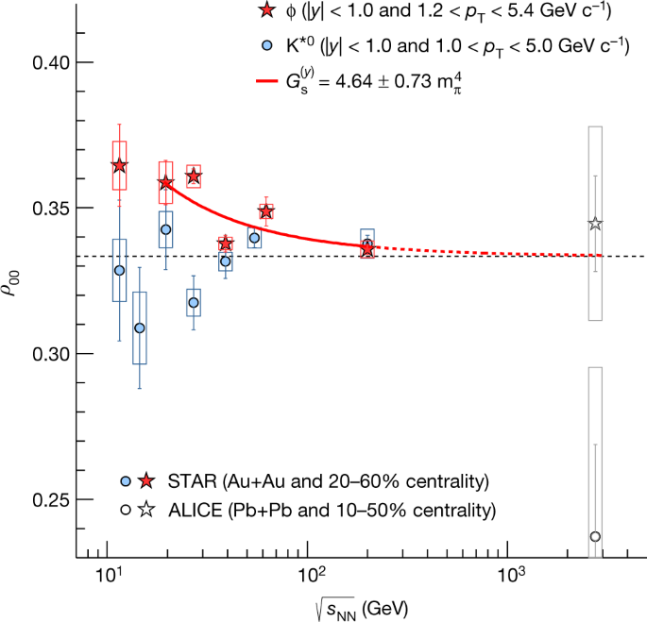
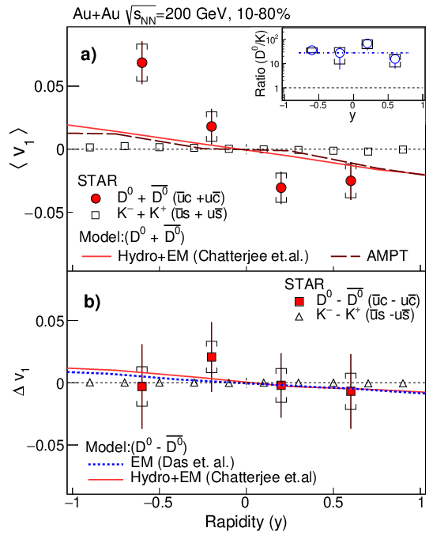
Hope the academic interactions were fruitful and the stay was pleasant
Polarization of hyperons
Spin alignment of vector mesons
Phys. Lett. B 815 (2021) 136146
Higher order flow coefficients
Large values of charge difference v₁ of charm hadrons
V_{n} vs n

Slide 5
Thanks goes to ….
All participants
Speakers
DAE
NISER
Organizers
Toshali staff
Look forward to such meeting in future
May be also include Criticality

