Slide 1
Investigating the Role of Electric Fields on Flow Harmonics in Heavy-Ion Collisions
arXiv:2301.00632
ANKIT KUMAR PANDA
IN COLLABORATION WITH R.Gangadharan and V.Roy

Slide 2
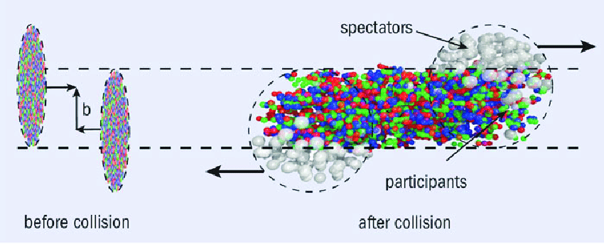
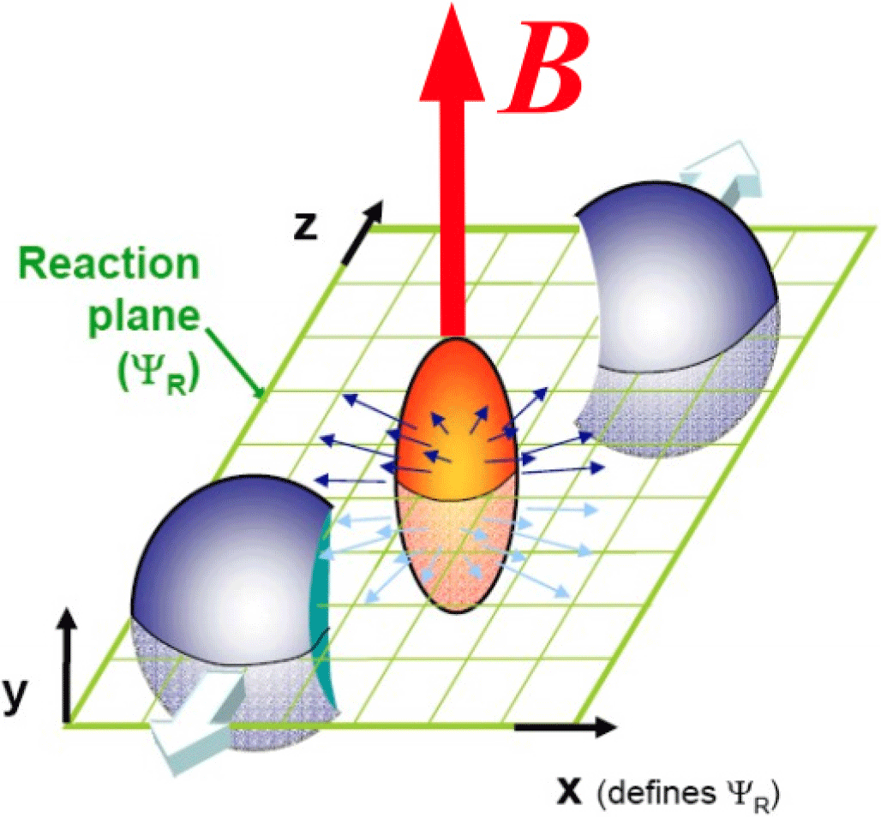
HEAVY ION COLLISION
Peripheral Au+Au collisions at √ sNN = 200 GeV may reach as high as (∼ ${10}^{18}−{10}^{19}$G) .
Strongest magnetic field produced.
D. E. Kharzeev, L. D. McLerran, and H. J. Warringa, Nucl. Phys. A803, 227 (2008), 0711.0950.

Slide 3
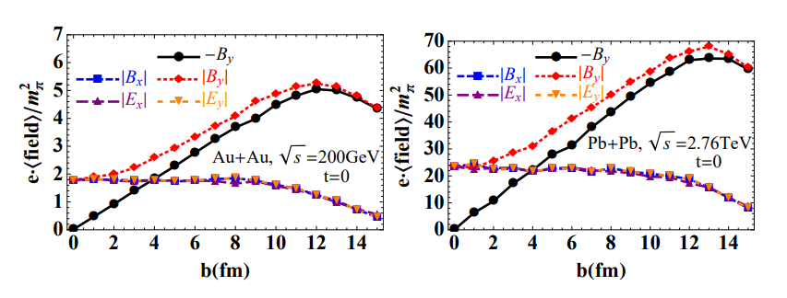
MOTIVATION
t=0 and r=0
Event-by-event generation of electromagnetic fields in heavy-ion collisions
Wei-Tian Deng and Xu-Guang Huang
arXiv: 1201.5108

Slide 4
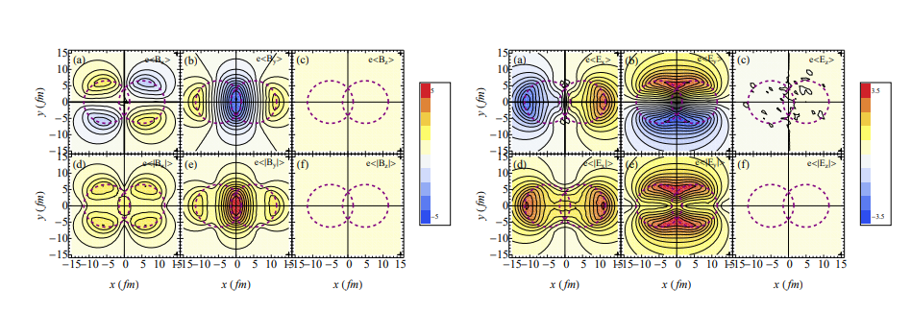
MOTIVATION
t=0 and b= 10 fm
Event-by-event generation of electromagnetic fields in heavy-ion collisions
Wei-Tian Deng and Xu-Guang Huang
arXiv: 1201.5108

Slide 5
AIM :
STUDYING THE ROLE OF ELECTRIC FIELDS ON BULK OBSERVABLES
USING BLAST WAVE MODEL
AT FREEZEOUT HYPERSURFACE
COOPER-FRYE PRESCRIPTION FOR PARTICLIZATION PROCESS

Slide 6
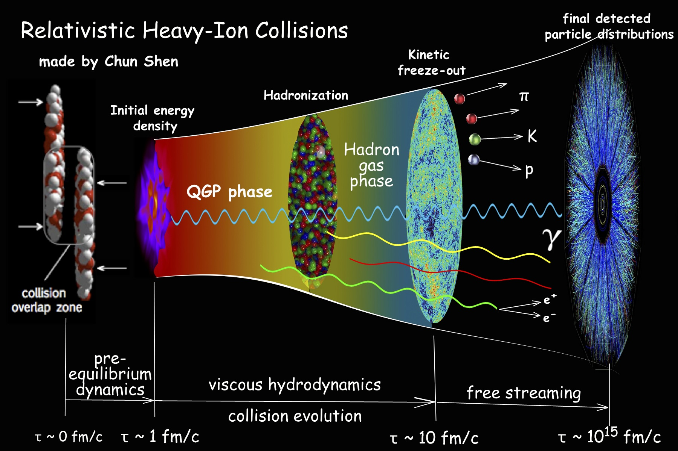
PARAMETERIZE:
u and T on the hypersurface of the fire ball.
WHAT IS BLAST WAVE MODEL ?
ASSUME : VERY CLOSE TO LOCAL THERMAL EQUILIBRIUM

Slide 7
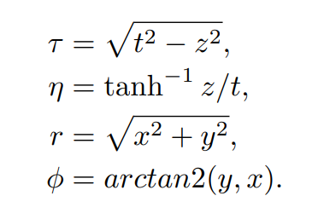
BLASTWAVE MODEL PARAMETERIZATION
MILNE CO-ORDINATE
BOOST INVARIANT

Slide 8
FREEZEOUT HYPERSURFACE
PARAMETERIZE:
u and T on the hypersurface
USING BLASTWAVE
FLUID PICTURE
PARTICLE FREE-STREAM
RELATIVISTIC HEAVY ION COLLISION
INPUTS FROM KINETIC THEORY
CALCULATE BULK OBSERVABLES ($p_{T}$ SPECTRA AND ELLIPTIC FLOW)
COOPER-FRYE FORMALISM

Slide 9
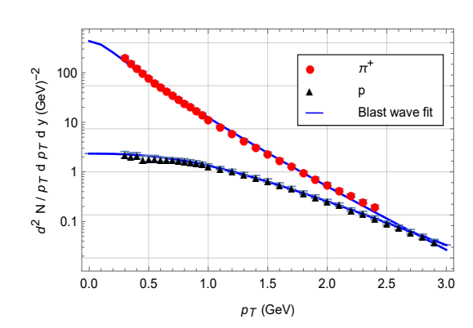
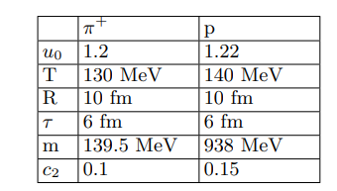
COOPER-FRYE FORMALISM
=
$$f_{0}= \frac{1}{e^{β\left(u.p\right)−α}+r}$$
$\sqrt{s_{NN} }=2.76$ TeV for Pb + Pb at 20-30 %
B. Abelev et al. (ALICE), Centrality dependence of π, K, p production in Pb-Pb collisions at √ sNN = 2.76 TeV, Phys. Rev. C 88, 044910 (2013), arXiv:1303.0737 .

Slide 10
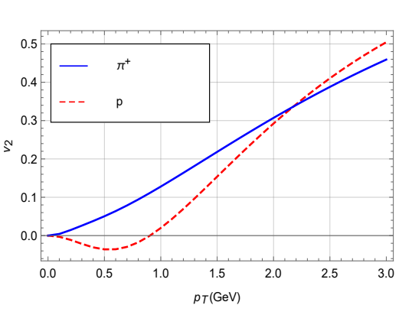

Slide 11
INORDER TO CALCULATE THE EFFECT OF ELECTRIC FIELDS
Kinetic theory
$f=f_{0}+ δf$

Slide 12
RELATIVISTIC KINETIC THEORY
where
$$f_{0}= \frac{1}{e^{β \left(u.p\right)−α}+r}$$
f= $f_{0}+ {δf}^{(1)}+…$
Force term

Slide 13
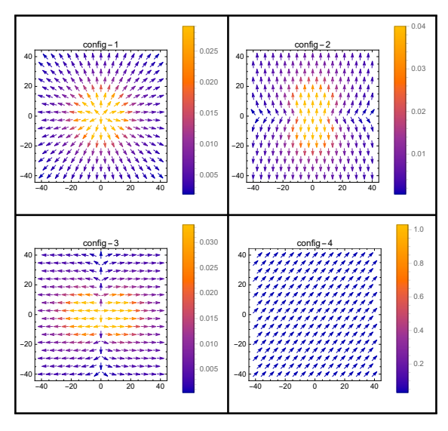
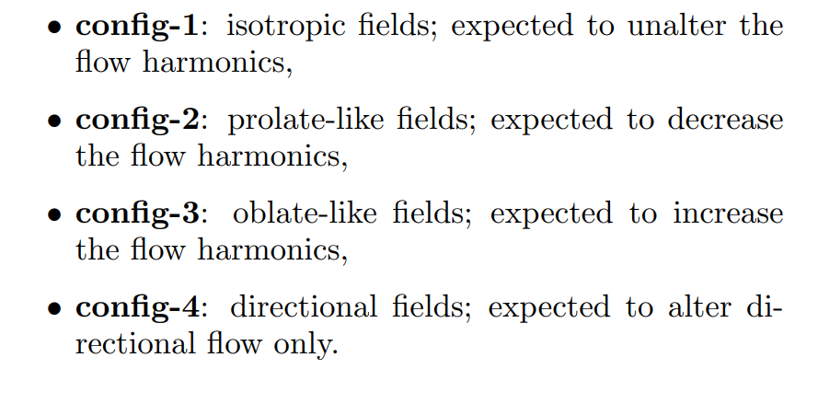
CONFIGURATIONS OF ELECTRIC FIELD

Slide 14
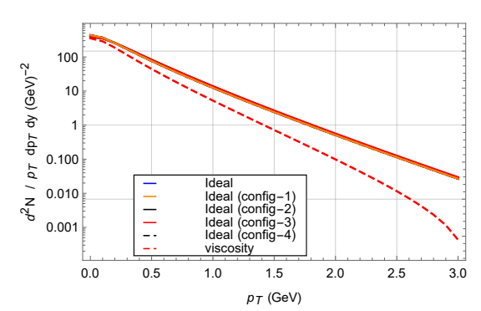
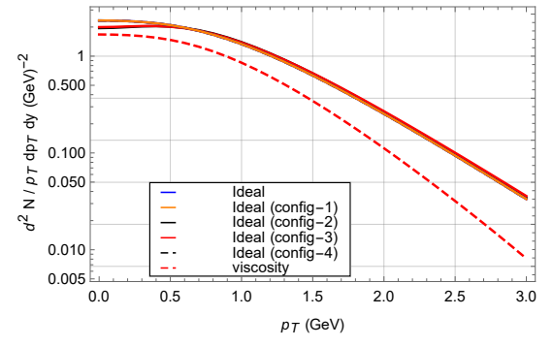
RESULTS
$p_{T}$ SPECTRA
PION
PROTON

Slide 15
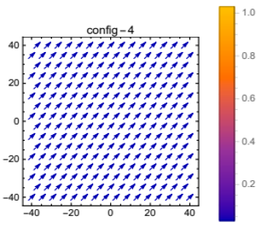
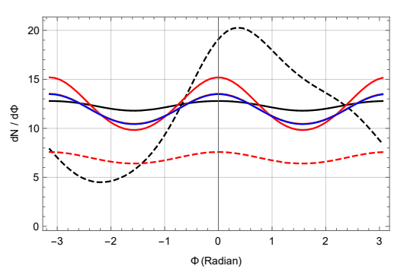
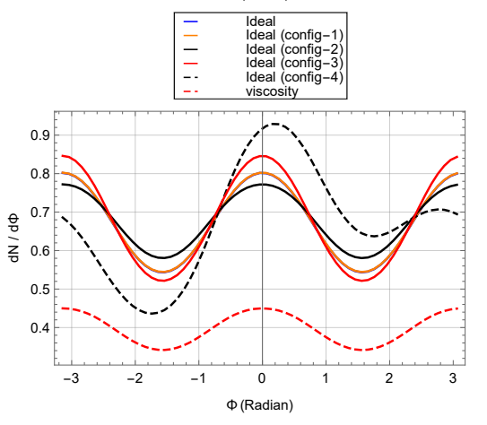
ANGULAR DEPENDENCE OF MULTIPLICITY
PION
INTERESTING
PROTON

Slide 16
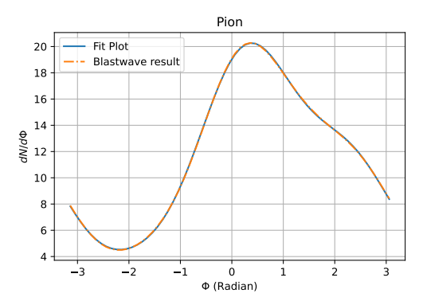
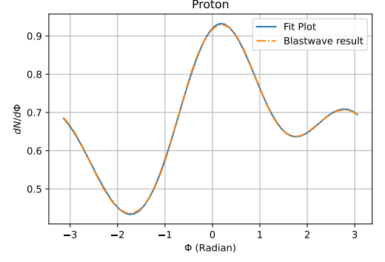
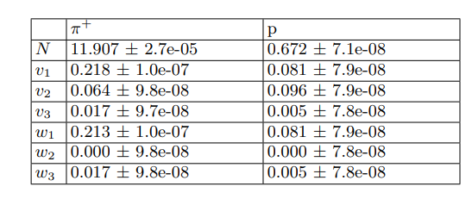

Slide 17
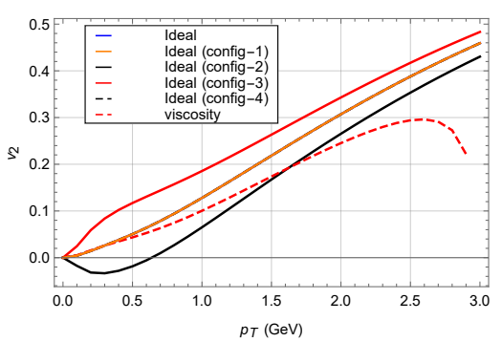
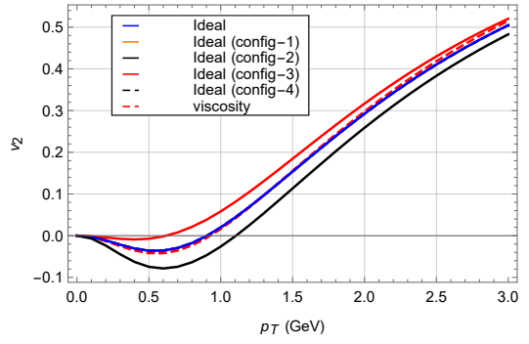
$$v_{2}$$
PION
PROTON

Slide 18
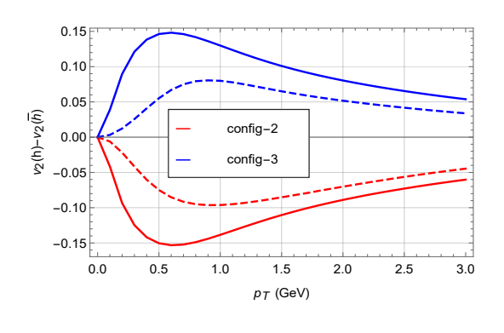
$$v_{2}(h) −v_{2} (\overline{h})$$
Solid- pion
Dashed - proton

Slide 19
SUMMARY
Here we studied the effect of electric field on bulk observables like $p_{T}$ spectra and $v_{2} .$
We employed Blastwave model at the freezeout hypersurface and cooper-frye formula for the Particlization process.
We considered 4 different configurations of electric field in the transverse plane and we saw there effect on the spectra and $v_{2}$for pion and proton.
There was not much effect in the spectra.
In the azimuthal dependence of spectra we found a non-monotonic effect of electric field for the case of directed field which leads to a production of directed flow.
In $v_{2}$ we could see a clear effect of electric field.
Lastly we also studied the effect of electric field for pions and protons via. ${∆v}_{2}$ .
OUTLOOK :
We should take into account both the contributions of electric and magnetic field during the study of bulk observables .

Slide 20
THANK YOU

Slide 21
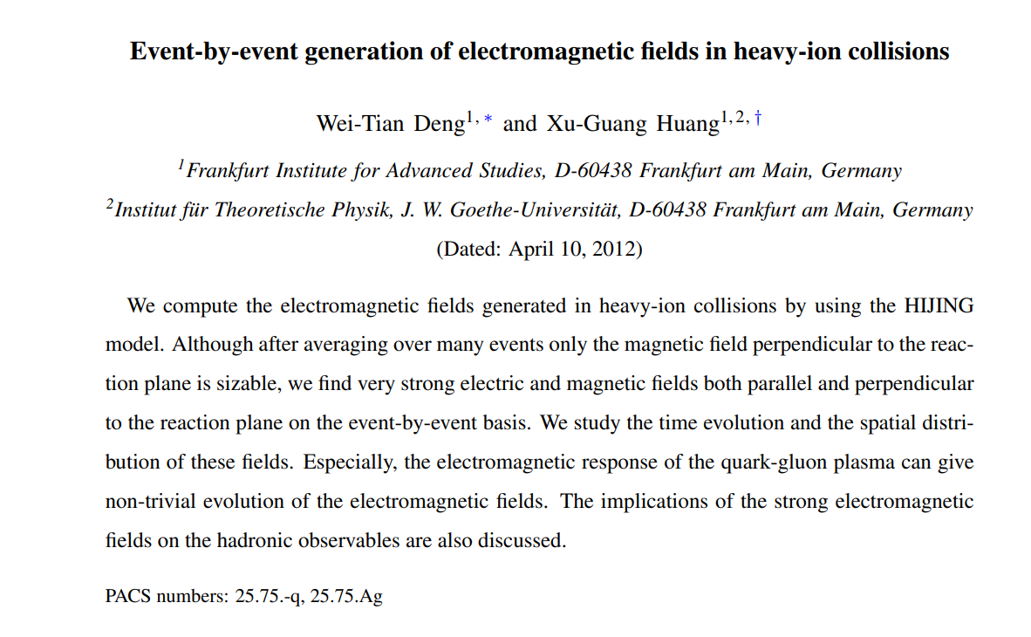
BACK UP SLIDES

Slide 22
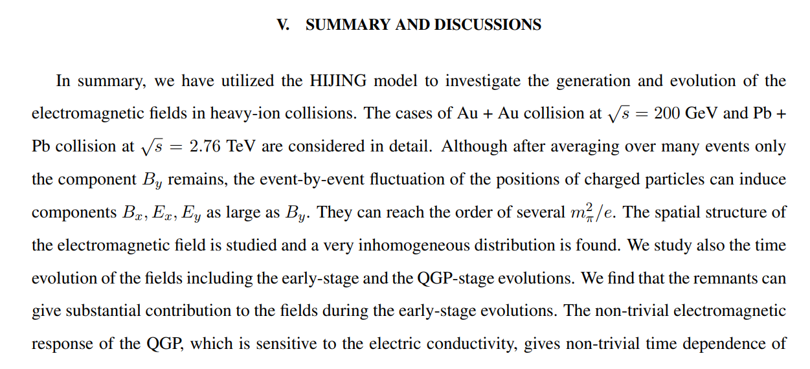
BACK UP SLIDES

Slide 23
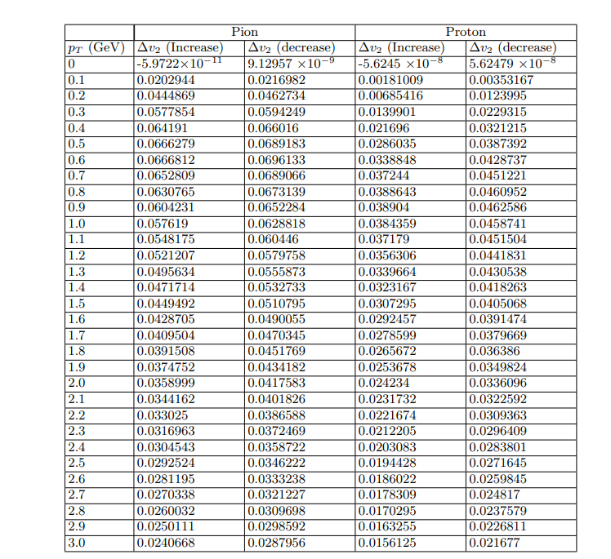
BACK UP SLIDES

Slide 24
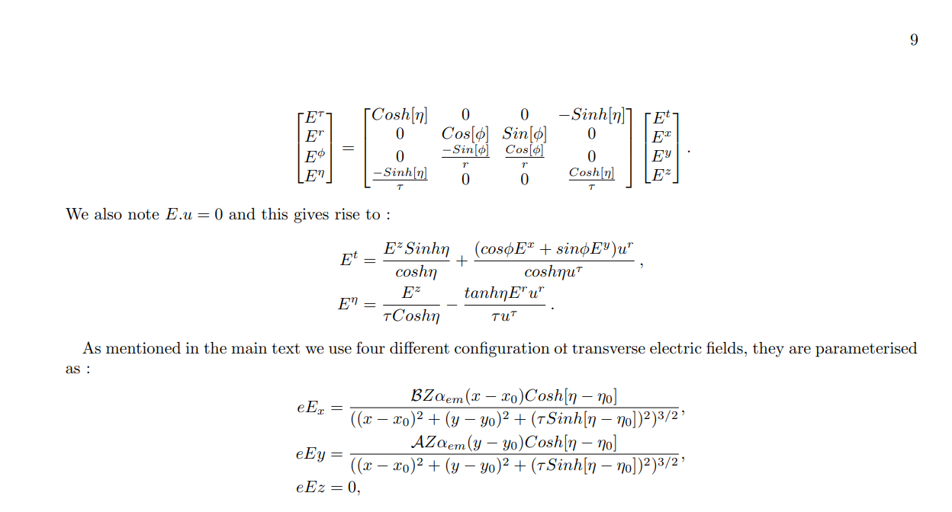
BACK UP SLIDES

