Slide 1
Hawking radiation from acoustic black holes in relativistic heavy-ion collisions
and in hydrodynamical flow of electrons
Ajit M. Srivastava
Institute of Physics
Bhubaneswar, India

Slide 2
Outline:
1. Black holes and Hawking radiation
Velocity perturbations in fluids, acoustic metric,
Scalar field in Curved spaces (Unruh, 1981)
Subsonic – supersonic flow boundary as event horizon
of black hole: Hawking radiation of sound modes
Acoustic black holes in relativistic heavy-ion collisions:
Dynamical horizon and Doppler-shifted Hawking radiation
(A. Das, S.S. Dave, O. Ganguly, AMS, PLB 817 (2021) 136294)
5. Electron hydrodynanmics in condensed matter systems and
resulting acoustic black holes. (S.S. Dave, O. Ganguly, P.S. Saumia, AMS,
EPL 139 (2022) 6, 60003)
6. Ultra-relativistic case in heavy-ion collisions, and for electron flow in
Graphene in condensed matter systems, (work in progress)

Slide 3
Laboratory analogues of cosmic/astrophysical phenomena have proved to be of great importance.
One of the most important examples of this is the laboratory analogue of black holes in hydrodynamical fluid flow (Unruh, 1981)
The so called Acoustic Black Hole
Black holes in Cosmos:
The most exotic objects known to occur in the Universe.
Ample observational evidence of accretion disks around
astrophysical black holes
but the region close to the horizon has not been readily accessible.
(Though, with gravitational wave observations of black hole collisions, even this regime of black hole physics should be within reach of future experimental investigations). .

Slide 4
Bekenstein-Hawking Radiation:
Probably the most intriguing phenomena associated with black holes
It arises from the behavior of quantum fields in the background of a black hole space-time.
It raises deeply conceptual issues related to unitary evolution and information loss in the formation and subsequent evaporation of black holes.
Any experimental probe of the physics of BH radiation will be an important step towards understanding this important phenomenon.
It does not seem possible, in any foreseeable future experiment, to probe this exotic phenomenon for any astrophysical black hole
Laboratory investigations with acoustic black holes can give
access to the regime of strong gravity close to the event horizon,
Hence to Hawking Radiation

Slide 5
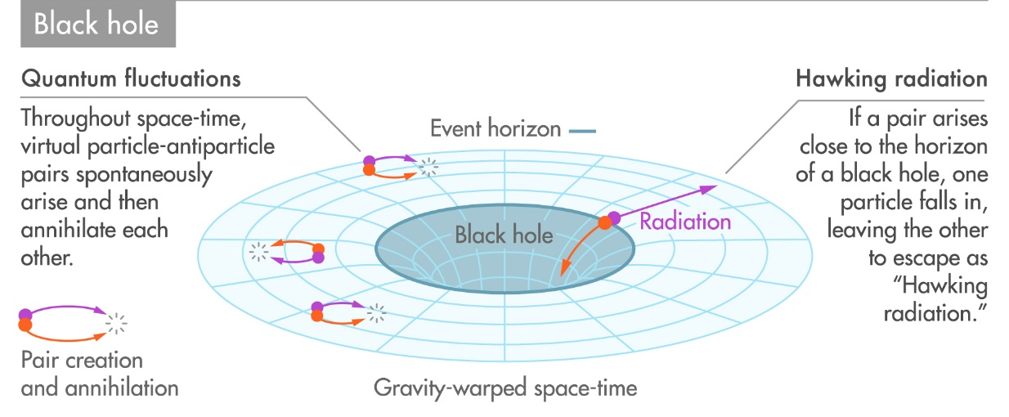
Bekenstein-Hawking Radiation:
Black hole Radiation is thermal, with a black body spectrum
$T_{H }$ = $\frac{ℏc^{3}}{8πGMk_{B}}$ ~ 6 x ${10}^{−8}$ K, for a solar mass black hole
Note: CMBR Temperature = 2.7 K

Slide 6
Intuitive concept of acoustic black hole:
Consider fluid flowing through a drain
Becoming supersonic

Slide 7
Intuitive concept of acoustic black hole:
Fluid flowing through a drain – becoming supersonic
Sound modes can
Propagate in all directions
Subsonic fluid flow
subsonic –
supersonic
Flow boundary
sound modes
cannot Propagate
against flow
Supersonic
fluid flow

Slide 8
Acoustic black hole: Tilting of sound cones
Just like tilting of light cones for standard black holes

Slide 9
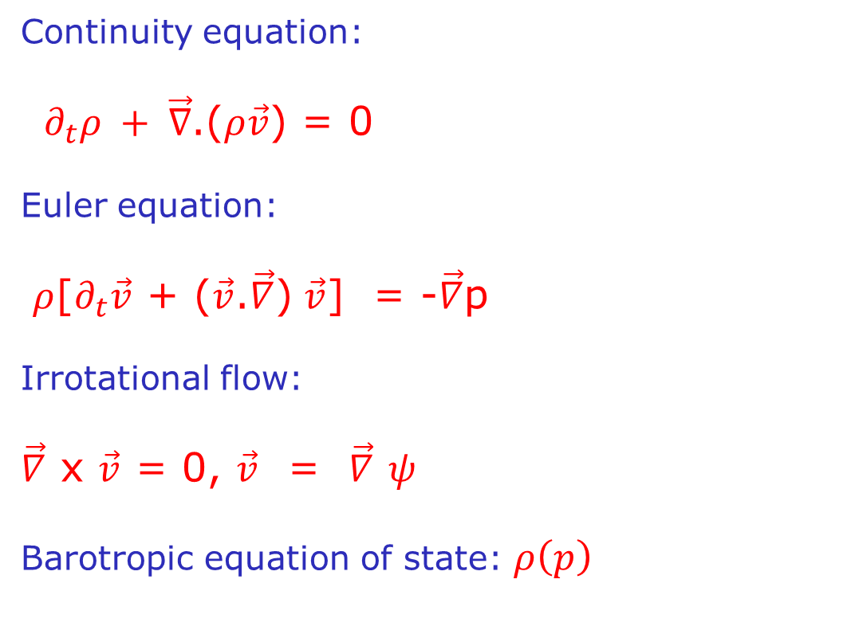
This “Intuitive” correspondence is made rigorous by considering
The Acoustic Metric: Metric for sound waves
Unruh, Phys. Rev. Lett. 46, 1351 (1981)
Ideal, non-relativistic fluid with pressure p, density ρ, and velocity $\vec{v }$
Continuity equation:
$∂_{t}ρ + \vec{∇}$.($ρ\vec{v}$) = 0
Euler equation:
$ρ$[$∂_{t}\vec{v}$ + ($\vec{v}$.$\vec{∇}$) $\vec{v}$] = -$\vec{∇}$p
Irrotational flow:
$\vec{∇}$ x $\vec{v}$ = 0, $\vec{v}$ = $\vec{∇}$ $ψ$
Barotropic equation of state: $ρ\left(p\right)$

Slide 10
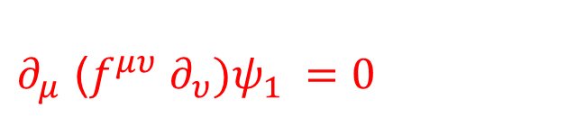
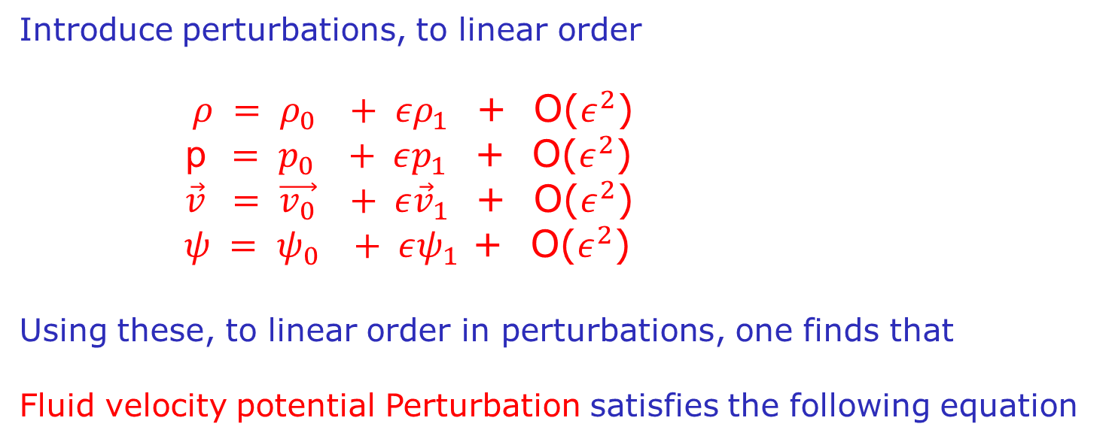
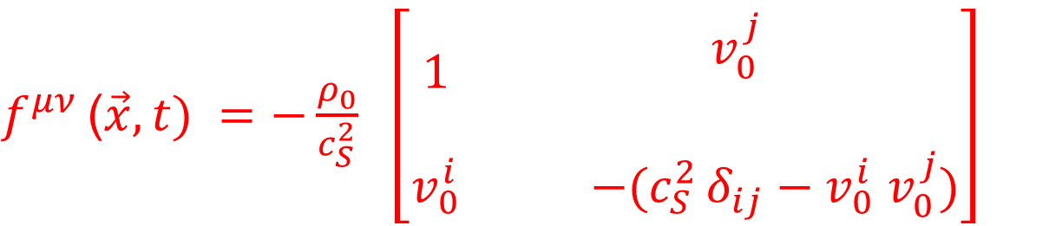
Introduce perturbations, to linear order
$ρ = ρ_{0} + ερ_{1}$ + O($ε^{2}$)
p$= p_{0} + εp_{1}$ + O($ε^{2}$)
$\vec{v} = \vec{v_{0}} + ε{\vec{v}}_{1}$ + O($ε^{2}$)
$ψ = ψ_{0} + εψ_{1}$ + O($ε^{2}$)
Using these, to linear order in perturbations, one finds that
Fluid velocity potential Perturbation satisfies the following equation
$∂_{μ}$ ($f^{μυ} ∂_{υ})ψ_{1} =0$
Where:
$f^{μν }$($\vec{x}, t) =−\frac{ρ_{0}}{c_{S}^{2}} \left[\begin{matrix}1 & \begin{aligned}v_{0}^{j} \\ \end{aligned} \\ v_{0}^{i} & −(c_{S}^{2 }δ_{ij}−v_{0}^{i} v_{0}^{j})\end{matrix}\right]$

Slide 11
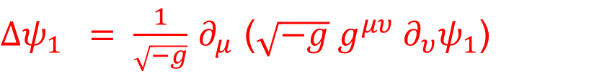
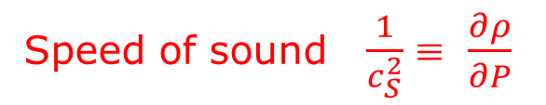
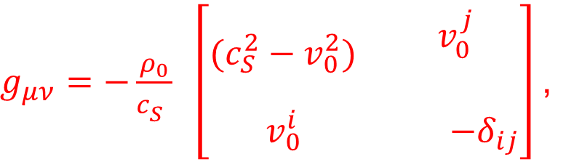
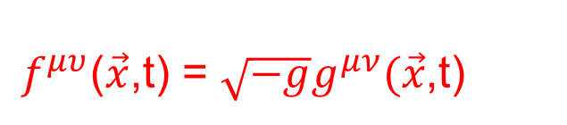

d’Alembertion in curved space-time
$Δψ_{1} = \frac{1}{\sqrt{−g}}$ $∂_{μ}$ ($\sqrt{−g} g^{μυ} ∂_{υ}ψ_{1}$)
$∂_{μ}$ ($f^{μυ} ∂_{υ})ψ_{1} =0$
Thus, from the equation for ψ₁ :
We identify the acoustic metric via:
$f^{μυ}$($\vec{x}$,t) = $\sqrt{−g}g^{μν}(\vec{x}$,t)
So, velocity potential perturbations propagate as a scalar field
in a curved space-time with relativistic metric
$g_{μν}=−\frac{ρ_{0}}{c_{S}^{}} \left[\begin{matrix}(c_{S}^{2}−v_{0}^{2}) & \begin{aligned}v_{0}^{j} \\ \end{aligned} \\ v_{0}^{i} & −δ_{ij}\end{matrix}\right]$,
Speed of sound $\frac{1}{c_{S}^{2}}$ ≡ $\frac{∂ρ}{∂P}$
The resulting Acoustic Lorentzian Geometry:
$ds^{2} = −\frac{ρ_{0}}{c_{S}}$ [($c_{S}^{2 }−v_{0}^{2 }) dt^{2}$ - $δ_{ij}$d$x^{i}$ d$x^{j}$ + 2($v_{0})_{i}$dt d$x^{j}]$

Slide 12
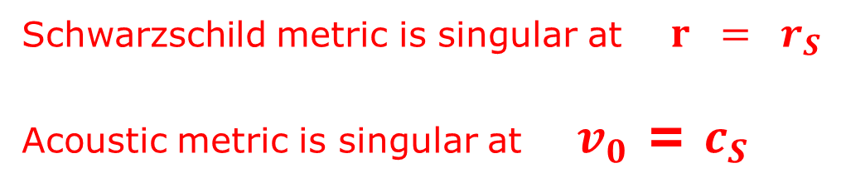
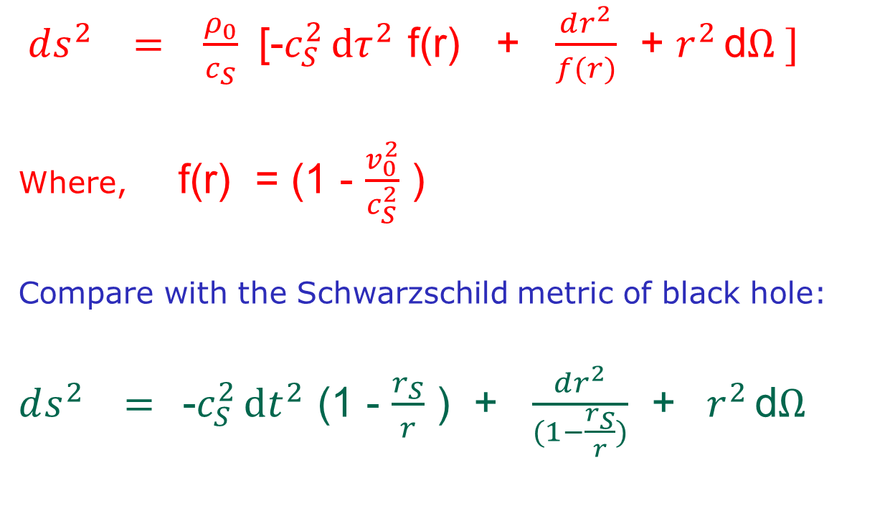
With a coordinate transformation, we can write this metric in
the following form
$ds^{2} = \frac{ρ_{0}}{c_{S}}$ [-$c_{S}^{2 }dτ^{2}$ f(r) + $\frac{dr^{2}}{f(r)}$ + $r^{2 }$d$Ω ]$
Where, f(r) = (1 - $\frac{v_{0}^{2}}{c_{S}^{2}}$ )
Compare with the Schwarzschild metric of black hole:
$ds^{2} =$-$c_{S}^{2 }dt^{2}$ (1 - $\frac{r_{S}}{r}$ ) + $\frac{dr^{2}}{(1−\frac{r_{S}}{r})}$ + ${ r}^{2 }$d$Ω$
Schwarzschild metric is singular at $r = r_{S}$
Acoustic metric is singular at ${ v}_{0}$ = $c_{S}$

Slide 13
Important points about this Fluid-Gravity correspondence:
The derivation of the curved space-time metric for the propagation
of velocity potential perturbations is Exact.
This means, all physical phenomena expected of scalar fields
in curved space-times will be expected to occur for this system
In particular, for a quantum system, Hawking radiation should
arise in the presence of event-horizon.
Limitations of the correspondence:
No dynamics of curved space here, the metric is not obtained
as a solution of Einstein’s equations. No back-reaction.
But for fixed space-time, the correspondence is exact.

Slide 14
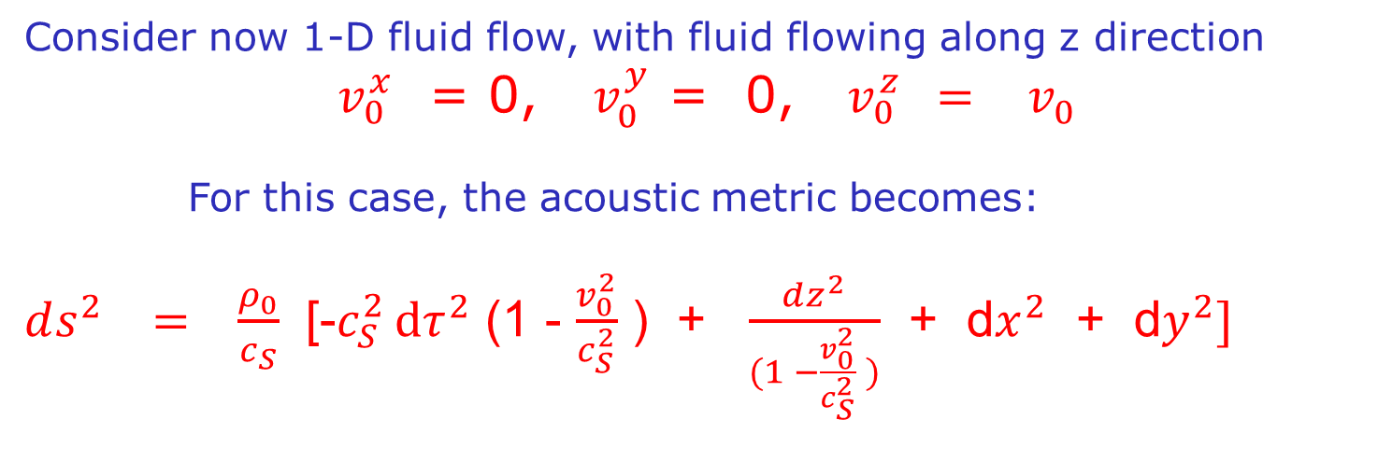
Consider now 1-D fluid flow, with fluid flowing along z direction
${ v}_{0}^{x}$ = 0, $v_{0}^{y}$ = 0, ${ v}_{0}^{z}$ $=$ $v_{0}^{}$
For this case, the acoustic metric becomes:
$ds^{2} = \frac{ρ_{0}}{c_{S}}$ [-$c_{S}^{2 }dτ^{2}$ (1 - $\frac{v_{0}^{2}}{c_{S}^{2}}$ ) + $\frac{dz^{2}}{(1 −\frac{v_{0}^{2}}{c_{S}^{2}} )}$ + d$x^{2}$ + d$y^{2}]$
Horizon occurs at z = z_{H} where fluid velocity becomes supersonic
Hawking radiation (consisting of quanta of velocity perturbations)
will be emitted from this event-horizon, in the sub-sonic region.
Asymptotic observer will be located where fluid velocity v₀ = 0
(Asymptotically Flat space-time metric).
This observer will see thermal radiation with the Black Hole
temperature corresponding to this metric

Slide 15
Important:
Hawking radiation arises from pair production,
The partner particle of the Hawking radiation are absorbed inside
a black hole
Hence can never be observed for standard black holes
(Interior of a black hole is inaccessible to the outside observers)
Situation is completely different for Acoustic Black holes
Here, the Hawking partners are swept in the supersonic regime.
This is fully accessible to observations.
Remarkable possibility of observing correlations of Hawking partners
May shed light on conceptual issues relating to black hole evaporation

Slide 16
Observation of acoustic Hawking radiation in an atomic Bose-Einstein condensate, J. Steinhauer, Nat. Phys. 12 (2016) 959

Slide 17
Acoustic black holes in relativistic heavy-ion collisions
Arpan Das, Shreyansh S. Dave, Oindrila Ganguly, AMS, PLB 817 (2021) 136294
Longitudinal expanding plasma (exaggerated longitudinal scale shown)
supersonic
plasma flow
subsonic
plasma flow
V_{z} = c_{S}
V_{z} = c_{S}
Recall: Asymptotic observer
is located where fluid velocity
is zero. Here it is at z = 0
subsonic
plasma flow
supersonic
plasma flow

Slide 18
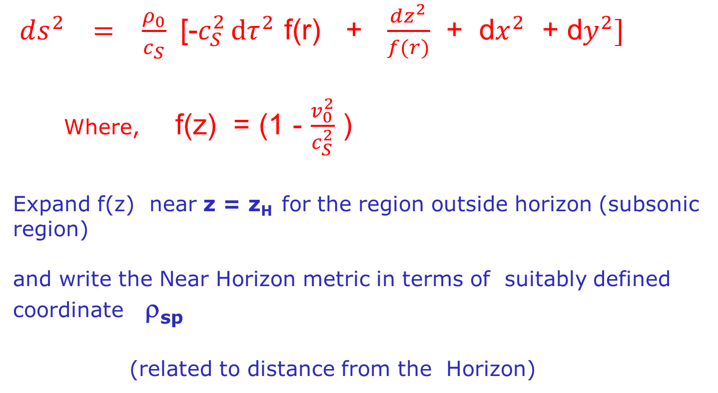
Hawking Temperature for the acoustic black hole:
Recall, acoustic metric for 1-D flow with fluid flow on z axis
$ds^{2} = \frac{ρ_{0}}{c_{S}}$ [-$c_{S}^{2 }dτ^{2}$ f(r) + $\frac{dz^{2}}{f(r)}$ + d$x^{2}$ + d$y^{2}]$
Where, f(z) = (1 - $\frac{v_{0}^{2}}{c_{S}^{2}}$ )
Expand f(z) near z = z_{H} for the region outside horizon (subsonic region)
and write the Near Horizon metric in terms of suitably defined coordinate ρ_{sp}
(related to distance from the Horizon)
Resulting Near Horizon metric has the following form:

Slide 19
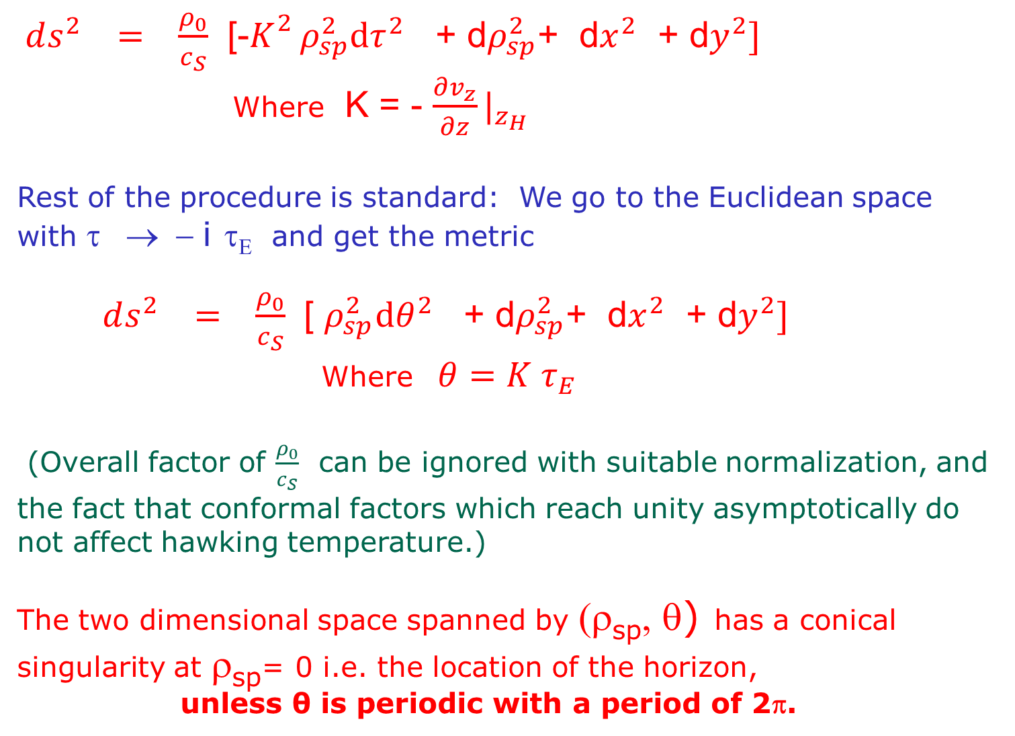
$ds^{2} = \frac{ρ_{0}}{c_{S}}$ [-$K_{}^{2 }ρ_{sp}^{2}dτ^{2}$ + d$ρ_{sp}^{2}$+ d$x^{2}$ + d$y^{2}]$
Where K = - $\frac{∂v_{z}}{∂z}|_{z_{H}}$
Rest of the procedure is standard: We go to the Euclidean space
with τ → − i τ_{Ε} and get the metric
$ds^{2} = \frac{ρ_{0}}{c_{S}}$ [ $ρ_{sp}^{2}dθ^{2}$ + d$ρ_{sp}^{2}$+ d$x^{2}$ + d$y^{2}]$
Where $θ=K τ_{E}$
(Overall factor of $\frac{ρ_{0}}{c_{S}}$ can be ignored with suitable normalization, and the fact that conformal factors which reach unity asymptotically do not affect hawking temperature.)
The two dimensional space spanned by (ρ_{sp}, θ) has a conical singularity at ρ_{sp}= 0 i.e. the location of the horizon,
unless θ is periodic with a period of 2π.

Slide 20
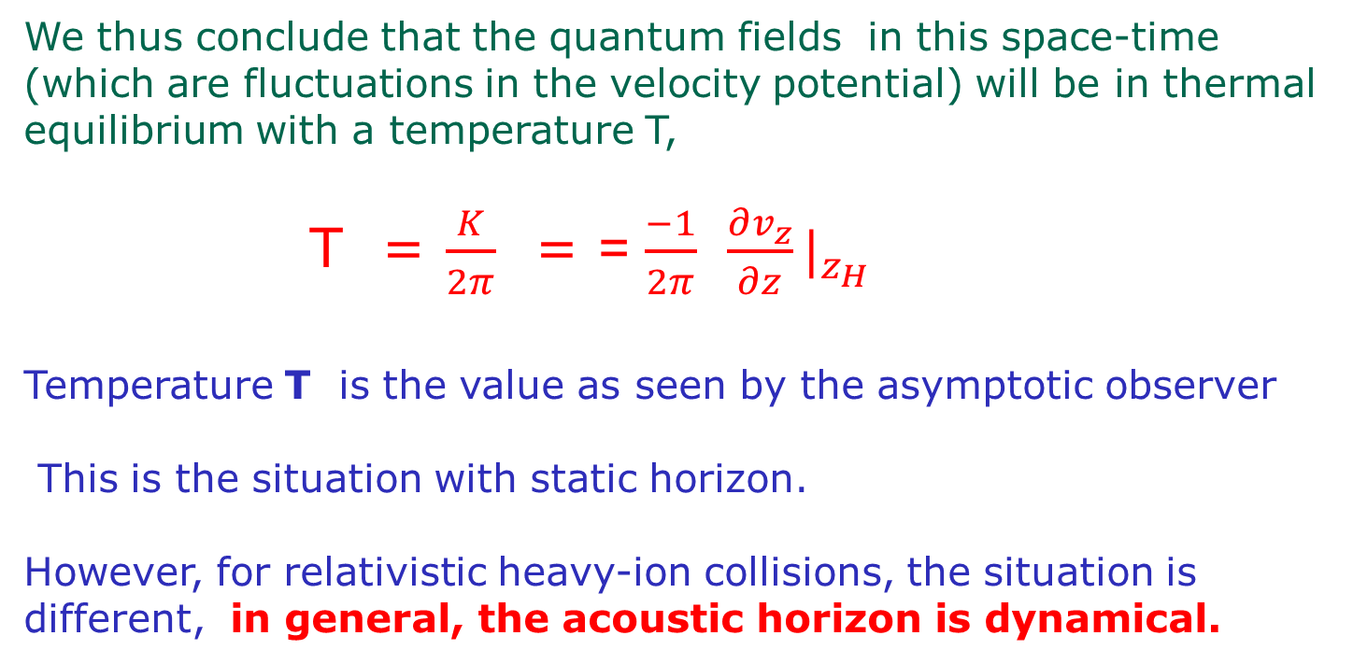
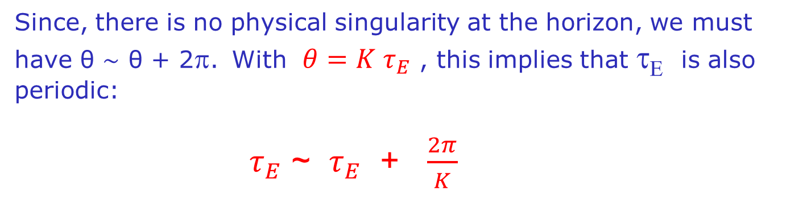
Since, there is no physical singularity at the horizon, we must have θ ∼ θ + 2π. With $θ=K τ_{E}$ , this implies that τ_{Ε} is also periodic:
$τ_{E}$ ~ $τ_{E}$ + $\frac{2π}{K}$
We thus conclude that the quantum fields in this space-time (which are fluctuations in the velocity potential) will be in thermal equilibrium with a temperature T,
T = $\frac{K}{2π}$ = = $\frac{−1}{2π}$ $\frac{∂v_{z}}{∂z}|_{z_{H}}$
Temperature T is the value as seen by the asymptotic observer
This is the situation with static horizon.
However, for relativistic heavy-ion collisions, the situation is
different, in general, the acoustic horizon is dynamical.

Slide 21
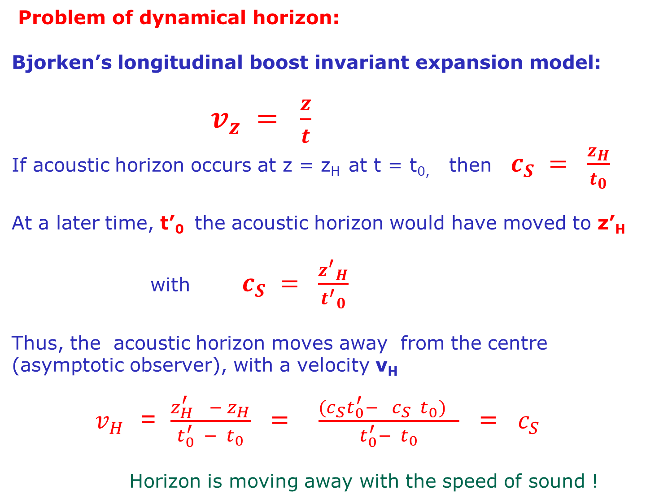
Problem of dynamical horizon:
Bjorken’s longitudinal boost invariant expansion model:
$v_{z} = \frac{z}{t}$
If acoustic horizon occurs at z = z_{H} at t = t_{0,} then $c_{S} = \frac{z_{H}}{t_{0}}$
At a later time, t’₀ the acoustic horizon would have moved to z’_{H}
with $c_{S} = \frac{{z^{′}}_{H}}{{t^{′}}_{0}}$
Thus, the acoustic horizon moves away from the centre (asymptotic observer), with a velocity v_{H}
$v_{H }$ = $\frac{z_{H }^{′} − z_{H}}{t_{0}^{′} − t_{0}}$ = $\frac{(c_{S}t_{0}^{′}− c_{S} t_{0}) }{t_{0}^{′}− t_{0}}$ = $c_{S}$
Horizon is moving away with the speed of sound !

Slide 22
Hawking radiation with evolving horizon
Deep conceptual issues
There has been some previous work on slowly evolving horizon.
But the acoustic horizon in QGP is not slowly evolving.
Intuitively one may expect that a horizon receding away from the asymptotic observer should lead to red-shifted Hawking radiation
while a horizon moving towards the observer will lead to blue shifted radiation.
For Bjorken scaling expansion, horizon moves away from the
Asymptotic observer (located at z = 0) with speed of sound
(which replaces speed of light in the black hole metric)
Thus, Hawking radiation will be red shifted, with infinite Red-shift.
It will be unobservable.

Slide 23
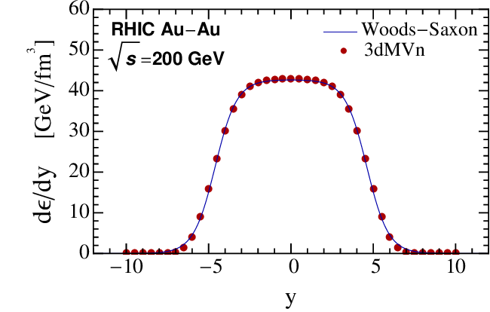
Deviation from Bjorken scaling expansion:
Bjorken’s scaling expansion model is not strictly valid for the
entire plasma region.
For large rapidity regions, especially near the receding nuclei,
One expects significant deviations from the scaling law due to
non-trivial gradients of energy density and pressure.

Slide 24
Note:
Acoustic horizon moves away from centre as the plasma
expansion at a given location slows down with time.
Energy density gradients can accelerate the fluid, and compensate
for the expansion slow down.
This can make horizon velocity smaller than sound velocity
leading to finite red-shift of the radiation temperature.
In specific conditions, one can make the horizon static,
In that case, standard black hole temperature will be observable.

Slide 25
UrQMD analysis:
Au-Au central collisions with laboratory energy of 10.7 GeV
Hadronic system, we only consider nucleons. Local plasma velocity is determined by the condition that distribution functions should be isotropic.
Sound speed for this system taken from literature c_{S} = 0.35
(assumed constant for
The relevant time period)
For t ~ 9 – 11 fm,
Horizon is almost
static at z ~ 2.5
We calculate
Velocity derivative
Here to get
Hawking temperature
v^{z} = c_{S}
z

Slide 26
Interesting dynamics of the Acoustic Horizon:
v^{z} = c_{S}
For t ~ 6 – 9 fm: Horizon moves towards center (asymptotic observer)
Hawking radiation will be Blue-shifted
For t ~ 9 – 11 fm: Horizon is almost static at z ~ 2.5 .
Standard Hawking temperature will be observed
For t ~ 11- 13 fm: Horizon moves away from center, but with sub-sonic
velocity: Hawking radiation will be Red-shifted

Slide 27
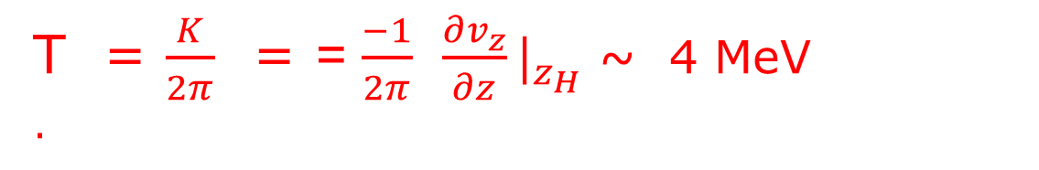
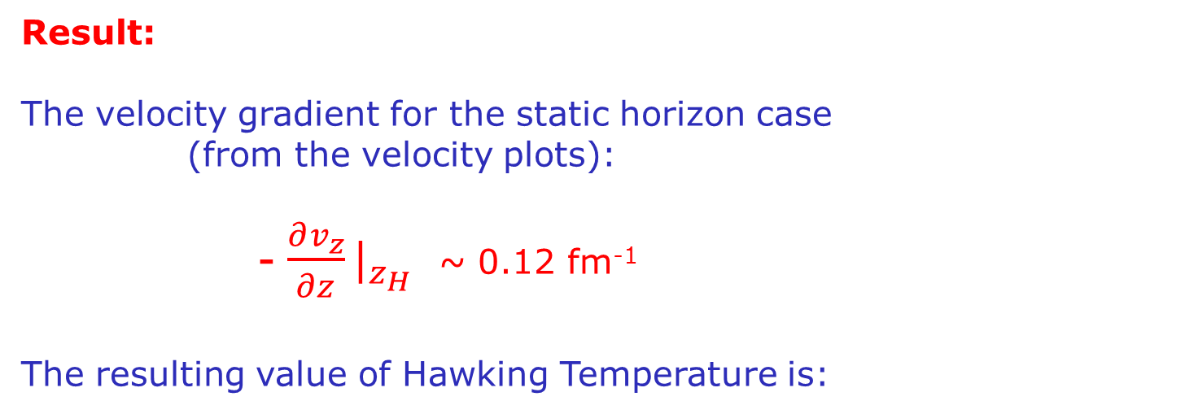
Result:
The velocity gradient for the static horizon case
(from the velocity plots):
- $\frac{∂v_{z}}{∂z}|_{z_{H}}$ ~ 0.12 fm⁻¹
The resulting value of Hawking Temperature is:
T = $\frac{K}{2π}$ = = $\frac{−1}{2π}$ $\frac{∂v_{z}}{∂z}|_{z_{H }}$~ 4 MeV
.
The background plasma temperature during this period
was about 135 MeV.
Will be very difficult to observe its signal.

Slide 28
Observable:
Recall: Relevant scalar field here is fluctuations of fluid velocity
potential.
Hawking radiation will consist of quanta of this scalar field
This will translate to perturbations in the rapidity of particles
Emanating from the region near the acoustic horizon,
This has to be compared to rapidity distributions of particles
coming from other regions.
The Signal of the Hawking radiation:
Anomalous fluctuations in momentum distributions as function
of rapidity near specific rapidity windows (close to horizon).
Hawking pair correlations: Correlated fluctuations in rapidity
Distributions on the two sides of the acoustic horizon.

Slide 29
Note: Relativistic heavy-ion collisions are the only relativistic
systems in lab where analogue black holes can be probed
Our set up so far has used non-relativistic hydrodynamics
equations.
For fluid velocities we have used with c_{S} ~ 0.35,
So, relativistic corrections will not be large.
For equation of state, we only use the condition that it is
barotropic.
However, for such low energy heavy-ion collisions, velocity gradients are small, leading to small Hawking temperature.
Expect much larger values for ultra-relativistic case, with larger
speed of sound, and larger velocity gradients.
Acoustic metric with Relativistic fluid equations may give
Large Hawking temperature for suitably chosen collisions.

Slide 30
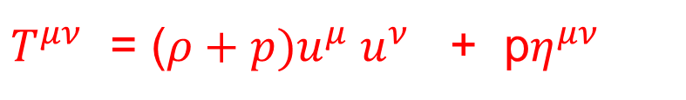
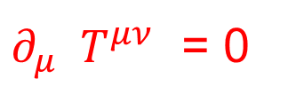
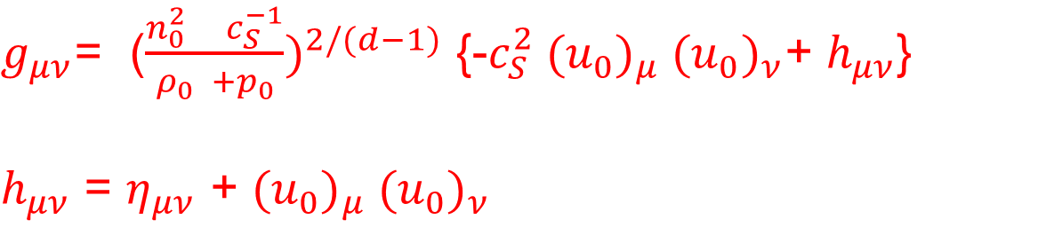
Acoustic metric for relativistic case:
Starting with ideal relativistic hydro equations:
${ ∂_{μ} T}^{μν}$ = 0
${ T}^{μν}$ = ($ρ+p)u^{μ} u^{ν}$ + p$η^{μν}$
Following similar steps as earlier, one can derive the acoustic
metric for the relevant velocity potential (in (d+1) dimensions):
(M. Visser and C.M. Paris, arXiv: 1001.1310)
$g_{μν}$= ($\frac{n_{0 }^{2 }c_{S}^{−1}}{ρ_{0} +p_{0}})^{2/(d−1)}$ {-$c_{S}^{2} ({u_{0})}_{μ} {(u_{0})}_{ν}$+ $h_{μν}$}
$h_{μν}$ = $η_{μν}$ + $({u_{0})}_{μ} {(u_{0})}_{ν}$
n₀ is the background number density (e.g. baryon number).
(ρ_{0,} p₀ ) are the background (energy density, pressure) of the fluid.

Slide 31
Work in progress:
Suitable 4-velocity profiles to give a black hole metric
for the ultra-relativistic case
Find appropriate energy density profile for ultra-relativistic
collision (suitable nuclei, centrality) to give slowly
moving acoustic horizon.
Along with large velocity gradient near acoustic horizon
to give large Hawking radiation.

Slide 32
Acoustic black holes in hydrodynamical flow of electrons
Shreyansh S. Dave, Oindrila Ganguly, Saumia P. S., AMS, EPL 139, 60003 (2022)
Possibility of electron hydrodynamics was first proposed by Gurzhi (1963) for a system where electron-electron scattering dominates over non-momentum conserving scattering of electrons, e.g. with impurities and with phonons.
Hydrodynamical flow of electrons believed to have been achieved
In a 2-dimensional electron gas in high mobility heterostructures (e.g. (Al,Ga)As heterostructures) ,
in Graphene (with relativistic hydrodynamics for Dirac electrons)
as well as in Dirac and Weyl semimetals in 3-dimensions.
We consider such a quasi 2-d system, with de Laval geometry allowing electron hydrodynamical flow to become supersonic

Slide 33
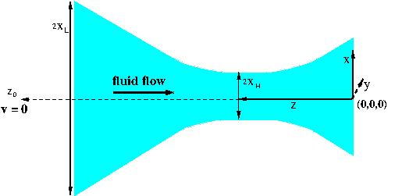
Quasi 2-D sample with de Laval geometry
Velocity gradient here depends on the curvature of the
Boundary at the Location of the acoustic horizon.
For typical values of a 2-d sample, we estimated value
of resulting Hawking temperature T ~ 0.6 K

Slide 34
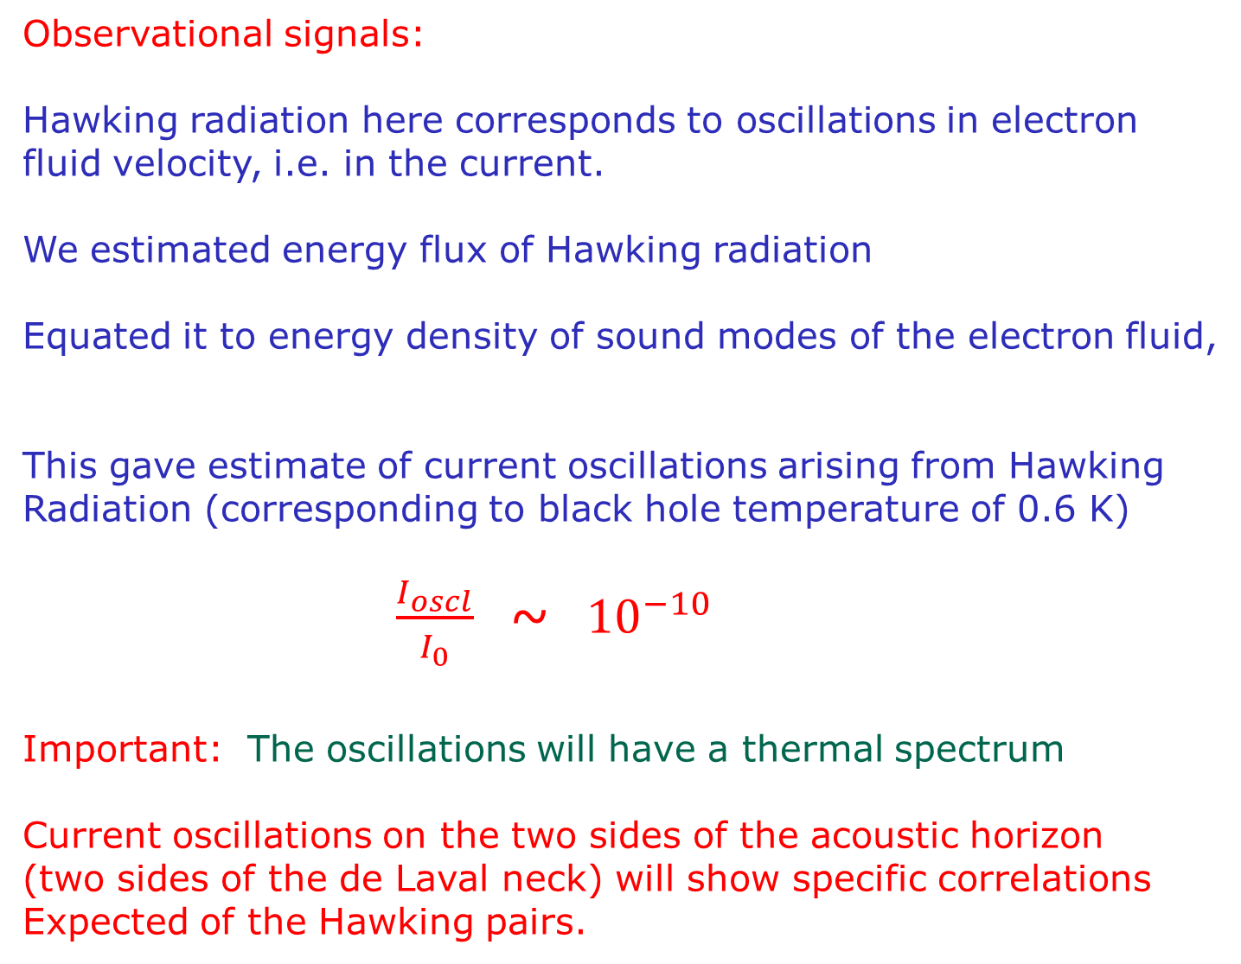
Observational signals:
Hawking radiation here corresponds to oscillations in electron
fluid velocity, i.e. in the current.
We estimated energy flux of Hawking radiation
Equated it to energy density of sound modes of the electron fluid,
This gave estimate of current oscillations arising from Hawking
Radiation (corresponding to black hole temperature of 0.6 K)
$\frac{I_{oscl}}{I_{0}}$ ~ ${10}^{−10}$
Important: The oscillations will have a thermal spectrum
Current oscillations on the two sides of the acoustic horizon
(two sides of the de Laval neck) will show specific correlations
Expected of the Hawking pairs.

Slide 35
THANK YOU

