Slide 1
Studying the QCD Phase diagram using Conserved Number distributions in high energy collisions
QCD Phase Diagram
Experimental Measurement
Physics issues which can be addressed
Conclusion
Bedangadas Mohanty, VECC, Kolkata
CPOD 2011, Wuhan

Slide 2
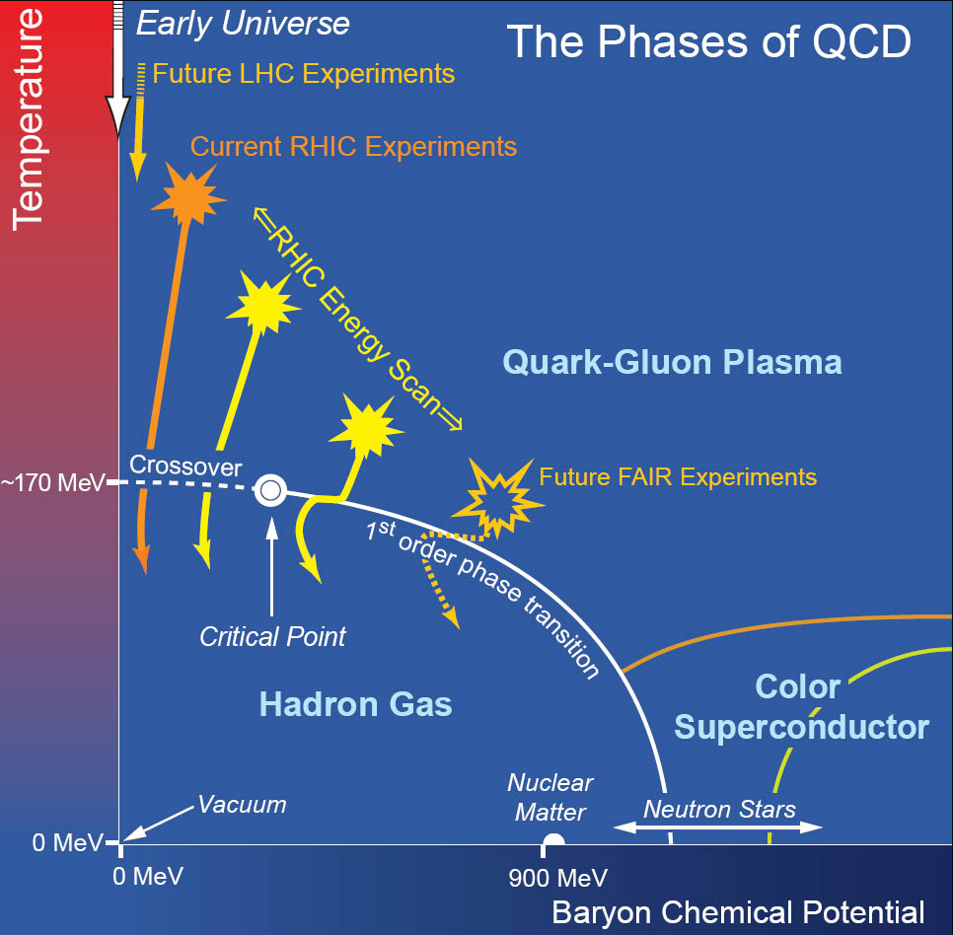
QCD Phase Diagram
Physical systems undergo phase transitions when external parameters such as the temperature (T) or a chemical potential (μ) are tuned.
Conserved Quantities:
Baryon Number ~ μ_{Β}
Electric Charge ~ μ_{Q} ~ small
Strangeness ~ μ_{S} ~ small
Signals for phase transition/phase boundary
Search for Critical Point
Scale of phase diagram/Test of QCD
Test of thermal model calculations

Slide 3
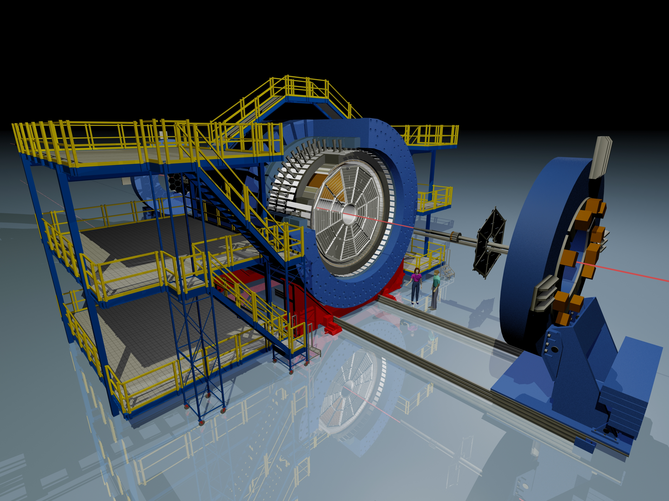
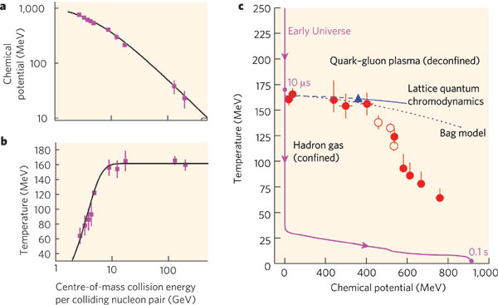
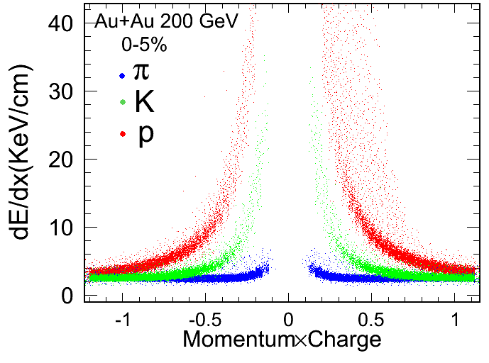
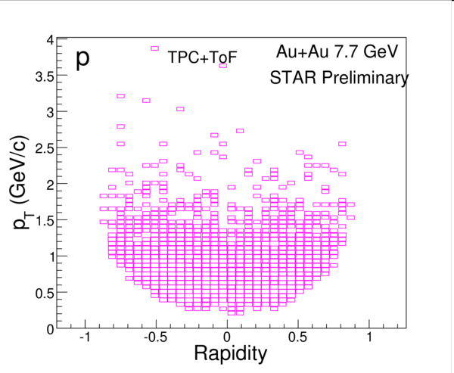
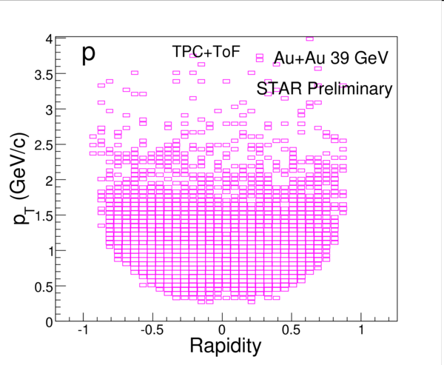
Experiment
Typical Experiment - STAR
TOF
TPC
Nature 448:302-309,2007
Proton identification
Uniform Acceptance
Varying beam energy varies Temperature and Baryon Chemical Potential

Slide 4
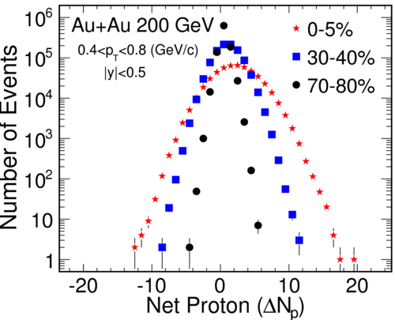
Net-proton number distributions
Typical net-proton distributions
Shape of distribution ~ higher order
correlations
Moments relates to Correlation length (ξ):
Study phase transition and Critical Point
< (δN)²> ~ ξ²
< (δN)³> ~ ξ^{4.5}
< (δN)⁴> - 3 < (δN)²>² ~ ξ⁷
Moments relates to Susceptibility (χ) :
Study Bulk properties of QCD matter
Kurtosis x Variance ~ χ⁽⁴⁾/ [χ⁽²⁾ T²]
Skewness x Sigma ~ [χ⁽³⁾ T]/ [χ⁽²⁾ T²]
Product of moments cancel volume effect

Slide 5
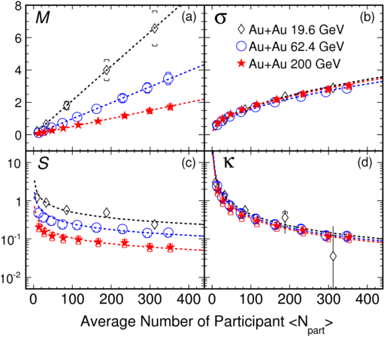
Moments of net-proton distribution
Moments:
Central Limit Theorem:
M_{i} = CM_{x} <N_{part}>_{I}
σ²_{i} = C σ²_{x} <N_{part}>_{I}
S_{i} = S_{x}/√ [ C <N_{part}>]_{I}
κ_{i} = κ_{x}/ [ C <N_{part}>]_{I}
Breakdown of CLT trends could indicate
Critical Point Like physics effect

Slide 6
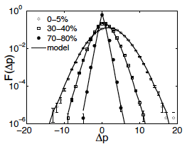
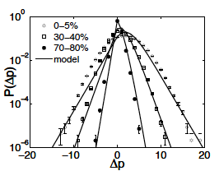
Net-Proton dist. – Baryon sources
C.B. Yang and in Wang - arXiv: 1107.4740
Multiple emission source
Model based on:
Baryon Stopping (initial state)
Baryon pair production (final state)
Single emission source
No assumption of thermal equilibrium
and critical fluctuations

Slide 7
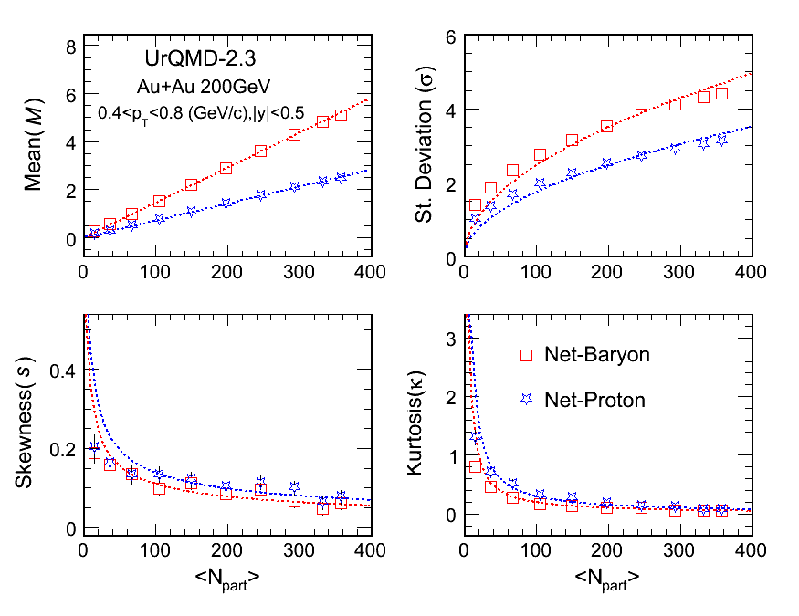
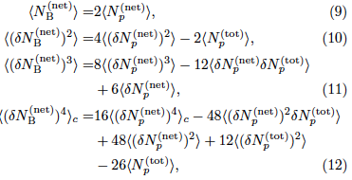
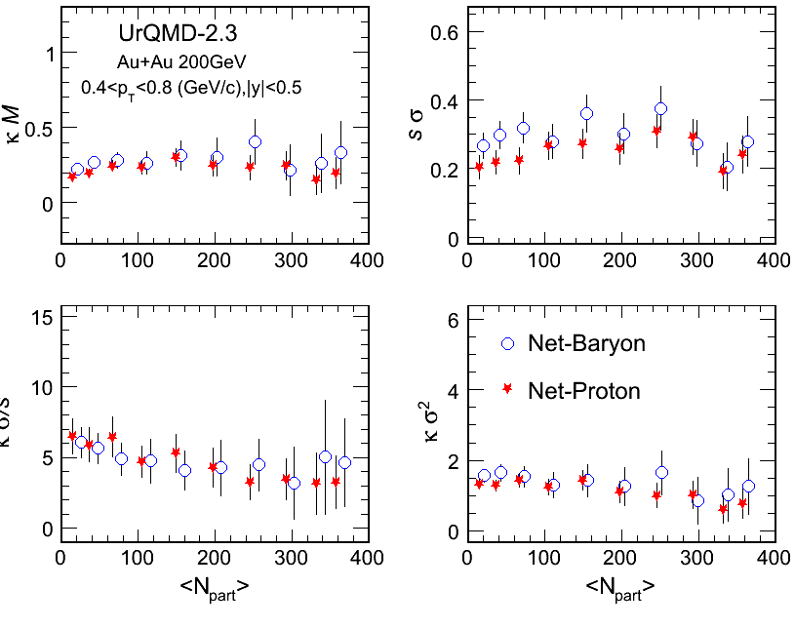
Other Baryons
M. Kitazawa and M. Asakawa – arXiv: 1107.2755
UrQMD
Proton number fluctuations modified in hadron phase
Isospin distribution of nucleons binomial
Individual
Moments
change
Products of
Moments
similar

Slide 8
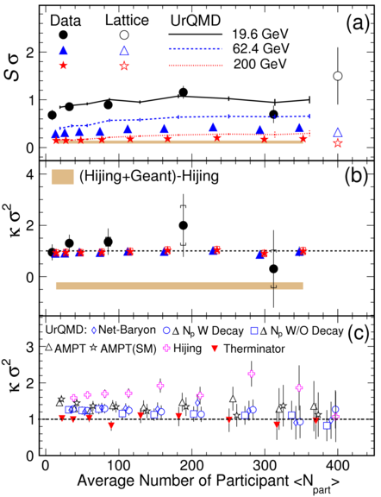
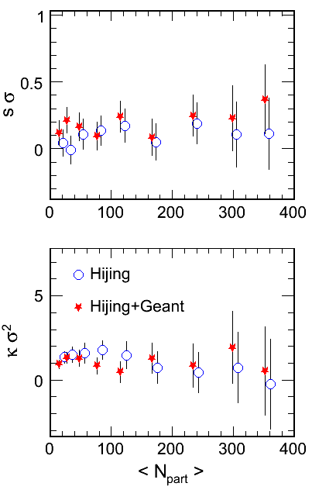
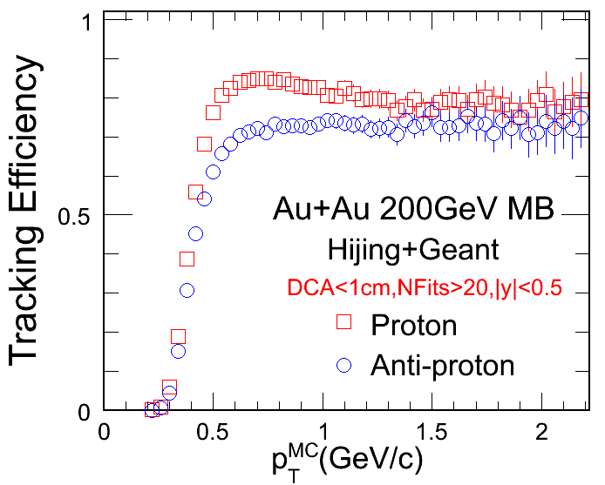
Proton detection efficiency
HIJING through STAR detector response
Typical efficiency
Cannot be corrected event-by-event
Estimated to be small on distribution shape through realistic simulations

Slide 9
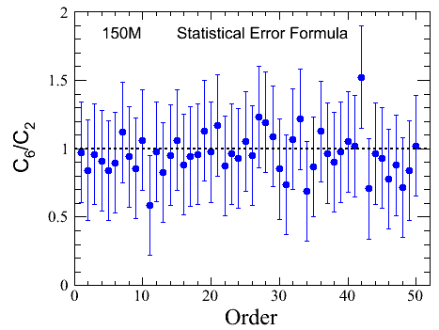
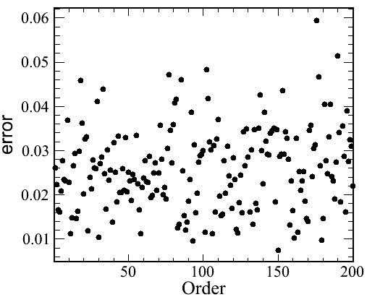
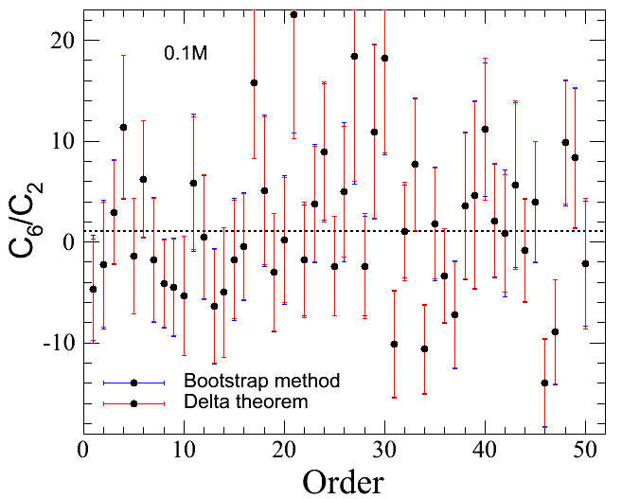
Statistical Errors
Error formula
Sub group method
Bootstrap/Delta theorem method
Over estimates
Large fluctuations
Correct value
Simulations: Net proton distribution is Skellam, with average number of protons = 4
And average number of anti-protons = 3

Slide 10
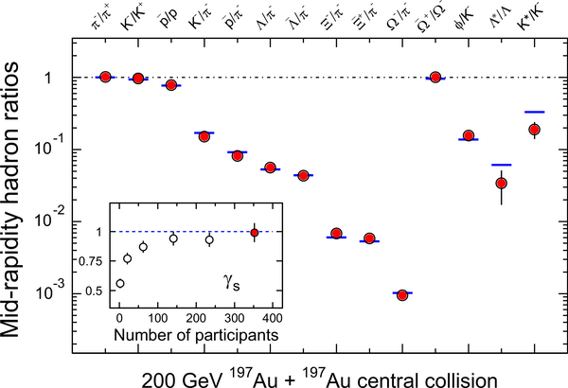
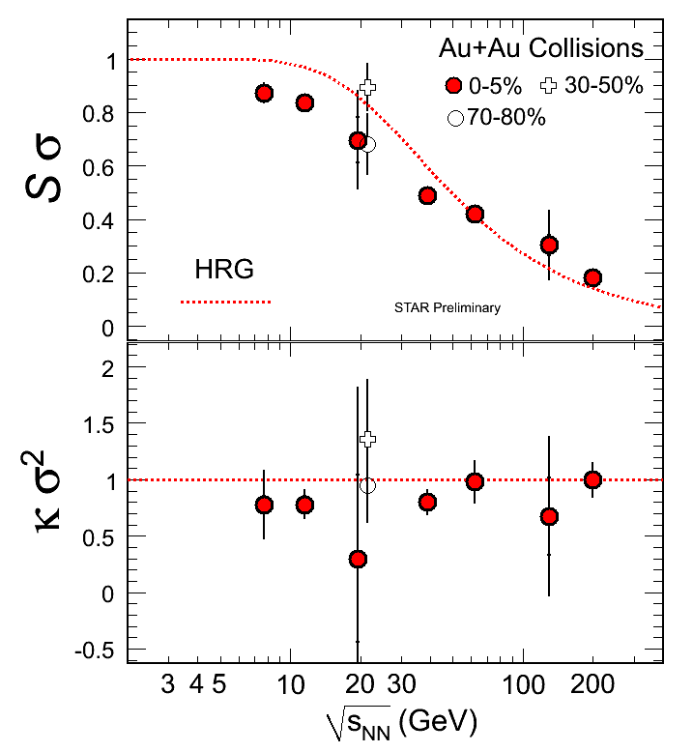

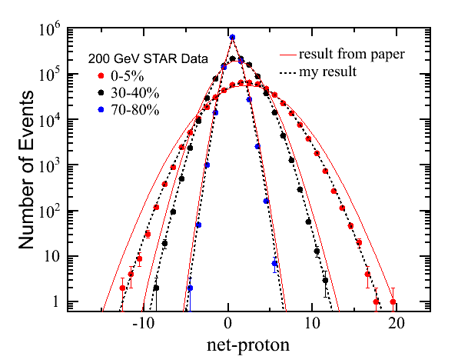

Fluctuations and Hadron Resonance Gas Model
Success of Thermal model
STAR:
NPA 757, 102 (2005)
Higher order correlations
a test of hadron resonance gas model
arXiv: 1107.4267

Slide 11
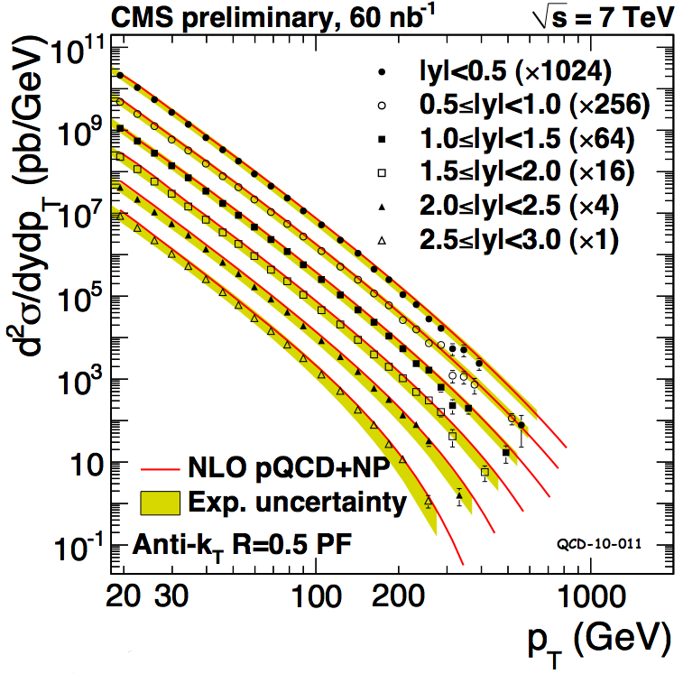
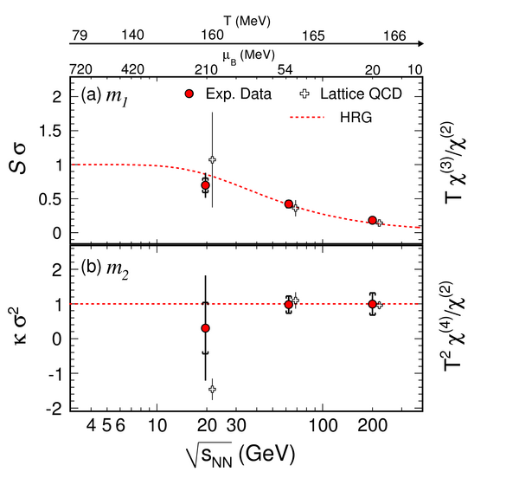
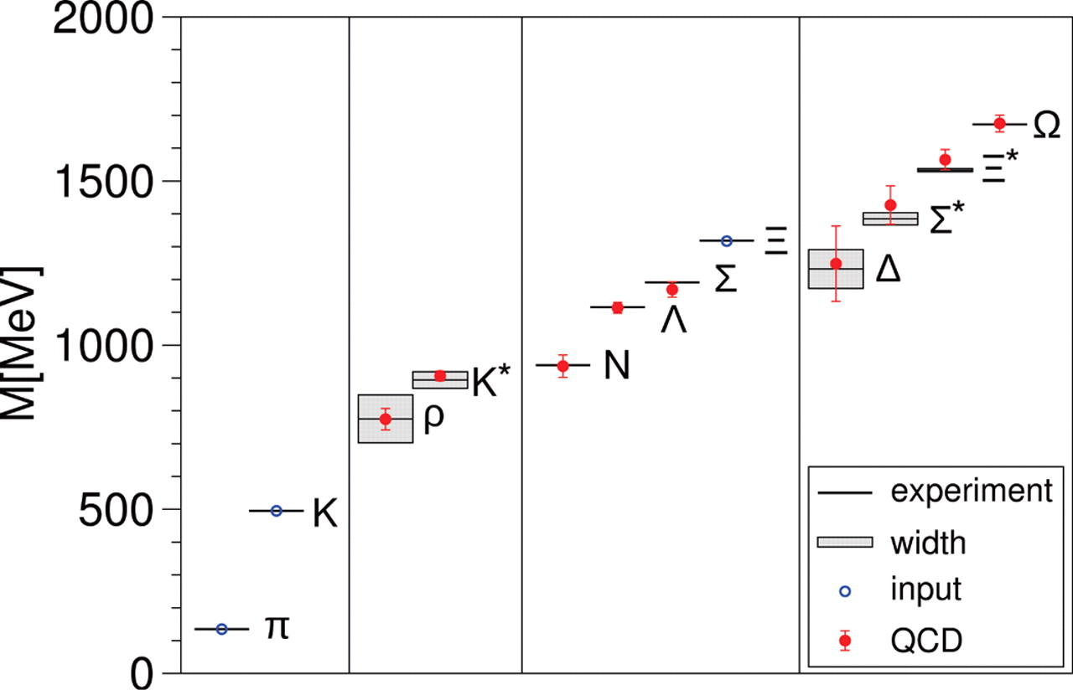
Fluctuations and test of QCD
Short distance
Non-perturbative regime
Long-distance
perturbative regime
Higher order correlations a test of
thermodynamics of bulk strongly interacting matter

Slide 12
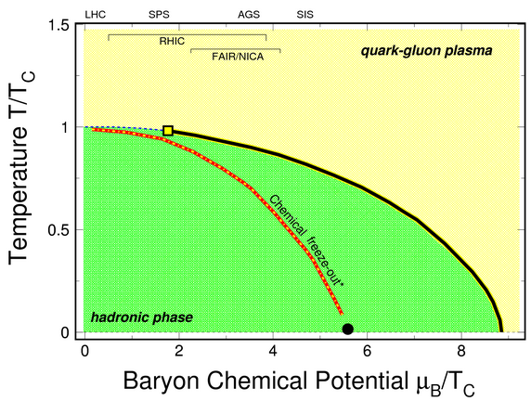
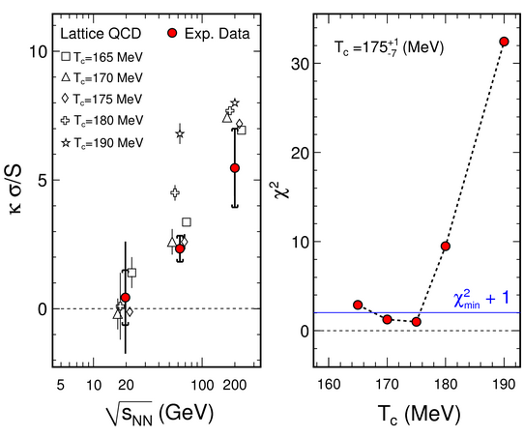
Fluctuations and Scale of Phase diagram
T_{c} sets the scale of the QCD phase diagram

Slide 13
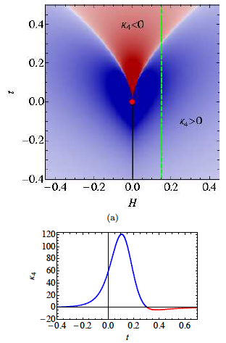
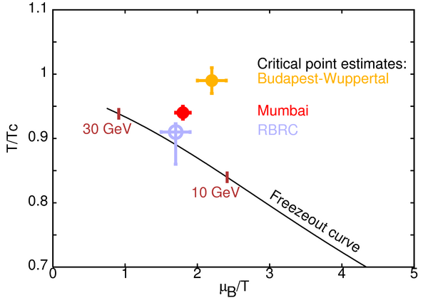
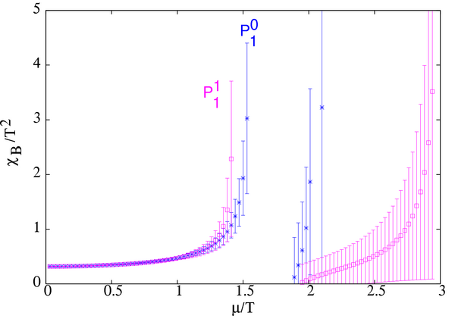
Fluctuations and Critical Point
Kurtosis could be negative
Current positive results on Lattice
Expect susceptibilities to diverge
S. Gupta
Critical point:
Enhanced fluctuations
Non-monotonic variations as a function of
beam energy

Slide 14
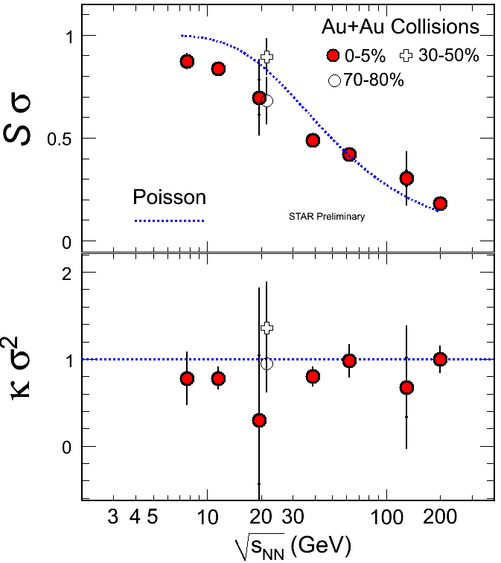
Fluctuations and Critical Point
Deviation from Poissionian
expectations for third moments
Important to have precise results
in the energy range of 15 – 30 GeV

Slide 15
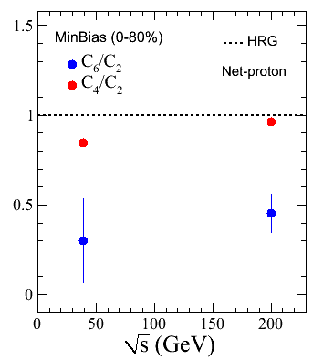
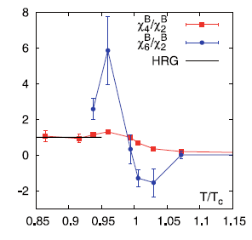
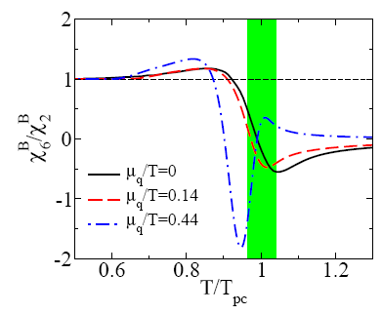
Fluctuations and Phase Transition
Deviation from HRG if freeze-out curve close to
Phase Boundary/Cross over line
STAR Data
Polyakov loop extended
Quark Meson Model
Lattice QCD
Chiral phase transition
STAR Preliminary
Deviation from HRG increases as
beam energy decreases
Cheng et al, Phys.Rev. D79 (2009) 074505

Slide 16
Conclusions
Contribution to QCD and phase diagram
Non-perturbative QCD tests
Scale of QCD phase diagram
Search for Critical Point
Search for Signals of Phase Transition
Test of Hadron Resonance Gas Model
Test of QCD based models
Thermalization in heavy-ion collisions
Baryon production in heavy-ion collisions

Slide 17
Outlook
Theory:
More realistic Lattice QCD calculations
Transverse momentum dependence
Know separately contribution from Quantum statistics
Know separately effect of baryon number conservation
Experiment:
Net-charge studies
Complete study on net-protons in BES program
Do we need data at 15 GeV ?
LHC results

