Slide 1


Measurements of global polarization of hyperons and spin alignment of vector mesons with ALICE at the LHC
Bedanga Mohanty (For the ALICE collaboration)
National Institute of Science Education and Research, INDIA
17th International Conference on Strangeness in Quark Matter
Universiteit Utrecht, Netherlands, 10-15 July, 2017

Slide 2
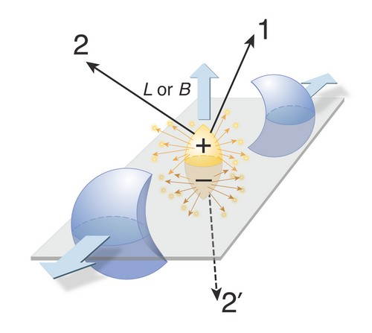
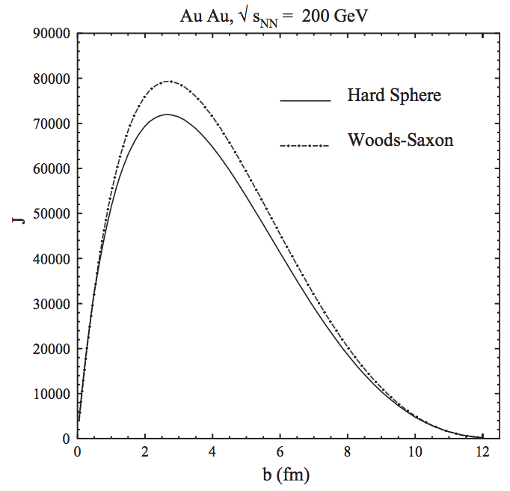
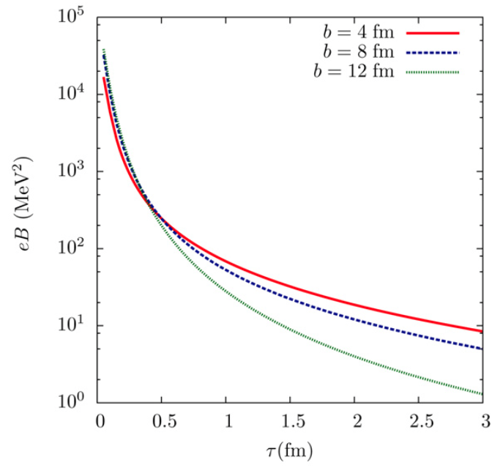
Initial conditions in heavy-ion collisions
F. Becattini, F. Piccinini and J. Rizzo
Phys.Rev.C 77, 024906 (2008)
D. E. Kharzeev, L. D. McLerran
and H.J. Warringa
Nucl.Phys.A 803, 227 (2008)
Large angular momentum
(conserved quantity)
Large magnetic field
Goal: Look for signature of these in measurements
M²_{π} ~ 2 x 10⁴ MeV² ~ 3 x 10¹⁴ Tesla ~ 3 x 10¹⁸ Gauss

Slide 3
Angular distribution of vector mesons and hyperons
K^{*0} Vector meson
Mass: 896 MeV/c²
Lifetime: 1.38 × 10⁻²³ s
Spin: 1
Decays to K⁺ and π⁻ (Β.R – 66.6%)
Quark content (d,sbar)
Quantization axis
θ*
K⁺
K^{*0}
π⁻
Beam axis
K. Schilling, P. Seyboth and G. Wolf, Nucl. Phys. B 15, 397 (1970)
Quantization axis
Normal to production plane
Normal to reaction plane
ρ₀₀ = Element of spin density matrix
= 1/3 → No spin alignment
Λ Hyperon
Mass: 1115 MeV/c²
Lifetime: 2.632 × 10⁻¹⁰ s
Spin: 1/2
Decays to p and π⁻ (Β.R – 63.9%)
Quark content (u,d,s)
STAR: Phys.Rev.C 76, 024915 (2007)
|Ρ_{H}| → Polarization
= 0 → No polarization
α_{H} → Decay parameter

Slide 4
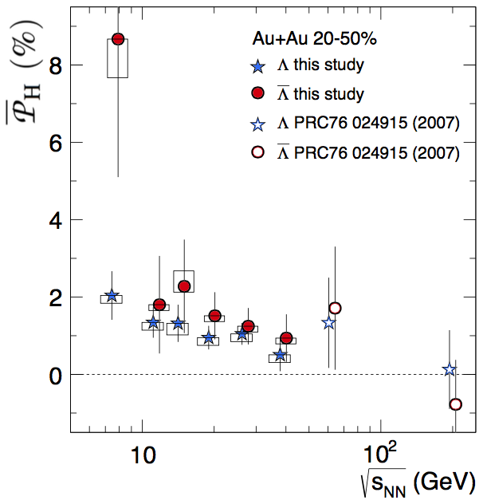
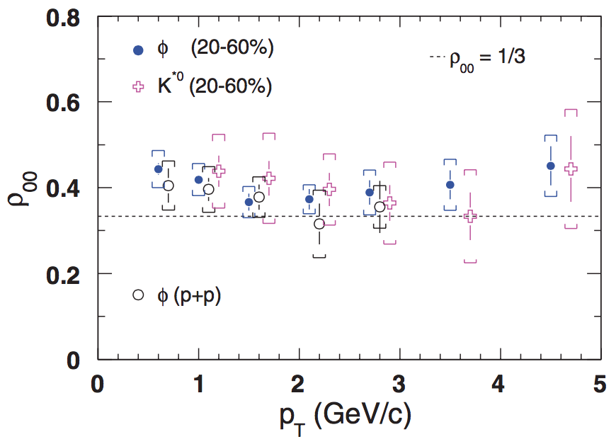
Global polarization and spin alignment results at RHIC
All results from the STAR Experiment
Au+Au, 200 GeV
STAR: Phys.Rev. C77 (2008) 061902
STAR: arXiv: 1701.06657
Global Λ hyperon polarization
Results w.r.t event plane
Spin alignment of vector mesons
Results w.r.t production plane

Slide 5
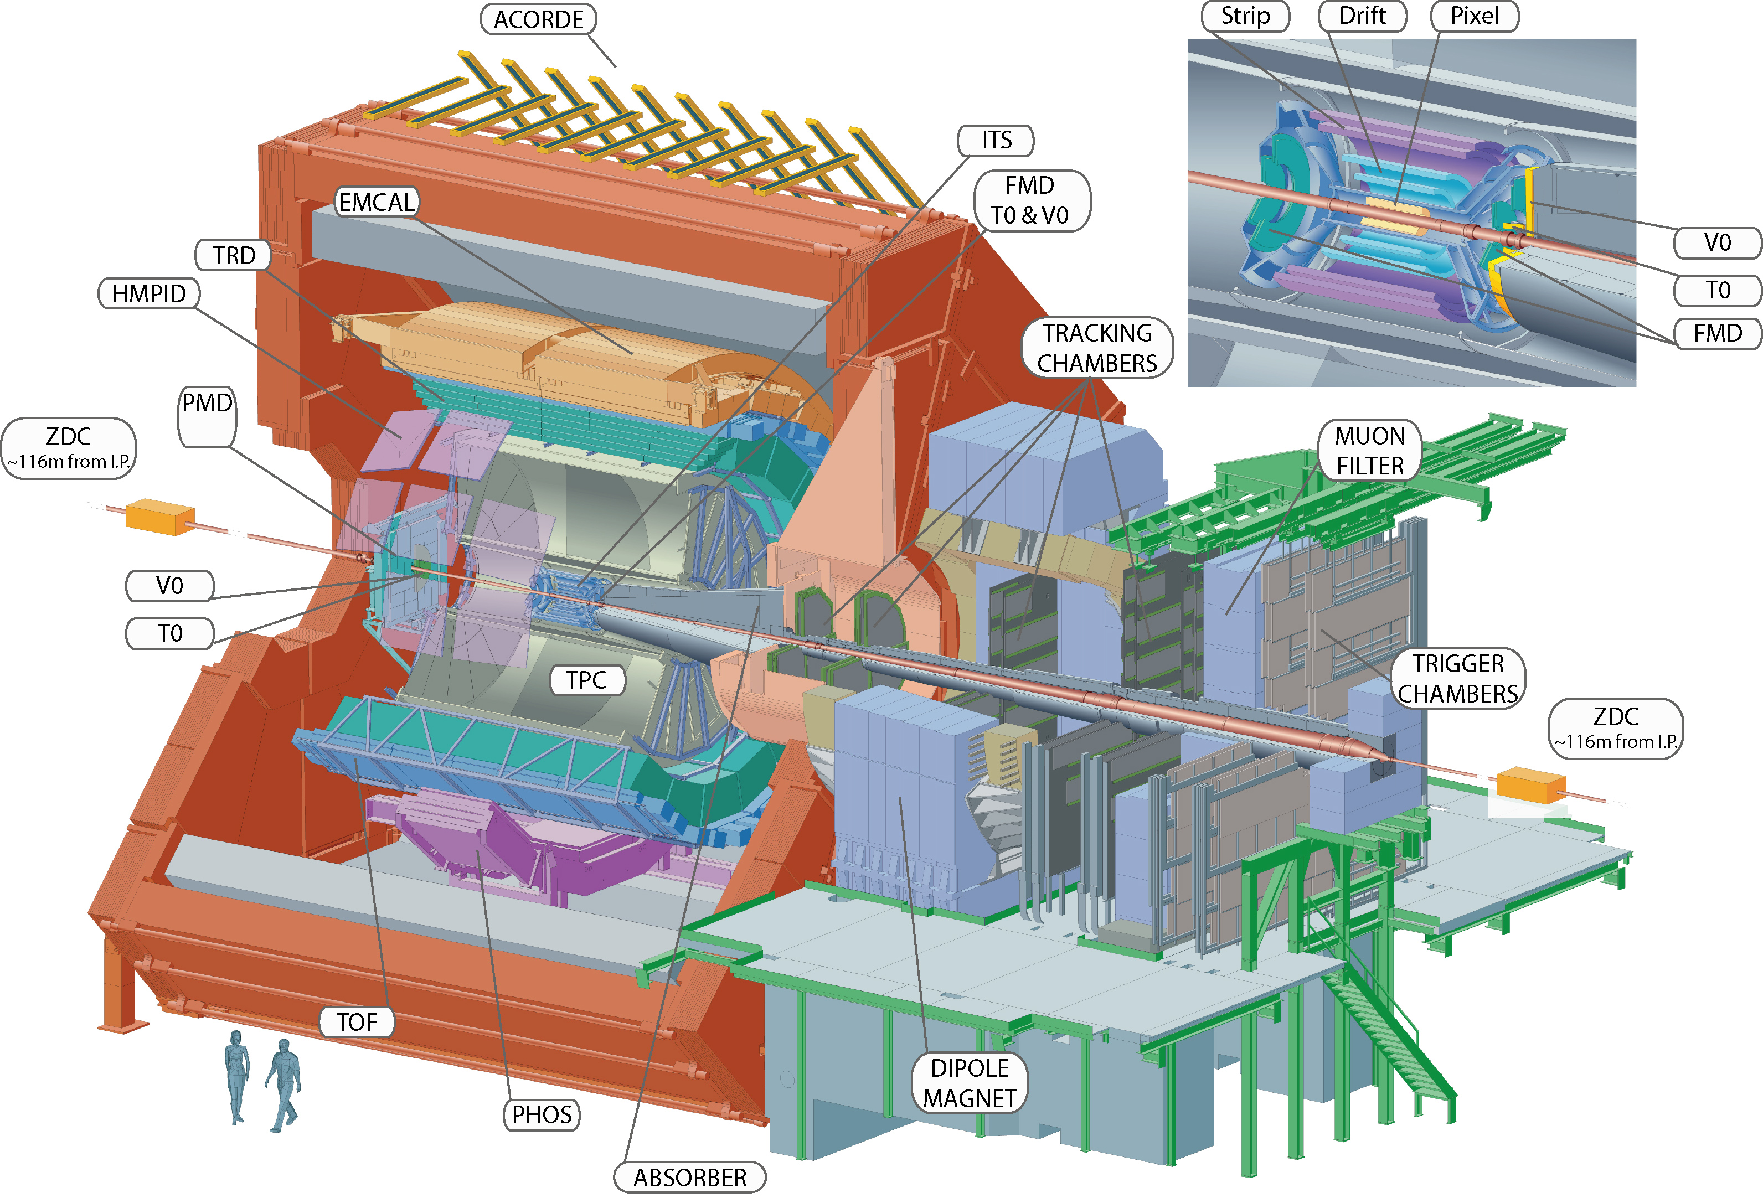
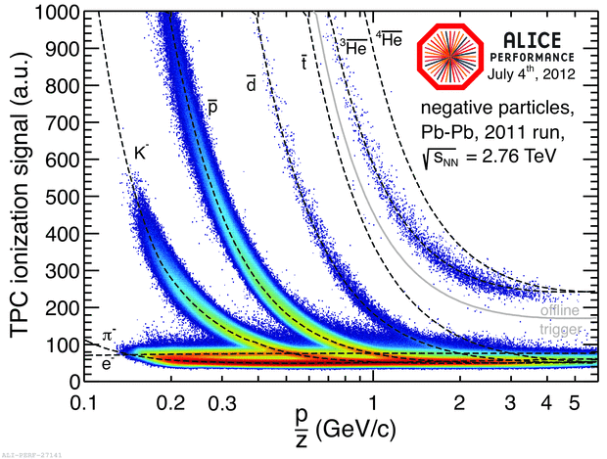
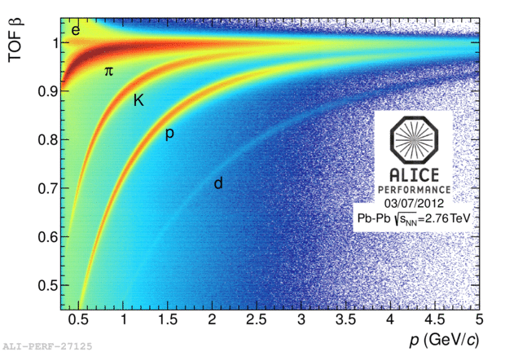
ALICE detector
TPC : |η| < 0.9
Tracking and particle
identification
V0 : −3.7 < η < −1.7
and 2.8 < η < 5.1
Trigger and event centrality
ZDC : |η| > 8.7
Event plane estimation
Time of Flight :|η| < 0.9
Particle identification
ALICE: Int. J. Mod. Phys. A 29 1430044 (2014)

Slide 6
Global polarization of Λ hyperon

Slide 7



Data set and analysis
Collision system and energy | Pb-Pb and 2.76 TeV
Rapidity | +/- 0.5
No. of events | ~49 M
Collision centrality | 5-15% , 15-50%
Hadrons | Λ-hyperons
Background | Side bands
Quantization axis | First order event plane from ZDC
Measurement observable
Angles are of daughter proton in rest frame of hyperon
Component perpendicular to reaction plane and averaged over all events
Statistical uncertainty
Event plane using the two neutron ZDCs

Slide 8
Signal extraction and EP resolution
M_{inv} distribution and
background distribution
Fit distribution
P_{H} is the polarization signal
Event plane resolution ~ 0.39 (Max)

Slide 9


Hyperon polarization measurements: p_{T} dependence
p_{T} integrated results
5-15%
Feed down corrections underway (model dependent) ~ 1.7 +/- 0.5
15-50%

Slide 10
Summary of global polarization results
P_{Η} consistent with zero for Pb-Pb collisions at midrapidity for √s_{NN} = 2.76 TeV in ALICE @ LHC
1σ significance for combined Λ and anti-Λ results
10 times more event statistics needed for
a 3σ significance result

Slide 11
Spin alignment of K^{*0} vector meson

Slide 12
Data set and analysis
pp collisions
Heavy-ion collisions
Collision system and energy | pp and 13 TeV, Minimum bias
Rapidity | +/- 0.5
No. of events | ~ 43 M
Hadrons | K^{*0}
Background | Mixed events
Efficiency x acceptance | Corrected
Quantization axis | Production plane
Collision system and energy | Pb-Pb and 2.76 TeV
Rapidity | +/- 0.5
No. of events | ~ 14 M
Collision centrality | 10-50% (K^{*0}), 20-40% (K⁰_{S})
Hadrons | K^{*0} and K⁰_{S}
Background | Mixed events
Efficiency x acceptance | Corrected
Quantization axis | Production plane
Goal: Measure dN/dcosθ* vs. cosθ* and extract ρ₀₀ value as
a function of p_{T} of K^{*0}.

Slide 13
K^{*0} vector meson reconstruction in pp collisions at ALICE
Same event (sig+bkg) and mixed event (bkg) distributions
Same event distribution after
mixed event background
subtraction
Yield is the area under Breit-Wigner distribution

Slide 14
K^{*0} vector meson reconstruction in Pb-Pb collisions at ALICE
Same event (sig+bkg) and mixed event (bkg) distributions
Same event distribution after
mixed event background
subtraction
Yield is the area under Breit-Wigner distribution

Slide 15
Angular distribution
pp collisions
Heavy-ion collisions
Two parameters (N₀ and ρ₀₀) fit to cosθ* distributions measured in different p_{T} bins

Slide 16
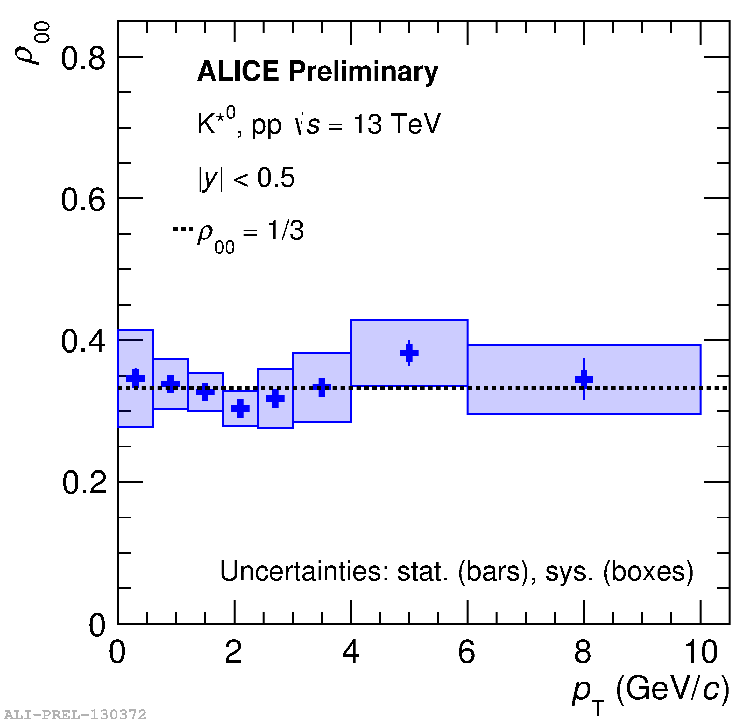
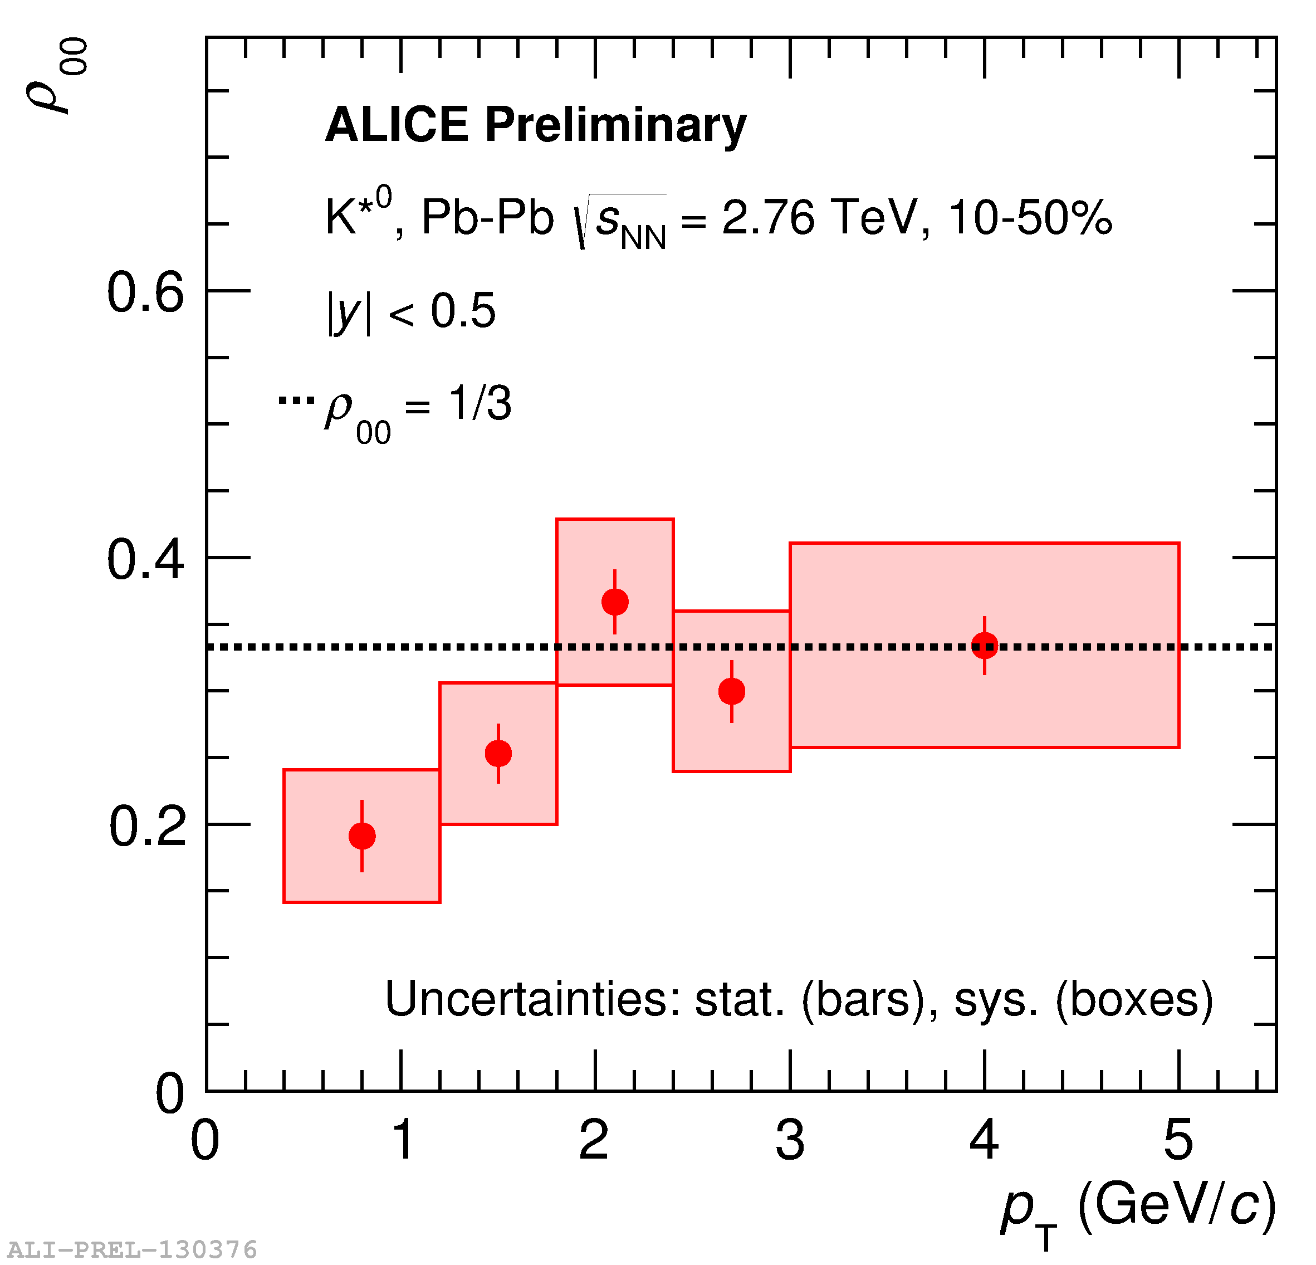
Spin density matrix element (ρ₀₀) measurements
pp collisions: ρ₀₀ = 1/3
Pb-Pb collisions: ρ₀₀ values about 2.5σ below 1/3 for 0.4 ≤ p_{T} < 1.2 GeV/c and 1.4σ for 1.2 ≤ p_{T} < 1.8 GeV/c
Sources of systematic errors include: Signal extraction, track reconstruction parameter variations, material budget and uncertainties associated with determination of efficiency x acceptance

Slide 17
Spin alignment of K^{*0}(spin 1) and K⁰_{s}(spin 0)
Null hypothesis test:
No spin alignment observed for spin 0 hadron K⁰_{S}

Slide 18
Summary of spin alignment results
ρ₀₀ < 1/3 by about 2.5σ for the lowest p_{T} range (0.4-1.2 GeV/c) studied, about 1.4σ for the p_{T} range (1.2-2.4 GeV/c) and consistent with 1/3 for higher p_{T} in Pb-Pb collisions at √s_{NN} = 2.76 TeV in ALICE @ LHC
ρ₀₀ ~ 1/3 : Spin alignment not observed in proton-proton collisions at 13 TeV
ρ₀₀ ~ 1/3 (within systematic errors) : Spin alignment not observed for K⁰_{s} (spin 0) in
Pb-Pb collisions at √s_{NN} = 2.76 TeV

Slide 19
Outlook
Analysis with Pb-Pb 5.02 TeV data with higher statistics underway
Centrality dependence of ρ₀₀ study ongoing
Spin alignment studies with respect to event plane ongoing

