Slide 1
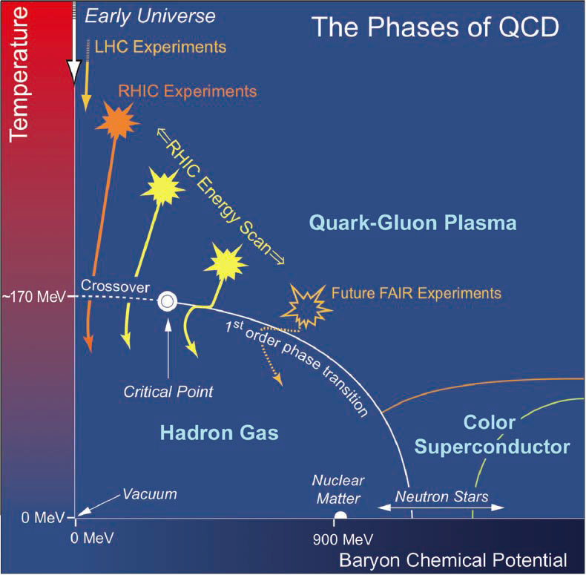


Freeze-out Dynamics In Relativistic Heavy-Ion Collisions
1/20
Outline:
Chemical Freeze-out
Kinetic Freeze-out
Summary
See also talks at -
Chemical FO – 28th June 2016 – Parallel sessions
Freeze-out – 29th June 2016 – Plenary sessions
Particle production – 30th June 2016 – Parallel session
Bedanga Mohanty
National Institute of Science Education and Research (NISER)

Slide 2

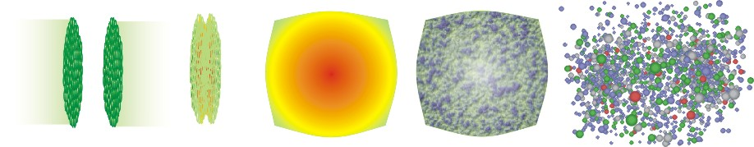
Dynamics of Relativistic Heavy Ion Collisions
2/20
Time Evolution of Heavy-ion Collisions:
T_{initial}
T_{C}
T_{chem}
T_{kin}
T
Initial state
QGP and
Hydro. expansion
Hadronization
t
Colliding ions
De-confined
state
Chemical freeze-out
Inelastic collision
cease
Kinetic freeze-out
Elastic collision
cease
Information of QCD phase diagram and particle production

Slide 3
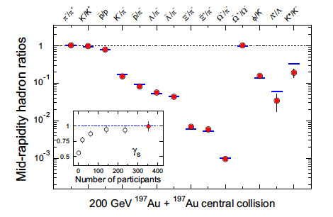
Chemical Freeze-out
3/20
Inelastic Collisions Ceases
Statistical Model
J. Cleymans and K. Redlich, PRC 60 (1999)054908
F. Becattini, J. Manninen, M. Gazdzicki, PRC 73 (2006) 044905
A. Andronic, P. Brau-Munzinger and J. Stachel, NPA 772 (2006) 167
THERMUS: S. Wheaton, J. Cleymans Comp. Phys. Comm. 180, 84 (2009)
Parameters:
Temperature (T_{ch}), Chemical Potentials (μ_{Β},μ_{S},μ_{Q}), γ_{S} and Volume
Obtained by fitting the particle yields
STAR: NPA 757 (2005)102
Model Features:
Assumes non-interacting hadrons and resonances
Assumes thermodynamically equilibrium system
Ensembles : Grand Canonical - average conservation of B, S, and Q
Strangeness Canonical - exact conservation of S
Canonical - exact conservation of B, S, and Q

Slide 4
Freeze-out Conditions – Particle Yields
4/20
SIS: JPG 25, 281 (1999); PRC 57, 3319 (1998);
AGS: PLB 344, 43 (1995); PLB 365, 1 (1996); PRC 67, 015205 (2003);
SPS: PLB 365, 1 (1996); PLB 465, 15 (1999); PRC 67, 015205 (2003); JPG 28, 1861 (2002); PRC 64, 024901 (2001); PRC 73, 034905 (2006); NPA 772, 167 (2006)
STAR: L. Kumar QM2011 & QM2014
ALICE: A. Andronic, NPA 904 (2013)535c
THERMUS
For study on dependence of parameters to choice of
ensemble, initial conditions, and particle set see: Adv.High Energy Phys. 2015 (2015) 349013
New aspect from BES RHIC
Centrality dependence of
T_{ch} vs. μ_{B}
STAR Preliminary
AGS results: Does not include
Multi-strange hadrons

Slide 5
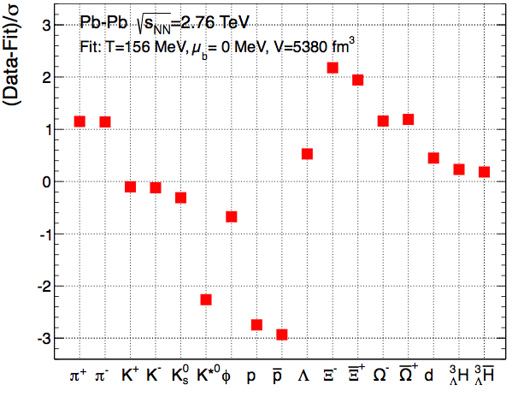
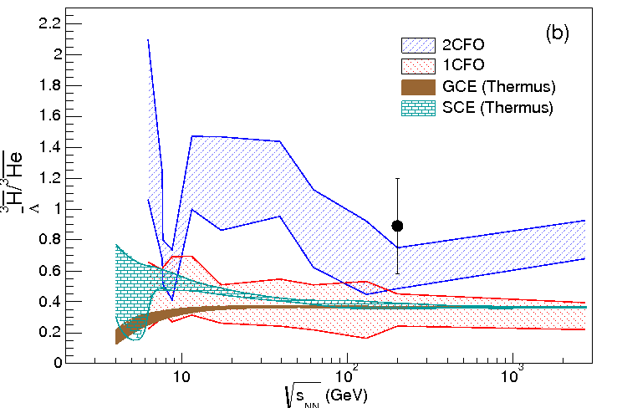
Multiple Freeze-out Scenarios
5/20
J Stachel, A Andronic, P Braun-Munziger,
K. Redlich: J. Phys. Conf.Ser 509 (2014) 012019;
Nucl. Phys. A904 (2013) 535c
Departure from equilibrium physics:
Hadronization followed by hadronic afterburner within the hybrid UrQMD model.
FO with nonequilibrium quark phase space factors for light and strange quarks were used.
Advent of LHC data
Difficulty in explaining Strange-to-non-Strange Particle/nuclei ratios
– Led to new developments
Within ambit of equilibrium physics:
Flavor dependent freeze-out surfaces
J. Steinheimer, et al., PRL 110 (2013) 042501
F. Becattini, et al., PRC 90 (2014) 054907
M. Petran, et al., PRC 88 (2013) 034907
S. Chatterjee, et al., PLB 727 (2013) 554
K. Bugaev, EPL 104 (2013) 22002
S. Chatterjee & B. Mohanty, PRC 90 (2014) 034908
S. Gupta, R. Sharma,
PRC 89 (2014) 057904
Υ – Τ ∼ 250 MeV

Slide 6
Strange vs. Non-Strange Freeze-out
6/20
S. Chatterjee, A. Dash & BM
π, K, p, Λ, Ξ,φ,Ω and antiparticles
Strange hadrons Freeze-out at different time compared to non-strange hadrons ?
Preferred for AA collisions (medium) and NOT preferred for pA or pp

Slide 7
Freeze-out Conditions from Higher Moments of Multiplicity Distributions
7/20
PHENIX
Phys.Rev. C93 (2016) 011901
STAR
Phys.Rev.Lett. 113 (2014) 092301
Phys.Rev.Lett. 112 (2014) 032302
Phys.Rev.Lett. 105 (2010) 022302
Ratios of Susceptibilities of conserved quantities (B, Q, S) calculated in QCD/Models are related to products of moments of corresponding distributions measured in experiments – Use this to extract Freeze-out conditions
Theory (Susceptibilities) | Experiment (moments/Cumulants)
χ₃/χ₂ | Sσ
χ₄/χ₂ | κσ²
χ₁/χ₂ | M/σ²
χ₃/χ₁ | Sσ³/M
One strategy : χ₃ /χ₁ is independent of μ_{B} – estimate temperature
LO in χ₂ /χ₁ is linear in μ - estimate chemical potential
Phys.Rev.Lett. 113 (2014) 052301
Phys.Rev.Lett. 113 (2014) 072001
Phys.Lett. B738 (2014) 305-310
Phys.Rev.Lett. 111 (2013) 062005
Phys.Rev.Lett. 109 (2012) 192302
Phys.Lett. B 696 (2011) 459-463
Theory: Lattice QCD
HRG

Slide 8
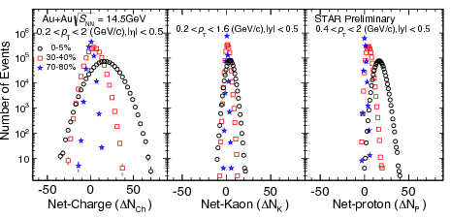
Experimental data on Higher Moments
PHENIX
Phys.Rev. C93 (2016) 011901
STAR
Phys.Rev.Lett. 113 (2014) 092301
Phys.Rev.Lett. 112 (2014) 032302
Phys.Rev.Lett. 105 (2010) 022302
arXiv:1601.00951
8/20
Experiment | Net-Charge | Net-Proton | Net-Kaon
STAR | Obs: Μ, σ, S, κ Beam Energy (evts): 7.7 (1.4M), 11.5(2.4M), 19.6(15.5), 27(24M), 39(56M), 62.4(32M), 200(75M) η: +/- 0.5; Φ: 2π p_{T} : 0.2 – 2 GeV/c | Obs: Μ, σ, S, κ Beam Energy (evts): 7.7 (3M), 11.5(6.6M), 19.6(15M), 27(30M), 39(86M), 62.4(47M), 200(238M) y: +/- 0.5; Φ: 2π p_{T} : 0.4 – 0.8 (2) GeV/c | Obs: Μ, σ, S, κ Beam Energy (evts): 7.7 (3M), 11.5(6.6M),14.5 19.6(15), 27(30), 39(86M), 62.4(47M),200(238M) y: +/- 0.5; Φ: 2π p_{T} : 0.2 – 1.6 GeV/c
PHENIX | Obs: Μ, σ, S, κ Beam Energy (evts): 7.7 (2M), 19.6(6M), 27(21M), 39(154M), 62.4(474M), 200(1681M) η: +/- 0.35 Φ: π/2 p_{T} : 0.3 – 2 GeV/c
Data: Finite Acceptance (y, φ, p_{T})
Efficiency Corrected
net-proton – proxy for net-baryon
net-kaon – proxy for net-strangeness
STAR:QM2015
J. Phys. G 40 (2013) 055103
1603.09057

Slide 9
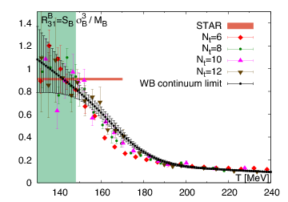
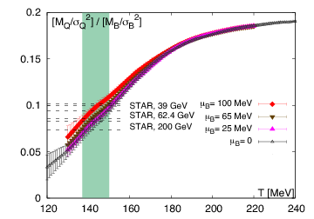
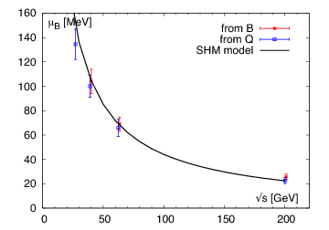
LQCD: Freeze-out Conditions from Higher Moments of Multiplicity Distributions
9/20
S. Borsanyi, et al.,
Phys.Rev.Lett. 113 (2014) 052301
^{T} < ^{148 MeV}
^{T} ^{= (144±6)MeV}
Assumption: If the freeze-out can be described by the same temperature and chemical potentials for charge and protons.
Consistency in freeze-out parameters for
various observables.
2. Fluctuations Freeze-out at a slightly lower
temperature than yields ?

Slide 10
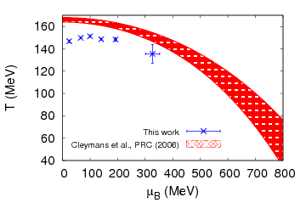
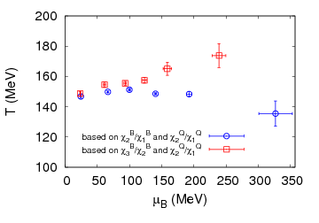
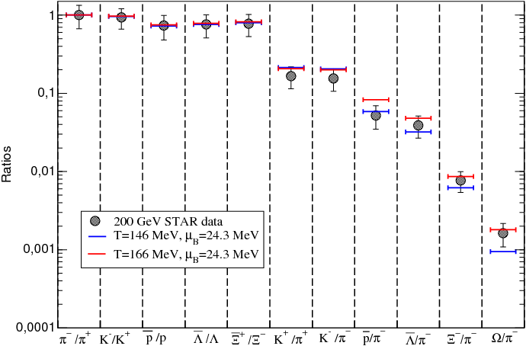
HRG: Freeze-out Conditions from Higher Moments of Multiplicity Distributions
Paolo Alba, et al.
Phys.Lett. B738 (2014) 305-310
10/20
(Calculations with experimental acceptances, resonance decay, isospin randomization )
Fluctuations Freeze-out at a lower temperature than yields ?
Consistency in freeze-out parameters for
various observables at higher energies
(indication of chiral critical fluctuations at
lower energies ?)
Freeze-out temperature from fluctuations – explains anti-proton yields better, misses the multi-strange baryons (need for strangeness fluctuations ?)

Slide 11
Compilation of Freeze-out Conditions
11/20
Does Particle yields and
Fluctuations freeze-out
differently ?
Or
It is a simple question of
Sensitive observable ?
Or
Strange and non-Strange
Freeze-out at different
Times ?
FLUCTUATIONS
YIELDS

Slide 12


Freeze-out line and Transition Line
12/20
Assumption:
Charge-conjugation invariance at μ_{B}=0
Analyticity at the point μ_{B}=0
Low Baryon densities and lowest order expansion
> 0 Transition line
~ 0 or < 0 Freeze-out line
κ-values (error) | Calculation | Remarks
0.020(4) | PRD 93, 014507 (2016) : LQCD, im. μ | Transition Line
0.0135(20) | PRD 92, 054503 (2015): LQCD im. μ | Transition line
0.059(2)(4) | PRD 83, 014504 (2011): LQCD T. exp. | Transition line
0.0089(14) (χ_{s}); 0.0066(20)(ψ_{c}) | JHEP 1104, 001 (2011): LQCD | Transition line
0.015(6) (I); 0.017(5) (ε) 0.018(7) (c_{s}); 0.016(4) (s) | JHEP 1208, 053 (2012) LQCD, T. exp.. | Transition line
0.023(3) | PRC 73, 034905 (2006): Fit to Yields | Freeze-out line
Weaker than above | PRL 111, 082302 (2013): Fit to yields | Freeze-out line
~ 0 | NPA 772, 167 (2006): Fit to Yields | Freeze-out line
-0.073(16)- STAR pub. -0.012(15) STAR-prel. -0.056(67) STAR+PHENIX | Phys.Rev. D93 (2016), 014512: Fit to higher moments | Freeze-out line < 0.011

Slide 13
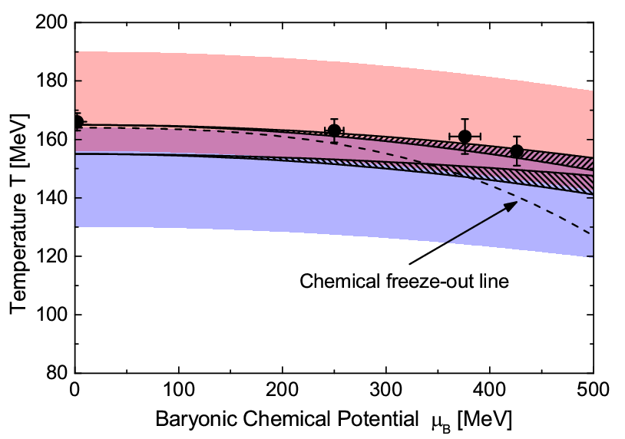
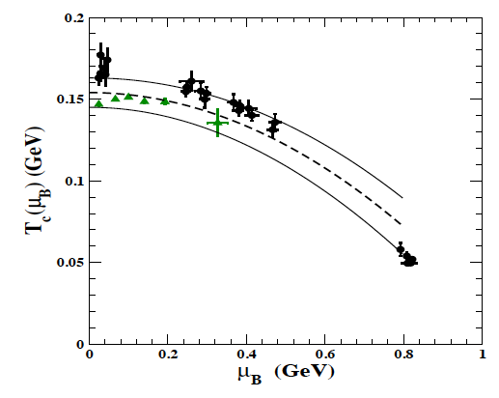
Freeze-out line and Transition Line
13/20
F. Becattini, M. Bleicher, T. Kollegger, T. Schuster, J. Steinheimer, R. Stock, Phys.Rev.Lett. 111 (2013) 082302
P. Cea, L. Cosmai, A. Papa, Phys. Rev. D 93, 014507 (2016)
LQCD: G. Endrodi, Z. Fodor, S. D. Katz and K. K. Szabo, JHEP 1104, 001 (2011) & O. Kaczmarek et al. , Phys. Rev. D 83, 014504 (2011)
FO - Yields: J. Cleymans, H. Oeschler, K. Redlich and S. Wheaton, Phys. Rev. C 73, 034905 (2006)
FO-Fluctuations: P. Alba, W. Alberico, R. Bellwied, M. Bluhm, V. Mantovani Sarti, et al., Phys.Lett. B738, 305 (2014)
FO: A. Andronic, P. Braun-Munzinger and J. Stachel, Phys.Lett. B 673 , 142 (2009) & J. Cleymans, H. Oeschler, K. Redlich and S. Wheaton, Phys. Rev. C 73 , 034905 (2006)
FO parameters using thermal model without multi-strange and strange baryons yields closer to FO parameters from net-p and net-Q fluctuation data.
Freeze-out points closely follow the parton-hadron phase boundary.

Slide 14
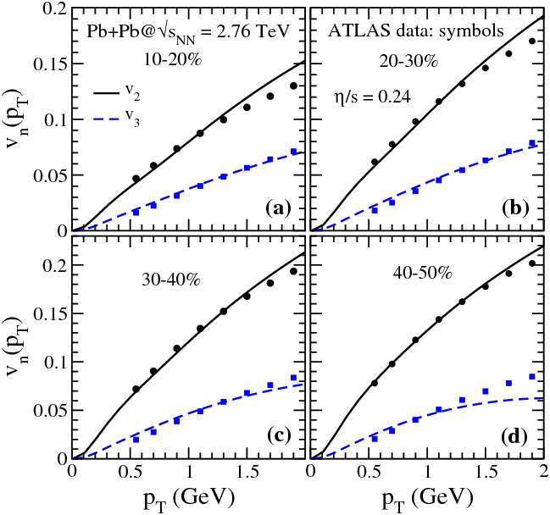
Kinetic Freeze-out
14/20
Elastic Collisions Ceases
E. Schnedermann, J. Sollfrank, and U.
W. Heinz, Phys. Rev. C 48, 2462 (1993).
Blast-Wave Model
Parameters: Temperature (T_{kin}) and transverse radial velocity (β)
Obtained by fitting the momentum distribution of particles
Features:
- Approximates Hydrodynamic based model
Assumes particles are locally thermal and moving with a common velocity
Recent work: Viscous Blast-Wave Model:
arXiv:1508.05878 , A. Jaiswal and V. Koch
SQM2016 – 28th July 2016

Slide 15
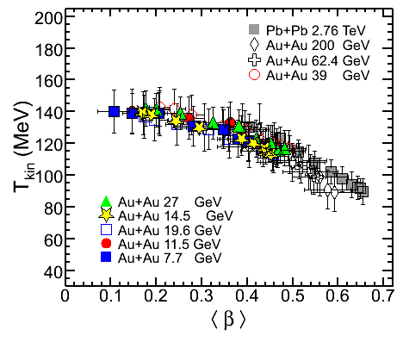
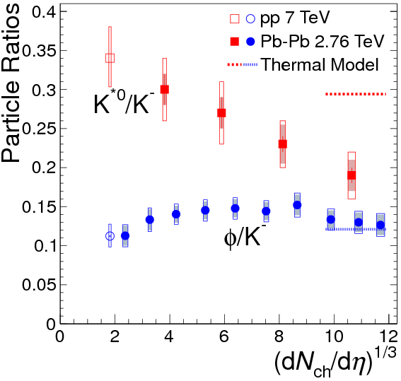
Kinetic Freeze-out Conditions
Central collisions: lower T_{kin} and larger collectivity β
Stronger collectivity at higher energy
Kinetic Freeze-out temperature lower
than Chemical Freeze-out temperature
Reflects Interactions in hadronic phase
BW: E. Schnedermann, J. et al., PR C 48, 2462 (1993).
STAR: V. Bairathi QM
L. Kumar QM2014
STAR : PRC 79 (2009) 034909;
ALICE: PRC 88, 044910 (2013)
ALICE:
Phys.Rev. C91 (2015) 024609
Experimental
evidence of
re-scattering
15/20
R. Holzmann talk – 28th June

Slide 16
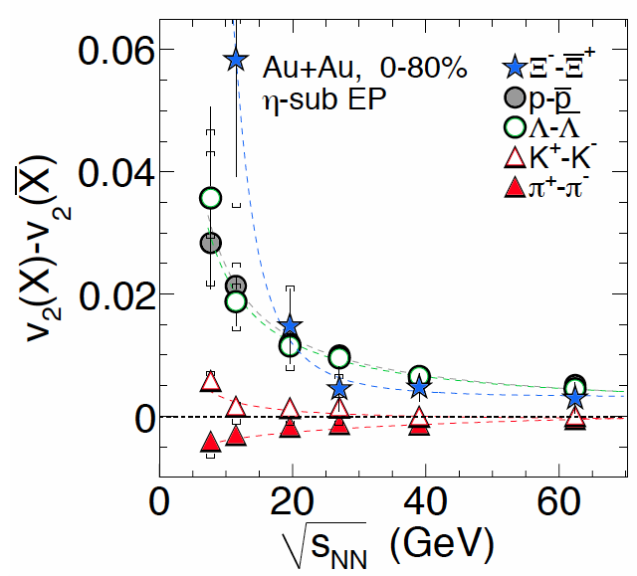
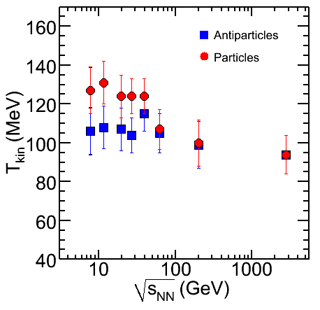
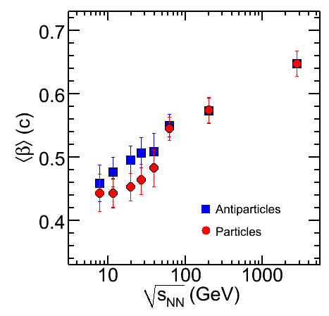
Kinetic Freeze-out New Observation: RHIC-BES
16/20
Particles: π⁺, K⁺, p, Λ, Ξ⁻ ;
Antiparticles: π⁻, K⁻, pbar, Λbar, Ξ⁺
Phys.Rev.Lett. 110 (2013) 142301; SN0598
Central collisions
STAR: L. Kumar QM2014
STAR Preliminary
STAR Preliminary
Central collisions
Differences between particle
And anti-particles ?

Slide 17
Summary
17/20
New data (LHC, RHIC BES)
New Observables (Higher Moments)
New Models/Approaches

Slide 18
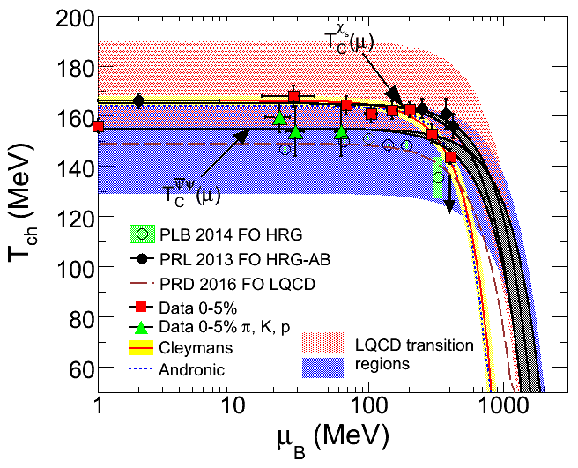
Discussion
New: Freeze-out parameters using Lattice QCD calculations and HRG vs. experimental data on high moments
Difference in Freeze-out parameters from yields and fluctuations:
Yields and fluctuations freeze-out at different times ?
Fluctuations more sensitive to Freeze-out dynamics than yields ?
Role of strangeness (Strangeness data on fluctuations important) ?
18/20

Slide 19
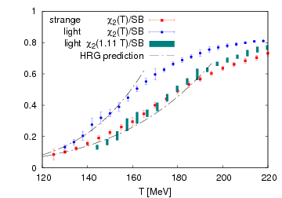
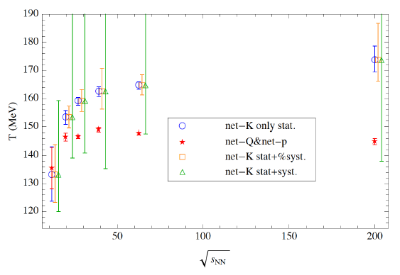
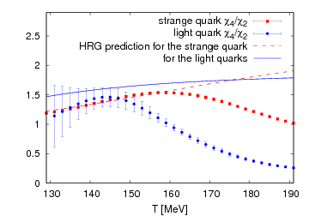
Discussion
Strange (s) vs. Non-Strange (u,d) FO
19/20
S. Chatterjee, A. Dash & BM
Yields: Statistical Model
T_{s} > T_{u,d}
Fluctuations: Lattice and HRG
T_{net-K} > T_{net-p} ~ T _{net-Q}
T_{s} > T_{u,d}
R. Bellwied – WWND2016
Role of additional Strange Hadrons ?
Phys.Rev.Lett. 113 (2014) 072001
R. Bellwied, S. Borsanyi, Z. Fodor, S. D. Katz
Phys.Rev.Lett. 111 (2013) 202302
Are there sufficient evidence that non-strange hadrons freeze-out at different time compared to strange hadrons ? – May be ?

Slide 20
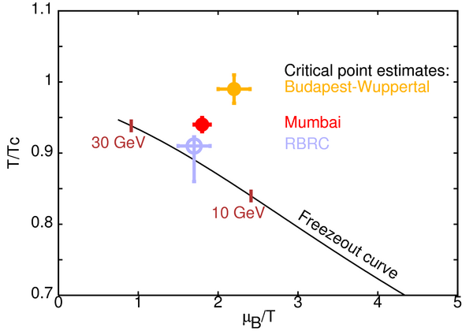
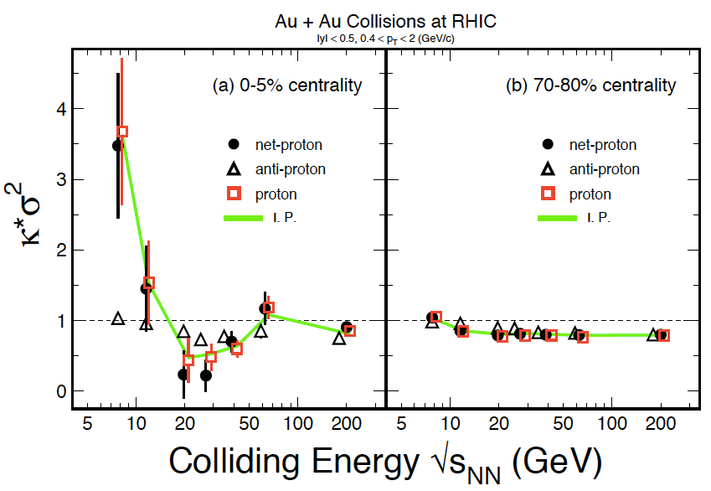
Landmark Point (CP) on Phase Diagram
S. Gupta
Lattice 2013
Expectation
Measurement
STAR: CPOD 2015
Exciting times ahead ….
20/20
Thanks

