Slide 1
The Phase Diagram of QCD
Bedanga Mohanty
NISER
Outline:
Phase Diagram of QCD
Experimental Realization
Summary
INSA Meeting, NISER – December 28-30, 2016
01/21

Slide 2
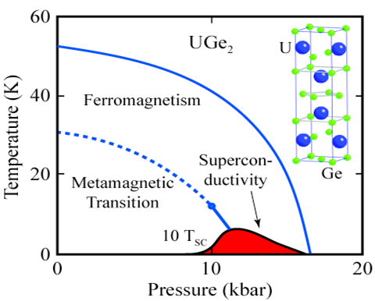
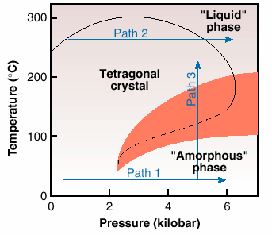
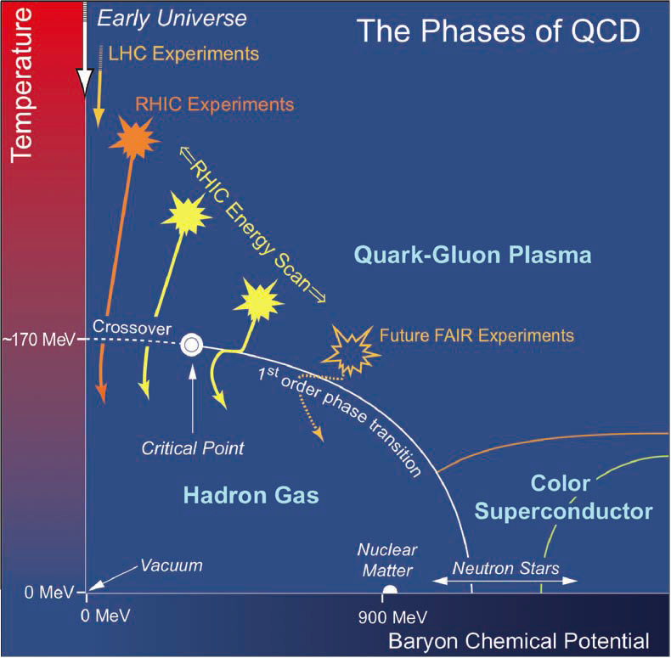
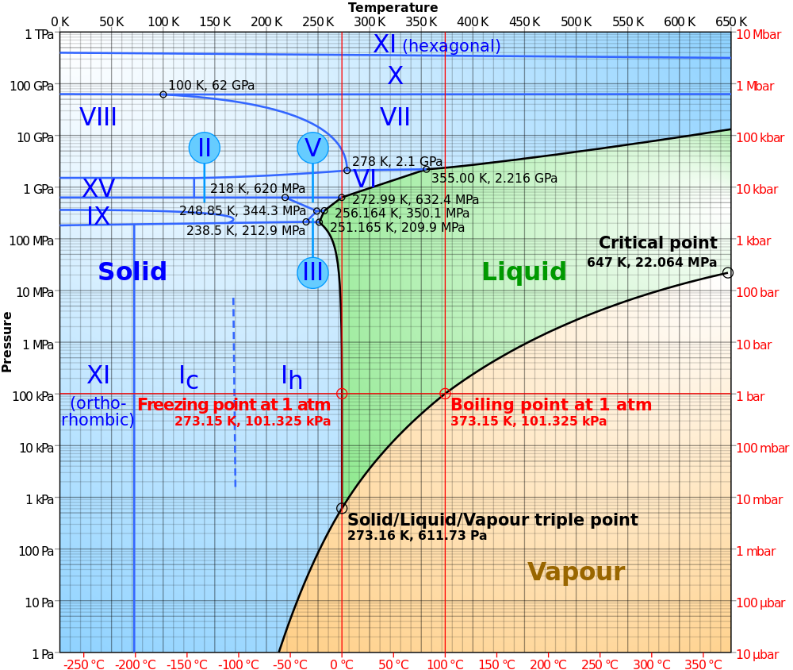
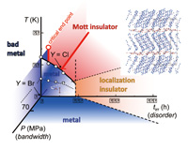
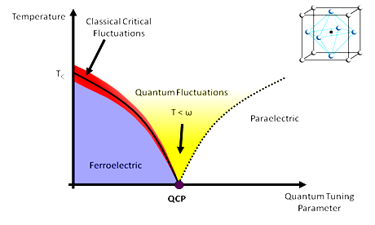
Phase diagram
Phase diagram of Water
Electromagnetic interaction
Precisely known
Phase diagram of strong interactions
Largely still a conjecture
http://www1.lsbu.ac.uk/water/water_phase_diagram.html
NSAC Long range plan
Many
Unique
02/21

Slide 3
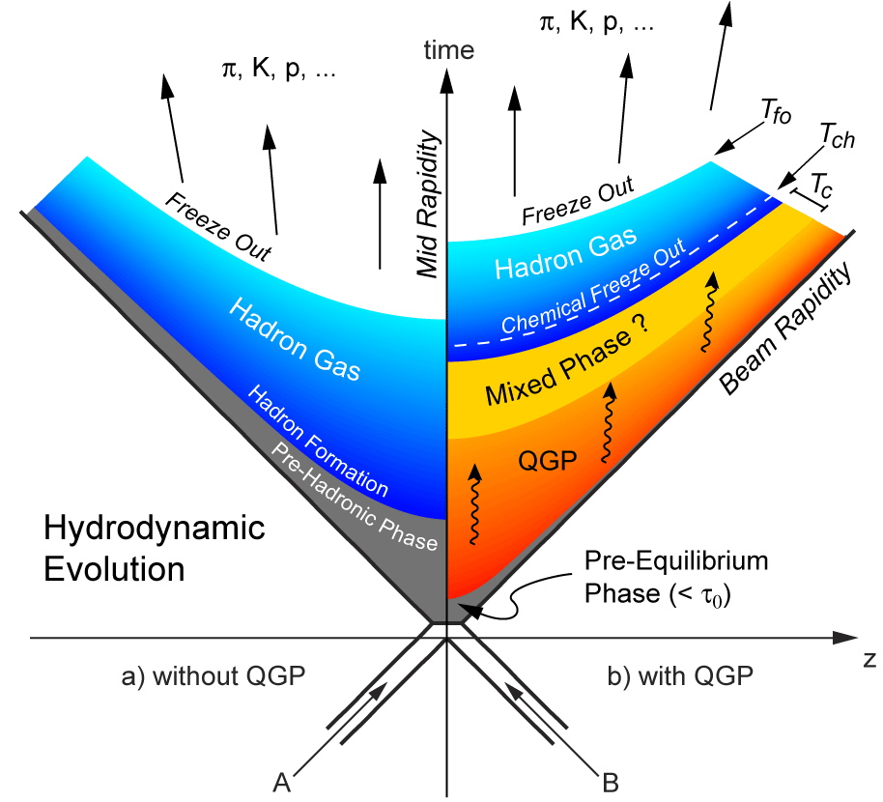
Heavy-Ion Collisions and QCD Phase diagram
p+p like collisions
A+A collisions
Colliding two nuclei we expect to create the QCD transitions
-- De-confinement
-- Chiral Symmetry
Restoration
in laboratory
Universe:
QCD Ph. Transition: T~200MeV
EW Ph. Transition: T ~ 150 GeV
GUT Ph. Transition: T ~ 10¹⁶ GeV
J. D. Bjorken Physical Review D 27 (1983) 140
03/21

Slide 4
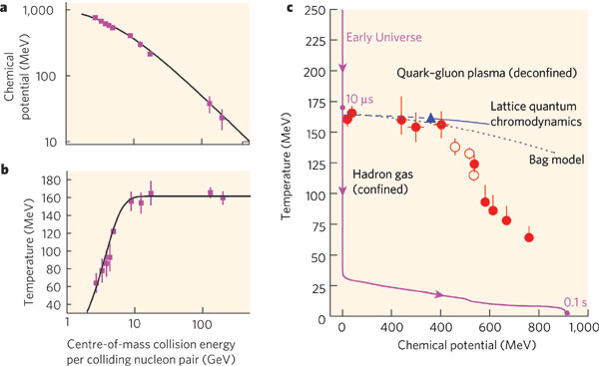
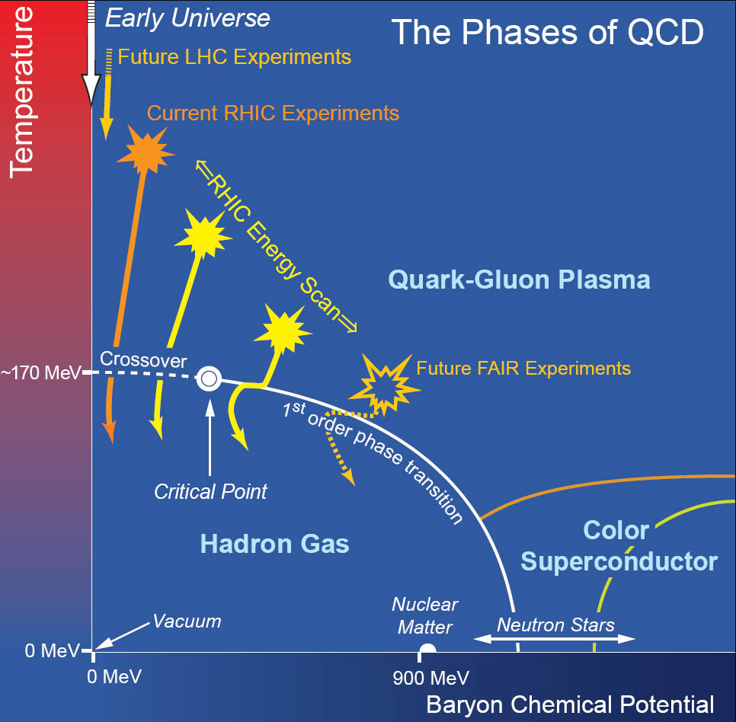
Experimental access to the Phase diagram of QCD
Physical systems undergo phase transitions when external parameters such as the temperature (T) or a chemical potential (μ) are tuned.
Conserved Quantities:
Baryon Number ~ μ_{Β}
Electric Charge ~ μ_{Q} ~ small
Strangeness ~ μ_{S} ~ small
Varying beam energy varies Temperature and Baryon Chemical Potential
P. Braun-Munzinger, J. Stachel
Nature 448:302-309,2007
04/21

Slide 5
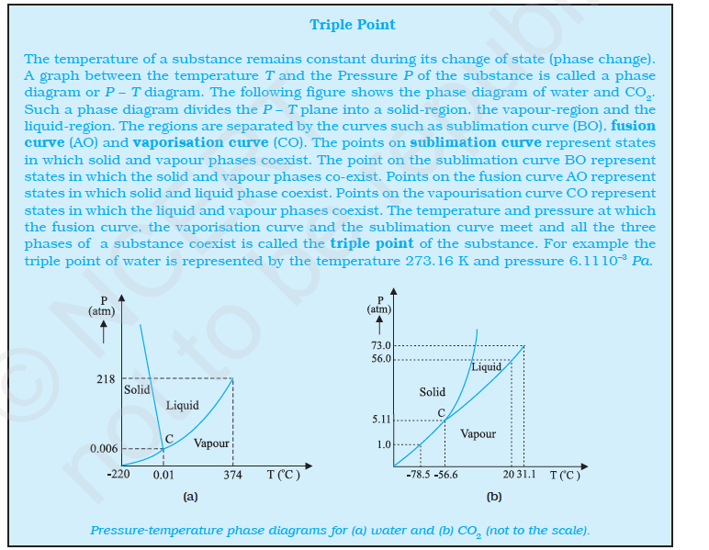
Establishing the Phase Diagram of QCD
Produce a QCD matter where Thermodynamics is applicable
Chapter – 11
Thermal Properties of Matter
NCERT - Book
Demonstrate existence of Quark-Gluon Phase
Establish cross-over at μ_{B} = 0 MeV
Establish – QCD Critical Point and/or
1st Order Phase Transition at high μ_{B}
If successful QCD PD could
also find place a in text books
05/21

Slide 6
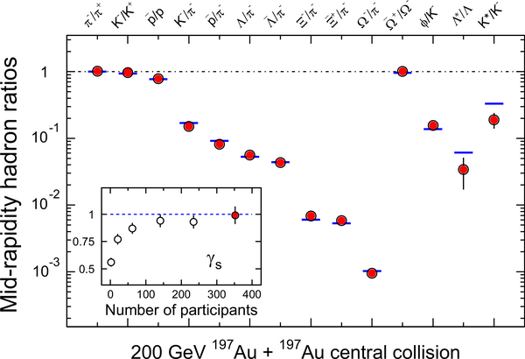
Particle Production – Thermalized Source
STAR PRL : 2004
STAR NPA : 2005
T_{ch} = 163 ± 4 MeV
μ_{B} = 24 ± 4 MeV
In central collisions, the system is thermalized at RHIC
Statistical Model with Grand Canonical Ensemble.
Incorporates the various conservation laws.
Assumes thermal and chemical equilibrium.
06/21

Slide 7
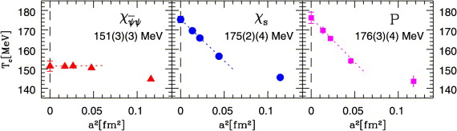
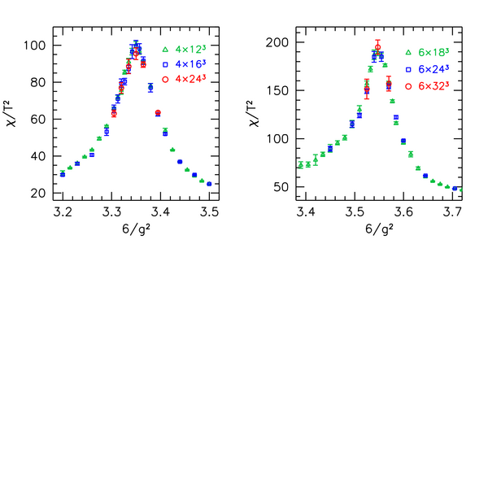
QCD Phase Structure & Transition Temperature at μ_{B} = 0 MeV
PRD85 (2012) 054503
NPA 830 (2009) 805c
Nature443:675-678,2006
Transition temperature and Cross Over established at zero baryon chemical potential
07/21

Slide 8
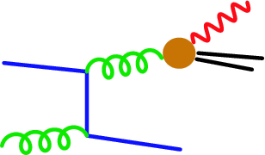
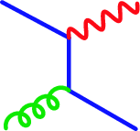
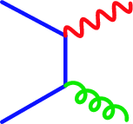
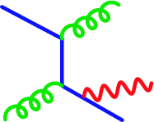
Establishing Quark-Gluon Plasma
If there is system of free quarks and gluons – Photons can be produced through:
Compton
Annihilation
Bremsstrahlung
In a hydrodynamic picture: Slope of momentum
distribution of these photons
T_{c} ~ 150 MeV ~ 10¹² Kelvin
Temperature for QCD transition from Lattice QCD
08/21

Slide 9
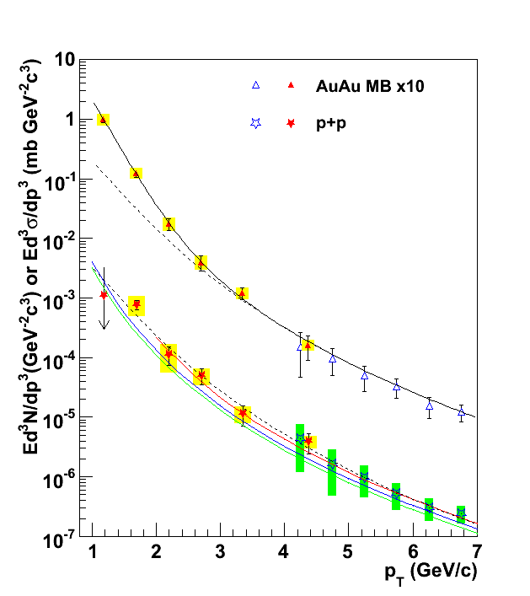
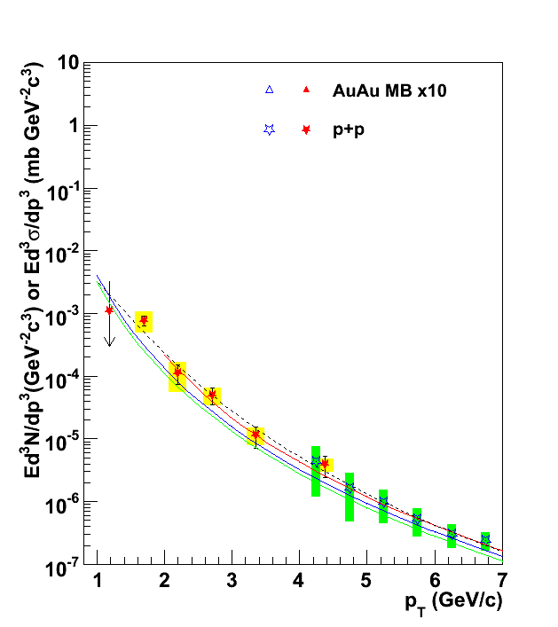
Establishing Quark-Gluon Plasma
T_{AA} scaled pp + Exponential
T_{i} = 300-600 MeV
> T_{c}
Gold-Gold
Direct Photons
Sinha, Srivastava, Alam, Sarkar, Gale,
Turbide, Rasanen, Liu, d’Enteria
Deconfined state of quarks
And Gluons
Fit to pp
Proton-Proton
Direct Photons
NLO pQCD (W. Vogelsang)
09/21

Slide 10

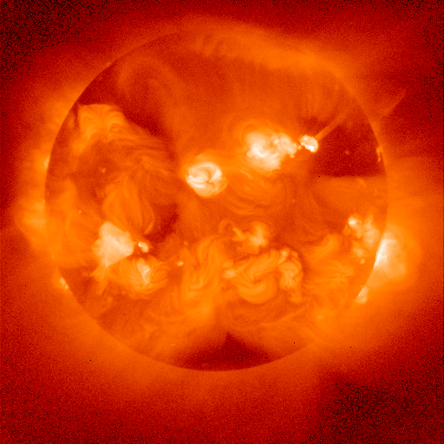
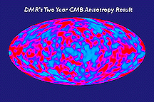
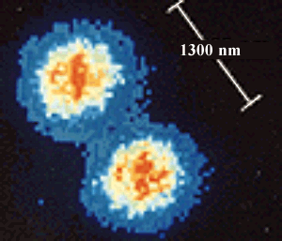
Perspective of Temperature Reached in
Heavy-ion Collisions
~10¹² K
Nucleus-Nucleus collisions
~ 150 MeV
~10⁹ K
Neutron Star Thermonuclear Explosion
(Terrestrial Nuclear explosions)
~10⁶ K
Solar Interior
~6000 K
Solar Surface
Room Temperature ~ 1/40 eV
~300 K
Cosmic Microwave Background
~3 K
~10⁻⁶ K
~10⁻¹⁰ K
Rhodium metal spin cooling (2000)
(Low-T World Record!)
Trapped Ions
10/21

Slide 11
Collectivity
coordinate-space-anisotropy ⬇ momentum-space-anisotropy
y
p_{y}
x
p_{x}
y
φ
x
18/35

Slide 12
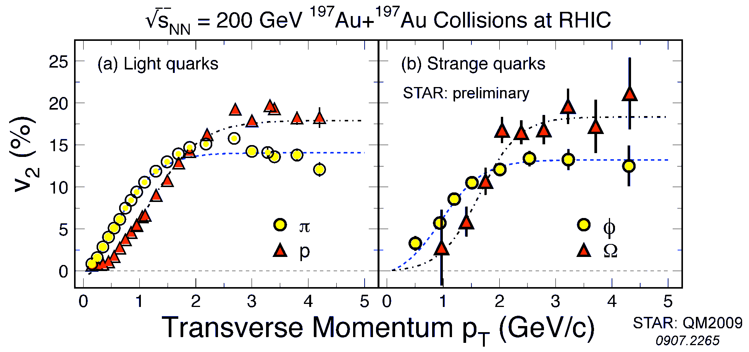
Strong Collectivity
Probes of the Medium
STAR PRL : 2016
y
φ
x
Low p_{T} : Heavier hadrons have lower v₂ ( ~ hydrodynamic pattern)
High p_{T} : Collectivity grouped along baryon-meson lines
( ~ Hadronization by partonic recombination)
All p_{T} : Collectivity similar for hadrons with strange and light quark
(~ developed at partonic stage)
11/21

Slide 13
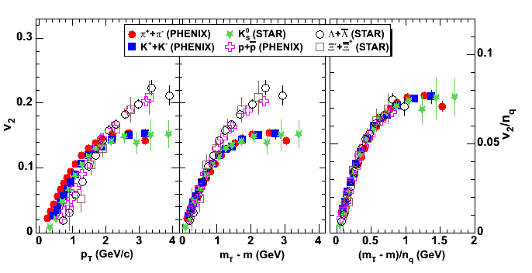
Partonic Collectivity
baryons
quarks
mesons
particle mass
dependence
plotted vs.
trans. kinetic energy
both axes scaled by number
of constituent quarks
n_{q} = 2 for mesons
n_{q} = 3 for baryons
recombination of quarks
quarks have v₂ before hadronization
12/21

Slide 14
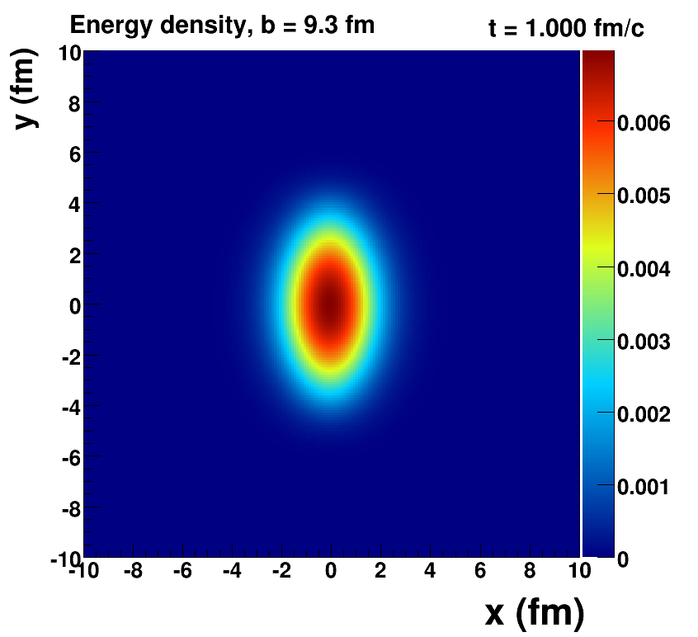
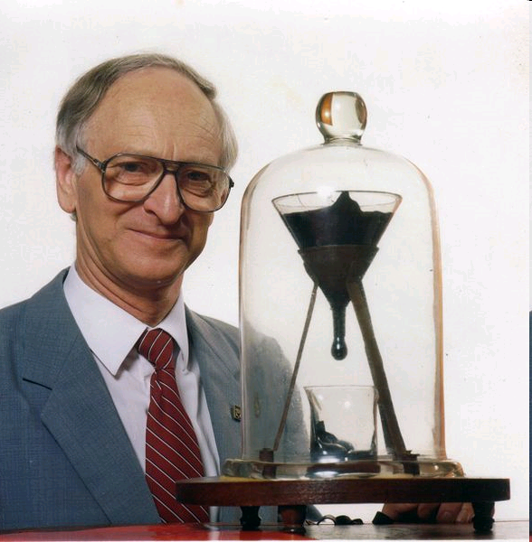
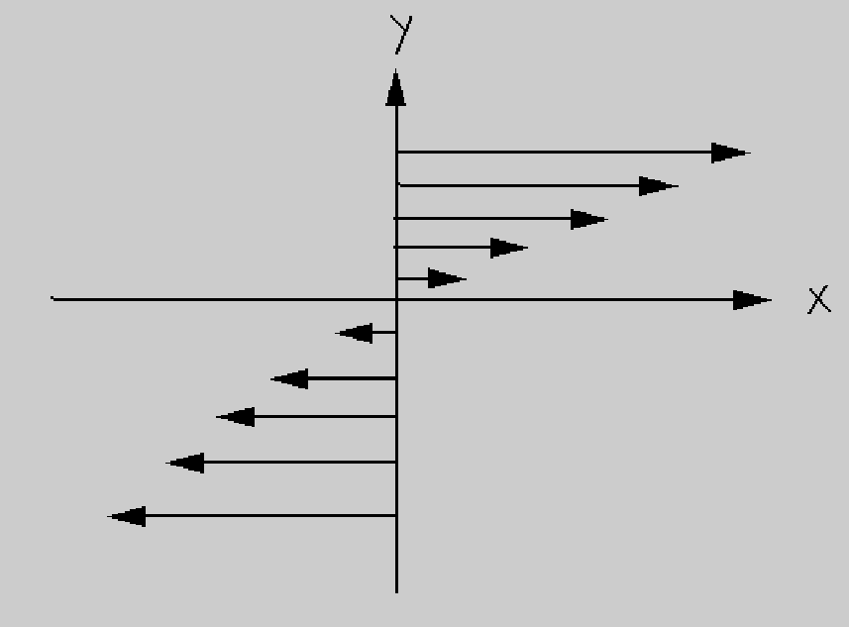
Properties of QGP
Pitch has viscosity approximately
230 billion times that of water.
Longest running experiment (1927-present) 8 drops so far, none ever seen fall!
Viscosity: Resistance to Flow
http://en.wikipedia.org/wiki/Pitch_drop_experiment
13/21

Slide 15
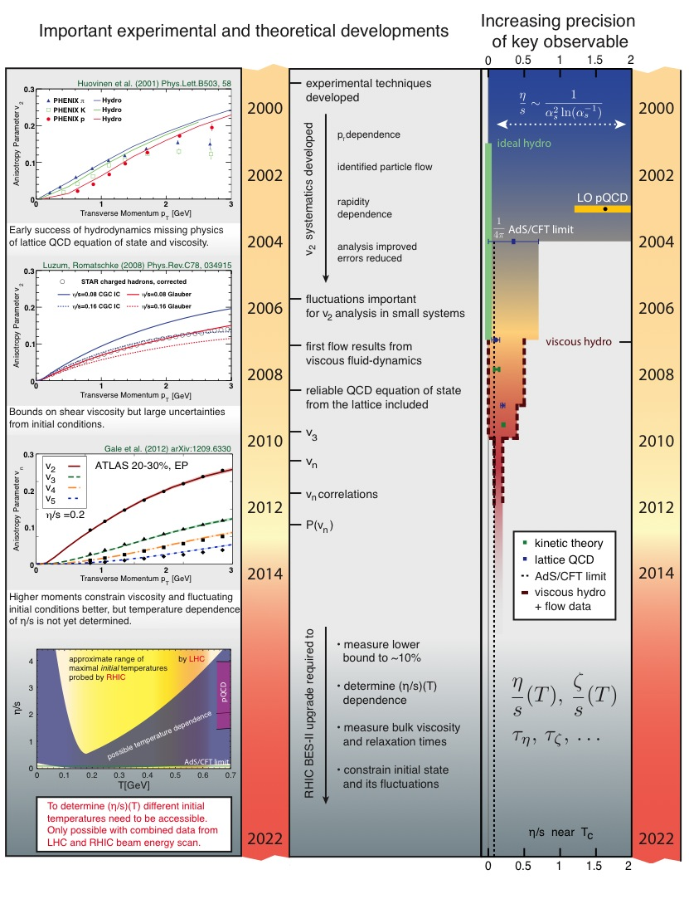
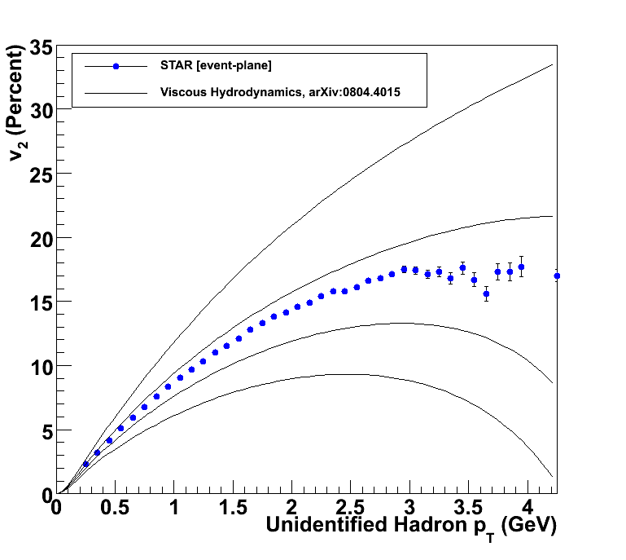
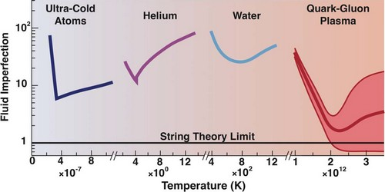
Viscosity
η/s ~ 0
η/s = 1/4π
η/s = 2 x 1/4π
η/s = 3 x 1/4π
Victor Roy, et al.
Perfect Fluid
14/21

Slide 16
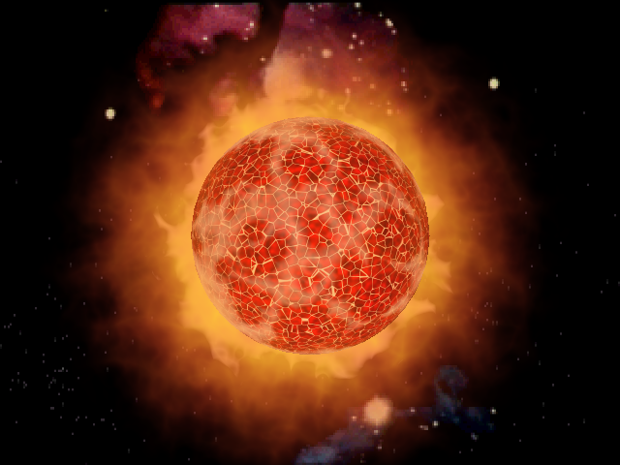
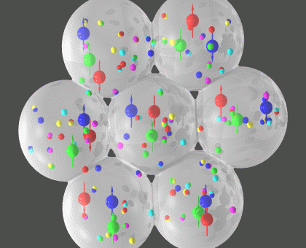
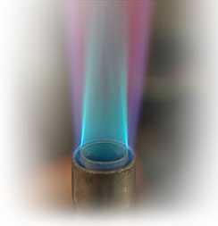
Opacity
Probes of the Medium
Matter we want to study
Calibrated
Light Meter
Calibrated
LASER
Jets
Calibrated
Heat Source

Slide 17
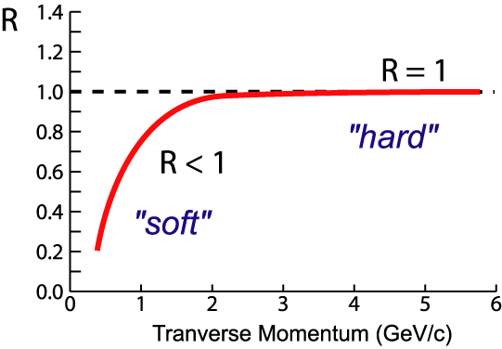
Quenching of Jets
leading particle suppressed
p+p
A+A
back-to-back jets disappear
Nuclear Modification Factor:
20/33

Slide 18
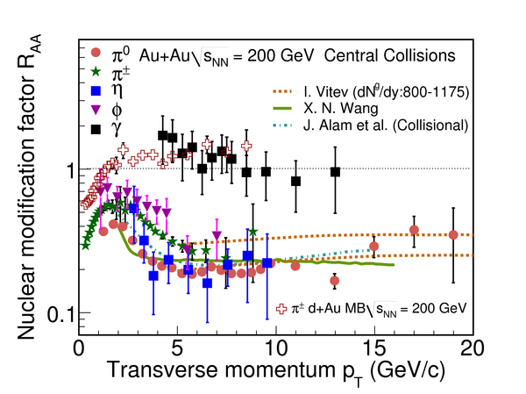
Experimental Evidence: Quenching of Jets
High p_{T} hadron production suppressed
Production of photons which do not participate in strong
interactions is not suppressed
No suppression in d+Au
collisions
ε_{initial} > ε_{C} (Lattice)
Interpretation : Energy loss of partons in a dense medium
21/33

Slide 19
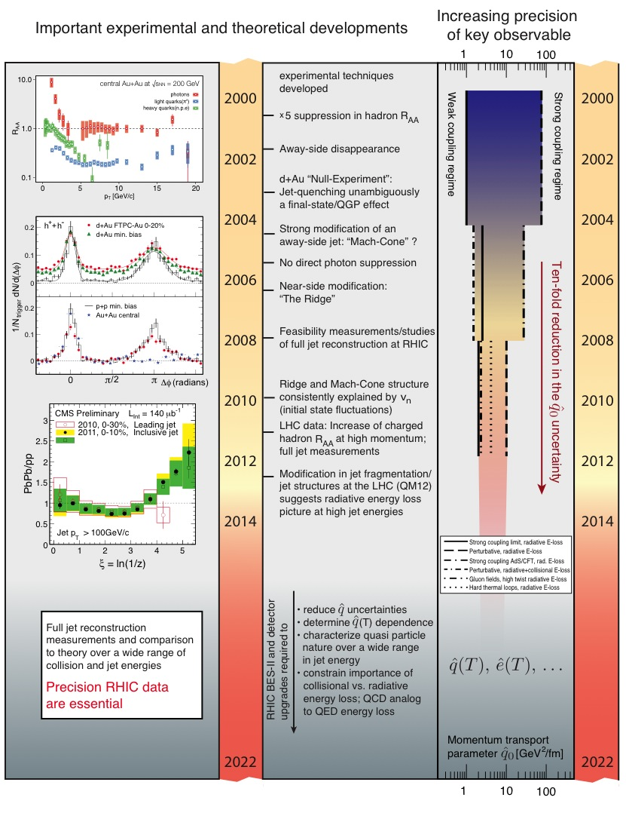
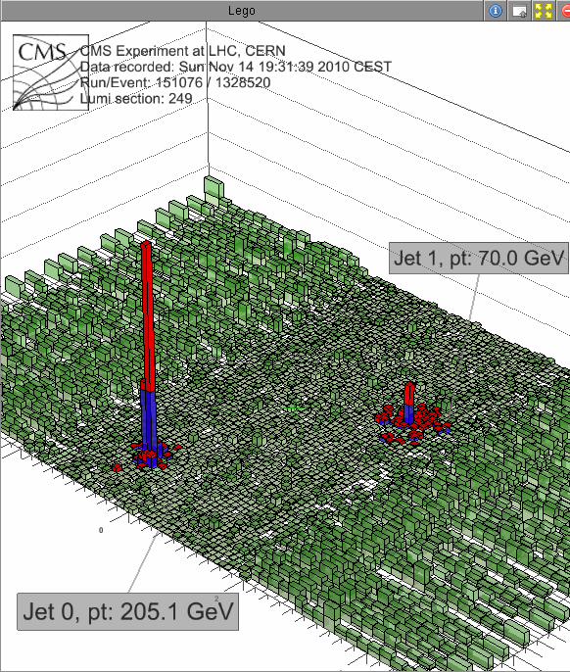
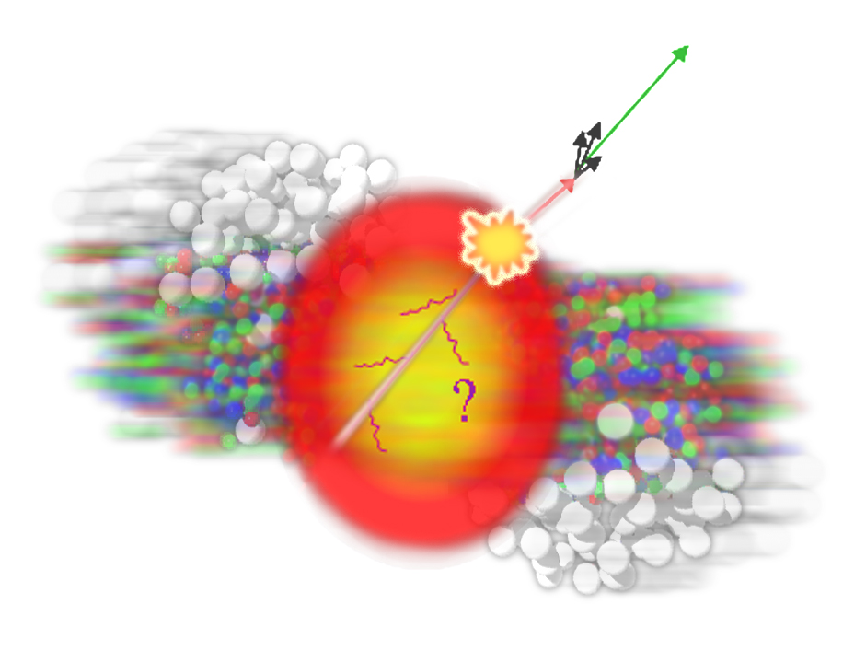
Opacity
Jets Quenched
The shear viscosity to entropy density ratio is found to lie between (1-2)/4π and that reflecting the stopping power was observed to be between 2-10 GeV²/fm.

Slide 20
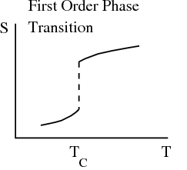
Experimental Result: 1st Order PT
Observations consistent with 1st order
Phase transition expectations
STAR: Physical Review Letters 2014
15/21

Slide 21
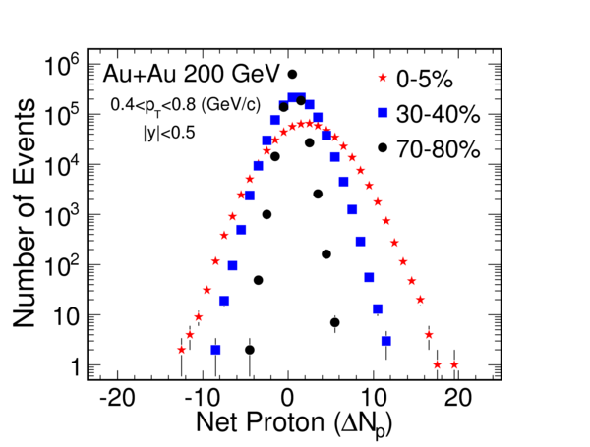
Experiment and Theory Direct Link
Shape of distribution
⬅➔
Correlations
Moments relates to Correlation length (ξ):
Study phase transition and Critical Point
< (δN)²> ~ ξ²
< (δN)³> ~ ξ^{4.5}
< (δN)⁴> - 3 < (δN)²>² ~ ξ⁷
Moments relates to Susceptibility (χ) :
Study Bulk properties of QCD matter
Kurtosis x Variance ~ χ⁽⁴⁾/ [χ⁽²⁾ T²]
Skewness x Sigma ~ [χ⁽³⁾ T]/ [χ⁽²⁾ T²]
STAR: Physical Review Letters 2010& 2014
M. Stephanov: Physical Review Letters 2009;2011
S. Gupta and R. Gavai : Physics Letters B 2011
M. Cheng .. F. Karsch ..: Physical Review D 2009
16/21

Slide 22
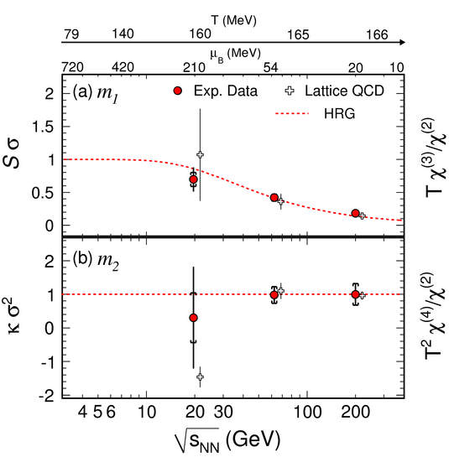

Data and QCD (Non-Zero T) 1st Comparison
1st comparison of high energy nuclear collision data to 1st principle QCD calculations
Confirms formation of QGP
Quark-Hadron transition is a cross over
“Scale for the Phase Diagram of Quantum Chromodynamics”
Science, 332, 1525(2011)
17/21

Slide 23
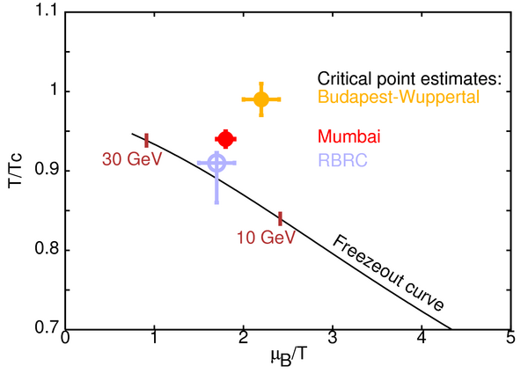
Theory : Critical Point
TIFR, Mumbai
18/21

Slide 24
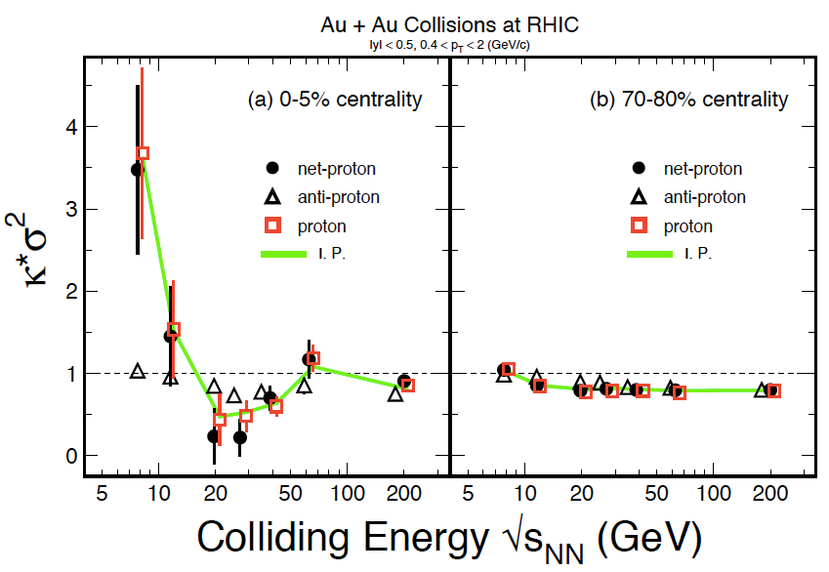
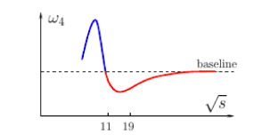
Experimental Result: Critical Point
M.A. Stephanov, Phys. Rev. Lett. 107, 052301 (2011).
Exciting Period !!
BES-II
(2018-2020)
CBM
(2024- ..)
χ⁽⁴⁾/ χ⁽²⁾
Τ, μ_{Β}
STAR: Physical Review Letters 2014
And STAR Preliminary
19/21

Slide 25
Summary
QCD phase transition and primordial matter created in Laboratory. System of de-confined quarks and gluons formed.
The de-confined quarks and gluons (fundamental constituent of any visible matter ) exhibits the property of perfect fluidity with high degree of opacity
Phase Diagram of Strong Interactions being laid out. Transition temperature and order of phase transition established at zero baryon chemical potential.
Exciting experimental results on critical point and phase boundary. Susceptibility has a non-monotonic variation with beam energy.
Emergent Properties of QCD Matter
20/21

Slide 26

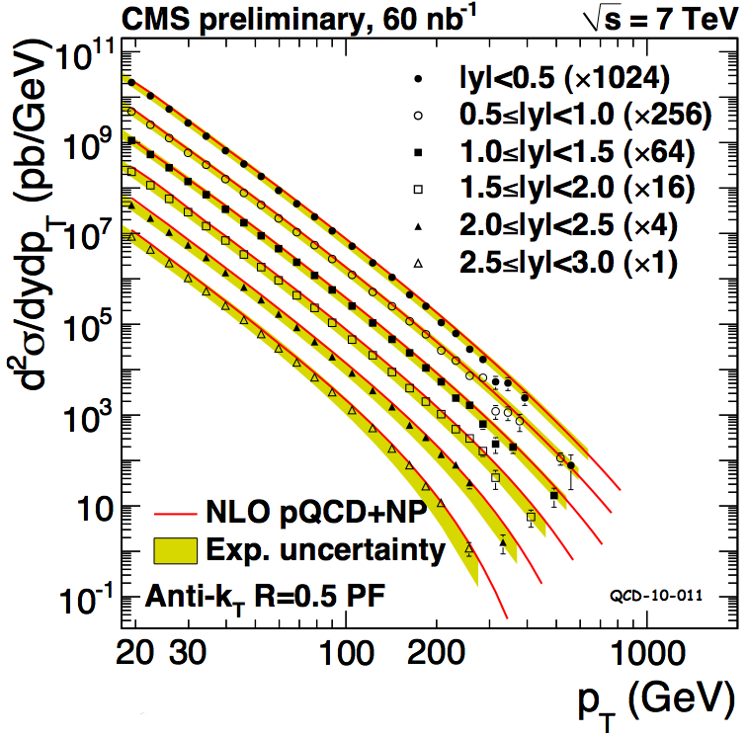
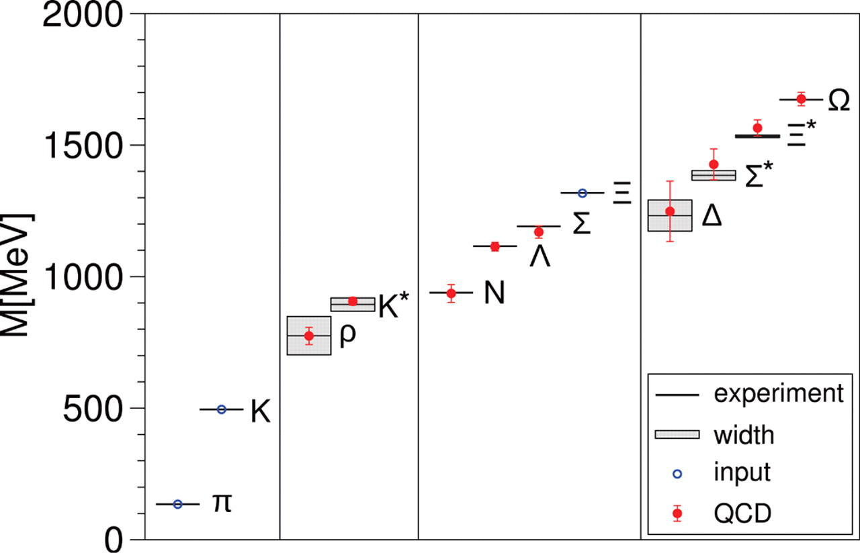
QCD in 21st Century
Standard Model & Origin of Mass
Test of QCD
Non-perturbative T>0
&
Phase structure of QCD
Phase diagram
Test of QCD, Long distance scales, Non-perturbative regime
Test of QCD, Short distance scales, perturbative regime
Science 332, 1525 (2011)
Science 322, 1224 (2008)
T=0
Towards a complete test of QCD as a theory
21/21

Slide 27
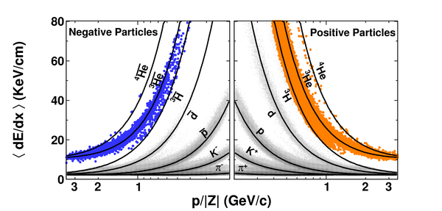
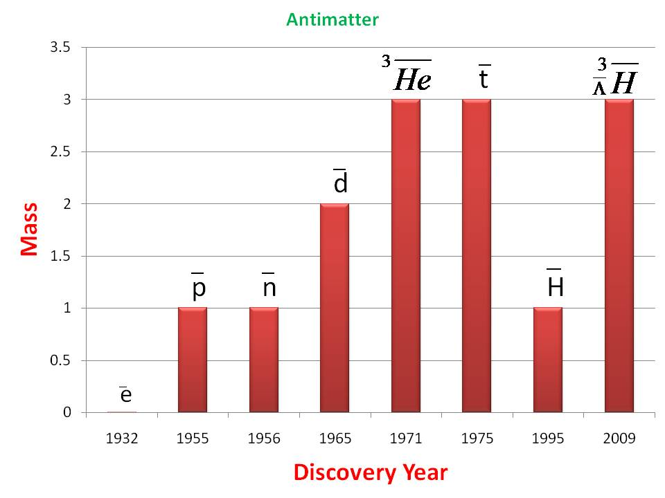
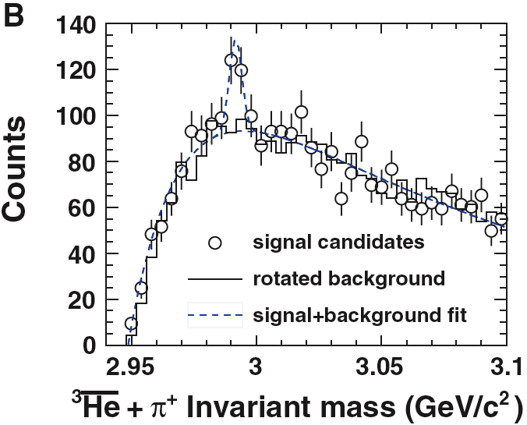
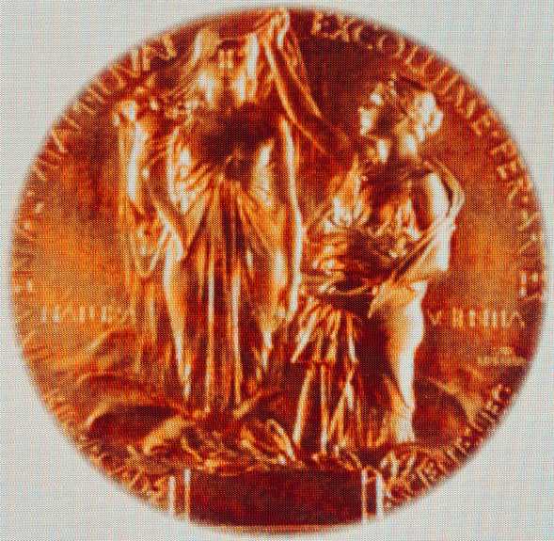
Anti-Nuclei
Ionization energy loss:
- < dE/dx > ~ A / β²
= A (1 + m²/ p²)
5 kind of charged
Particles and two
Neutral particles
Nature, 473, 353(2011).
⁴He
2011
Science, 328, 58(2010)
M² = E² - p²
Louis Pasteur: “In the field of observation, chance only
favours those minds which have been prepared”
27

Slide 28


