Slide 1
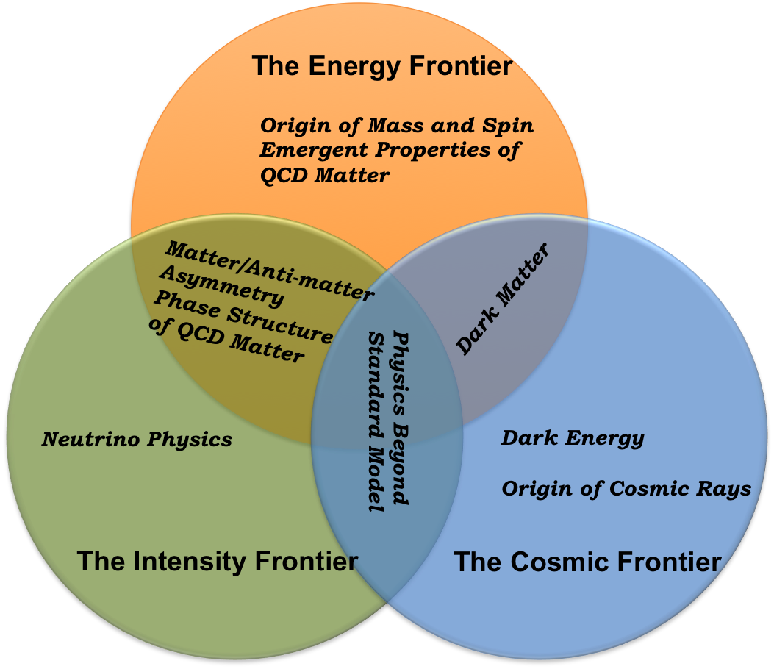
High Energy Physics Research Program
Intricate combination
Needs R&D
Accelerator
Computing
Research
Theory
Simulation
Detector
Experiment
Impact
High Energy Physics
Science Education and Human Resource Development
Detectors
Medical Science, Radiation Monitoring,
Security
Accelerators
Medical Science
ADSS (Energy) and Radioactive Waste disposal
Computing
Modeling Climate
Modeling Economy
Other fields of Science
01/14

Slide 2
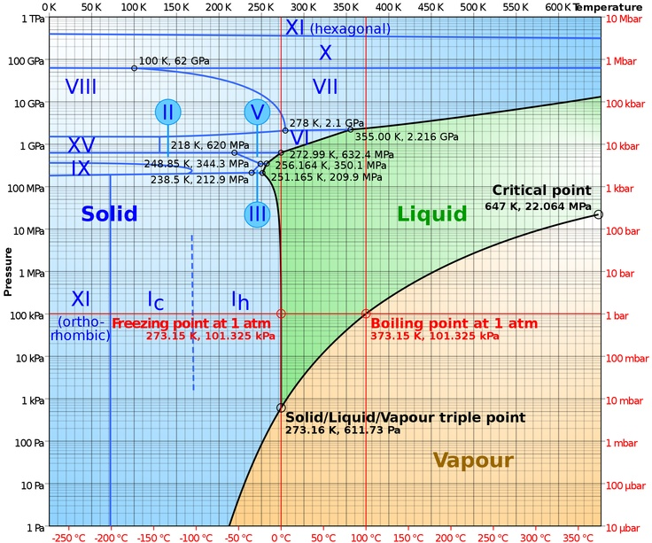
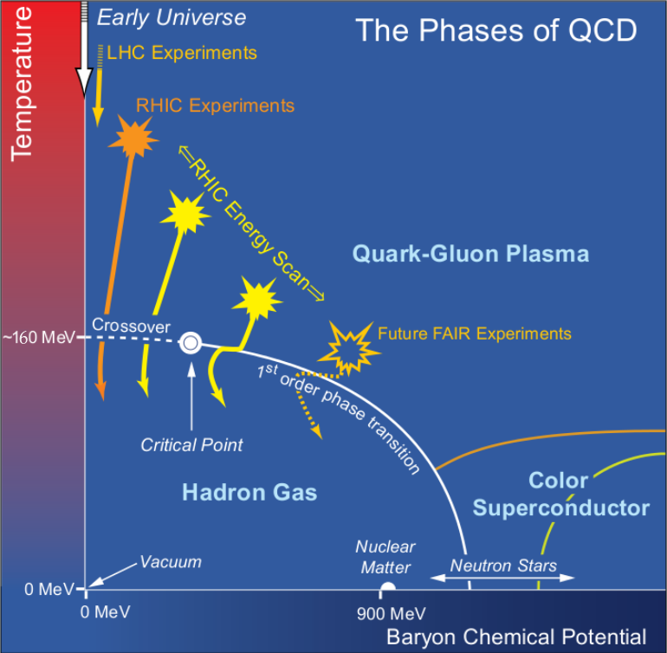
Phase Diagram of Matter
Phase Diagram of QED Matter
Phase Diagram of QCD Matter
NSAC LRP 2007
Wiki
Widely studied, precisely known
Studied for many system
Part of Text Book
Largely conjectured, Little is known
Unique, needs Accelerators
Goal to make it part of Text Book
Need to have experiments at LHC, RHIC, FAIR
02/14

Slide 3
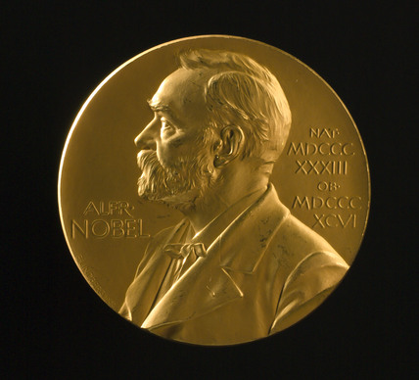
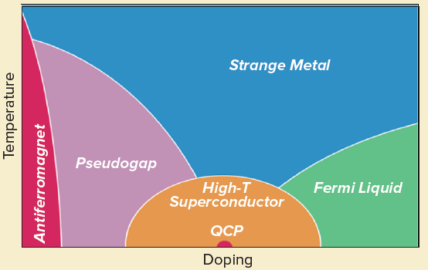
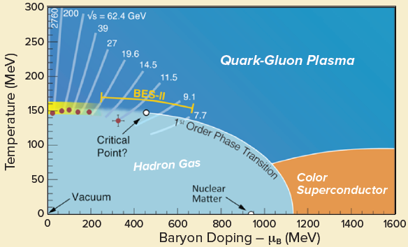
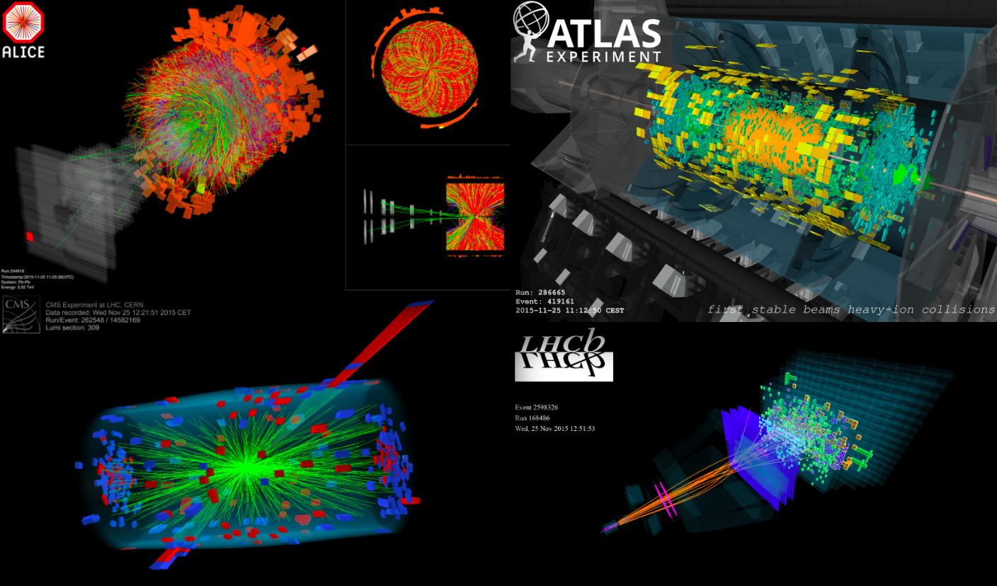
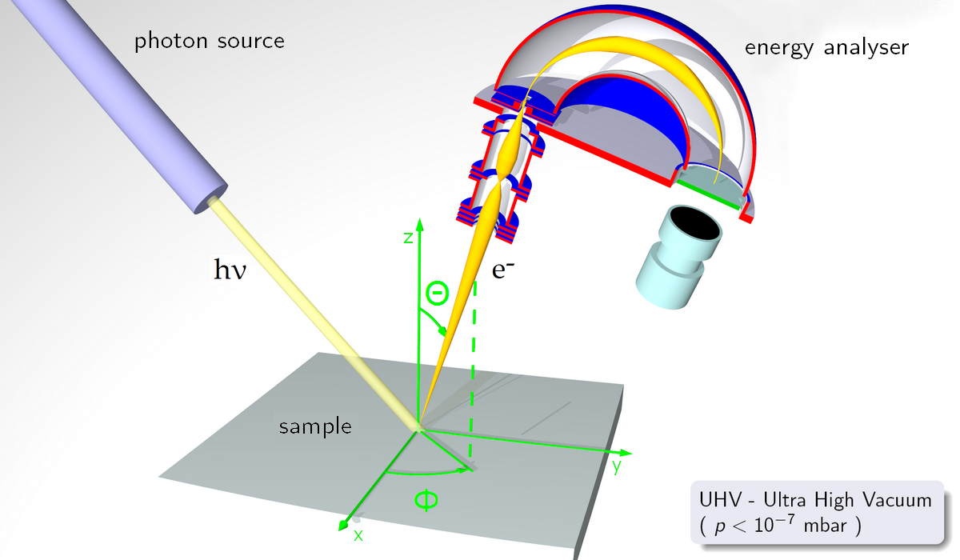
Emergent Properties of matter
Strongly correlated QED Matter
Emergent property: Strange Metal
Strongly correlated QCD Matter
Emergent property: Perfect Fluid
NSAC LRP 2015
Experiments
QCD:
2 Nobel Prizes ...more to come
Need to have experiments at LHC, RHIC, FAIR
03/14

Slide 4
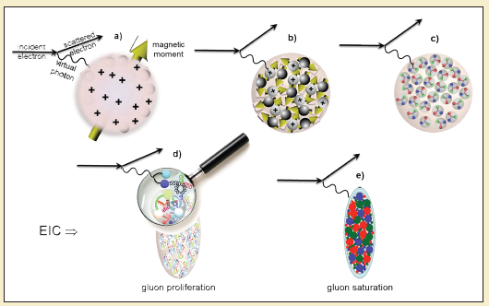
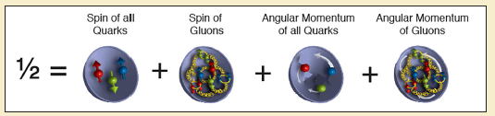
Emergent Properties of Cold QCD Matter
How confinement happens ?
Origin of Mass & Spin of Hadron ?
How nucleus looks in terms of its partonic content ?
https://arxiv.org/abs/1708.01527
Need to have experiments at EIC
04/14

Slide 5
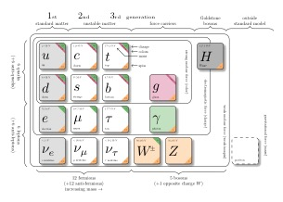
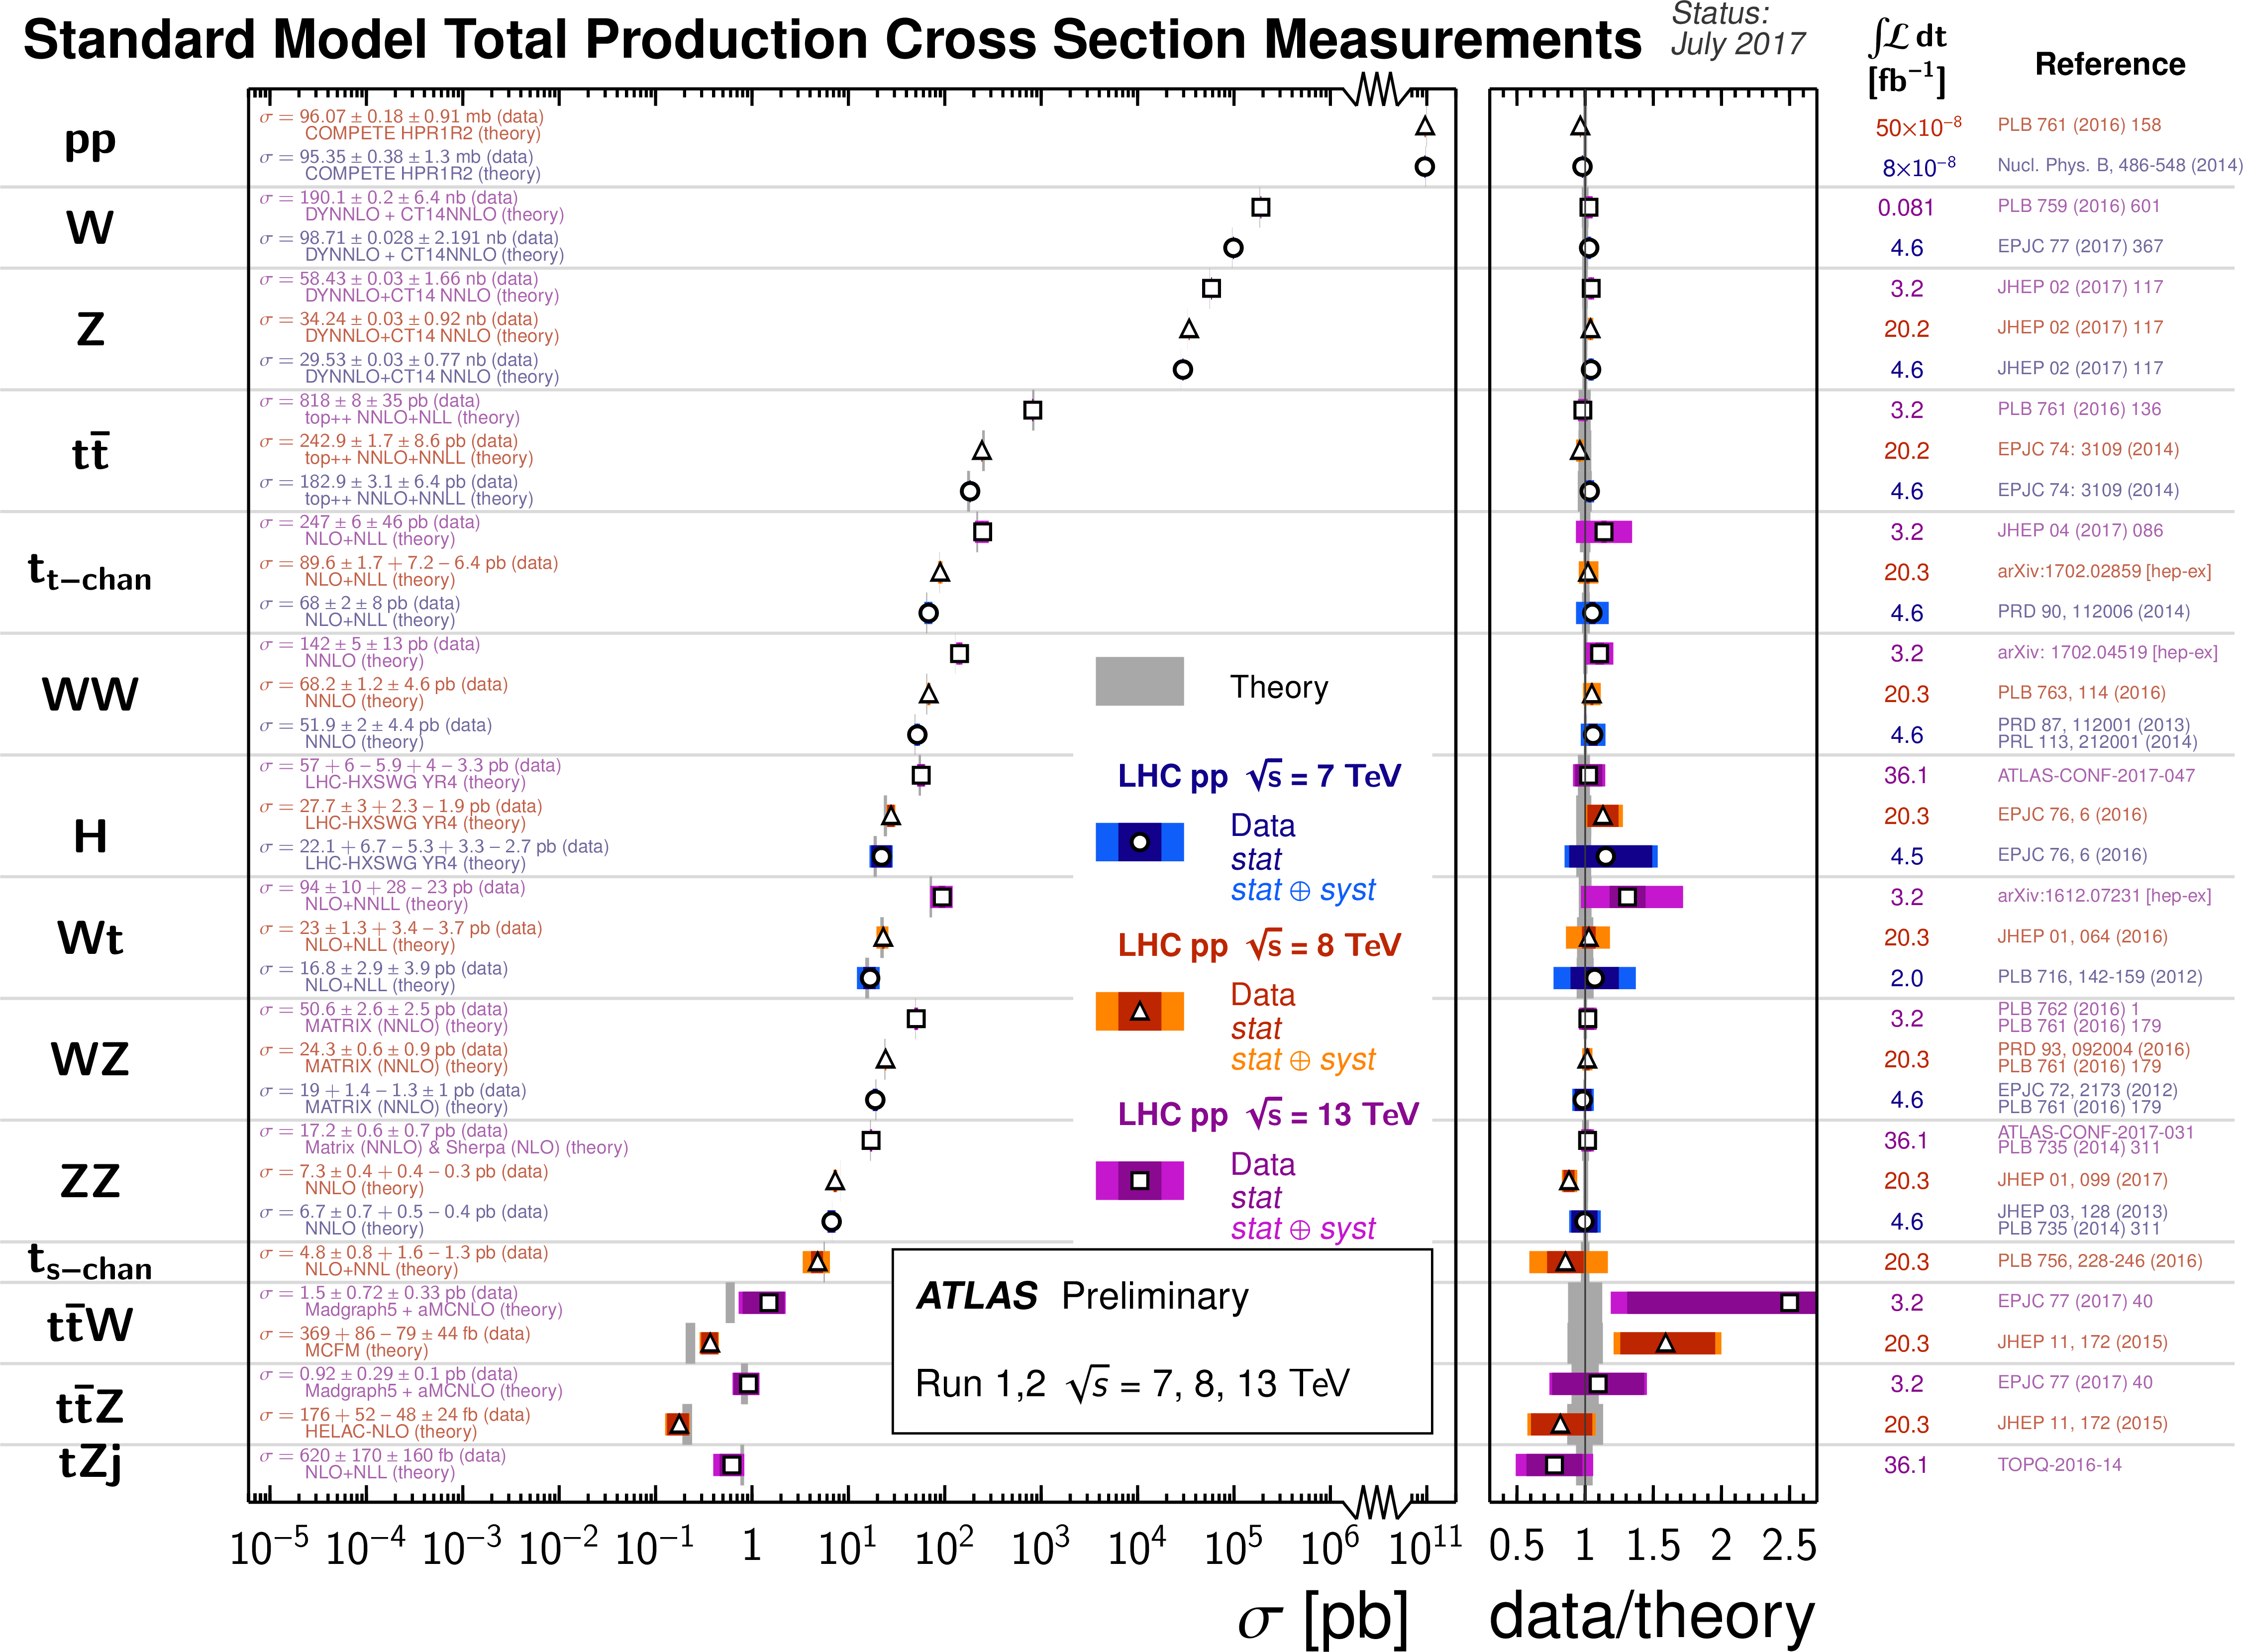
Success of Standard Model
(1897-2012)
05/14

Slide 6
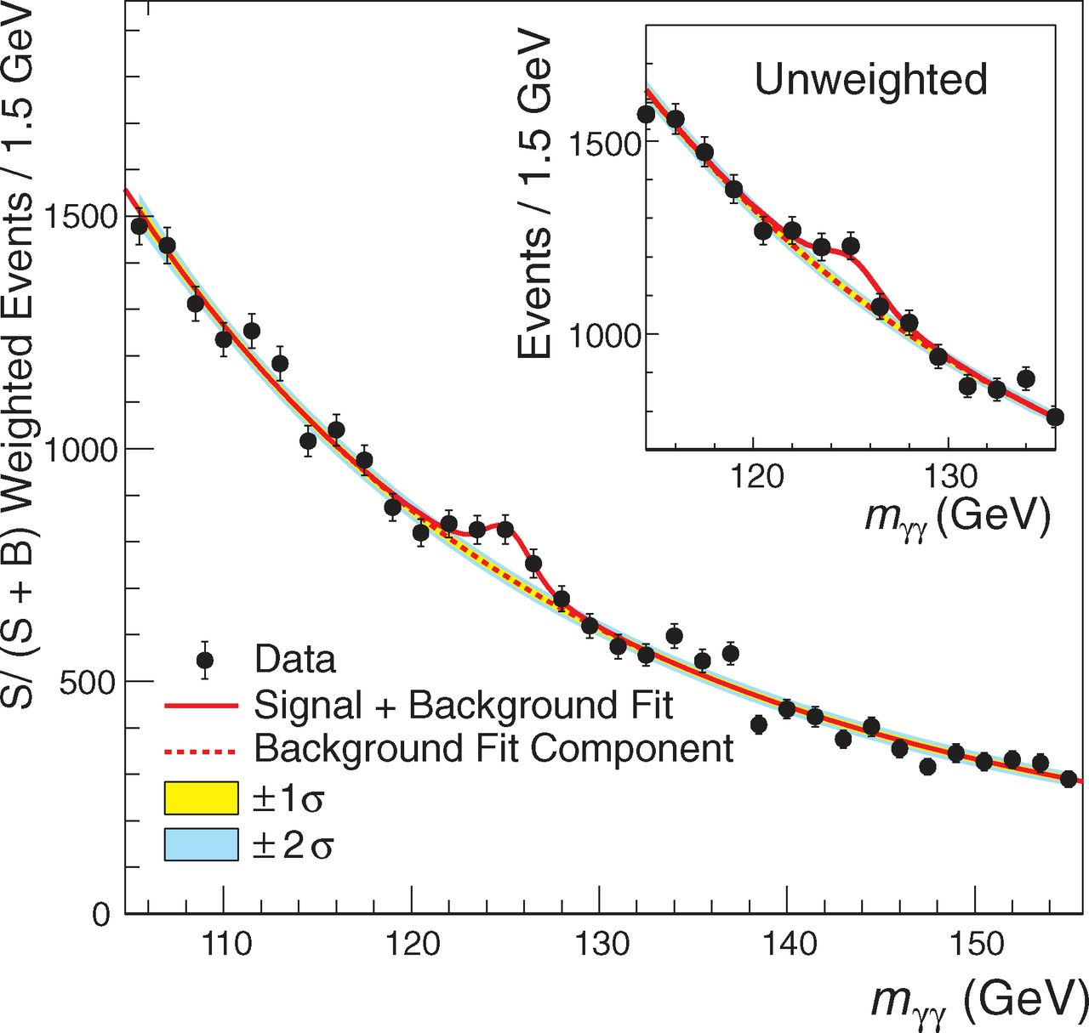
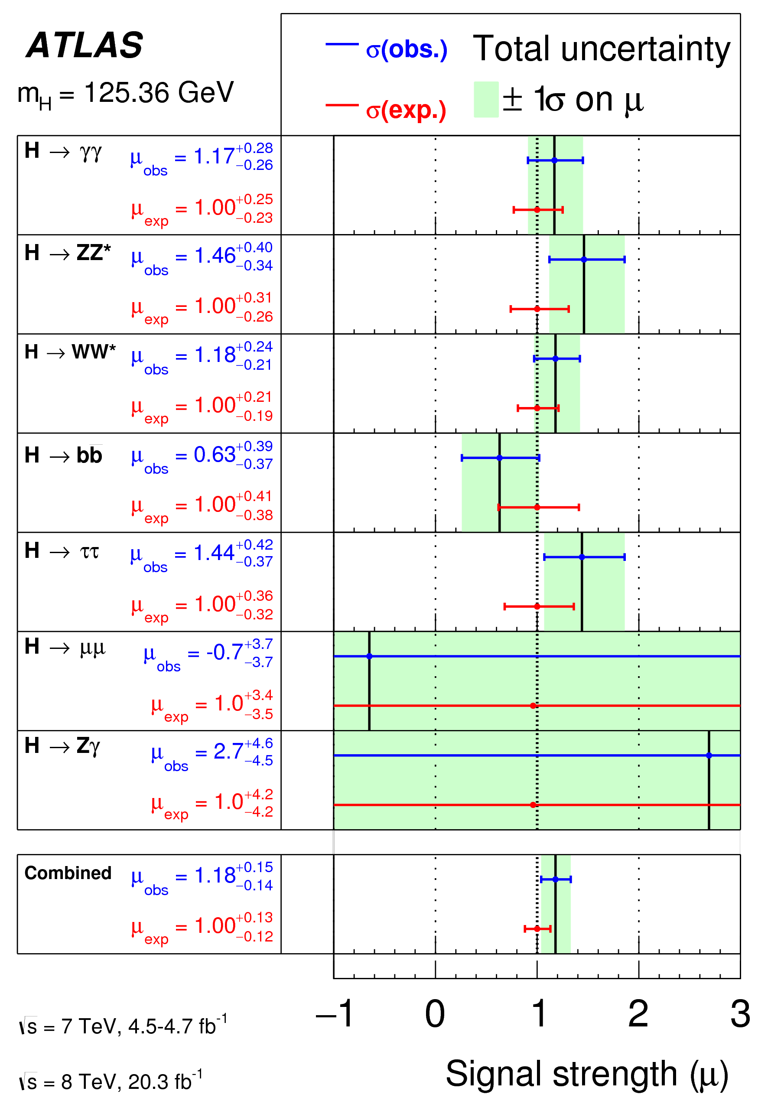
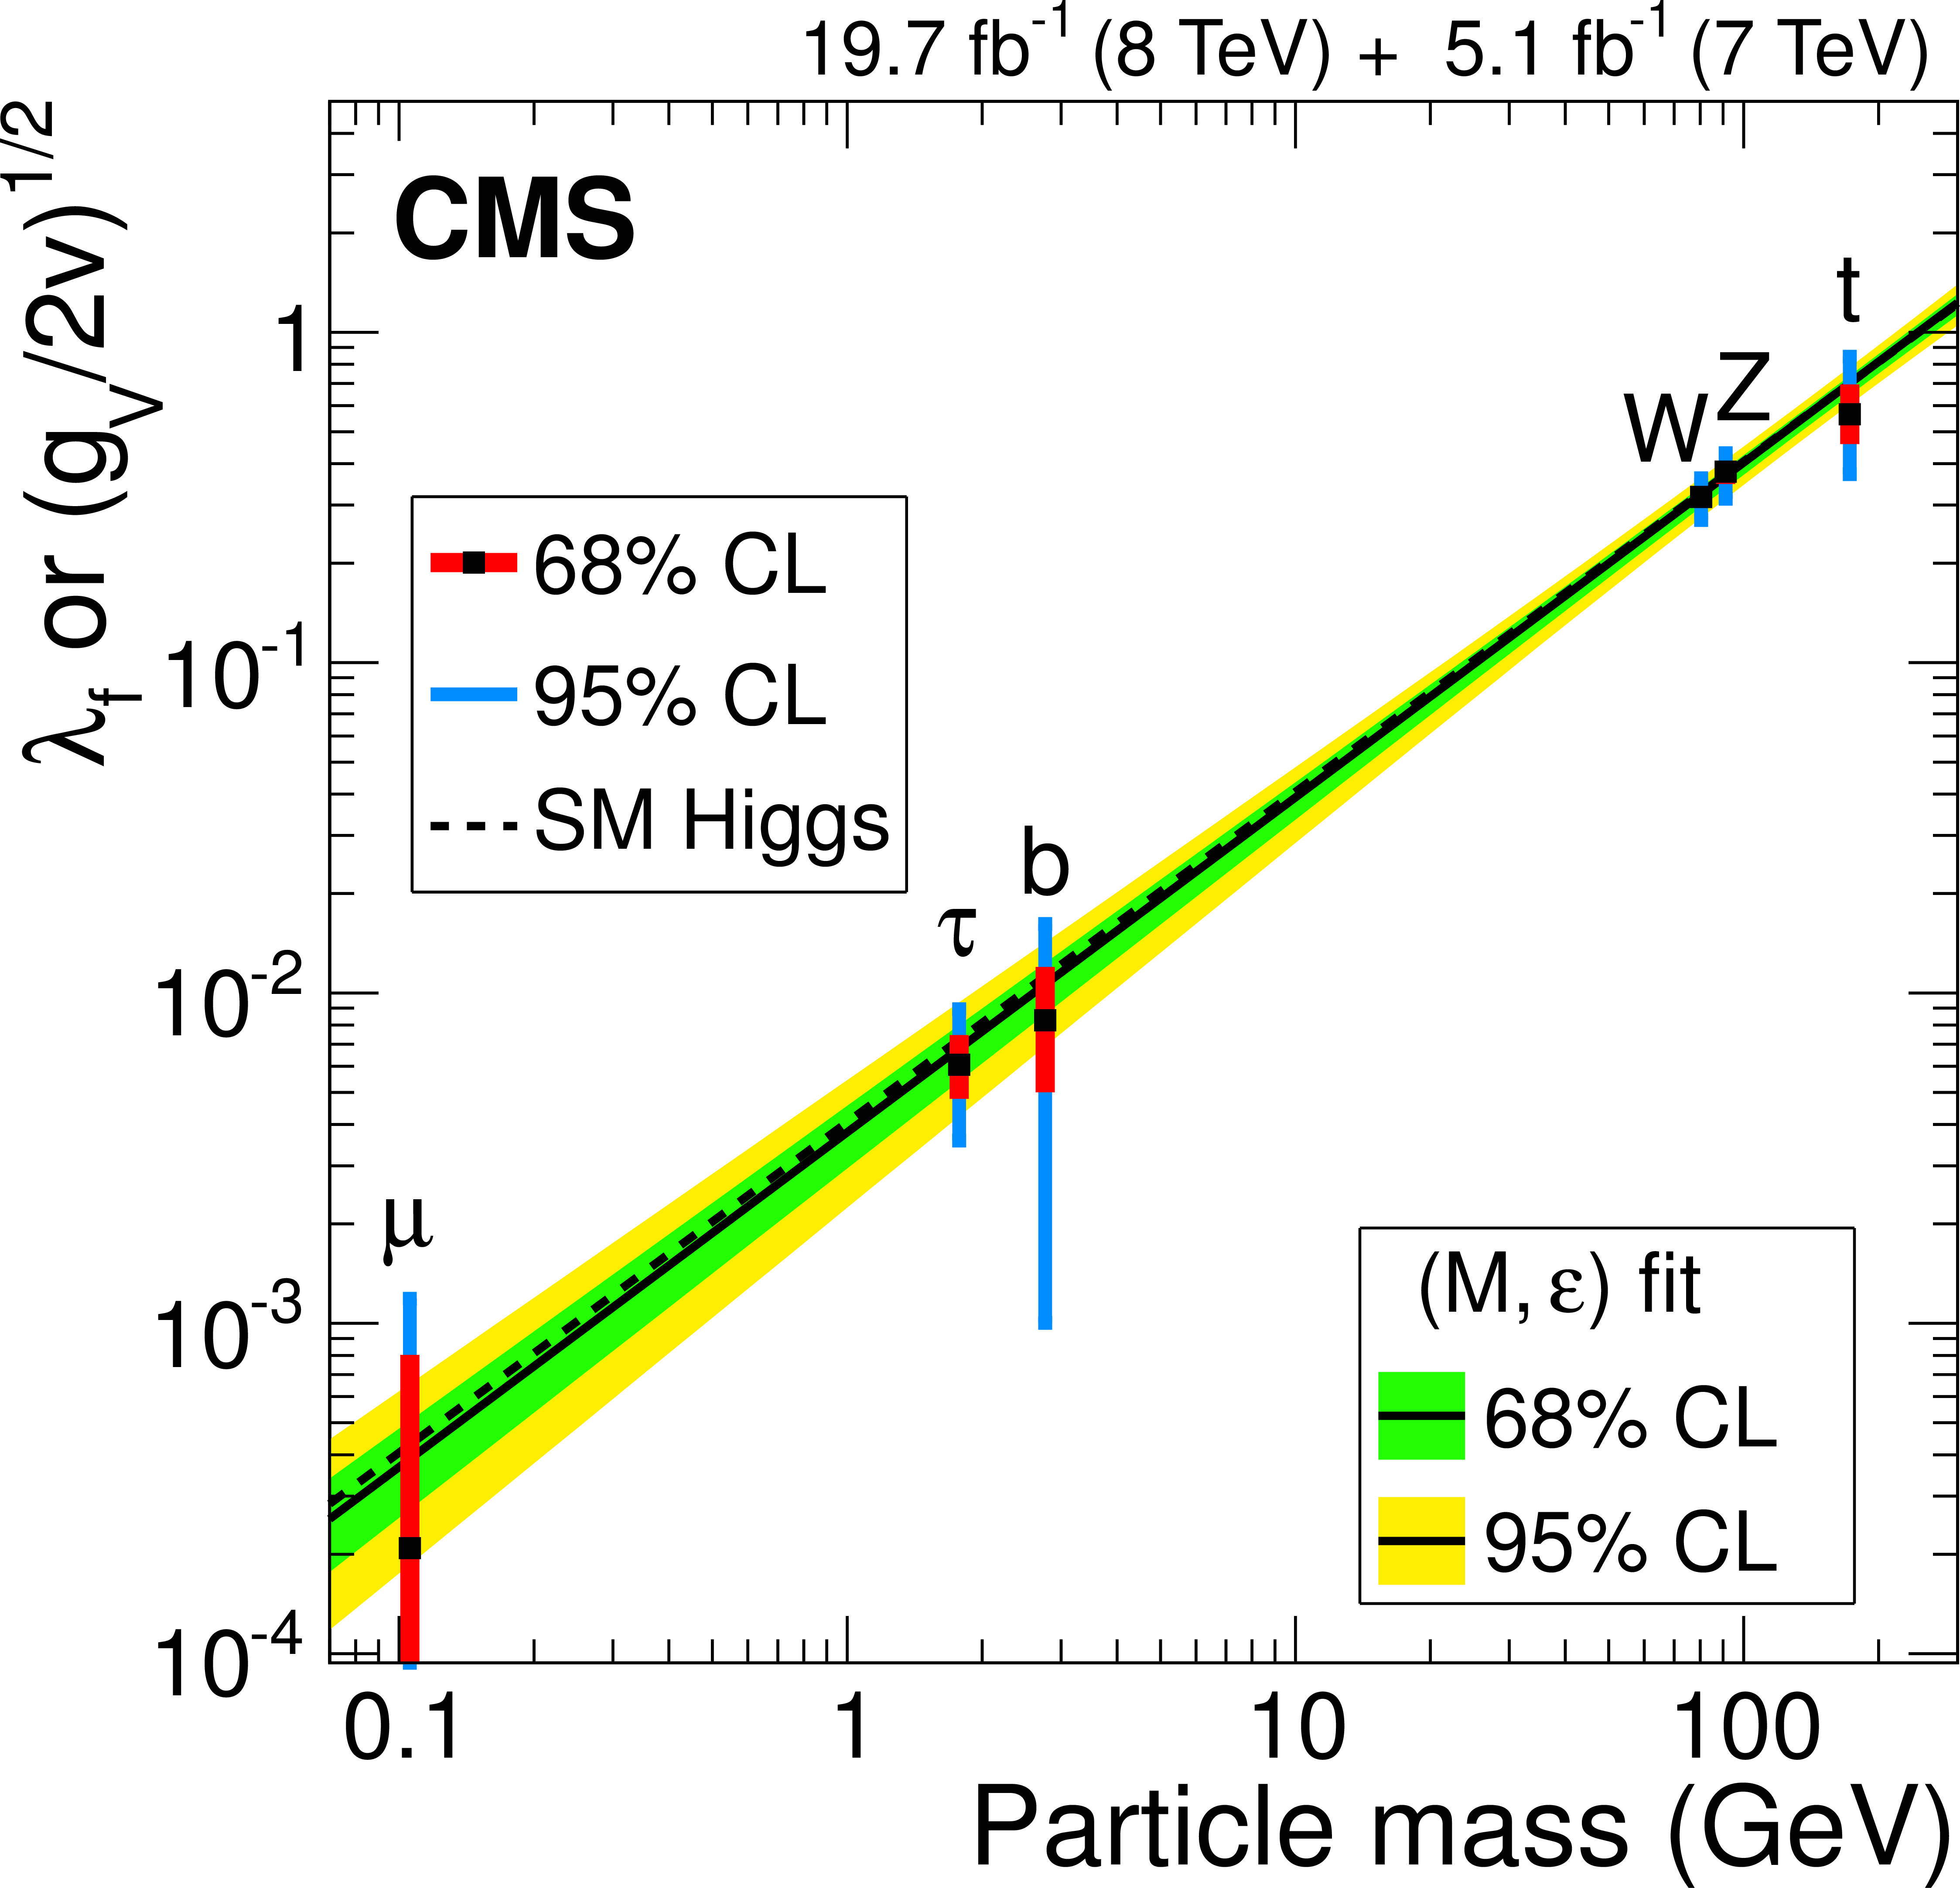
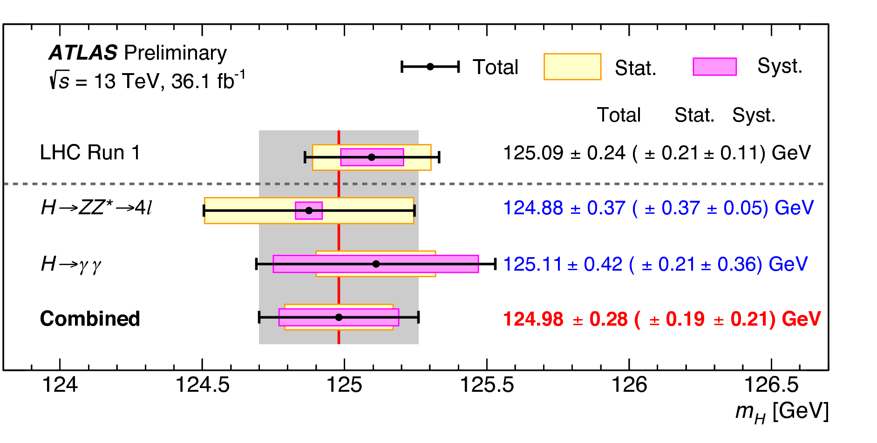
Higgs Discovery & Properties
Precision demands experiments at ILC (e+/e- collider)
06/14

Slide 7
Beyond Standard Model
https://arxiv.org/abs/1311.0299
07/14

Slide 8
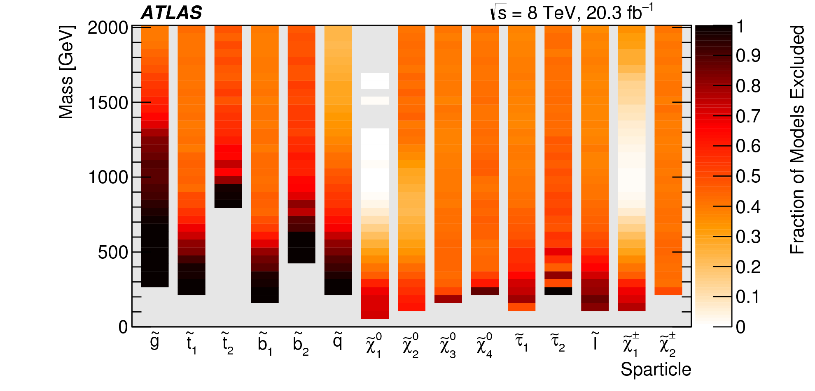
Status of SUSY
Need to have experiments at higher energies – Future pp collider
08/14

Slide 9
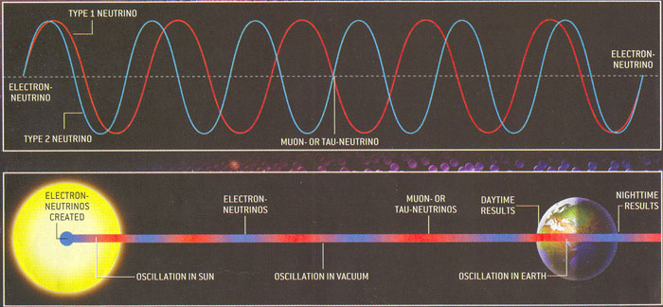
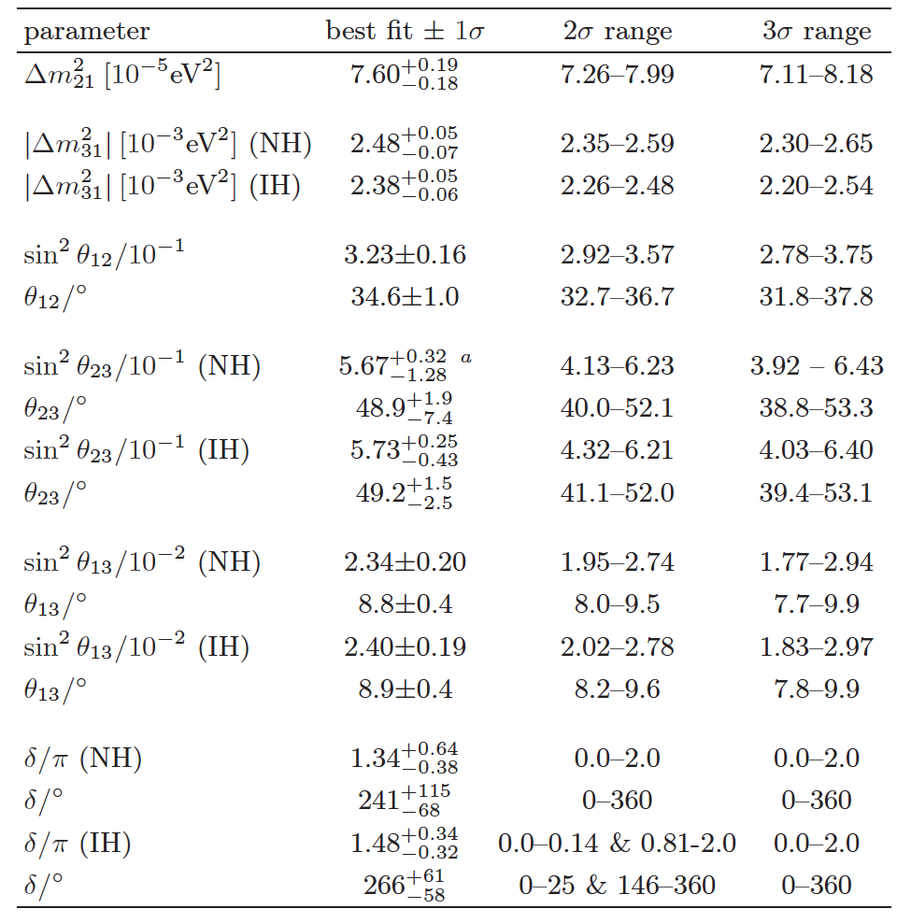
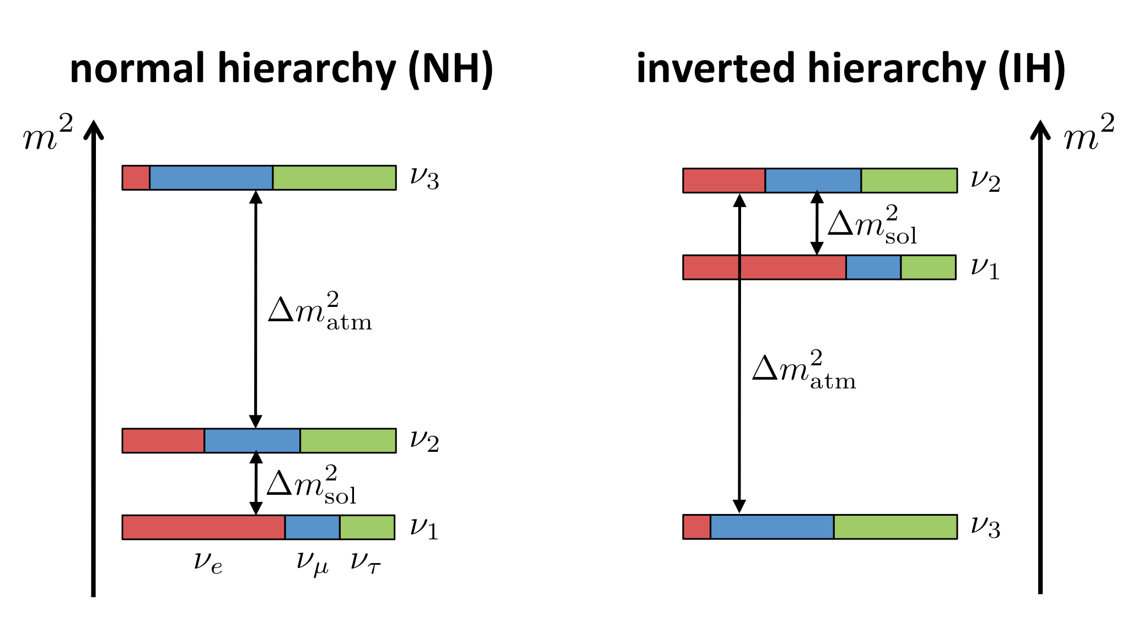
Neutrino Physics
The topic has already 4 Nobel Prizes. Many more expected ..
ν-mass is Zero in Standard Model
QM says if ν has mass it will oscillate
Oscillations measured – but not all parameters with precision
Experiments:
India – INO
Outside: DUNE, LBNE etc
09/14

Slide 10
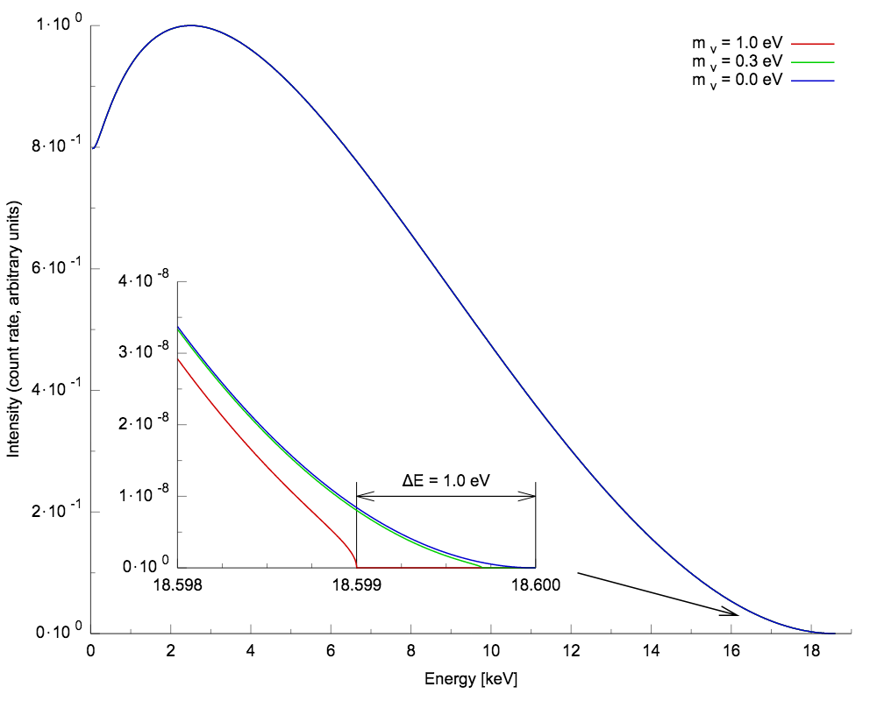
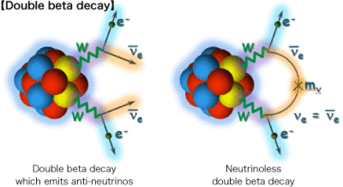
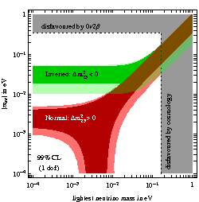
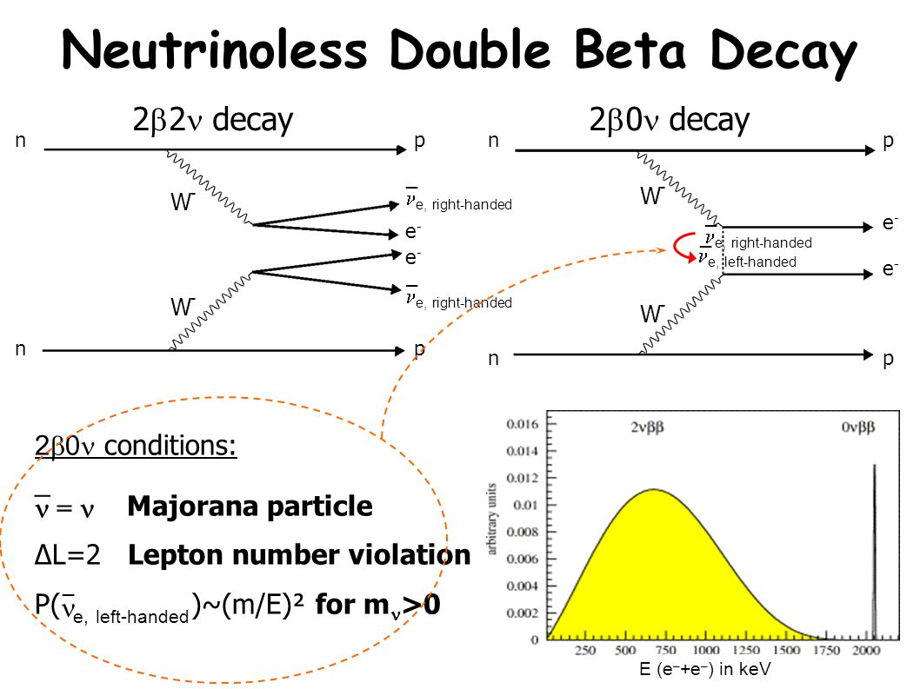
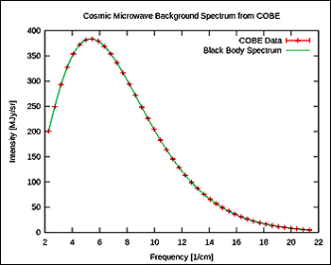
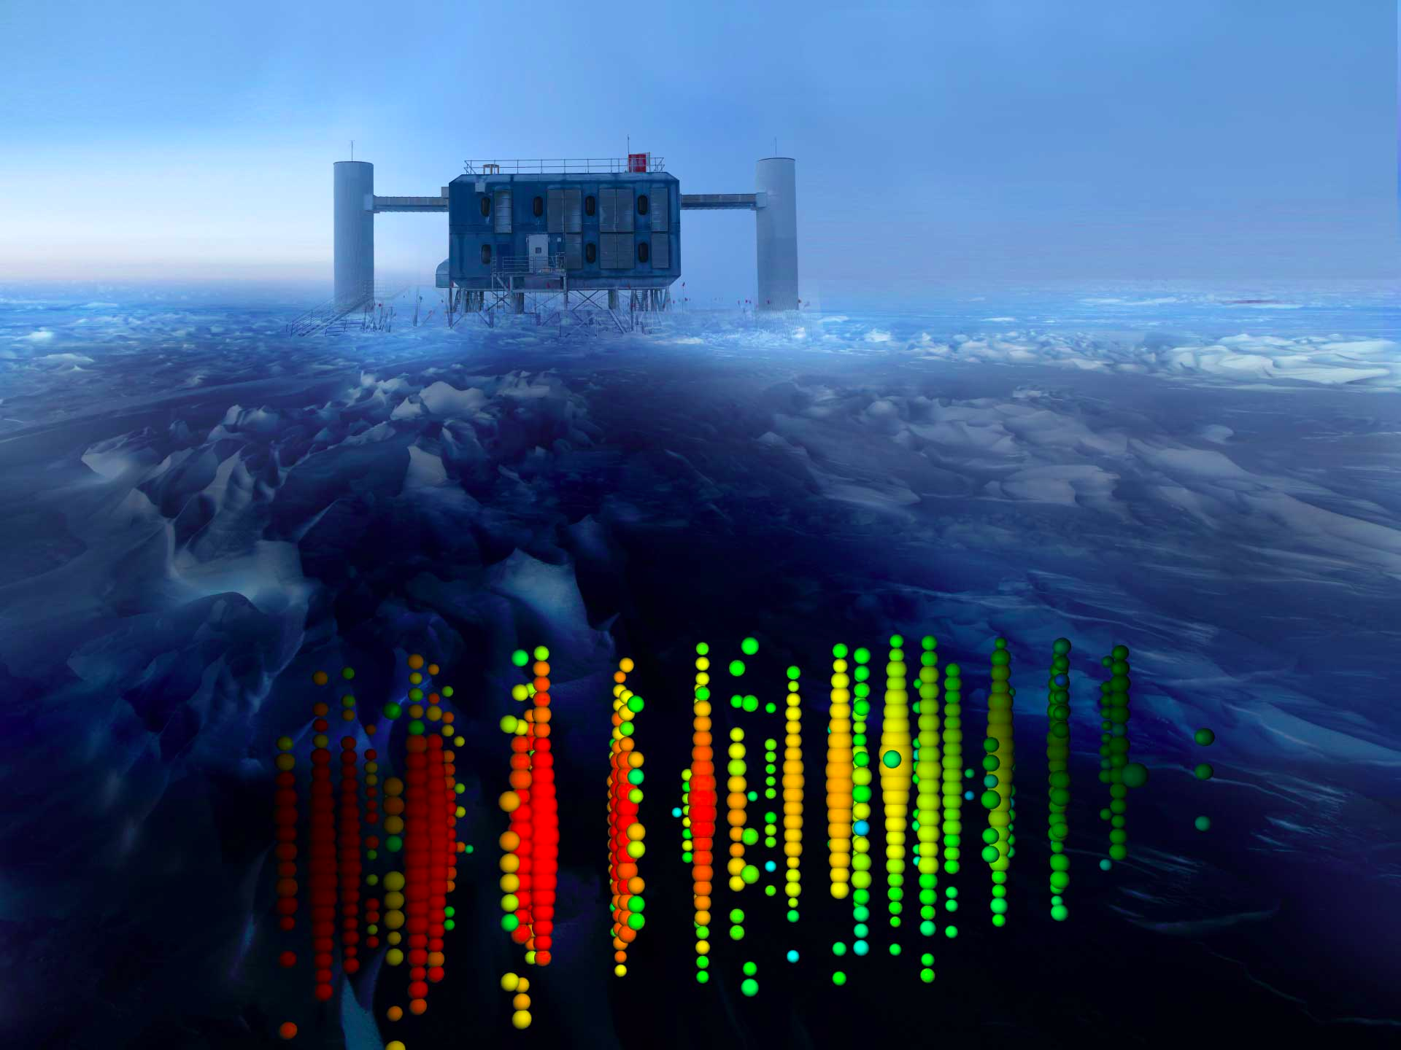
Neutrino Physics
Mass of neutrino: Precise measurement
of β-decay spectrum – Expt. in India ?
Neutrino-less double beta decay
Particle/Anti-particle
Lepton number violation
Matter-AM asymmetry
@ INO
Similar spectrum for relic ν
Astrophysical ν
ICECUBE
India (?) Antarctica
/ISRO
10/14

Slide 11
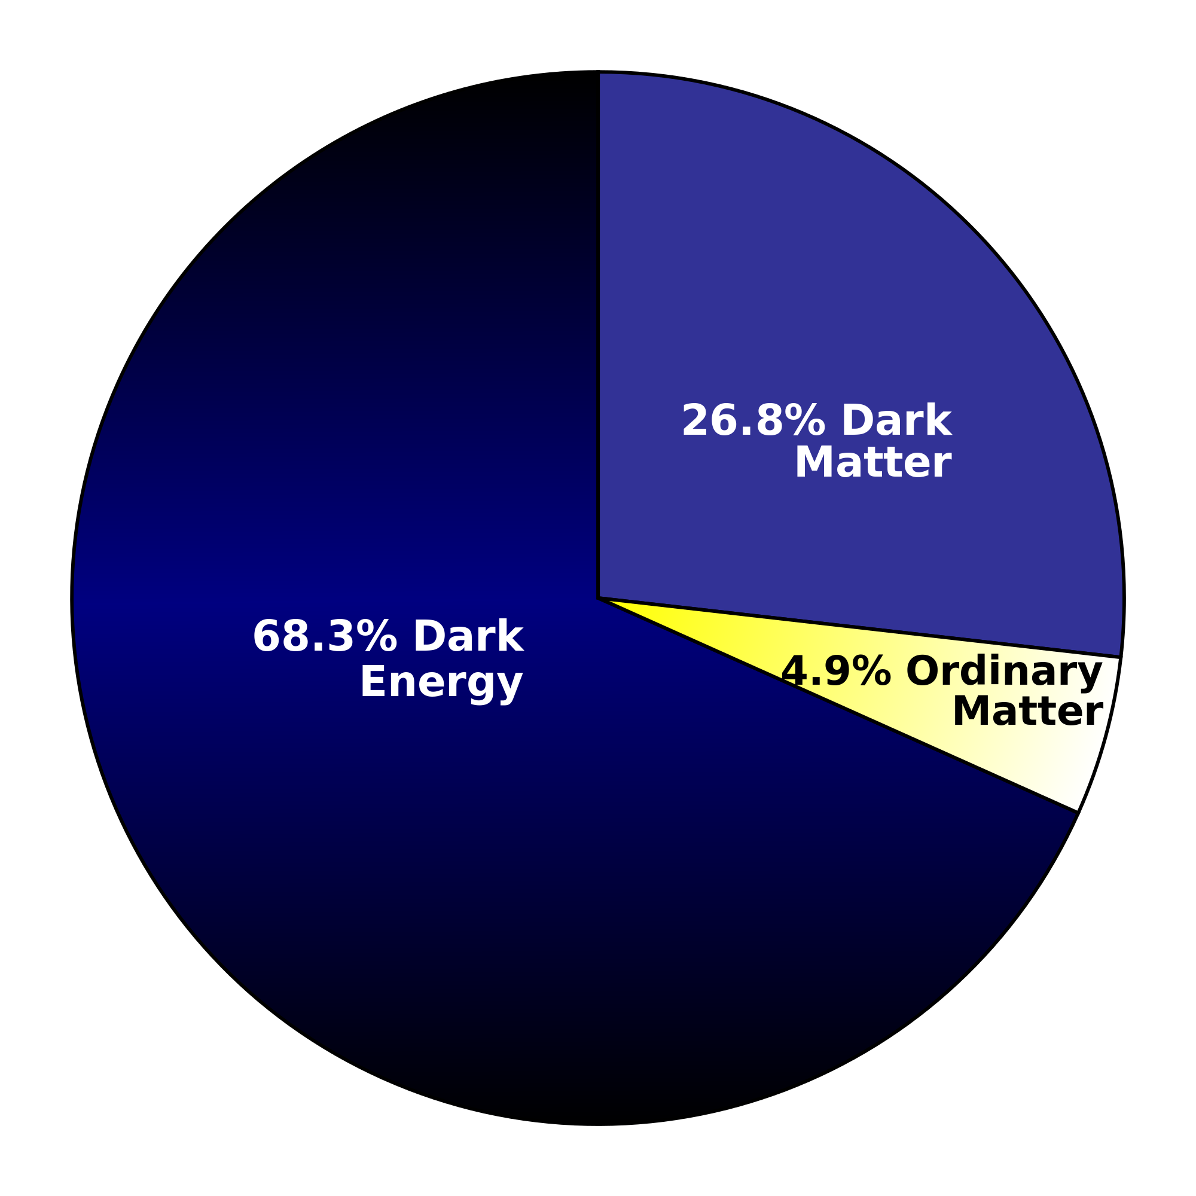
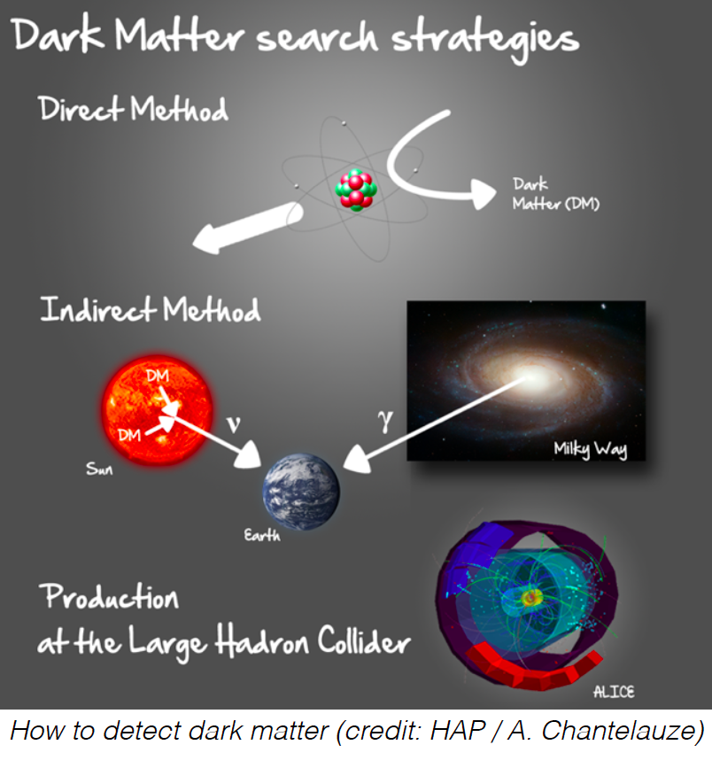
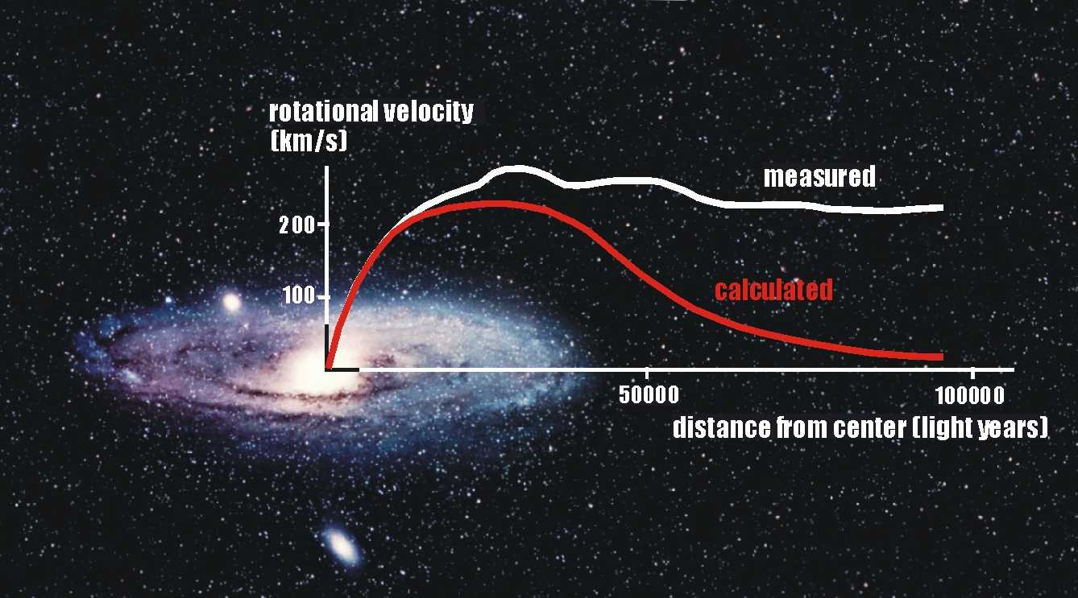

Dark Matter
Mass-Energy Budget of Universe
Detection Approaches
Composition and Properties Unknown
Evidences:
Galactic Rotation Curves
The Bullet Clusters
Large Scale Structure Formation
The CMB Spectrum
Galaxy Clusters …
11/14

Slide 12
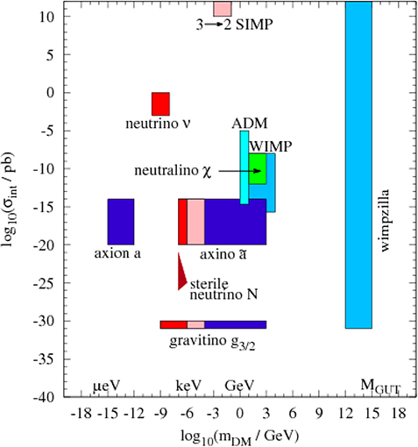
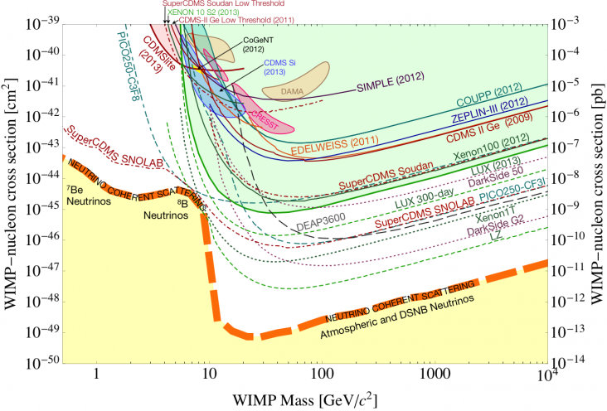
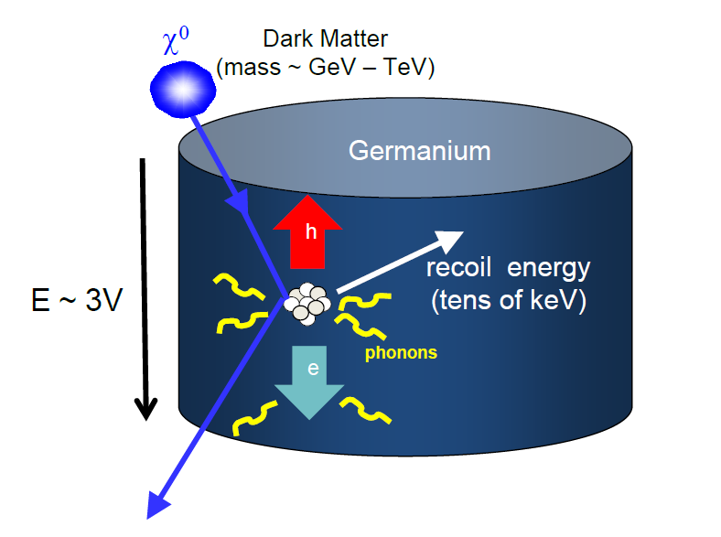
Dark Matter
Candidates:
Weakly Interacting Massive Particles
Axion Like Particles
Future in India
Make World Class facility
for Direct Detection
@ DINO
Status
MINER
Participate in other World
Wide experiments: SuperCDMS
Snowmass report 2013
12/14

Slide 13
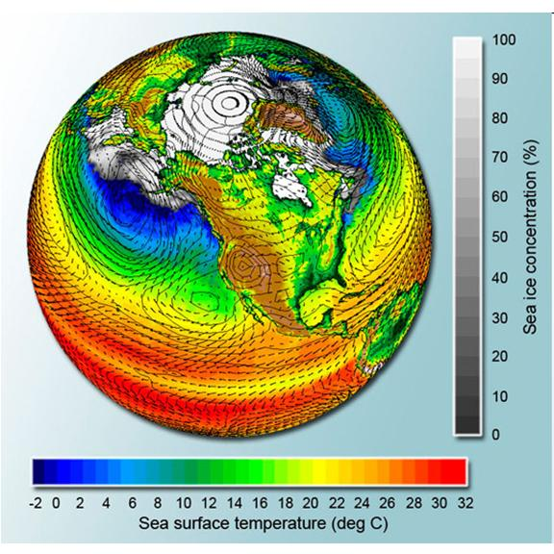
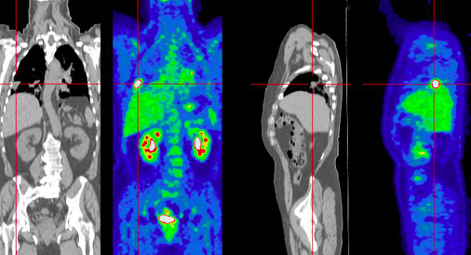
Impact
High Energy Physics
(Global)
Science Education and Human Resource Development
Detectors
Medical Science, Radiation Monitoring,
Security
Accelerators
Medical Science
ADSS (Energy) and Radioactive Waste disposal
Computing
Modeling Climate
Modeling Economy
Other fields of Science
13/14

Slide 14
HEP Requirements
Facilitate Global Participation with Leadership role. Identify one high impact sub-project in each Mega-Science project to support fully.
Build Global Level experiments in India – Dark Matter, Neutrino physics …DST-Priority Program or DST Thematic Program – Identify team (multi-institution) and a leader. Monitor strictly, fund generously/flexibly.
Globally Competitive Post Doctoral Program.
DST-Technology Development Program
  State-of-art – Detector R&D (higher resolution, higher efficiency, better signal-to-noise ratio) – Time bound Group funding – tune of Rs. 05-10 Crs.
  State-of-art – Accelerator R&D
  State-of-art – Computing R&D – Exascale (=1000PFLOPS/s)
Sustained funding for longer period is key.
14/14

