Slide 1
Physics with Relativistic Heavy-Ion Collisions
DAE-DST Vision Meeting
Mumbai
(24-25 August 2014)
Period covered : 2006 – 2014
Last vision meeting was held in 2006.
Bedanga Mohanty
(behalf of HI expt. Group)

Slide 2
Indian Groups: HI Collisions Experiment
Institution | Experiment/Facility | Approx number of persons
Univ. of Jammu | STAR@RHIC, ALICE@LHC, CBM@FAIR | 10
Univ. of Panjab | STAR@RHIC, ALICE@LHC, CBM@FAIR | 5
Univ. of Rajasthan | STAR@RHIC, ALICE@LHC | 3
Inst. of Phy. BBSR | STAR@RHIC, ALICE@LHC, CBM@FAIR | 4
NISER, BBSR | STAR@RHIC, ALICE@LHC | 6
VECC, Kolkata | STAR@RHIC, ALICE@LHC, CBM@FAIR | 15
IIT, Bombay | STAR@RHIC, ALICE@LHC | 8
SINP, Kolkata | ALICE@LHC | 5
Bose Inst. Kolkata | ALICE@LHC, CBM@FAIR | 5
IIT, Indore | ALICE@LHC CBM@FAIR | 3
BHU, Varanasi | PHENIX@RHIC, CBM@FAIR | 3
AMU, Aligrah | ALICE@LHC, CBM@FAIR | 6
BARC, Mumbai | PHENIX@RHIC, CMS@LHC | 10
Gauhati Univ. | ALICE@LHC, CBM@FAIR | 2
Univ. Calcutta | CBM@FAIR | 4

Slide 3
Contributions
Institution | Physics, Detector, Experiment (selected list only)
Univ. of Jammu | Heavy Flavour Physics, PMD, DCS, Trigger, GRID computing
Univ. of Panjab | Fluctuation and correlations, photon multiplicity, nuclei production
Univ. of Rajasthan | Anisotropic flow, photon multiplicity
Inst. of Phy. BBSR | Light hadron spectra, PMD
NISER, BBSR | Spectra, fluctuations, azimuthal anisotropy
VECC, Kolkata | PMD, MUCH, fluctuations, correlations, Jet physics
IIT, Bombay | Resonance, fluctuations, correlations, simulations
SINP, Kolkata | Muon Spectrometer ALICE, High Level trigger, RAA, J/Psi, Upsilon
Bose Inst. Kolkata | ALICE-TPC upgrade, photon multiplicity
IIT, Indore | Photon Multiplicity, HBT, Freeze-out dynamics
BHU, Varanasi | Non-photonic electrons PHENIX@RHIC, CBM@FAIR
AMU, Aligrah | Heavy-quark Measurements, Muon Detector
BARC, Mumbai | Heavy-quark Measurements, Fluctuations and Correlations, jets, UPC

Slide 4
Future
Institution | Physics, Detector, Experiment
Univ. of Jammu | EIC, Kaon experiments, STAR-HFT, Silicon det ALICE, Muon Det. CBM and DCS, Triggers
Univ. of Panjab | BES-II, EIC, GEM and electronics, CBM
Univ. of Rajasthan | Initial state physics, Tier-2 Grid Computing
Inst. of Phy. BBSR | ALICE-TPC upgrade, MUCH CBM
NISER, BBSR | RHIC-BES-II, CBM-ToF, ALICE-TPC=GEM upgrade
VECC, Kolkata | Dilepton, quarkonia, ALICE-TPC, CBM-MUCH, CRU, Silicon Detector, electronics
IIT, Bombay | Physics analysis, silicon detector, GEM based detectors
SINP, Kolkata | Physics analysis
Bose Inst. Kolkata | Physics analysis and Gas based detectors
IIT, Indore | Physics Analysis
BHU, Varanasi | Physics Analysis
AMU, Aligrah | Physics analysis and detector R&D
BARC, Mumbai | Gas based detectors (GEM, RPC), Silicon based deetctors, Electronics, Physics analysis

Slide 5
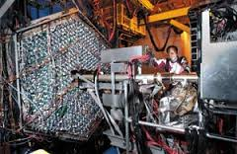
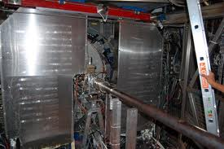
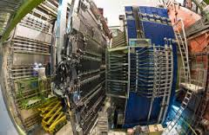
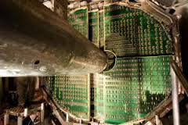
Detector Highlights
Photon Multiplicity Detector : STAR @ RHIC
ALICE @ LHC
Publications:
Physical Review Letters 95 (2005) 062301
Physical Review C 73 (2006) 034906
Nuclear Physics A 832 (2010) 134
NIM A 499 (2003) 751
NIM A 488 (2002) 131
Muon Spectrometer : ALICE @ LHC
Publications:
Physics Letters B 734 (2014) 314
JHEP 1402 (2014) 073
Physical Review Letters 111 (2013) 162301
Physical Review Letters 109 (2012) 112301
Physical Review Letters 109 (2012) 072301
Physics Letters B 708 (2012) 265
Physics Letters B 704 (2011) 442

Slide 6
Human Resource Highlights
Graduate Student training : Building future leaders in Science
PhD awarded/Submitted
STAR Experiment: 16
PHENIX Experiment: 02
ALICE Experiment: 10
CMS: 02
CBM: 01
Placements:
Faculties at:
National Labs: BARC, VECC
Indian Institute of Technology
Universities
Postdocs at:
USA, Europe and Asia
30 students pursuing their PhD degree
Undergraduate students: Catering to the needs of the community and
Training in general students in experimental methods, techniques
For example NISER (DAE funded inst.)
Students are doing PhD in high energy
Physics at UCLA, SUNY after getting experience
Through MSc thesis in this field.
MSc students
Summer students

Slide 7


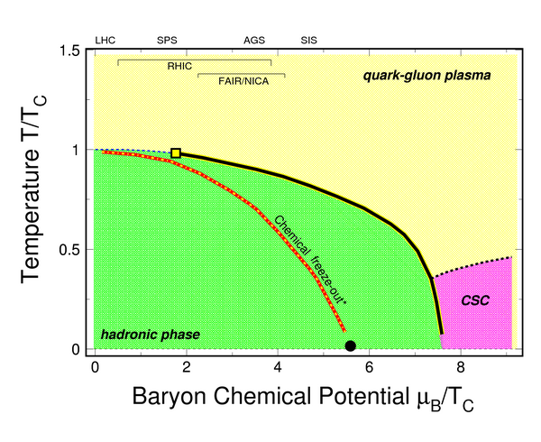
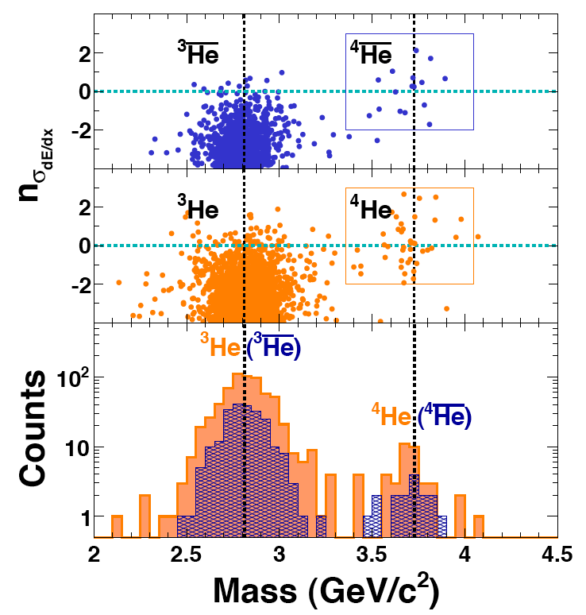
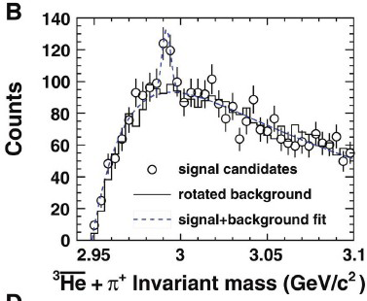
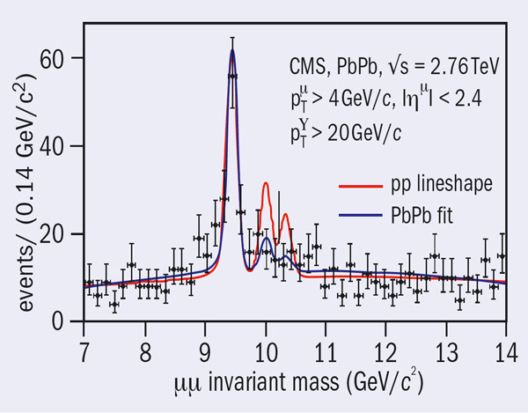
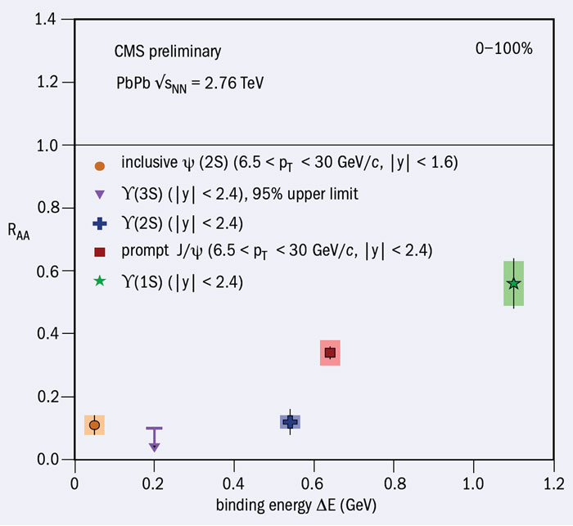
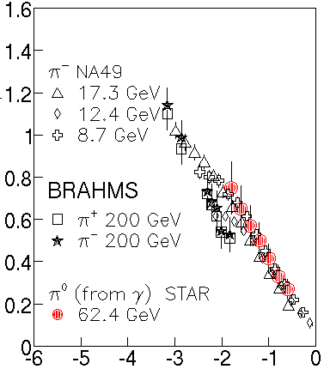
Publication in High Impact Journals
“Observation of the
Antimatter Helium-4
Nucleus“ by STAR Collaboration, Nature, 473, 353(2011).
“Observation of an
Antimatter Hypernucleus”
by STAR Collaboration, Science, 328, 58(2010).
“Scale of QCD phase diagram”
Science, 332, 1525(2011).
March, 2010

Slide 8
Future Physics Goals
Physics Goal | Experiment/Facility | Remarks
Establish the phase diagram of strong interactions | Relativistic Heavy Ion Collider (RHIC) Beam Energy Scan Phase – II of STAR experiment And Compressed Baryonic Matter (CBM) Experiment at FAIR | Detector + associated electronics development, construction and commissioning Physics analysis
Establish the properties of the de-confined state of quarks and gluons | Large Hadron Collider, RHIC and CBM@FAIR | Detector + associated electronics development, and Physics analysis
Establish the initial conditions of heavy-ion collisions | Electron Ion Collider and LHC | Detector development and Physics analysis

Slide 9
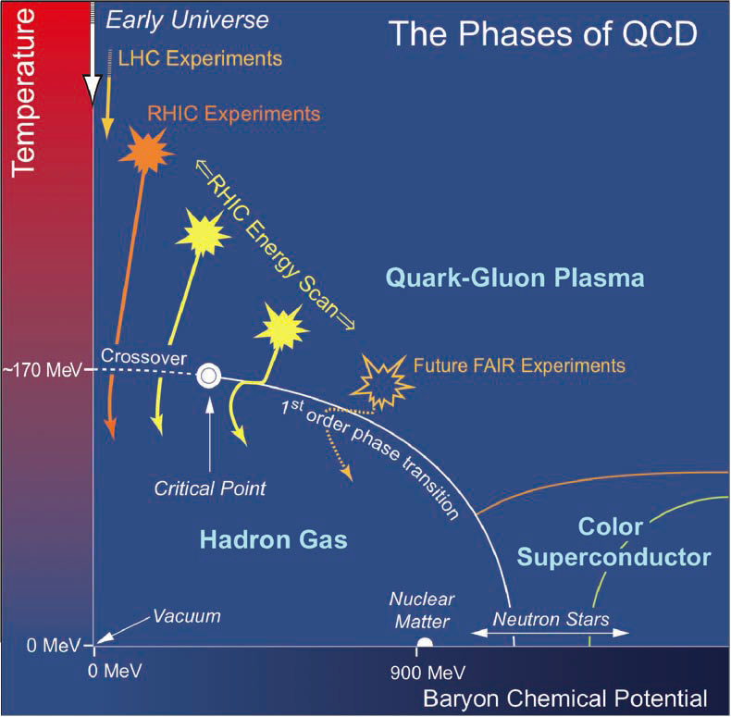
VISION – I
What is the phase diagram of strong interactions ?
High temperature system:
RHIC and LHC
High Baryon density system:
RHIC and CBM@FAIR

Slide 10
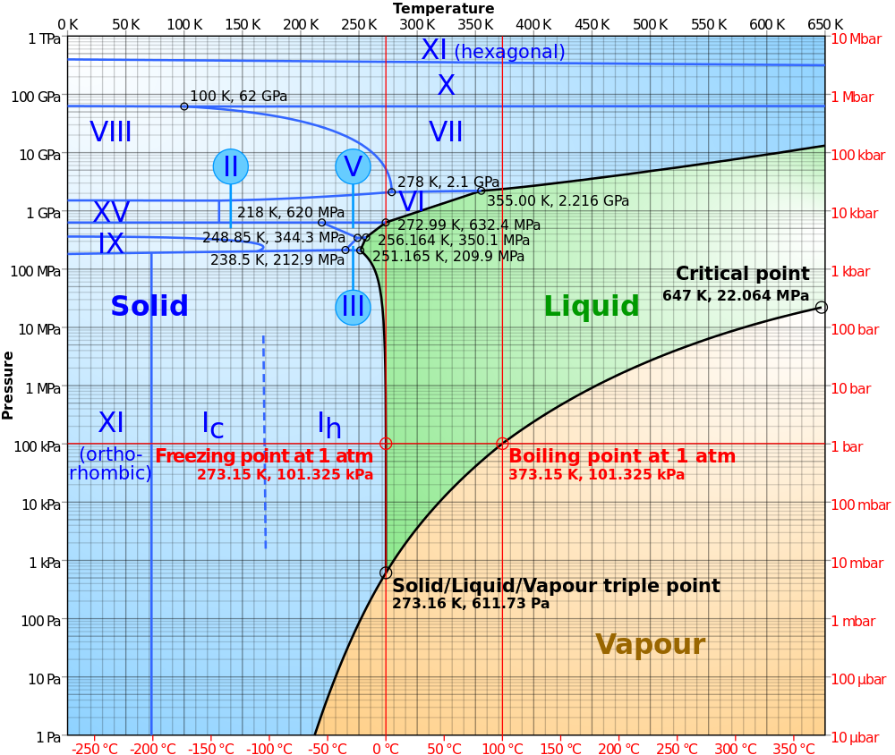
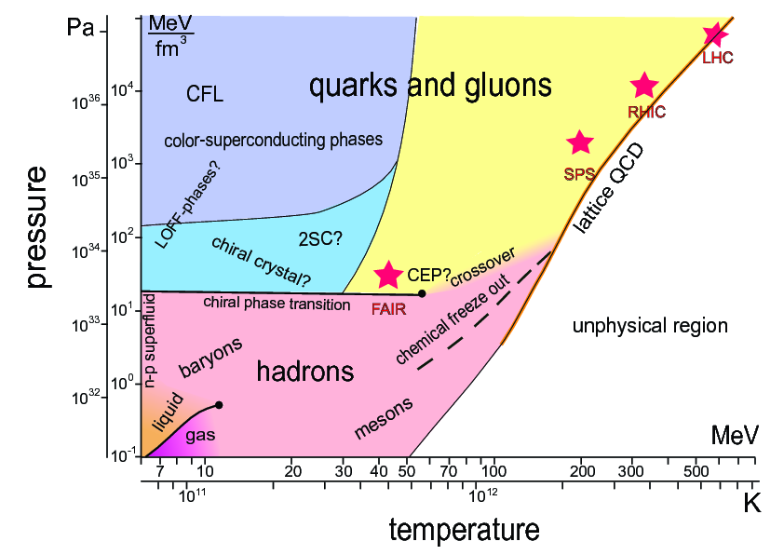
Physics Goal: Establishing QCD Phase Diagram
Phase diagram of Water
Electromagnetic interaction
Precisely known
Phase diagram of strong interactions.
arXiv:1111.5475 [hep-ph]

Slide 11
Phase Diagram: What Remains to be done
QGP
Cross over
CP
HRG
1st Order
Partonic Phase
Hadronic Phase
Cross Over
First Order
Critical region*
Quarkyonic Matter

Slide 12
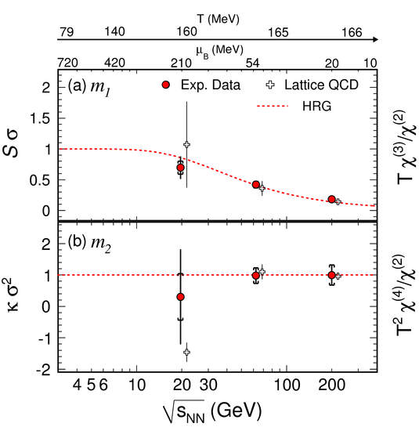
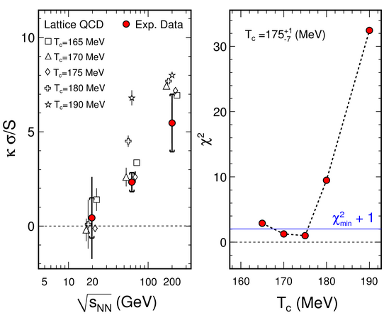
QCD Phase Diagram: Theory & Experiment
Science 332 (2011) 1525-1528

Slide 13
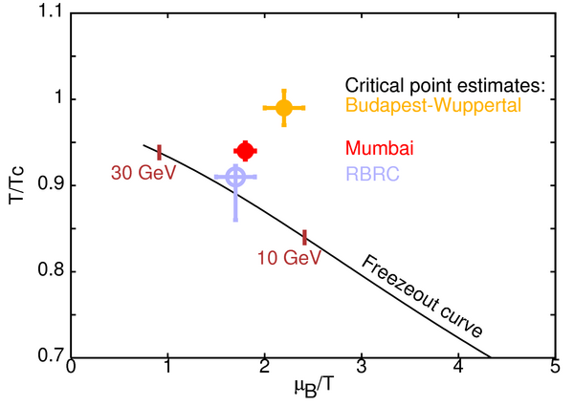
QCD Critical Point: Indian Contribution In Theory

Slide 14
QCD Critical Point: Indian Contribution In Experiment
Physical Review Letters 112 (2014) 032302
Physical Review Letters 105 (2010) 022302
arXiv:1402.1558 - Physical Review Letters in print
Complimentary analysis from BARC
Group in PHENIX experiment at RHIC

Slide 15
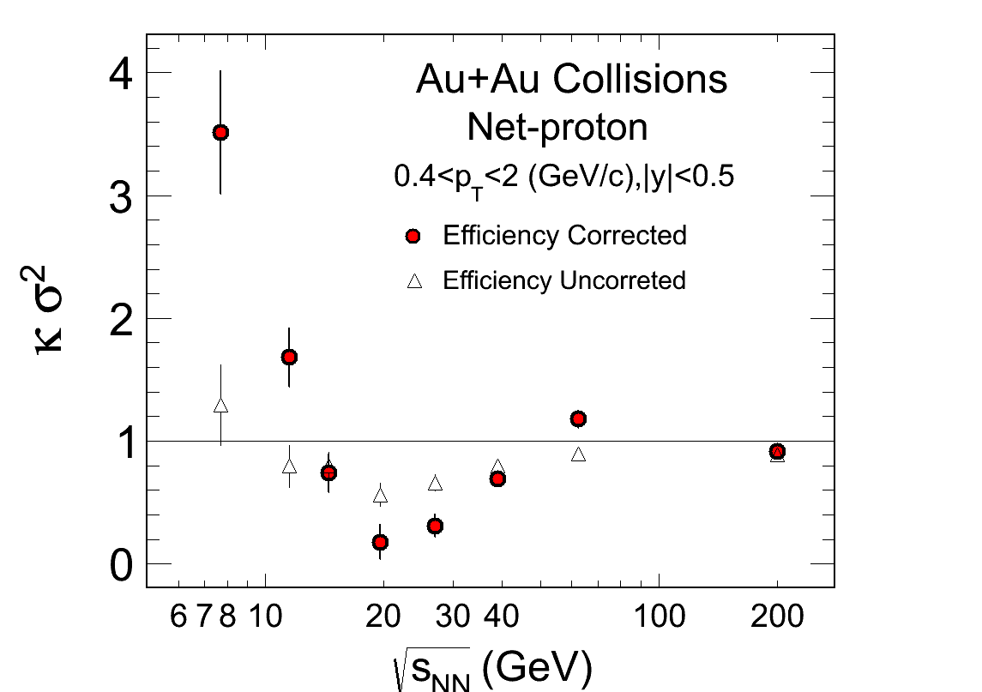
Complete the CP Measurement – Possible discovery
STAR Preliminary
Phys.Rev.Lett. 107 (2011) 052301
Phys.Rev.Lett. 102 (2009) 032301
High event statistics measurements of protons in narrow energy of collisions - RHIC BES-II
Lower energy collisions & measurement protons – ToF@CBM@FAIR

Slide 16
Future Experiments to achieve Physics Goals
Experiments/Facility | Nature of participation and time line
STAR Experiment Beam Energy Scan Phase – II – Relativistic Heavy Ion Collider, BNL, USA | Data taking and Physics Analysis 2014-2020
Compressed Baryonic Matter Experiment, FAIR facility, GSI, Germany | Detector for identified hadrons – Time of Flight in CBM Physics Analysis and Data Taking 2018 Onwards

Slide 17
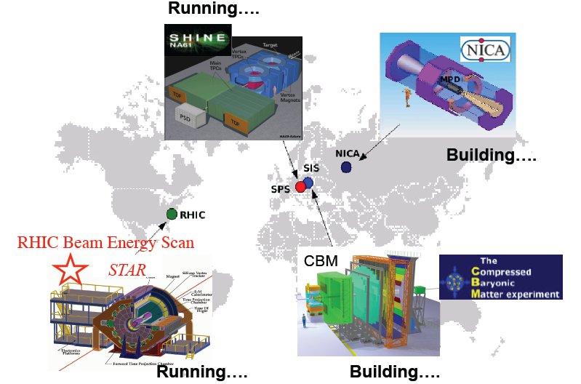
World wide interest
JINR
CERN
GSI
BNL

Slide 18
VISION – II
What are the properties of de-confined state
Of quarks and gluons ?
High temperature system: RHIC and LHC
High Baryon density system: RHIC and CBM@FAIR
Detector R&D
Phys. Rev. Lett. 98 (2007) 092301
Phys. Rev. Lett. 97 ( 2006) 162302
Phys. Rev. Lett. 98 (2007) 172301
Phys. Rev. Lett. 97 (2006) 152303
……..

Slide 19
Experimentally Discoveries about QGP at RHIC and LHC
High-Momentum Hadron Suppression
-- Jet Quenching
Away-Side Jet Modication (Tomography)
-- Medium Opacity
Elliptic Flow at the Hydrodynamic Limit
-- Perfect Fluid
Valence Quark Scaling of Elliptic Flow
-- Partonic Collectivity
Density-Fluctuation-Driven High Order Flow Moments
-- Analogous to CMBR effect in heavy-ion collisions
Suppression & Flow of Heavy Quarks
-- Screening of color charges
Sequential Melting of Heavy Quarkonia
-- Perfect color opacity, color screening
Charge Correlations Suggesting Chiral-Magnetic Effect – QCD topology
Suppression of particle production in the low-x coherent regime – CGC?
New Anti-Nuclei and Hyper-Nuclei created – anti-matter
Significant Indian Group Contribution!

Slide 20
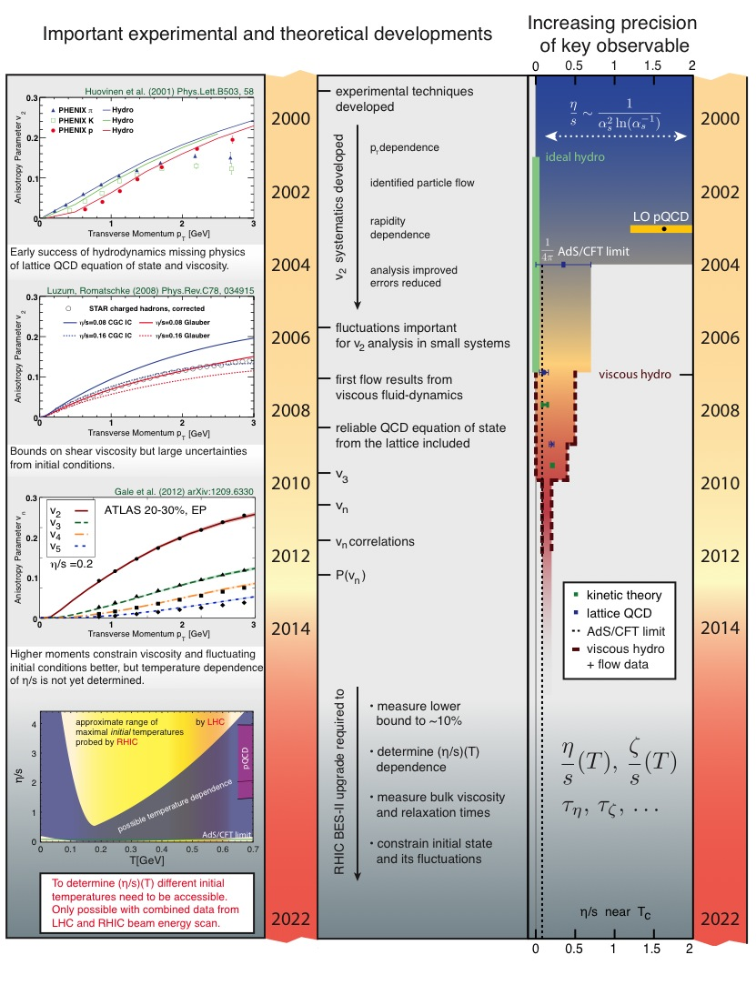
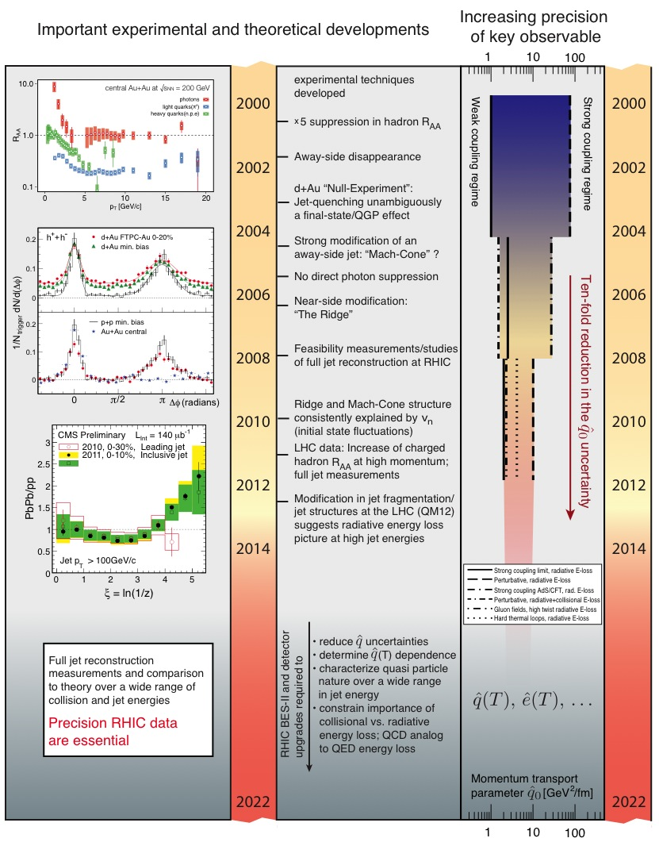
Properties of QGP : Fluidity and Opacity (2 examples)

Slide 21
Quantitative Estimates
Initial State Characterization:
The initial temperature Tinit, and formation time of the QGP have been determined to lie within the following ranges: 300 MeV - 600 MeV and 0.2 fm/c - 1.2 fm/c
Shear-Viscosity / Entropy-Density (η/s):
Expressed in dimensionless units, the effective value for the shear viscosity to entropy density ratio in the QGP phase near T_{C} has been found to be 1/4π - 2/4π
Momentum & Energy Transport coefficients:
The energy-loss transport coefficient qhat at the very early stage in the evolution ( ~ 0.6 fm/c) of Au+Au collisions has been determined to 2-10 GeV²/fm

Slide 22
What remains to de done
Build and Complete the Standard Model of Heavy-Ion Collisions – needs additional precision measurements ……
The initial state is understood to fluctuate event by event according to classical color dynamics relevant at sub-hadronic size scales (resulting from gluon saturation).
There is a rapid changeover from the glue-field dominated initial pre-equilibrium stage of the reaction to its hydrodynamic evolution. The actual mechanism of thermalization is still unknown
The equation of state is taken from lattice QCD calculations. Low temperature hadron gas, chemical FO and Kinetic FO
The dynamical evolution of the liquid proceeds using second order viscous hydrodynamic equations.
The kinetic break-up of the system occurs at temperatures well below the de-confinement transition temperature. During this period the system evolves as an expanding hadron gas that is optimally and reliably described with a microscopic transport calculation based on the Boltzmann equation.

Slide 23
What measurements needs to be done
Precision Measurement: Temperature dependence of η/s and other bulk transport parameters
Precision Measurement: Jets - The Physics of Partonic Energy Loss
Temperature dependence of qhat
Coupling strength of the medium
Quasi particle nature of QGP
Radiative vs. elastic energy loss
Full potential of Heavy Flavor and Quarkonia measurements yet to be achieved
Dileptons and Chiral Symmetry Restoration related measurements needed to be done over broad spectrum of densities and temperature
Pre-Equilibrium Physics related measurements yet to be made
Need to continue with experiments at LHC and RHIC with new detectors and
Upgrades!
Make Measurements in the high baryon density regions – CBM very essential
The detectors need to cope with high luminosity and should be radiation hard

Slide 24
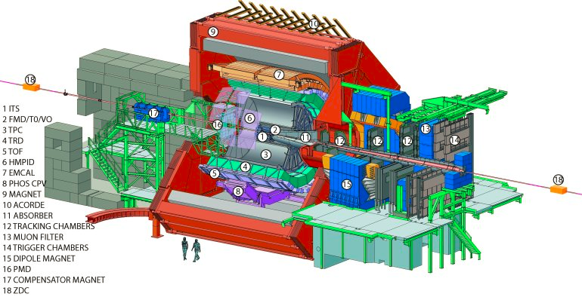
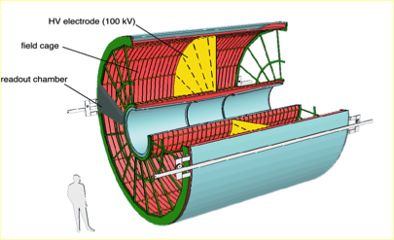
ALICE TPC up-gradation
Main tracking device: TPC
σ_{p}/p < 7% at 10 GeV
-0.9 < η < 0.9
σ_{dE/dx} = 5%
Readout rate: 500 Hz (Pb-Pb)
Volume: ~ 90m³; Gas: Ne/CO₂(/N₂) (90/10/5)
Drift voltage: 100kV, 94ms drift time
72 MWPCs with 557768 readout pads
Ref: ALICE-TDR-016, CERN-LHCC-2013-020, March 3 2014
Goal:
Use GEM to adjust to the high luminosity environment at LHC,
Reduce space charge effect and ion-back flow effect

Slide 25
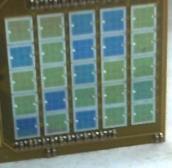
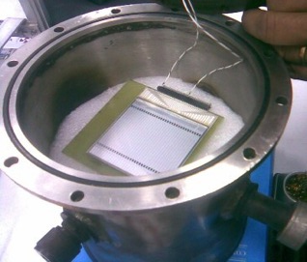
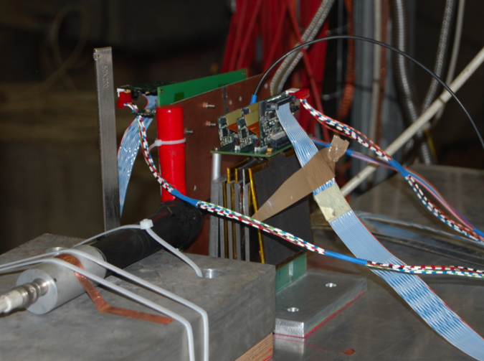
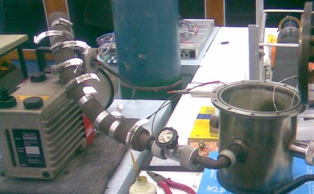
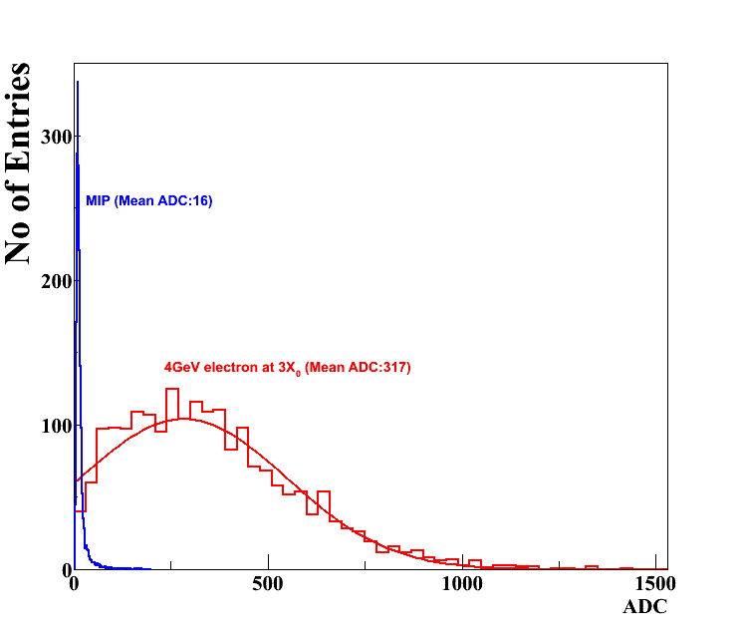
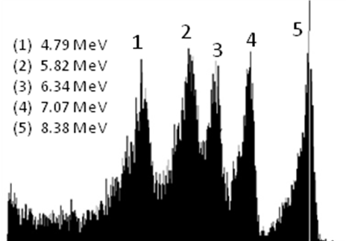
Silicon Sensors:
ALICE-India with BEL, Bangalore
Test at CERN
Test at VECC
Tungsten-Silicon Calorimeter Prototype
Silicon Strip
Silicon Pad
Thorium Alpha Spectra
Pion 5 GeV
ALICE
UPGRADE
Electron 4 GeV

Slide 26
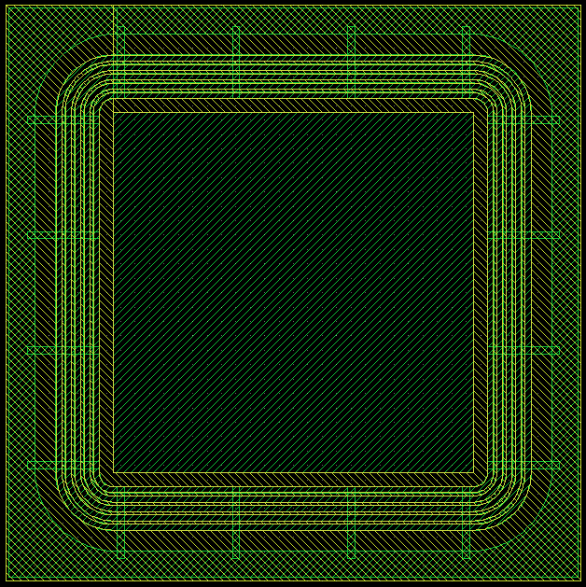
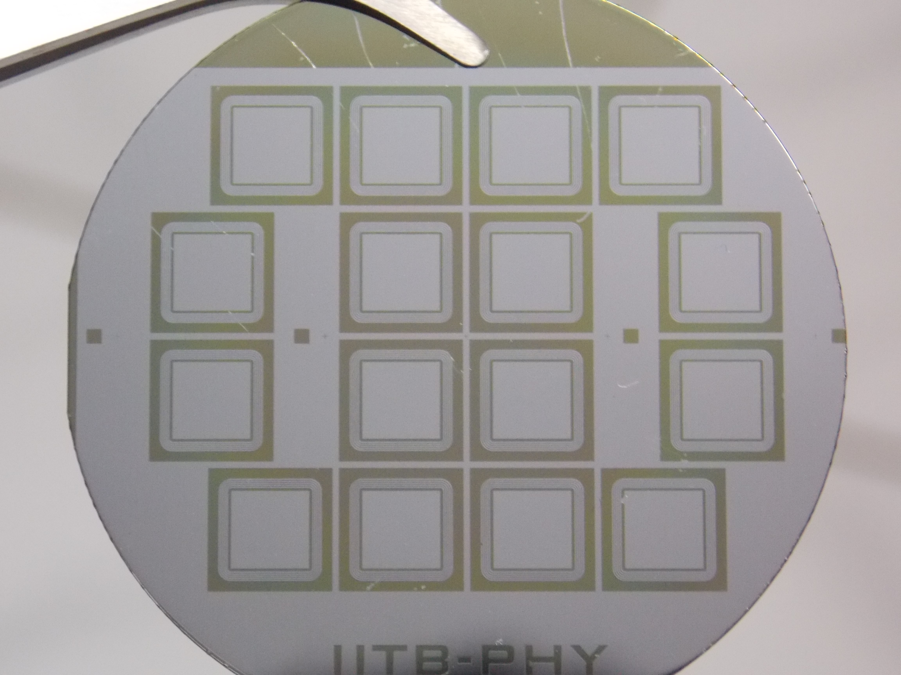
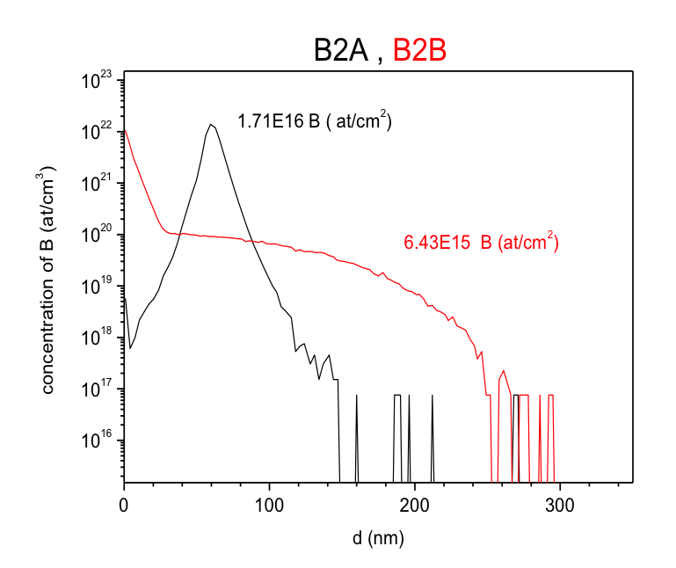
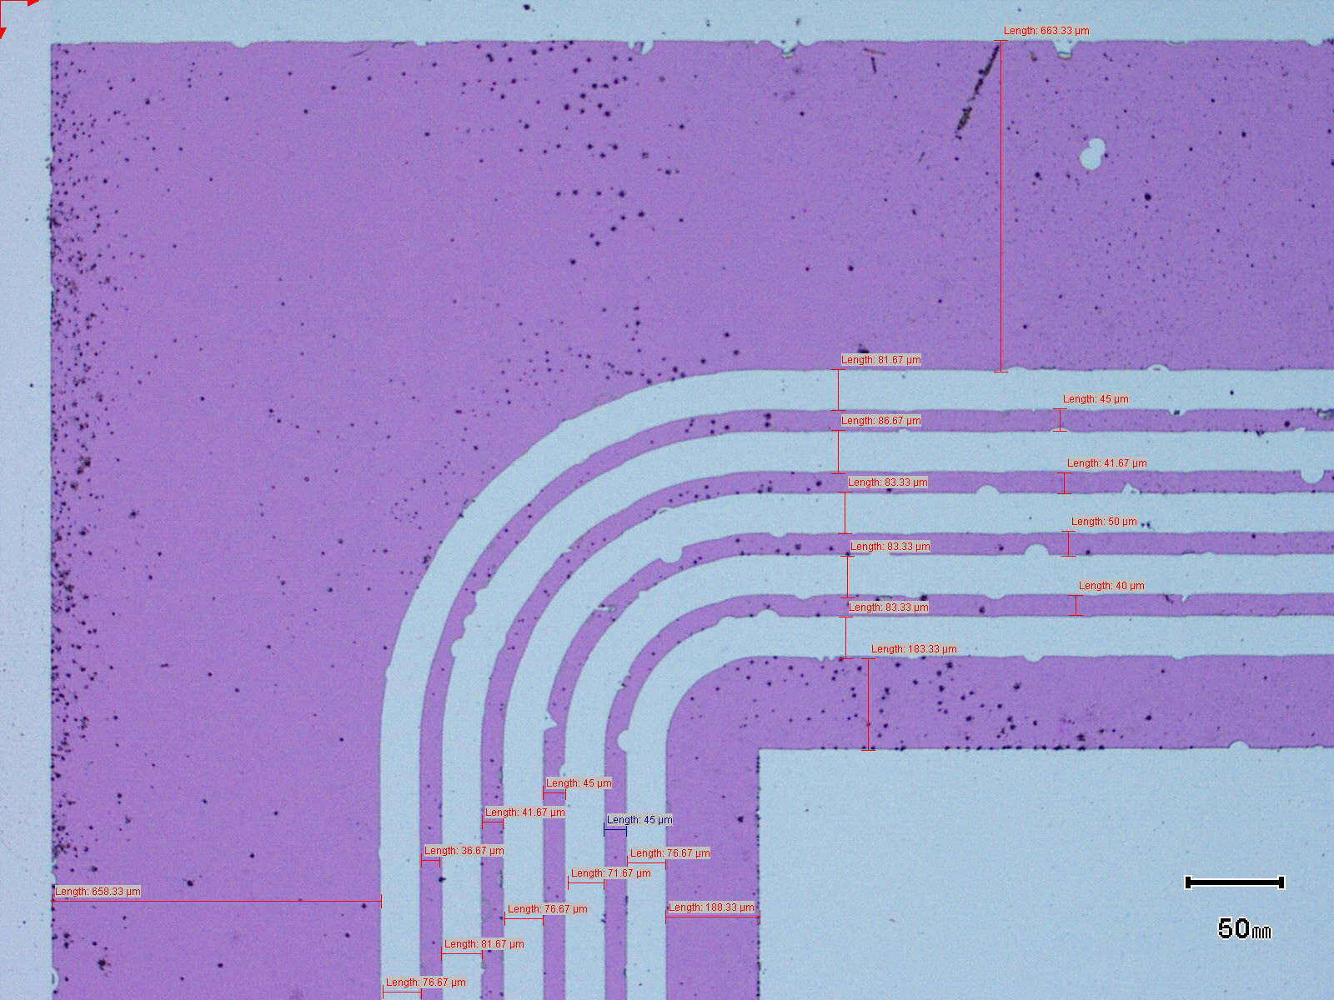

Silicon Detector Fabrication
Pad Detector
Pad Detector
Pad 5mm X 5mm; 250 ± 10 μm; Guard rings
N-type bulk: ρ = 3000-5000 Ωcm
Wet oxidation, at 1050oC, 630 ± 10 nm
Doping: (Boron & Phosphorus) 2 keV; dose 5 X 1015 ions/cm2
Anneal at 950oC in N2 environment
Aluminum contacts < 500 Å
Strip Detector
2cm X 2cm sensor; 50 μm pitch; 384 strips
1.92cm X 1.92cm active area; Punch through biasing
8 mm
Mask Exposure
Boron doped SiO2 patterning
Doping profile of Boron
Silicon Strip Detector: mask
Notes:
26

Slide 27
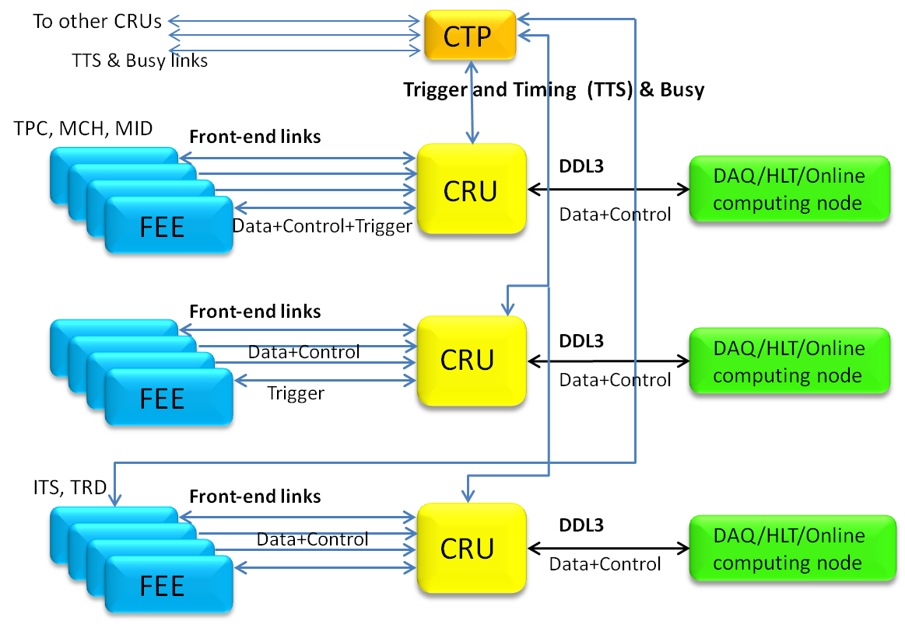


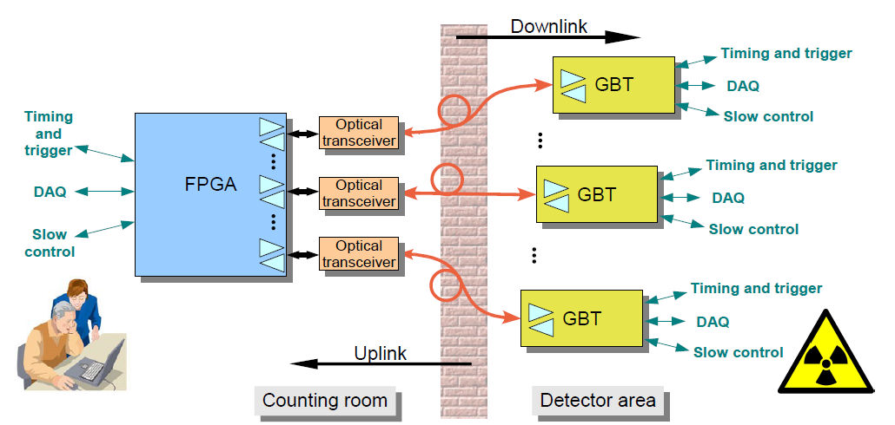
A New Architecture for the ALICE@CERN
Common Readout Unit (CRU)
Participating Countries:
India
Hungary
Data Acquisition Scheme based on up-to-date FPGA technology
ALICE
UPGRADE
  2014: Design specification
  2014/15: Common CRU firmware
  2016: Pre-series
  2017: Production in INDIA
  2018: HW & Firmware Support
  2018: Installation and
  Commissioning
Implementation & Planning

Slide 28
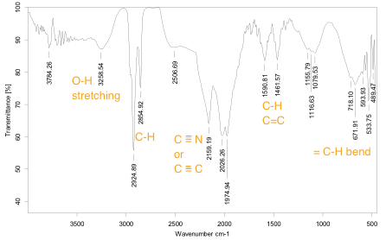
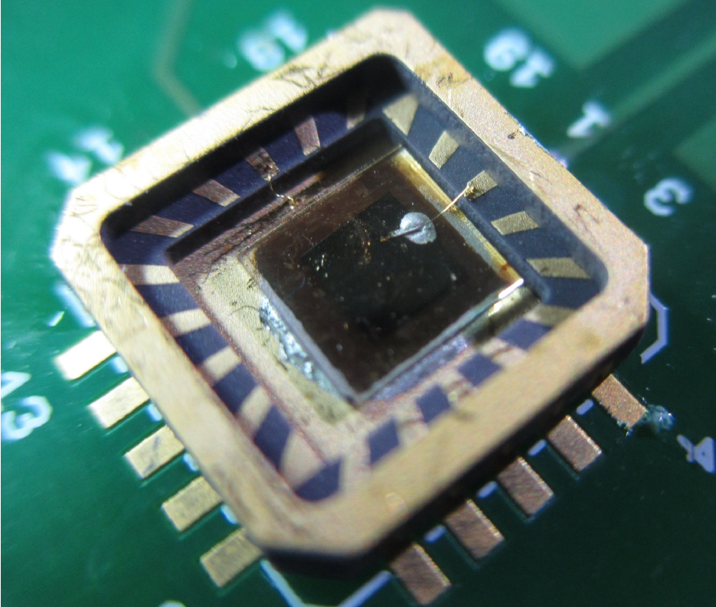
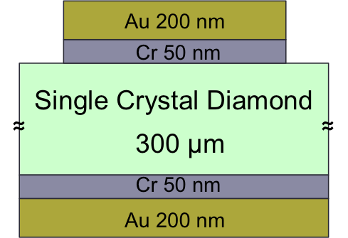
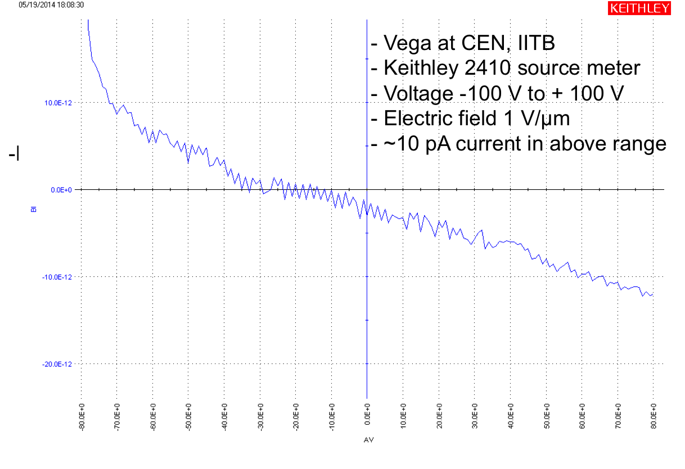
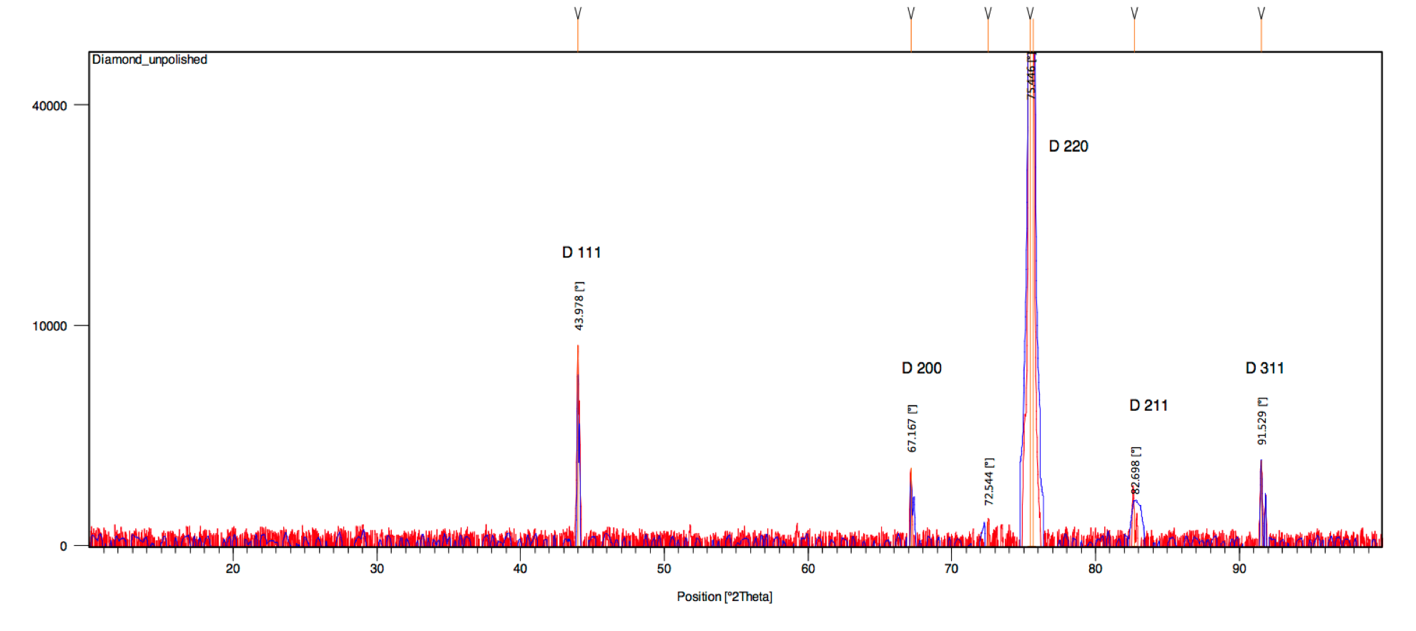
Diamond: Device Fabrication
Single crystal diamond: 3.5 mm X 3.5 mm, 300 μm
Metallization: Cr-50nm and Au-200nm & Annealing: At 700o Celsius
Electronic connections: Ceramic leadless chip carrier; wire bond + silver epoxy
Diamond Film Study:
FTIR plot
-I A
XRD plot
I-V Characterization; C ~ 7 pf
V volts
Notes:
FTIR results shows chemical bonds on surface of the diamond, which contains only Carbon and Hydrogen in this case.. XRD results shows lattice orientations in diamond sample. In above diamond sample planes present are D 111, D 200, D 220, D 211, D 311. Last plot shows characterization study of metallized diamond sample. Capacitance is aprroximately 7 pf and IV curve is plotted with current in range ~10 pA. Current on y-axis is inverted current measurement.
28

Slide 29
CBM Muon-Chamber (MuCh)
Triple GEM as a precise tracking detector in the Muon Chamber (MUCH) under the extreme conditions of the CBM experiment
Schematic view of the CBM experiment: Muon set up (left). Implementation of the muon detection system in GEANT (right).
The questions to be addressed under these conditions are:
Long-term stability of operation
Rate induced gas gain variation
Rate-induced discharges
Rate induced ageing
Spark probability due to slow, highly ionizing particles
Dependence of ageing on environmental parameters, and
Dependence of ageing on surface irradiation
All the study first with small size (10cmx10cm) and then large size (30cmx30cm) single mask GEM

Slide 30
Connecting the Sciences
arXiv:0710.5229

Slide 31
Future Experiments to achieve Physics Goals
Experiments/Facility | Nature of participation
LHC | Data taking, Physics Analysis Detector and Electronics R&D – upgrades coping with higher luminosity and building radiation hard detectors
CBM | Detector R&D and Construction – coping with high luminosity and radiation Physics Analysis and Data Taking

Slide 32
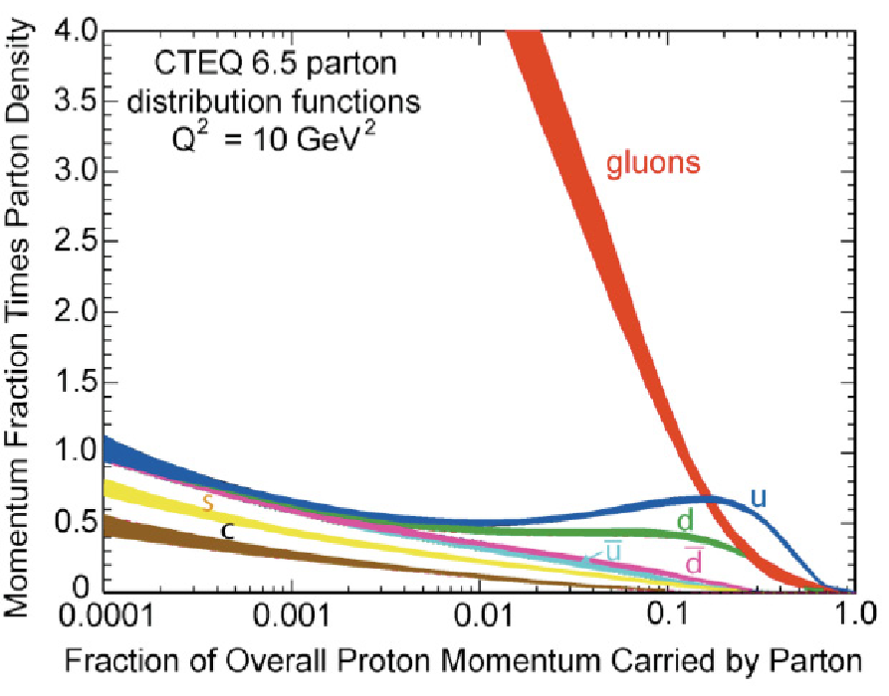
VISION – III
Initial conditions – Where does
Saturation of gluon density happens ?
Electron Ion Collider
Detector R&D

Slide 33
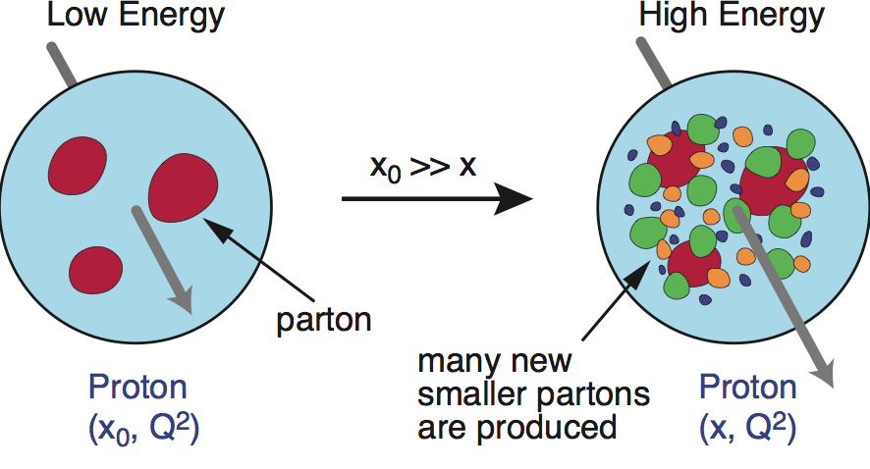
Physics Goal: Initial Conditions in HI Collisions
Using inputs from e-p/A collisions, the goal is to model the of initial stages of hadronic (p-p), light-heavy ion (p/d/He-A) and heavy ion (A-A) collisions at relativistic energies. Such initial conditions are essential input for modeling the fluid like properties of Quark Gluon Plasma using hydrodynamic or transport models for the extraction of transport coefficients like viscosity to entropy ratio which has been conjectured to have a lower bound.
Possibility to discover a new state of matter – Color Glass Condensate

Slide 34
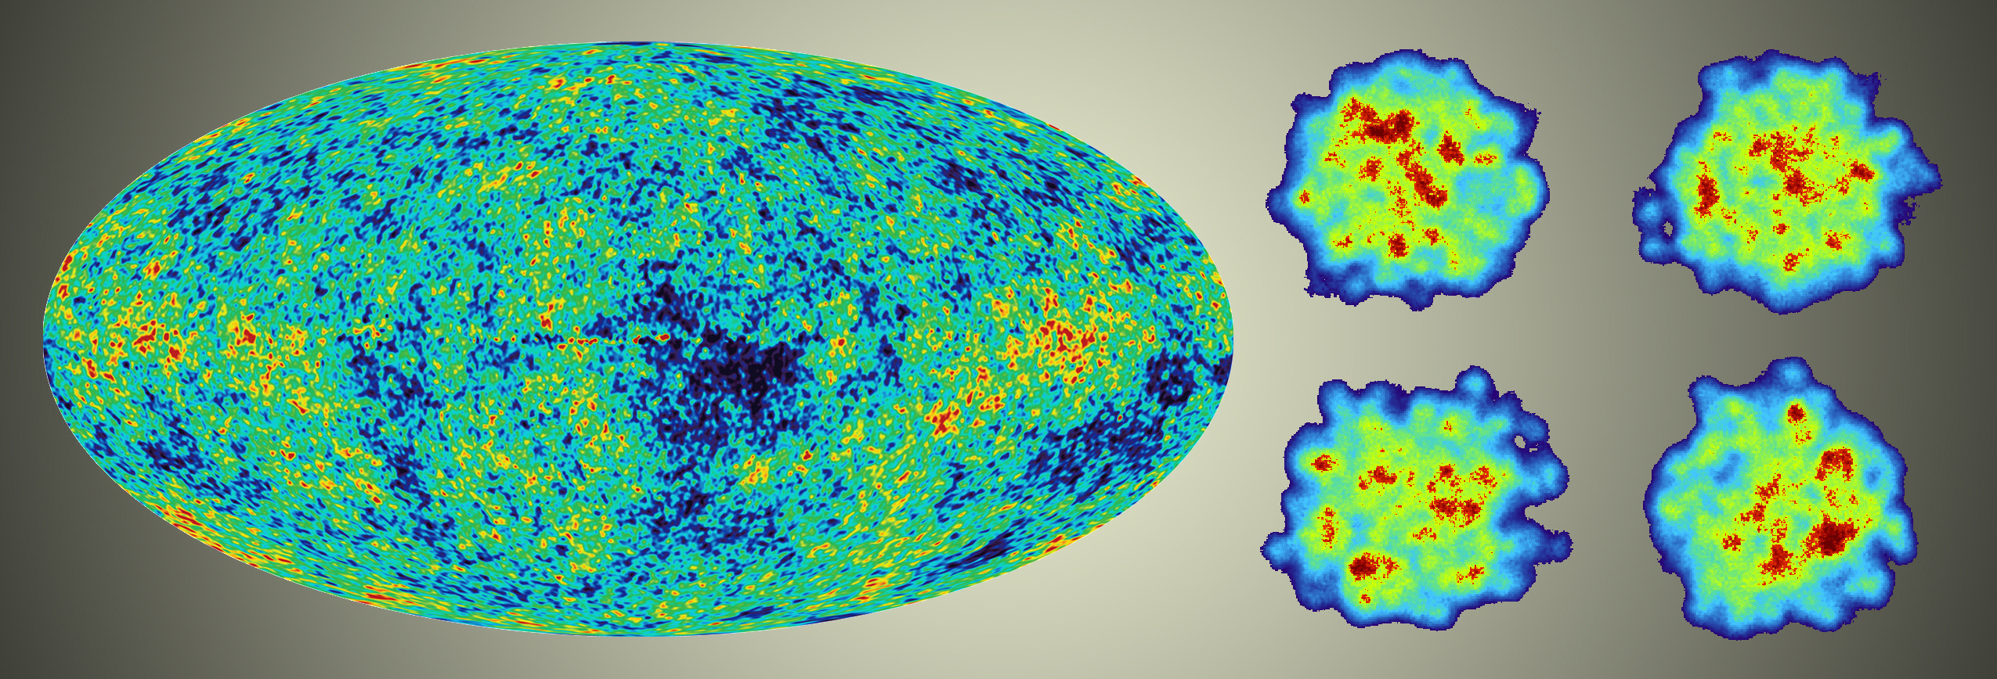
Physics Goal: Initial Conditions in HI Collisions
The dominant source of initial state fluctuations in heavy ion collisions are the Quantum fluctuations at nucleonic and sub-nucleonic length scale that leads to temperature fluctuations, which has analogy to Cosmic
temperature fluctuations.

Slide 35
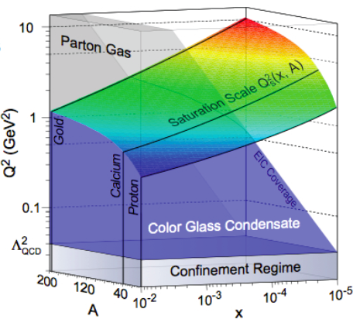
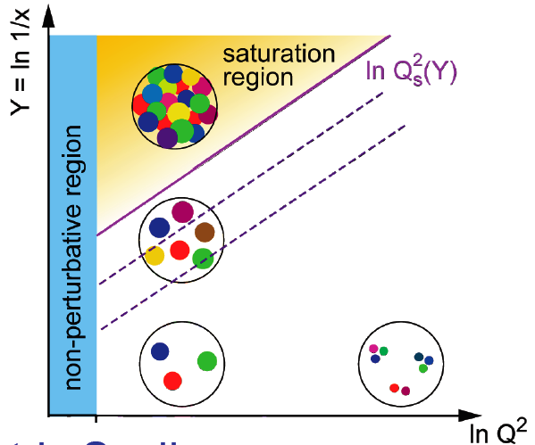
Physics Goal: Phase Diagram of Initial Condition
Ann. Rev. Nucl Part (60) 2010
Where does the saturation of gluon density set in?
  Is there a simple boundary that separates the region from the more dilute quark gluon matter? If so how do the distributions of quarks and gluons change as one crosses the boundary?
  Does saturation produce matter of universal properties in the nucleon and all nuclei viewed at nearly the speed of light?

Slide 36
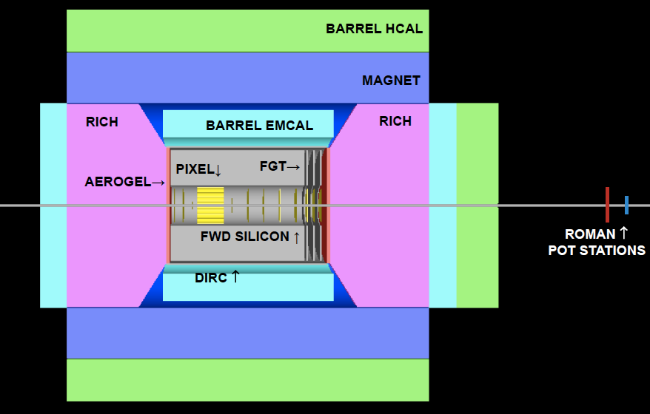
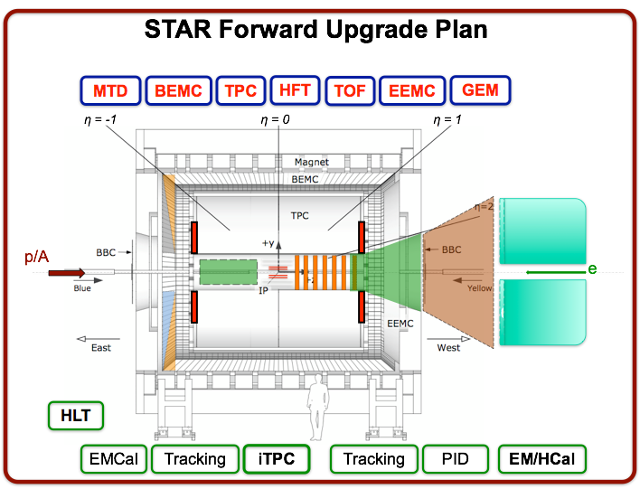
Initial Conditions: What is to be done
Do experiments with electron-hadron and electron-Nuclei collisions -- Electron Ion Collider
Build detectors for measuring observables sensitive to
Initial condition physics

Slide 37
World Wide Interest in the EIC
 | HERA@DESY | LHeC@CERN | eIC@BNL | MEIC@JLab | HIAF@CAS | ENC@GSI
E_{CM} (GeV) | 320 | 800-1300 | 45-175 | 12-140 | 12 → 65 | 14
proton x_{min} | 1 x 10⁻⁵ | 5 x 10⁻⁷ | 3 x 10⁻⁵ | 5 x 10⁻⁵ | 7 x10⁻³ →3x10⁻⁴ | 5 x 10⁻³
ion | p | p to Pb | p to U | p to Pb | p to U | p to ~ ⁴⁰Ca
polarization | - | - | p, ³He | p, d, ³He (⁶Li) | p, d, ³He | p,d
L [cm⁻² s⁻¹] | 2 x 10³¹ | 10³³ | 10³³⁻³⁴ | 10³³⁻³⁴ | 10³²⁻³³ → 10³⁵ | 10³²
IP | 2 | 1 | 2+ | 2+ | 1 | 1
Year | 1992-2007 | 2022 (?) | 2025 | Post-12 GeV (2025) | 2019 → 2030 | upgrade to FAIR

Slide 38
eRHIC Technically Driven Schedule
Mueller, BNL ALD
sPHENIX/eSTAR
ePHENIX
eSTAR
eRHIC

Slide 39
Future Experiments to achieve Physics Goals
Experiments/Facility | Nature of participation and time line
eSTAR or Forward rapidity experiments (in preparation for full experiment) | Data taking, Data Analysis (2019-2021) Detector R&D (2015-2019)
Electron Ion Collider | Detector R&D and Construction (2016-2024) Data Analysis and Data Taking (2025 Onwards)

Slide 40
VISION – I
What is the phase diagram of strong interactions ?
-- Discover CP
Physics analysis
Detector R&D
Grid Computing
VISION – II
What are the properties of de-confined state of quarks and gluons ?
--- Establish the Perfect Fluid
RHIC
LHC
FAIR
EIC
VISION – III
Initial conditions – Where does
Saturation of gluon density happens ?
-- Discover CGC state of matter

Slide 41
Acknowledgements
Several colleagues gave valuable inputs, would like to thank following
Colleagues for special inputs:
Tapan Nayak, Subhasis Chattopadhyay, Prithwish Tribedy, Jan-e Alam,
Anju Bhasin, Sudhir Raniwala, Ragahava Varma, Madan Aggarwal, Budhadeb
Bhattacharjee, Santosh Das, Pawan Netrakanti, Rupa Chatterjee, Soumya Mohapatra,
Partha Bhaduri, Bhartendu Singh, Prashant Srivastava, Ranbir Singh, Md. Nasim,
Pradip Roy, Renu Bala …….

Slide 42
Study QCD Phase Structure
2012 | 2013 | 2014 | 2015 | 2016 | 2017 | 2018 | 2019 | 2020 | 2021 | 2022 | 2023 | 2024
 | pp | HI | pp/HI | HI | pp | pA/HI | pA | pA |  | ep | ep/eA | ep/eA
HFT/MTD: HF, dileptons HFT’
BES-I e-cooling&iTPC BES-II, √s_{NN} ≤ 20GeV
Spin: Δg, W±, A_{N}
LHC FAiR RHIC
Upgrades at large-y & iTPC, CGC, pdf eSTAR/eRHIC
NICA/CBM Experiment (QCD phase structure)
x10 x100
LHC √s_{NN} = 5.5 TeV (sQGP properties)

Slide 43
Budget
LHC and RHIC upgrade participation: Rupees 600,000,000 (Rs. 60 Crs)
CBM MUCH : Rupees 900,000,000 (90 Crs)
CBM ToF: Rupees 100,000,000 (10 Crs)
EIC participation: Rupees: 600,000,000 (60 Crs)

Slide 44
CBM-MUCH Budget

Slide 45
ALICE TPC up-grade Budget

