Slide 1
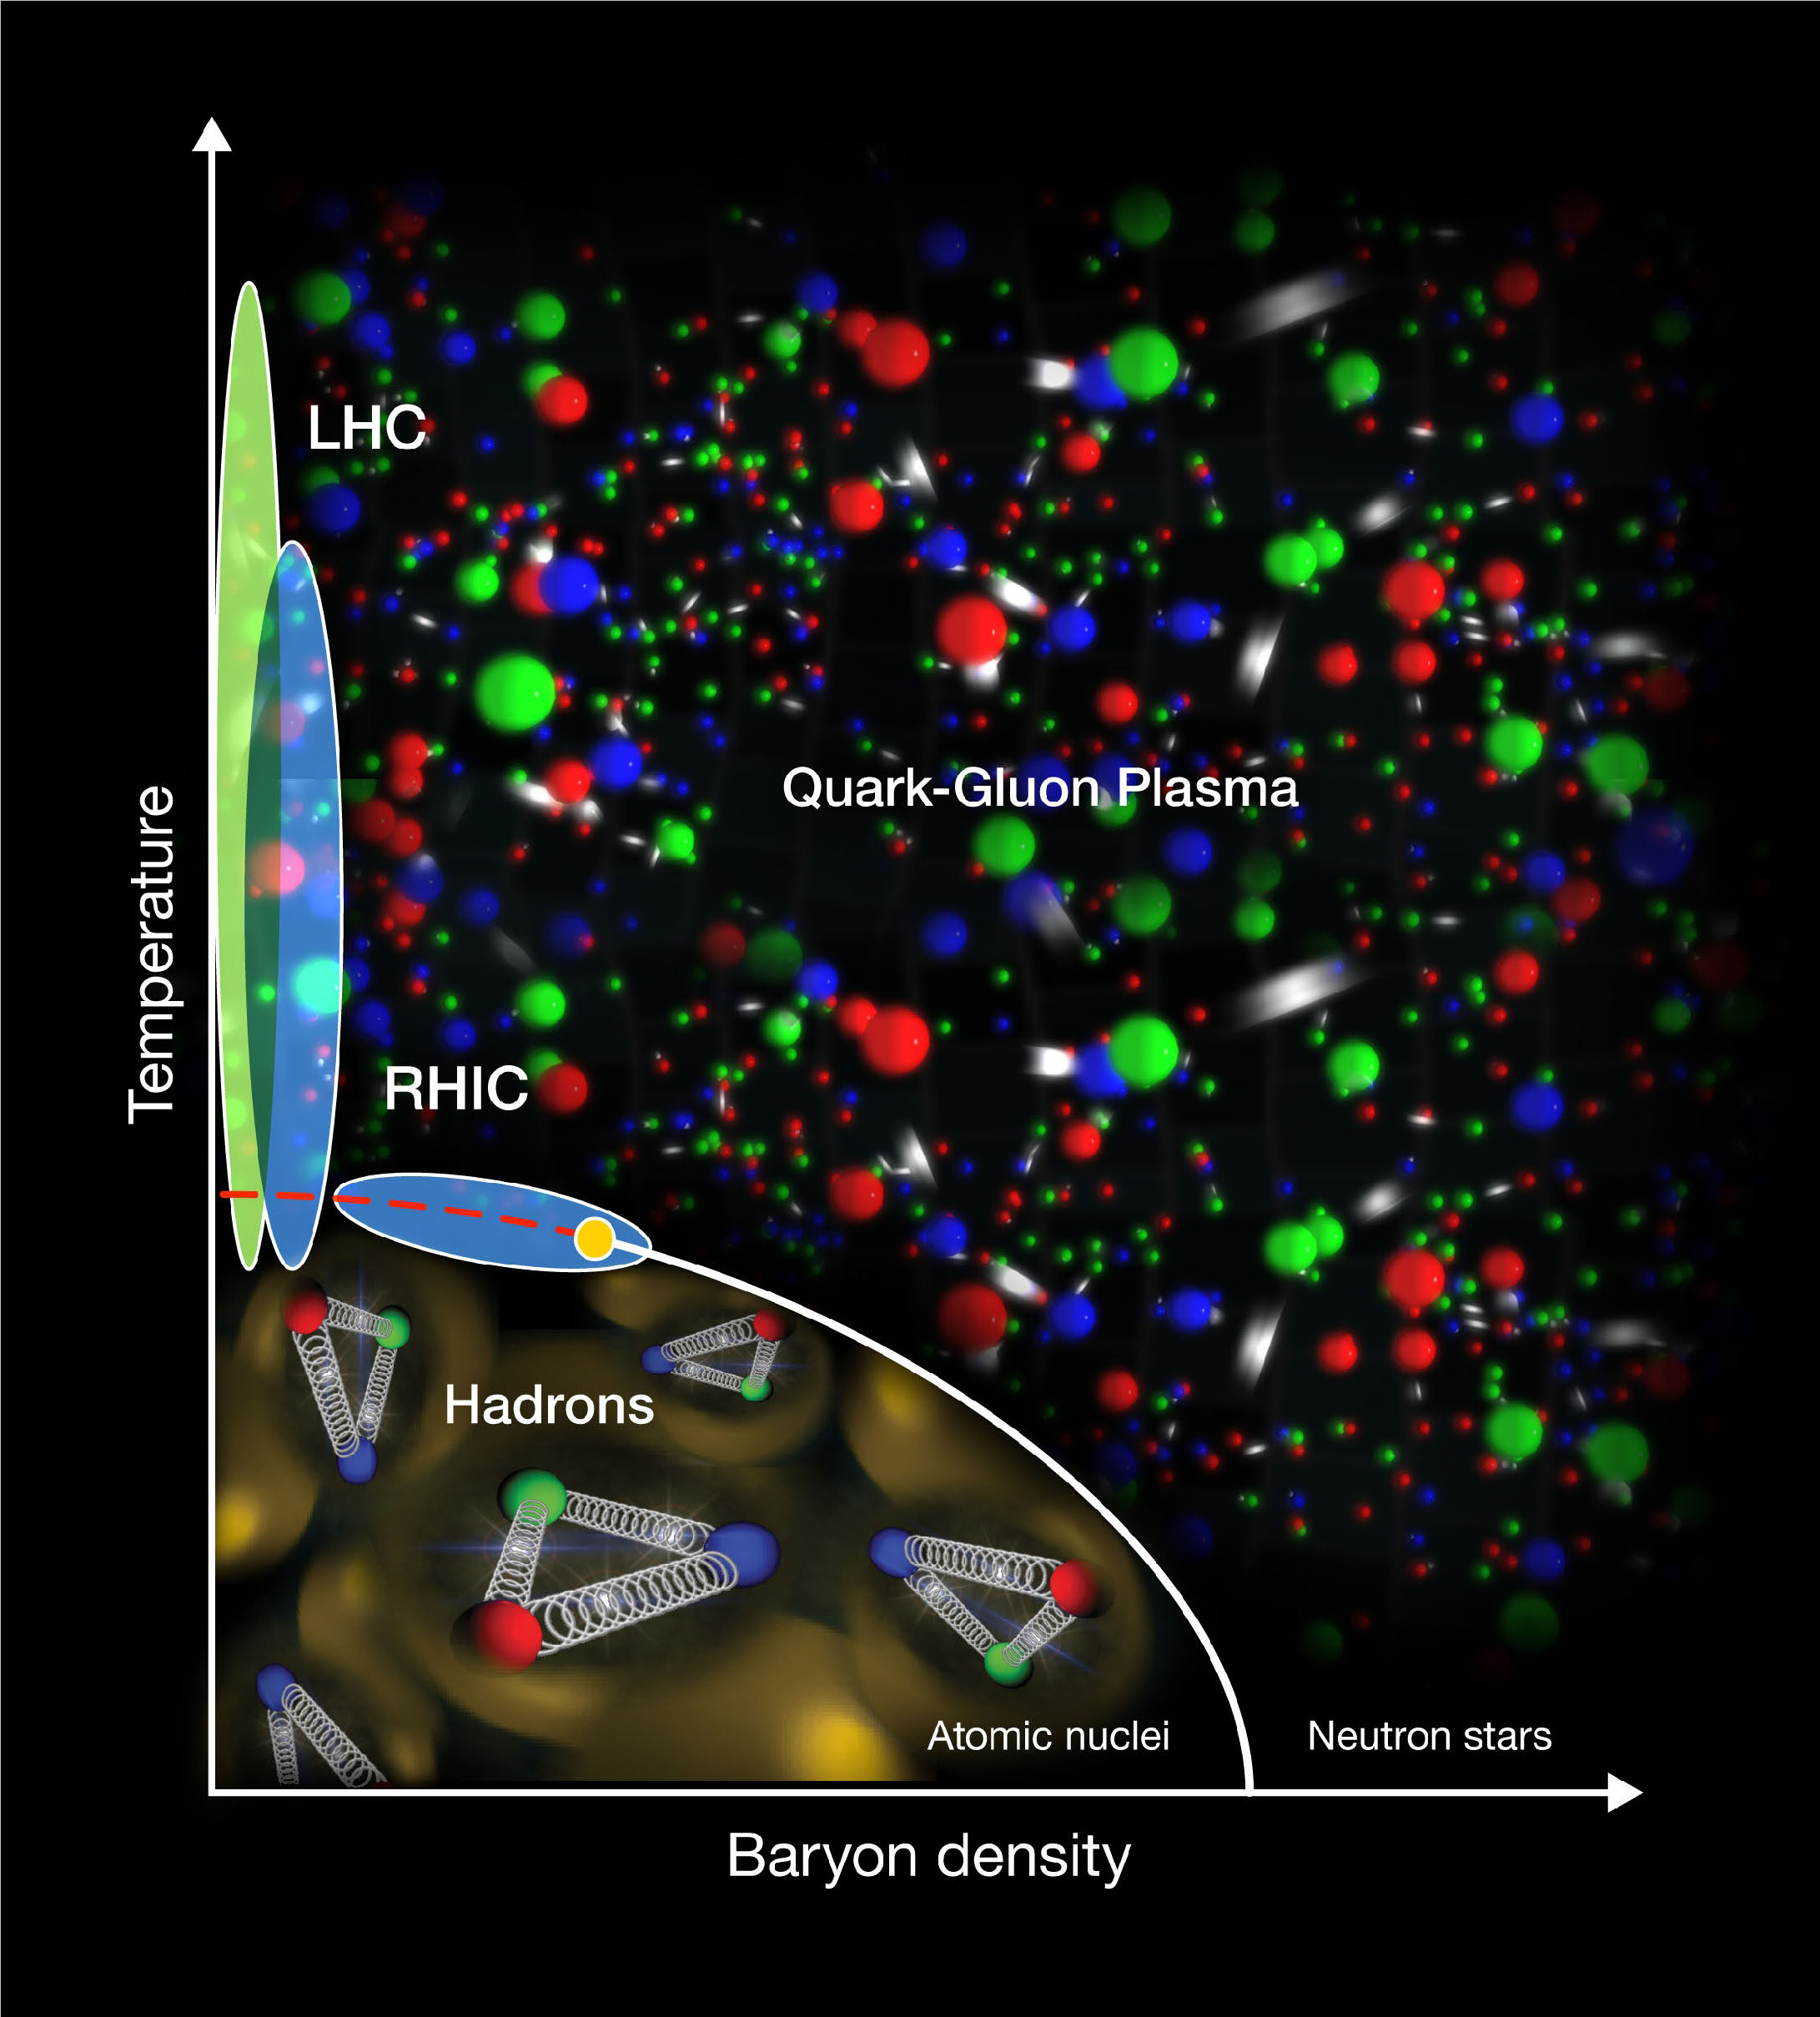
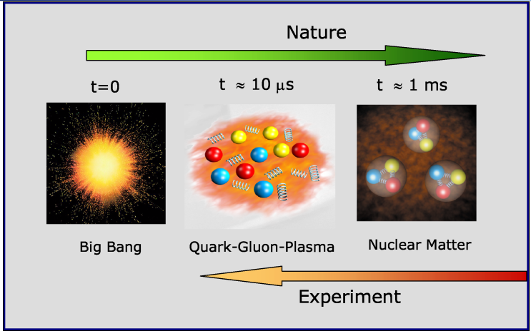
New Form of Matter : De-confined state of Quarks and Gluons
Bedanga Mohanty
National Institute of Science Education and Research, Bhubaneswar
01/34

Slide 2
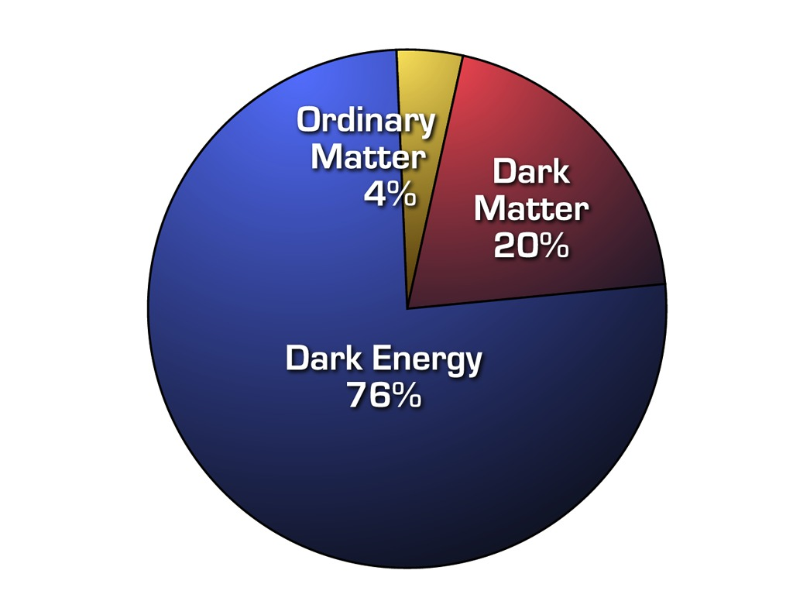
Universe: Ordinary Matter
Do we know about the
properties of the fundamental constituents that make the ordinary matter
http://www.euclid.caltech.edu/image/euclid2011-001a
02/34

Slide 3
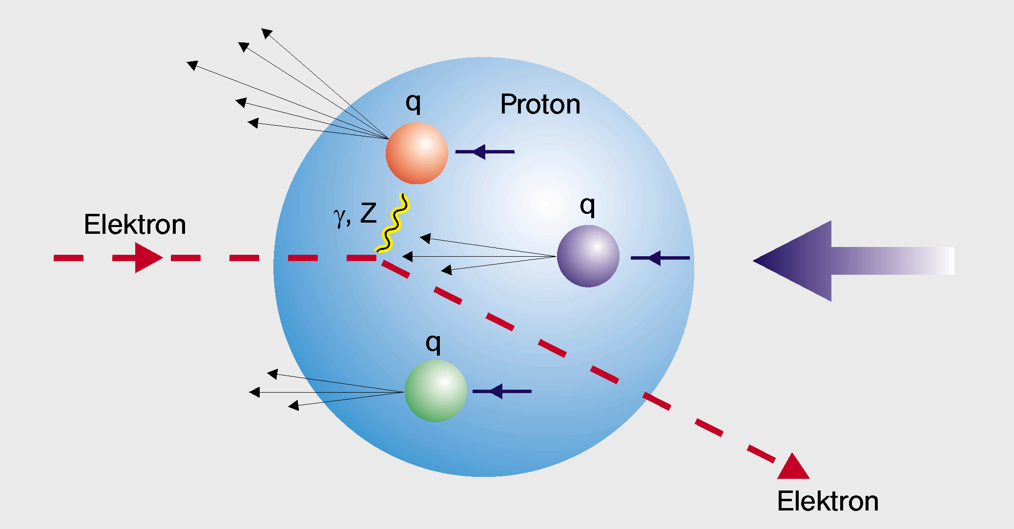
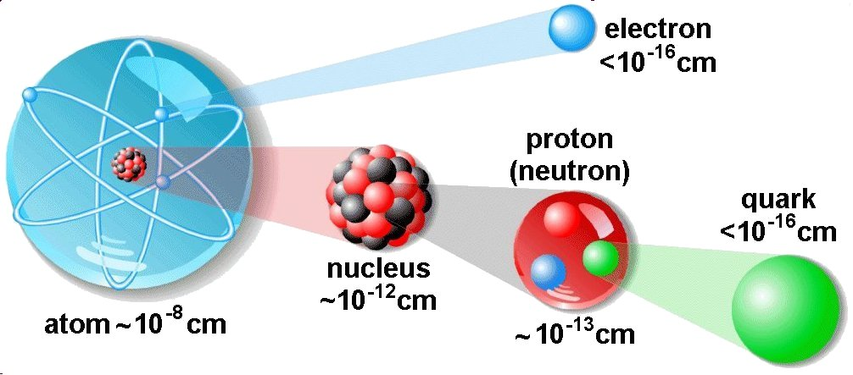

Fundamental Constituents of Visible Matter
~1900
~1910
~1940
~1970
atom
nucleus
10⁻⁸ cm
10⁻¹² cm
10⁻¹³ cm
ETH Zurich, Institute for Particle Physics.
De-Broglie
equation
Higher the momentum smaller the distance scale we probe
03/34

Slide 4
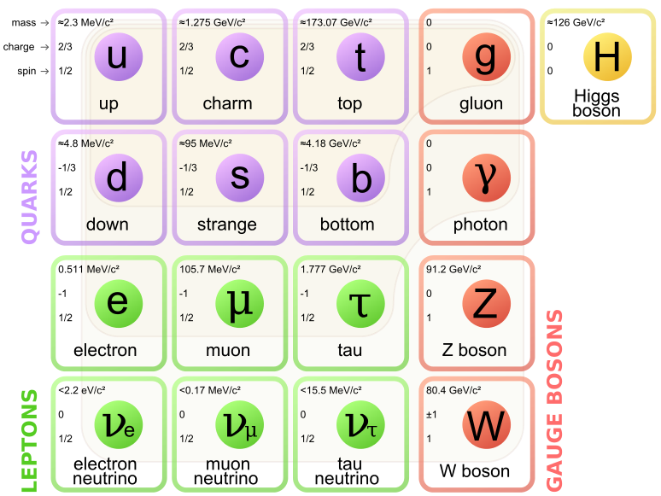
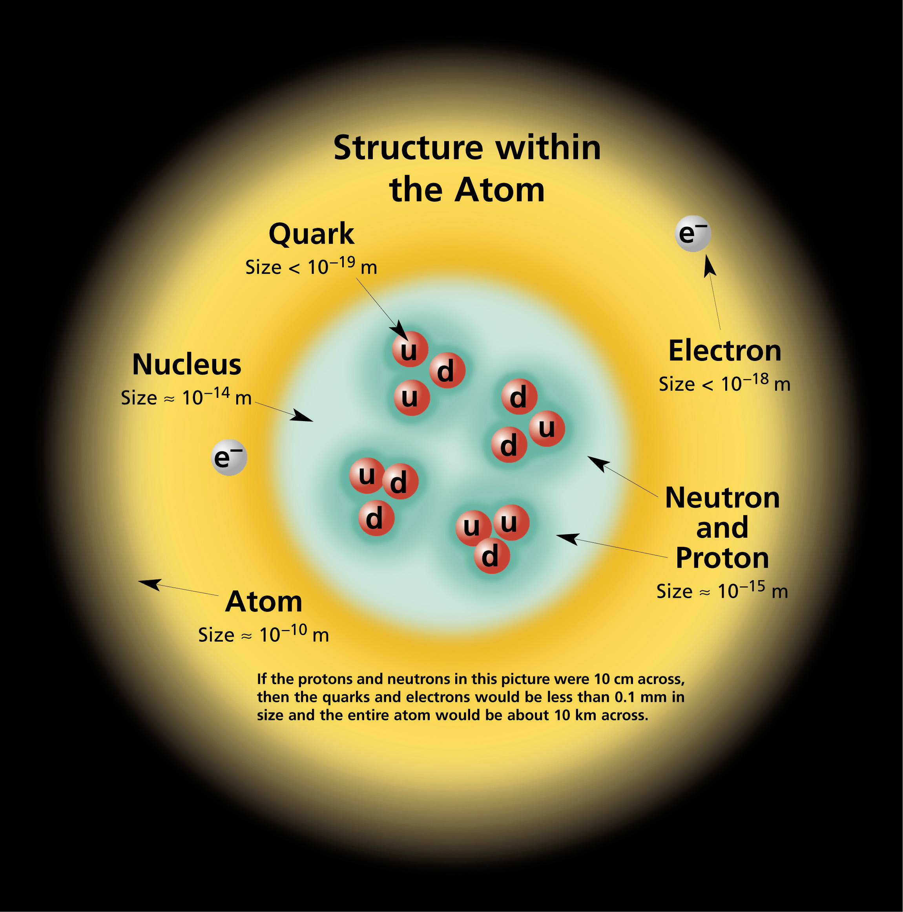
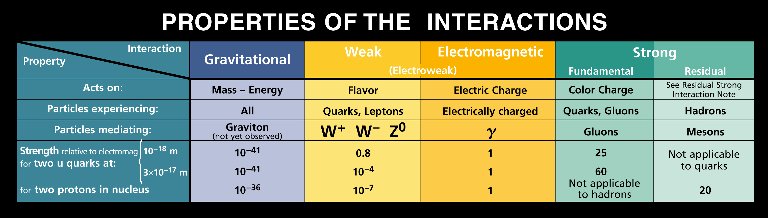
Standard Model: Ultimate Constituents
particleadventure.org
Fundamental constituents of visible matter are confined inside hadrons. No free quark seen.
04/34

Slide 5
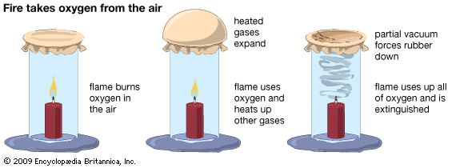
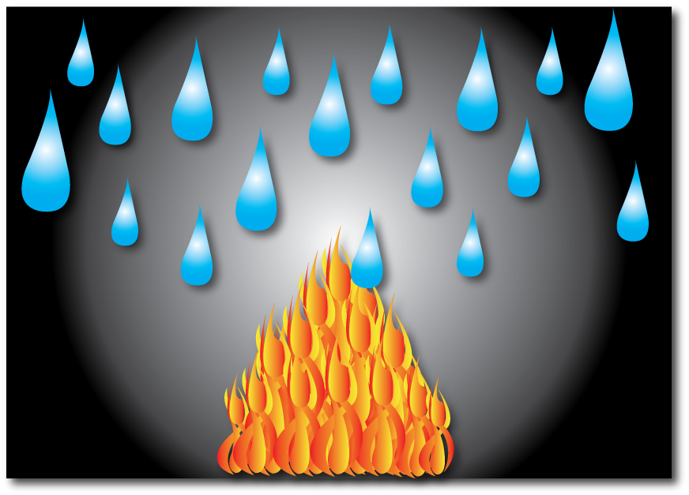
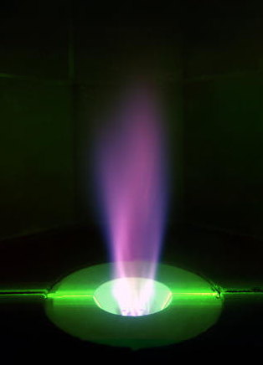
Properties of Fundamental Matter ?
Oxygen (O) aids burning
Hydrogen (H) itself burns
Water (H₂O) extinguishes fire
De-confined quarks and gluons needed to study its properties
05/34

Slide 6
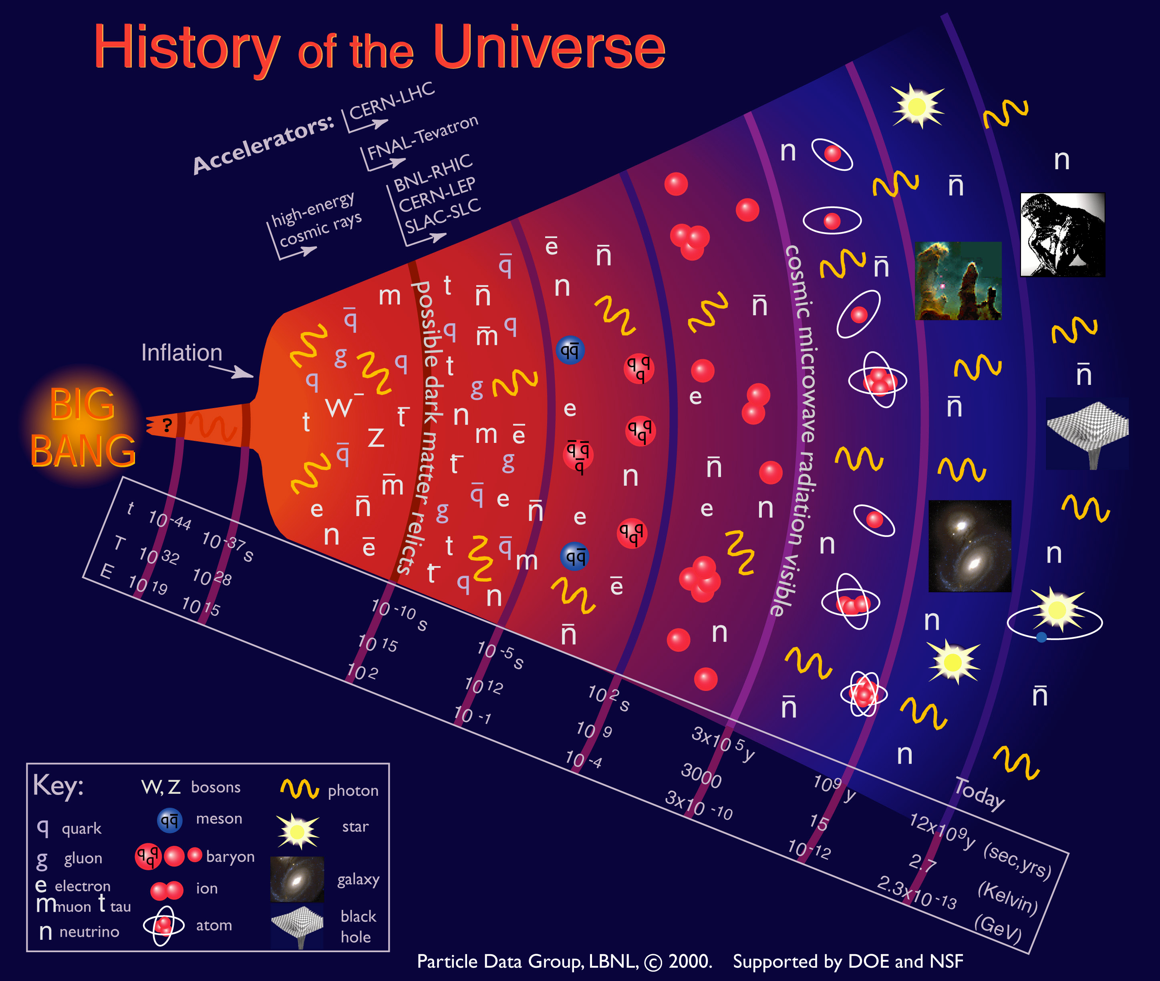
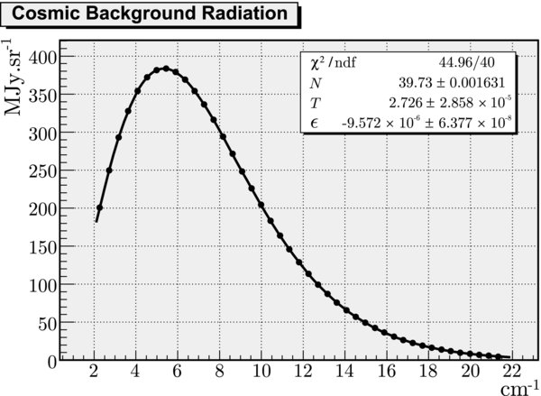

Primordial Matter in Early Universe
Micro-second old Universe had this primordial matter
As the universe cooled, they were confined and have remained that way since
06/34

Slide 7
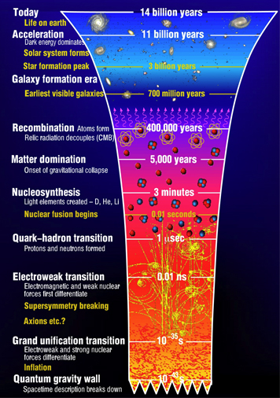
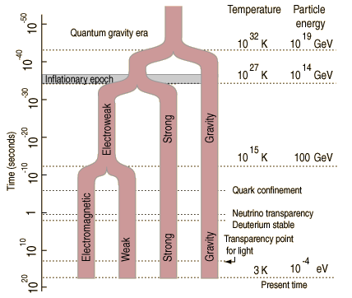
QCD Transition in Early Universe
Universe:
QCD Phase Transition: T ~ 200 MeV
Electroweak Phase Transition: T ~ 150 GeV
GUT phase Transition: T ~ 10¹⁶ GeV
QCD Transition the only one possible to study in Laboratory
07/34

Slide 8
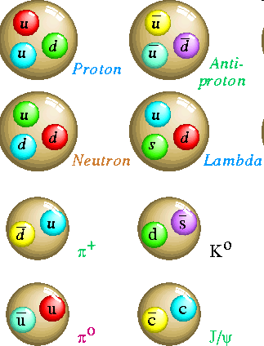
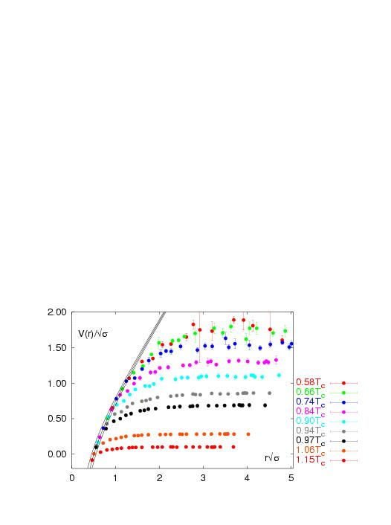
How to Create Primordial Matter
Hadrons are composite objects made of quarks and gluons.
QCD is a “confining” gauge theory, with an effective potential:
Karsch et al
V(r)
“Coulomb” “Confining”
r
No one has ever seen a free quark.
Matter at high temperature or energy density can be de-confined
08/34

Slide 9
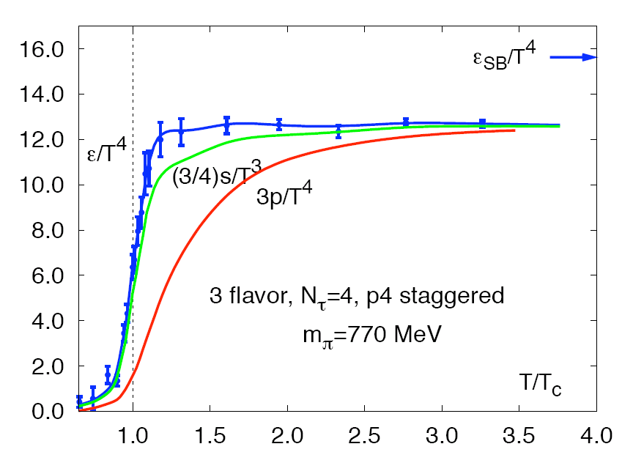
Quantum Chromodynamics
Energy density for “g” massless d.o.f.
Hadronic Matter:
3 π with spin=0
Quark Gluon Plasma:
8 gluons;
2 quark flavors, antiquarks, 2 spins, 3 colors
Lattice QCD
Matter at high temperature or energy density can be de-confined
T_{c} ~ 170 MeV
F. Karsch, Prog. Theor. Phys. Suppl. 153, 106 (2004)
09/34

Slide 10
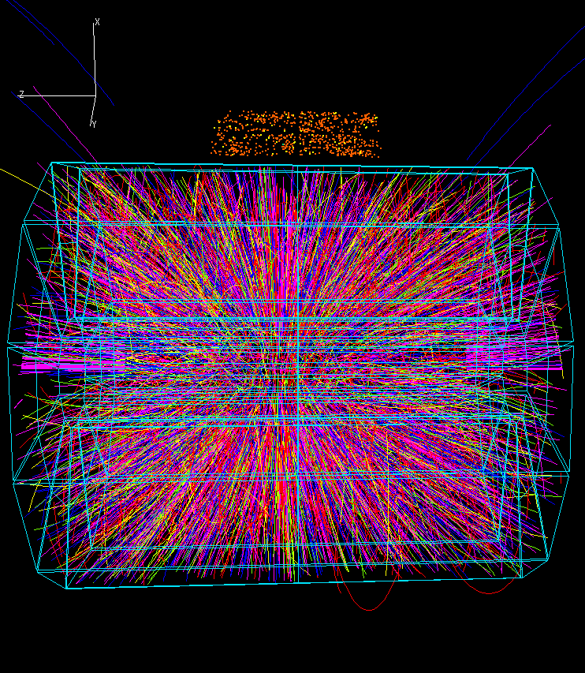
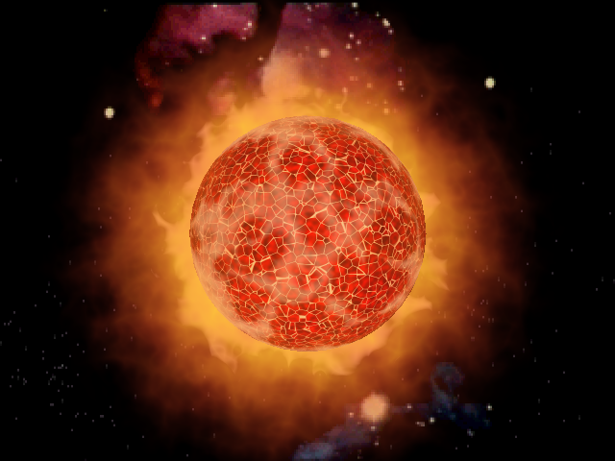
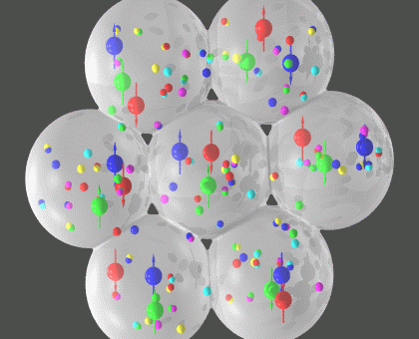
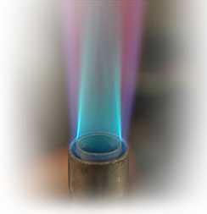
Relativistic Heavy Ion Collider
And
Large Hadron Collider
One trillion Kelvin !
10/34

Slide 11
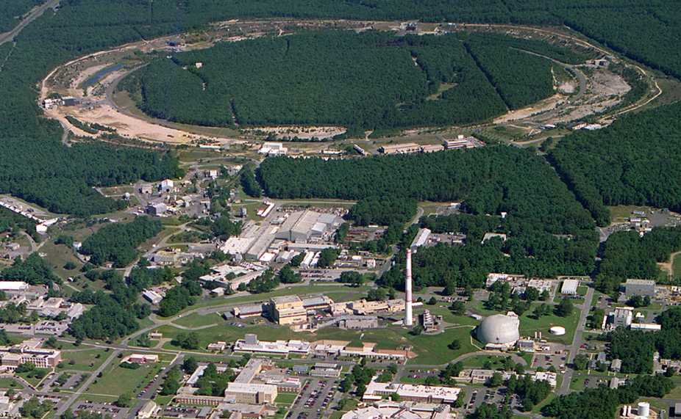
Relativistic Heavy Ion Collider
PHOBOS
BRAHMS
RHIC
PHENIX
STAR
- RHIC: The high-energy
heavy-ion collider
(i) Dedicated QCD collider
(ii) √s_{NN} = 200 - 5 GeV
(iii) U, Pb, Au, Cu, He, d, p
- RHIC: The highest energy
polarized proton collider!
√s = 200, 500 GeV
v = 0.99995⋅c = 186,000 miles/sec
Au + Au at 200 GeV
AGS
TANDEMS
Animation M. Lisa
https://www.bnl.gov/rhic/
11/34

Slide 12
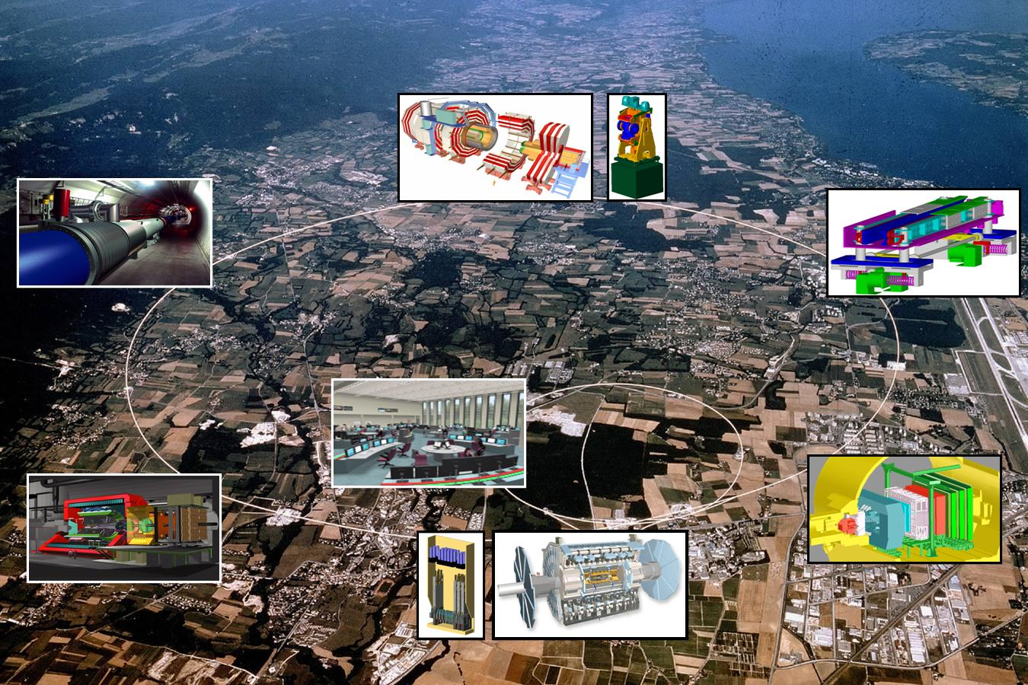
Large Hadron Collider
Largest particle accelerator: Circumference is 26.659 Km.
Worlds Coldest place: 9300 magnets at -271.3°C (1.9 K) – Colder than outer space
Worlds Loneliest place: Internal pressure 10⁻¹³ atm. 10 times less than the pressure on moon
Fastest Race track: Trillions of protons race 11245 times a second with speed 99.9999991% speed of light
Produces matter with temperature more than 100,000 times the temperature of Sun
Data recorded will fill around 100,000 dual layer DVDs every year
http://home.cern/topics/large-hadron-collider
The CMS magnet system contains about 10 000 t of iron, which is more iron than in the Eiffel Tower
The Sun never sets for such experiments
12/34

Slide 13
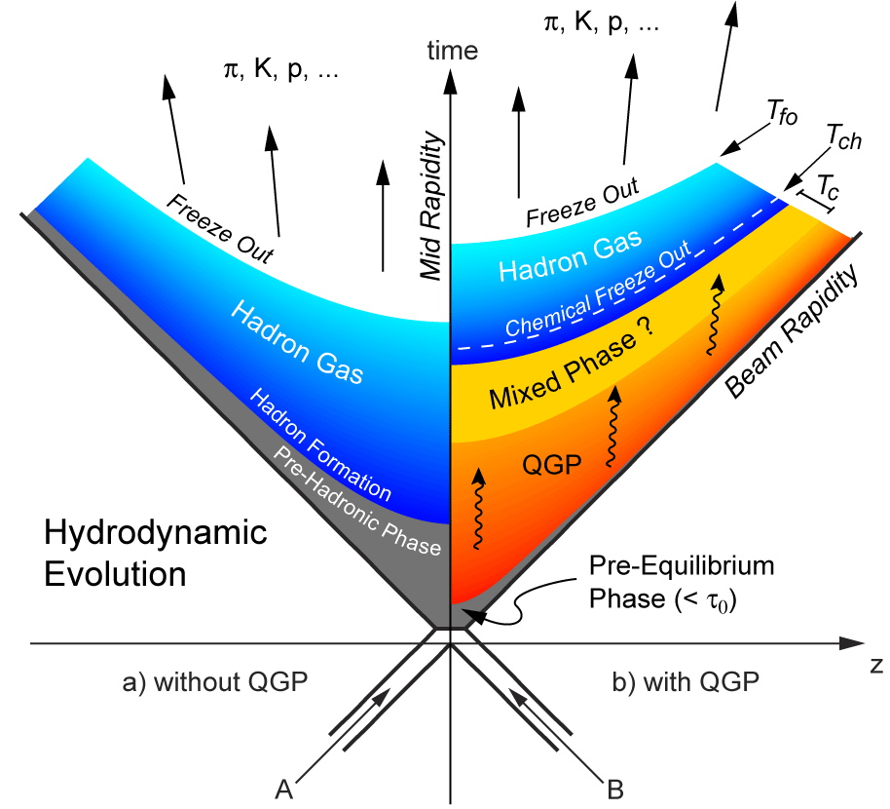
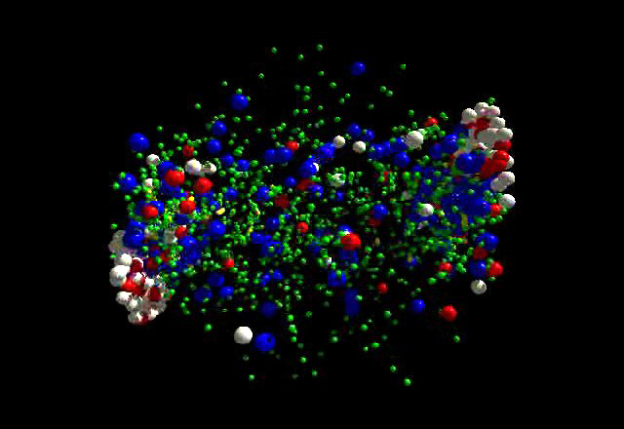
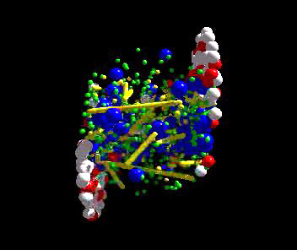
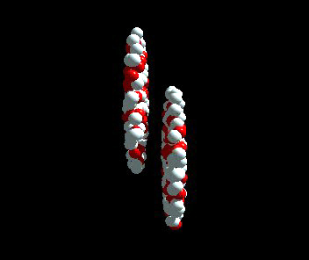
Heavy-Ion Collisions – QCD Transition
J. D. Bjorken Physical Review D 27 (1983) 140
p+p like collisions
A+A collisions
Colliding two nuclei - create the QCD transition Confined (hadrons) -- De-confined (quarks & gluons) in laboratory
13/34

Slide 14
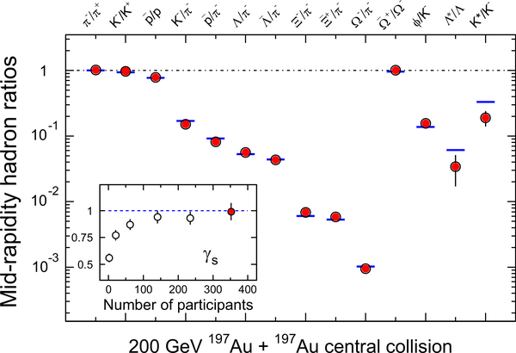
Particle Production – Thermalized Source
T_{ch} = 163 ± 4 MeV
μ_{B} = 24 ± 4 MeV
In central collisions, the system is thermalized at RHIC
Statistical Model with Grand Canonical Ensemble.
Incorporates the various conservation laws.
Assumes thermal and chemical equilibrium.
14/34

Slide 15
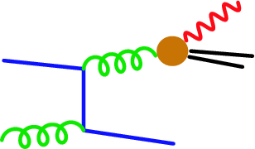
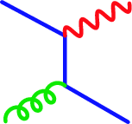
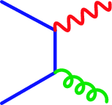
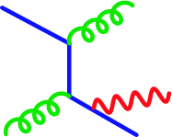
Did we form Primordial Matter
If there is system of free quarks and gluons – Photons can be produced through:
Compton
Annihilation
Bremsstrahlung
In a hydrodynamic picture: Slope of momentum
distribution of these photons
15/34

Slide 16
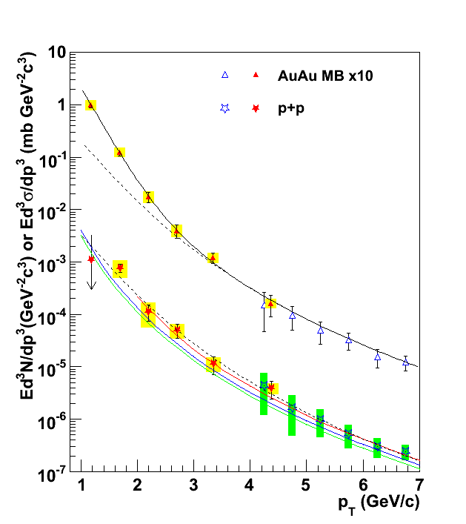
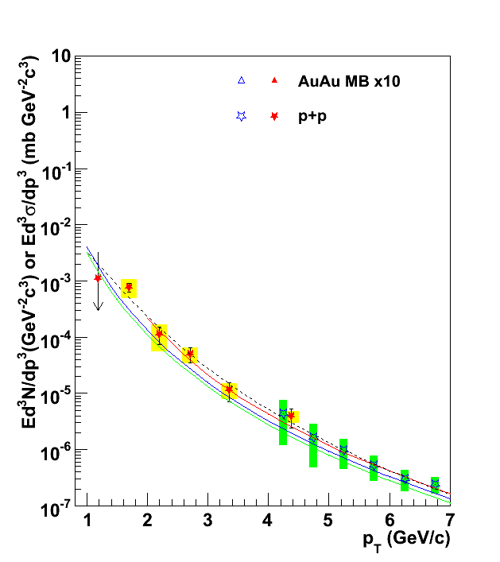
Did we form the Primordial Matter
T_{AA} scaled pp + Exponential
T_{i} = 300-600 MeV
Gold-Gold
Direct Photons
Deconfined state of quarks
And Gluons
Fit to pp
Proton-Proton
Direct Photons
NLO pQCD (W. Vogelsang)
16/34

Slide 17

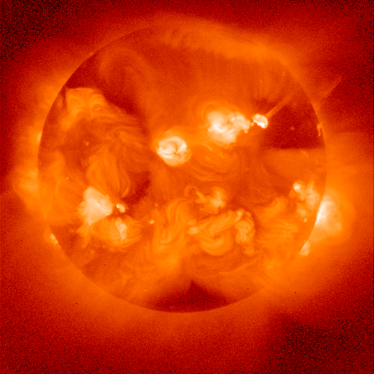
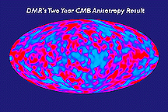
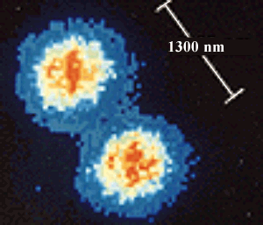
Perspective of Temperature
~10¹² K
Nucleus-Nucleus collisions
~ 120 MeV
~10⁹ K
Neutron Star Thermonuclear Explosion
(Terrestrial Nuclear explosions)
~10⁶ K
Solar Interior
~6000 K
Solar Surface
Room Temperature ~ 1/40 eV
~300 K
Cosmic Microwave Background
~3 K
~10⁻⁶ K
~10⁻¹⁰ K
Rhodium metal spin cooling (2000)
(Low-T World Record!)
Trapped Ions
17/34

Slide 18
Collectivity
coordinate-space-anisotropy ⬇ momentum-space-anisotropy
y
p_{y}
x
p_{x}
y
φ
x
18/34

Slide 19
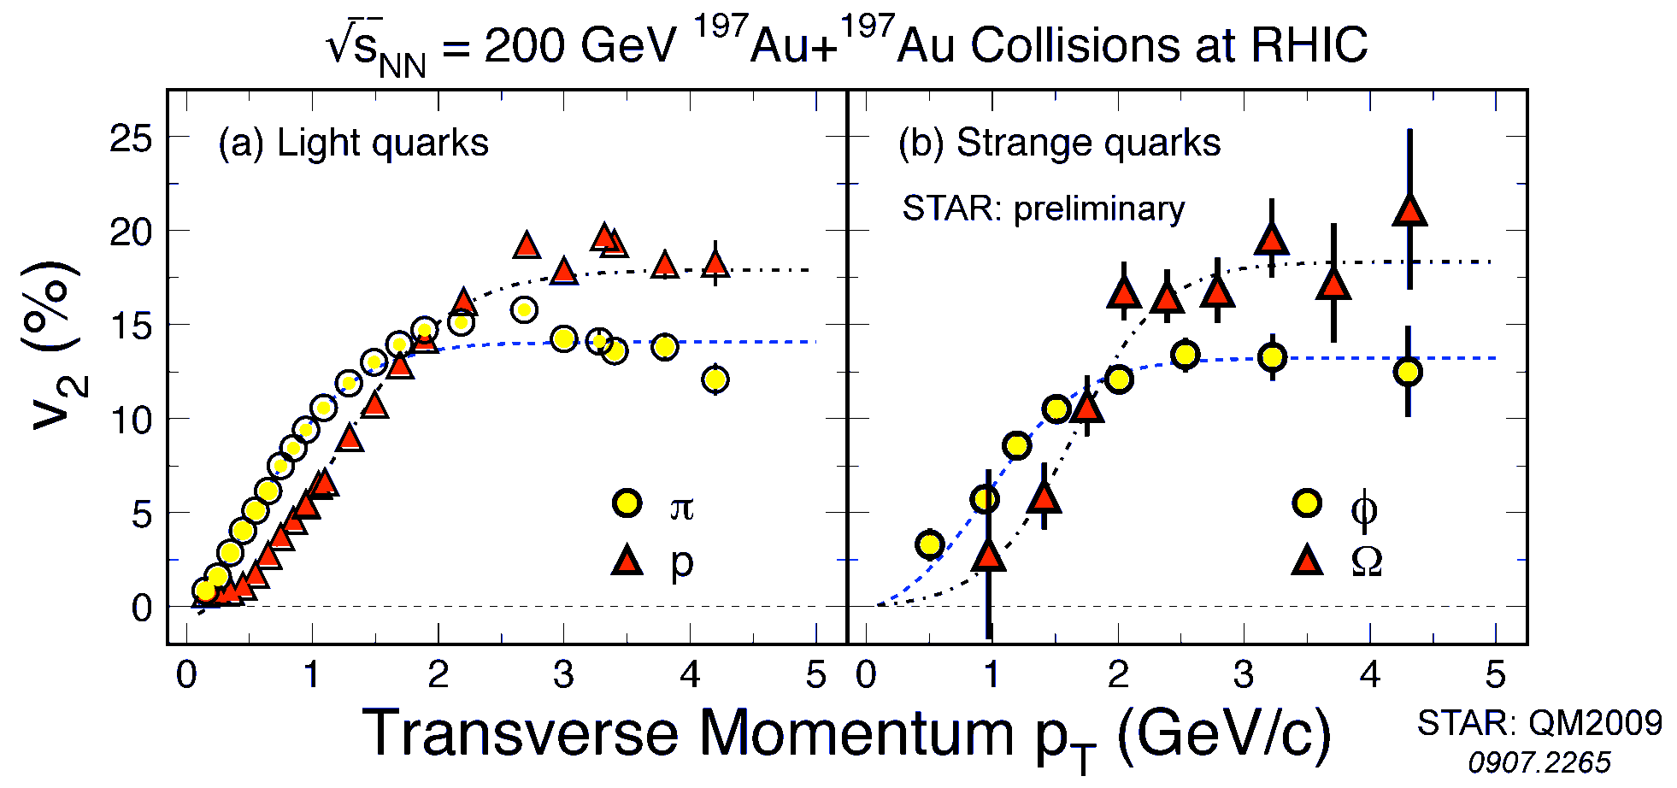
Strong Collectivity
Probes of the Medium
STAR PRL : 2016
Low p_{T} : Heavier hadrons have lower v₂ ( ~ hydrodynamic pattern)
High p_{T} : Collectivity grouped along baryon-meson lines
( ~ Hadronization by partonic recombination)
All p_{T} : Collectivity similar for hadrons with strange and light quark
(~ developed at partonic stage)
19/34

Slide 20
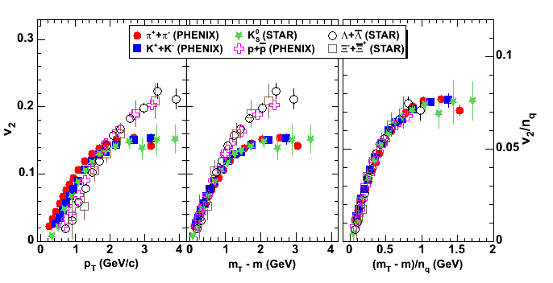
Partonic Collectivity
baryons
quarks
mesons
particle mass
dependence
plotted vs.
trans. kinetic energy
both axes scaled by number
of constituent quarks
n_{q} = 2 for mesons
n_{q} = 3 for baryons
recombination of quarks
quarks have v₂ before hadronization
20/34

Slide 21
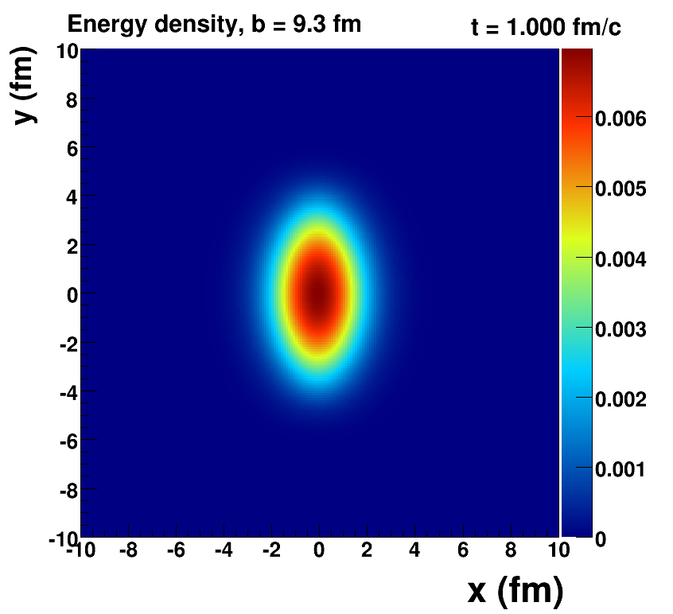
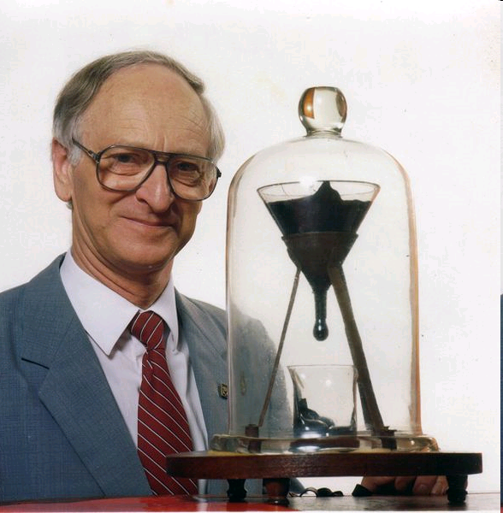
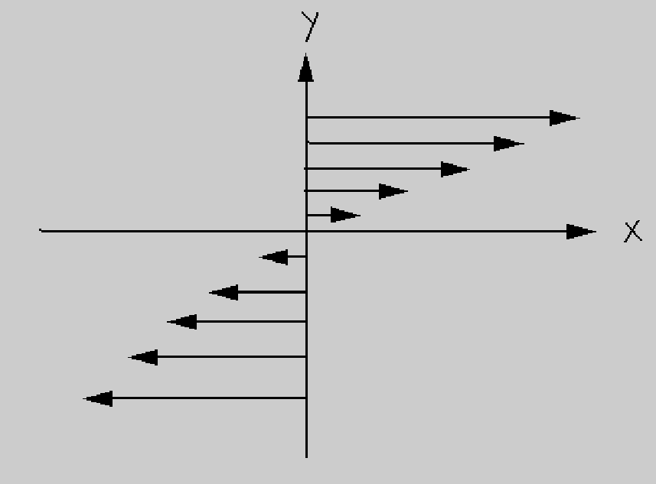
Properties of QGP
Pitch has viscosity approximately
230 billion times that of water.
Longest running experiment (1927-present) 8 drops so far, none ever seen fall!
Viscosity: Resistance to Flow
http://en.wikipedia.org/wiki/Pitch_drop_experiment
21/34

Slide 22
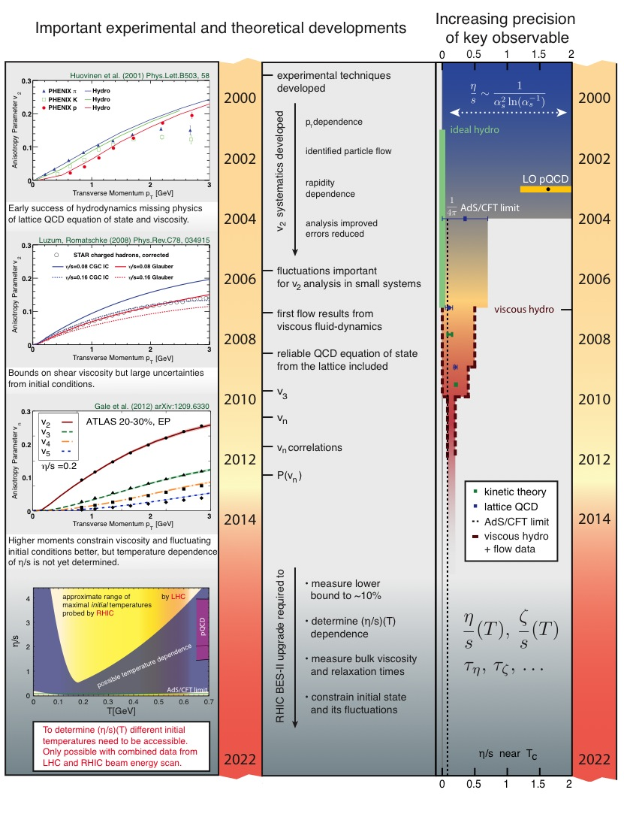
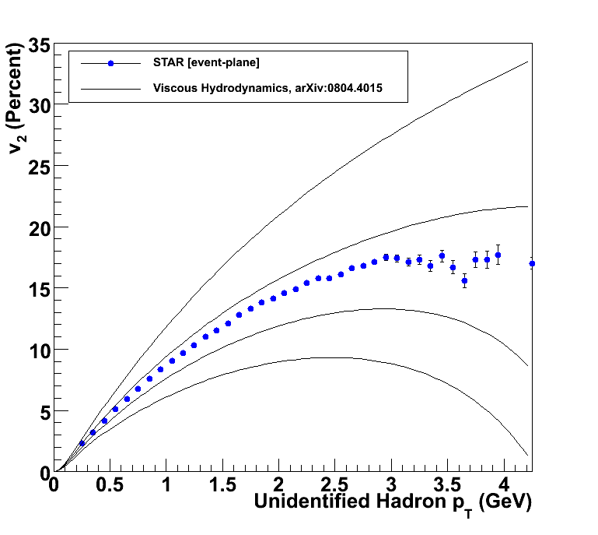
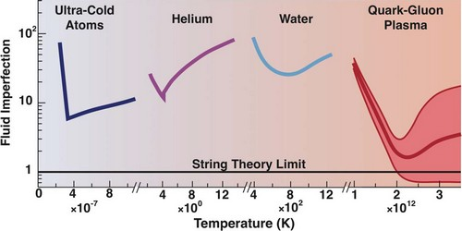
Viscosity
η/s ~ 0
η/s = 1/4π
η/s = 2 x 1/4π
η/s = 3 x 1/4π
Perfect Fluid
22/34

Slide 23
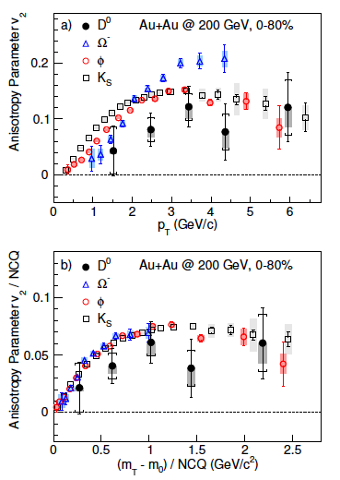
Collectivity : Heavy Quarks
Charm flow is smaller compared to light flavor particles.
Indicates charm quark is not fully thermalized and does not flow completely with the medium
Charm quarks initially produced, their ropagation in QGP medium is analogous to Brownian Motion in molecular physics
STAR PRL : 2016 (to be submitted)
23/34

Slide 24
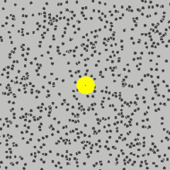

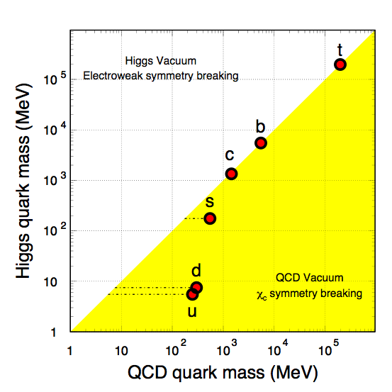
Properties of QGP
Brownian motion of a big particle (dust particle) that collides with a large set of smaller particles (molecules of a gas)
Served as definitive confirmation that atoms and molecules actually exist.
Einstein's theory
Wikipedia
Brownian Motion of Heavy Quarks in a bath of light partons
Diffusion: Measure of mobility
24/34

Slide 25
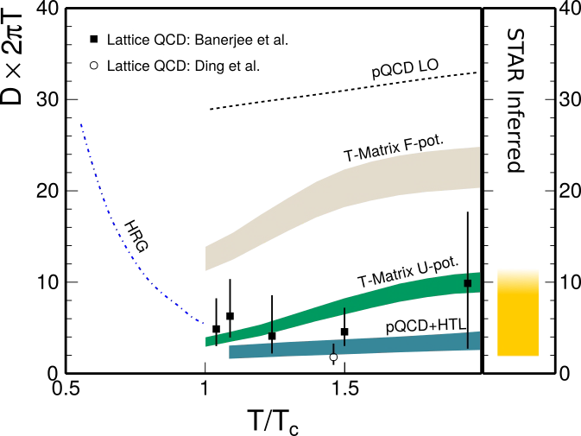
Diffusion Co-efficient
STAR: QM2015
The Diffusion co-efficient times 2π T is observed to be between 1 – 10 and consistent with Lattice QCD calculations
25/34

Slide 26






Phase diagram of QCD matter
Phase diagram of Water
Electromagnetic interaction
Precisely known
Phase diagram of strong interactions
Largely still a conjecture
http://www1.lsbu.ac.uk/water/water_phase_diagram.html
NSAC Long range plan
Many
Unique
26/34

Slide 27


Experimental access to the Phase diagram of QCD
Physical systems undergo phase transitions when external parameters such as the temperature (T) or a chemical potential (μ) are tuned.
Conserved Quantities:
Baryon Number ~ μ_{Β}
Electric Charge ~ μ_{Q} ~ small
Strangeness ~ μ_{S} ~ small
Varying beam energy varies Temperature and Baryon Chemical Potential
P. Braun-Munzinger, J. Stachel
Nature 448:302-309,2007
27/34

Slide 28



QCD Phase Structure ~ Transition Temperature
PRD85 (2012) 054503
NPA 830 (2009) 805c
Nature443:675-678,2006
Science 332 (2011) 1525-1528
Transition temperature and Cross Over established at zero baryon chemical potential
28/34

Slide 29

Experiment and Theory Link
Shape of distribution ~ correlations
Moments relates to Correlation length (ξ):
Study phase transition and Critical Point
< (δN)²> ~ ξ²
< (δN)³> ~ ξ^{4.5}
< (δN)⁴> - 3 < (δN)²>² ~ ξ⁷
Moments relates to Susceptibility (χ) :
Study Bulk properties of QCD matter
Kurtosis x Variance ~ χ⁽⁴⁾/ [χ⁽²⁾ T²]
Skewness x Sigma ~ [χ⁽³⁾ T]/ [χ⁽²⁾ T²]
STAR: Physical Review Letters 2010 and 2014
29/34

Slide 30


Data and QCD (Non-Zero T) 1st Comparison
1st comparison of high energy nuclear collision data to 1st principle QCD calculations
Confirms formation of QGP
Quark-Hadron transition is a cross over
“Scale for the Phase Diagram of Quantum Chromodynamics”
Science, 332, 1525(2011)
30/34

Slide 31

Critical Point and First Order Phase Transition
TIFR, Mumbai
31/34

Slide 32

Experimental Result: CP and 1st Order PT
STAR: Physical Review Letters 2014
32/34

Slide 33
Summary
QCD phase transition and primordial matter created in Laboratory. System of de-confined quarks and gluons formed.
The system of fundamental constituent of any visible matter exhibits the property of perfect fluidity with high degree of opacity. The heavy quarks exhibit Brownian motion in a thermal bath of light partons.
Phase Diagram of Strong Interactions being laid out. Transition temperature and order of phase transition established at zero baryon chemical point. Exciting experimental results on critical point and phase boundary. Susceptibility has a non-monotonic variation with beam energy.
Emergent Properties of QCD Matter
33/34

Slide 34



QCD in 21st Century
Standard Model & Origin of Mass
Test of QCD
Non-perturbative T>0
&
Phase structure of QCD
Phase diagram
Test of QCD, Long distance scales, Non-perturbative regime
Science 332, 1525 (2011)
Test of QCD, Short distance scales, perturbative regime
Science 322, 1224 (2008)
T=0
Towards a complete test of QCD as a theory
34/34

Slide 35
Back Up

Slide 36




Anti-Nuclei
Ionization energy loss:
- < dE/dx > ~ A / β²
= A (1 + m²/ p²)
5 kind of charged
Particles and two
Neutral particles
Nature, 473, 353(2011).
⁴He
2011
Science, 328, 58(2010)
M² = E² - p²
Louis Pasteur: “In the field of observation, chance only
favours those minds which have been prepared”
36
QCD Phase Structures…..

Slide 37







Origin of Mass
Large Hadron Collider contribution to science.

Slide 38



Opacity
Jets Quenched
The shear viscosity to entropy density ratio is found to lie between (1-2)/4π and that reflecting the stopping power was observed to be between 2-10 GeV²/fm.

Slide 39

Collectivity
Initial spatial anisotropy
Pressure gradient
y
φ
x
INPUT
Spatial Anisotropy
Interaction among
produced particles
2v₂
dN/dφ
dN/dφ
0
φ
2π
OUTPUT
Momentum Anisotropy
0
φ
2π
λ=(σρ)⁻¹
Free streaming
v₂=0
c²_{s}=dP/dε
18/34

