Slide 1
PLANAR SUPPORTS FOR NON-PIERCING REGIONS AND APPLICATIONS
RAJIV RAMAN
IIIT DELHI
Joint work with
SAURABH RAY
NYU ABU DHABI

Slide 2






Classic optimization problems
Hypergraph:$\left(P,𝓡\right), ℛ=\left\{R_{1},…R_{n}\right\}, R_{i}⊆P$
Hitting Set Problem:
Pick a smallest cardinality subset of points $P^{′}⊆P$ such that
each set $R∈ℛ$ contains a point of $P.$
Set Cover Problem:
Pick a smallest cardinality subset $ℛ^{′}⊆ℛ,$such that
each point $p∈P$ is contained in a set in $ℛ$’.
Graph: $G=(V,E)$
Independent Set Problem:
Pick a largest cardinality subset $V′⊆V$, such that the vertices in $V′$ are pairwise disjoint.
Dominating Set Problem:
Pick a smallest cardinality subset $V′⊆V$, such that each vertex not
in $V′$, is adjacent to a vertex in $V′$.

Slide 3



Classic optimization problems
Hitting Set, Set Cover, Dominating Set:
-$\ln{n}$ approximation algorithms in polynomial time.
[Lovasz’75, Chvatal’79]
No $\left(1−o\left(1\right)\right)\ln{n }$ approximation algorithms unless
NP $⊆$ DTIME($n^{O(\log{\log{n)}}}$).
[Feige’01]
Independent Set:
- $n/\log^{2}n$ approximation in polynomial time.
[Bopanna, Halldorsson’92]
- No $n^{1−ε}$ approximation unless P=NP.
[Hastad’01]

Slide 4





Geometric set systems
$P$: A set of points in the plane.
$ℛ:$A set of regions
Each region $R∈ℛ$defines a subset of $P.$
Hitting Set Problem:
Pick a smallest cardinality subset of points $P^{′}⊆P$ such that
each region $R∈ℛ$ contains a point of $P.$
Set Cover Problem:
Pick a smallest cardinality subset of regions $ℛ′⊆ℛ$ such that each point $p∈P$ is contained in a region of $ℛ^{′}.$
Weighted version: Pick the smallest weight subset.

Slide 5





Geometric Intersection graphs
$ℛ:$A set of regions
Intersection Graph: $G=(ℛ,E)$
Vertices: The regions $ℛ.$
Edges: Intersecting pair of regions.
Independent Set Problem:
Pick a maximum cardinality subset of regions
$ℛ′⊆ℛ$ that are pairwise disjoint.
Pick a minimum cardinality subset of regions
$ℛ′⊆ℛ$ such that each region in $ℛ$ intersects a region in
$ℛ$’.
Dominating Set Problem:
Weighted version: Pick the smallest weight subset.

Slide 6
Geometric optimization
Already NP-hard for even very restricted variants.
  Equal radius disks.
  Equal sized squares, etc.
  So we look for approximation algorithms.
Approximation algorithm:
An algorithm that runs in polynomial time, and guarantees to return a solution,
whose value is at most a bounded factor away from OPT.
PTAS (Polynomial time Approximation Scheme): Approximation algorithm with
approximation factor $\left(1+ε\right)OPT$, running in polynomial time for every fixed $ε>0.$

Slide 7
geometric setting
Can we do better when the set system (or graph) is defined by simple geometric objects?
Exploit geometry to obtain better approximation algorithms ?
But, why should we care ?
Geometric Optimization problems with simple shapes:
  Appear naturally in many problems.
  Appear in contexts that apriori do not seem to have any connection to geometry.
  Already push the boundaries in terms of existing algorithmic techniques.

Slide 8
Applications

Slide 9

Frequency assignment

Slide 10
Frequency assignment
Independent Set

Slide 11
Radio coverage
Set Cover

Slide 12
Radio coverage
Set Cover

Slide 13
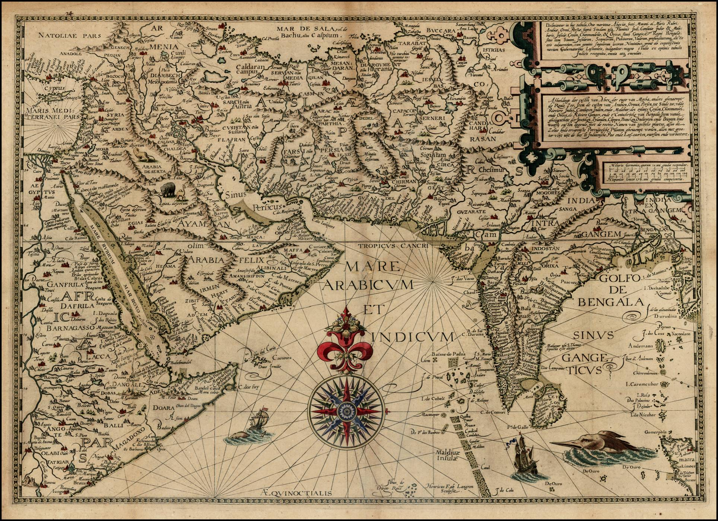
Map labeling

Slide 14
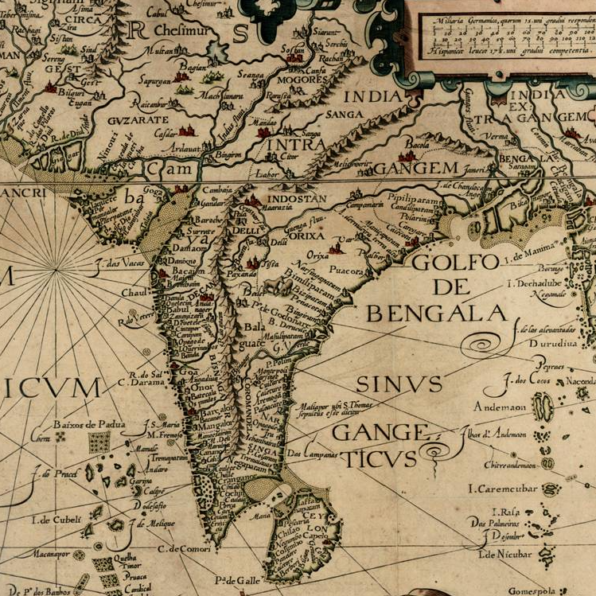
Map labeling
Map Labeling

Slide 15

Generalized scheduling
$n$ jobs: $\{J_{`},. . ., J_{n}\}$
Each job $J_{i}$has release time $r_{i}$, and processing time $p_{i}$.
Scheduling:
Objective:
  minimize sum of monotone function of completion
  of jobs.
  Includes: weighted flow time, weighted tardiness, etc.
An $O(\log{\log{nP)}}$-approximation ($P:max. processing time).$
[Bansal, Pruhs ‘14]
Reduction to a (weighted) Set Cover problem with rectangles on a line

Slide 16

UNSPLITTABLE FLOW
  Given Jobs $J=\left\{J_{1}, J_{2}, . . ., J_{n}\right\}$
  Each job $J_{i}$ has:
    (start time, end time, demand, profit).
  Each time slot has a capacity.
Unsplittable Flow on a Path:
Objective: Maximize the profit of jobs accepted, so that no job exceeds the
capacity of any time.
[Batra, et. al.’16]
Requires: a (weighted) Set Cover problem with rectangles on a line

Slide 17


Scheduling for flow time
$n$ jobs: $\{J_{`},. . ., J_{n}\}$
Each job $J_{i}$has release time $r_{i}$, and processing time $p_{i}, weight w_{i}.$
Scheduling:
Objective: Weighted flow time: $\sum_{k=0}^{n}{w_{i}}$($c_{i}$- $r_{i})$
  Weight.(Completion time – Release time)
An $O(1)$-approximation in pseudo-polynomial time.
[Batra, Garg, Kumar ‘18]
Reduction to a (generalized) Hitting Set problem with paths on a tree

Slide 18
Non-piercing regions
All the applications described above are captured in the following general setting:
Two compact. connected regions A, B are said to be non-piercing, if both A\B and B\A are connected.
Non-Piercing
Piercing

Slide 19

Non-piercing regions
Two compact. connected regions A, B are said to be non-piercing, if both A\B and B\A are connected.
Non-Piercing
A set of regions $ℛ$are said to be non-piercing, if they are pairwise non-piercing.
I will present results on geometric optimization problems for non-piercing regions.

Slide 20
Simply connected
We will sometimes restrict our attention to simply connected, non-piercing regions.
A region is simply connected, if every loop can be contracted to a point.
Simply Connected
Connected, but not simply connected.

Slide 21
Pseudodisks
A set of compact, simply connected regions are said to form pseudodisks if for
Each pair, their boundaries intersect either 2 times, or do not intersect.

Slide 22
Non-piercing regions
Two compact. connected regions A, B are said to be non-piercing, if both A\B and B\A are connected.
Disks
Unit Height Rectangles

Slide 23
Non-piercing regions
Two compact. connected regions $A,B$ are said to be non-piercing, if both $A\backslash B$ and $B\backslash A$ are connected.
Rectangles with a common base
Upward paths on a tree

Slide 24
Non-piercing regions
Two compact. connected regions $A,B$ are said to be non-piercing, if both $A\backslash B$ and $B\backslash A$ are connected.
Rectangles with a common base
Upward paths on a tree
Several other examples: Squares, homothets of convex regions, etc.

Slide 25
Related results

Slide 26







LP-rounding via $ε$-nets
$P:A$set of points in the plane.
$ℛ$ a set of disks in the plane.
Each $R∈ℛ$ defines a set of points.
Goal: Pick a smallest subset $P^{′}⊆P$ such that
Each disk is hit by a point in $P^{′}.$
Easier Goal: Pick a small subset $N⊆P$ hitting only disks with large number of points.
Large: A disk containing at least $ε\left|P\right|$ points.
Such a set is called an $ε$–net.
Fact: $ε$–nets of size $O(\frac{1}{ε}$) exist, and can be computed in polynomial time.

Slide 27




LP-rounding via $ε$-nets
[Bronimann, Goodrich’95]
$$\min{\sum_{p∈P}{x_{p} : \sum_{D∋p}{x_{p}≥1, ∀ D∈ ℛ , }}}$$
LP relaxation:
$$x_{p}≥0, ∀p∈P$$
Let $OPT$be the optimal solution to the hitting set problem.
Let ${OPT}_{LP}$ be the optimal solution to the LP relaxation.
If we consider $x_{p}^{′}s as multiplicities of points, then every$set is at least $\frac{1}{{OPT}_{LP}}$ large.
Round the fractional solution using an $ε$-net.
Size of $ε$-net = $O\left(\frac{1}{ε}\right)$for disks.
Hence, an $O(1)$-approximation algorithm (with same constant as in the $ε$-net.

Slide 28



LP-rounding via $ε$-nets
[Bronimann,Goodrich’95] Small $ε$-nets implies good approximation via LP rounding
LP-rounding via $ε$-nets to get an an $O\left(f\left(OPT\right)\right)$-approximation whenever
there exists $ε$-nets of size $O\left(\frac{1}{ε}f\left(\frac{1}{ε}\right)\right)$.
Bounded VC-dimension:
[Haussler, Welzl ’87]
If the VC-dimension is $d,$then there exist $ε$-nets of size $O\left(\frac{d}{ε}\log{\frac{1}{ε}}\right)$
Random Sampling yields an $ε$-net with high probability.
Hence, also works in the weighted setting.
Gives $O(d\log{OPT) }$-approximation.
Union Complexity (Shallow Cell Complexity):
[Varadarajan’10][Chan, et. al.’12]
If the Union Complexity n$φ\left(n\right),$ then there exist $ε$-nets of size $O\left(\frac{1}{ε}\log{φ\left(\frac{1}{ε}\right)}\right)$
Leads to $O(d\log{φ(OPT))}$-approximation.
Quasi-uniform sampling leads to an $O\left(\frac{1}{ε}\log{φ\left(\frac{1}{ε}\right)}\right)$-approximation

Slide 29

LP-rounding via $ε$-nets
[Bronimann,Goodrich’95] Small $ε$-nets implies good approximation via LP rounding
LP-rounding via $ε$-nets to get an an $O\left(f\left(OPT\right)\right)$-approximation whenever
there exists $ε$-nets of size $O\left(\frac{1}{ε}f\left(\frac{1}{ε}\right)\right)$.
Union Complexity:
[Clarkson, Varadarajan’ 07]
If the Union Complexity n$φ\left(n\right),$ then there exist $ε$-nets of size $O\left(\frac{1}{ε}\log{φ\left(\frac{1}{ε}\right)}\right)$
Leads to $O(d\log{φ(OPT))}$-approximation.
Weighted Setting:
[Varadarajan ‘10][Chan, et. al. ‘12]
Quasi-uniform sampling leads to an $O\left(\frac{1}{ε}\log{φ\left(\frac{1}{ε}\right)}\right)$-approximation.
Pseudodisks have linear union complexity. Hence, constant-factor approximation via LP-rounding for Set Cover.

Slide 30



LP-rounding via $ε$-nets
[Bronimann,Goodrich’95]
LP-rounding via $ε$-nets to get an an $O\left(f\left(OPT\right)\right)$-approximation whenever
there exists $ε$-nets of size $O\left(\frac{1}{ε}f\left(\frac{1}{ε}\right)\right)$.
Bounded VC-dimension:
[Haussler, Welzl ’87]
If the VC-dimension is $d,$then there exist $ε$-nets of size $O\left(\frac{d}{ε}\log{\frac{1}{ε}}\right)$
Random Sampling yields an $ε$-net with high probability.
Hence, also works in the weighted setting.
Gives $O(d\log{OPT) }$-approximation.
Union Complexity:
[Clarkson, Varadarajan’ 07]
If the Union Complexity r$φ\left(r\right),$then there exist $ε$-nets of size $O\left(\frac{1}{ε}\log{φ\left(\frac{1}{ε}\right)}\right)$
Leads to $O(d\log{φ(OPT))}$-approximation.

Slide 31

LP-rounding via $ε$-nets
Weighted Setting.
Bounded VC-dimension:
Random Sampling yields an $ε$-net with high probability.
Hence, also works in the weighted setting.
Gives $O(d\log{OPT) }$-approximation.
Union Complexity:
[Varadarajan ‘10][Chan, et. al. ‘12]
Quasi-uniform sampling leads to an $O\left(\frac{1}{ε}\log{φ\left(\frac{1}{ε}\right)}\right)$-approximation.

Slide 32
Random shifting
Random Shifting by a hierarchical grid,
and dynamic programming.
Can equivalently be done via a random
shifting of a quad-tree.
Works only for fat objects.
Primarily for packing problems.
[Erlebach, et. al.’05][Chan ‘03]

Slide 33
Local search

Slide 34

Local search
The Bronimann-Goodrich algorithm can not do better than a constant-factor.
There are lower bounds on the size of an $ε$-net.
The random grid shifting technique only works for packing the problems, and
only for fat objects.
Local Search Algorithm Scheme:
Start with a feasible solution.
Repeat
  If there is a swap of constant size that improves the solution,
improve the solution.
While local improvement is possible.
Return the current solution.

Slide 35
Local search
This simple local search algorithm has shown to be a PTAS for several problems.
Hitting Set for Pseudodisks. [Mustafa, Ray ’09]
Independent Set for Pseudodisks [Chan, Har-Peled ’09]
Dominating Set for Disks. [Gibson, Pirwani ’10]
Guarding 1.5D terrains. [Krohn, et. al.’10]
Region packing for disks, and several other problems. [Aschner, et. al. ’12]
Set Cover with Pseudodisks.
Dominating Set with Pseudodisks.
Region packing with Pseudodisks.
Point packing with non-piercing regions.
Unified algorithm for Hitting Set, Set Cover, Dominating Set for non-piercing regions even with holes [with Ray’18]
Several clustering problems, TSP with random input, etc.[Cohen-Addad,et. al. 17]
[with Basu Roy, et. al. ’16]

Slide 36

Local search
Local Search for Hitting Set:
Start with a feasible solution: all points.
Repeat
  Try to replace at most $k$ vertices from the current solution, by
  $k−1$ vertices that is a hitting set.
While an improvement is possible.
Return the current solution.
Choose $k=O(1/ε^{2}$), for a $\left(1−ε\right)$-approximation.

Slide 37
Local search for non-piercing regions
Showing the existence of a graph satisfying suitable conditions implies
Local search is a PTAS:
The graph captures the geometry of the problem.
The additional properties of the graph will help us to argue that the
the local search algorithm is a PTAS:
  We want a graph from a hereditary family that has sub-linear sized
  balanced vertex separators.
  Examples include planar graphs, bounded genus graphs, etc.

Slide 38
Planar support

Slide 39
Planar support
Planar Support:
Given a hypergraph $\left(X,ℬ\right), a$ planar support is a planar graph $G=\left(X,E\right),$ such that
for each $B∈ℬ$, the subgraph of $G$ induced on the points in $B$, is connected.
For showing that local search yields a PTAS, the existence of a planar support
for a suitably defined hypergraph is sufficient.
In many cases, a slightly weaker notion is sufficient.
Most results showing PTAS for the problems described show the existence of
a planar graph, specific to the problem, and satisfying the weaker condition.

Slide 40
Local search for non-piercing regions
Planar Support:
Given a hypergraph $\left(X,ℬ\right), a$ planar support is a planar graph $G=\left(X,E\right),$ such that
for each $B∈ℬ$, the subgraph of $G$ induced on the points in $B$, is connected.

Slide 41
Local search for non-piercing regions
Planar Support:
Given a hypergraph $\left(X,ℬ\right), a$ planar support is a planar graph $G=\left(X,E\right),$ such that
for each $B∈ℬ$, the subgraph of $G$ induced on the points in $B$, is connected.

Slide 42
Local search for non-piercing regions
Planar Support:
Given a hypergraph $\left(X,ℬ\right), a$ planar support is a planar graph $G=\left(X,E\right),$ such that
for each $B∈ℬ$, the subgraph of $G$ induced on the points in $B$, is connected.

Slide 43
Local search for non-piercing regions
Planar Support:
Given a hypergraph $\left(X,ℬ\right), a$ planar support is a planar graph $G=\left(X,E\right),$ such that
for each $B∈ℬ$, the subgraph of $G$ induced on the points in $B$, is connected.

Slide 44
Local search for non-piercing regions
Planar Support:
Given a hypergraph $\left(X,ℬ\right), a$ planar support is a planar graph $G=\left(X,E\right),$ such that
for each $B∈ℬ$, the subgraph of $G$ induced on the points in $B$, is connected.

Slide 45

Local search for non-piercing regions
Hitting Set:
Required Graph:
Consider the local solution (in blue) and
an optimal solution (in red).
A planar graph $G$ on a local solution, and an optimal solution, such that
For each region $R∈ℛ$, there is an edge between a red vertex in $R$, and a blue vertex in $R$.

Slide 46

Local search for non-piercing regions
Hitting Set:
Required Graph:
Consider the local solution (in blue) and an optimal solution (in red).
A planar graph $G$ on a local solution, and an optimal solution, such that
For each region $R∈ℛ$, there is an edge between a red vertex in $R$, and a blue vertex in $R$.

Slide 47

Local search for non-piercing regions
Hitting Set:
Required Graph:
Consider the local solution (in blue) and
an optimal solution (in red).
A planar graph $G$ on a local solution, and an optimal solution, such that
For each region $R∈ℛ$, there is an edge between a red vertex in $R$, and a blue vertex in $R$.

Slide 48
Local search for non-piercing regions
Hitting Set:
Required Graph:
Consider the local solution (in blue) and
an optimal solution (in red).
A planar graph $G$ on a local solution, and an optimal solution, such that
For each region $R∈ℛ$, there is an edge between a red vertex in $R$, and a blue vertex in $R$.

Slide 49
Local search for non-piercing regions
Hitting Set:
Required Graph:
Consider the local solution (in blue) and
an optimal solution (in red).
A planar graph $G$ on a local solution, and an optimal solution, such that
For each region $R∈ℛ$, there is an edge between a red vertex in $R$, and a blue vertex in $R$.

Slide 50

Local search for non-piercing regions
Hitting Set:
Required Graph:
Consider the local solution (in blue) and
an optimal solution (in red).
A planar graph $G$ on Local solution and optimal solution, such that
For each region $R∈ℛ$, the induced subgraph of $G$ is connected.

Slide 51
Planar support
Planar Support:
Given a hypergraph $\left(X,ℬ\right), a$ planar support is a planar graph $G=\left(X,E\right),$ such that
for each $B∈ℬ$, the subgraph of $G$ induced on the points in $B$, is connected.
The existence, and construction of a planar support have applications beyond
proving that a local search algorithm is a PTAS.
Other applications include:
  Hypergraph Visualization.
  Hypergraph Coloring, etc.
Building a planar support enables us to use tools from Graph Theory to solve many
Geometric problems

Slide 52

Planar support
Planar Support:
Given a hypergraph $\left(X,ℬ\right), a$ planar support is a planar graph $G=\left(X,E\right),$ such that
for each $B∈ℬ$, the subgraph of $G$ induced on the points in $B$, is connected.
Main Theorem:
Given a family $ℛ$, of red non-piercing regions, and a family $ℬ$, of blue non-piercing
regions, there exists is a planar graph $G=\left(ℬ,E\right)$, such that for each
$R∈ℛ$, the induced graph of $G$ on the blue regions intersecting $R,$forms a connected
subgraph.
Further, such a support can be computed in time polynomial in $\left|ℬ\right|,|ℛ|$, and
the number of vertices in the arrangement of the red and blue regions.

Slide 53

Planar support
Intersection Hypergraph
Given a family $ℛ$, of red non-piercing regions, and a family $ℬ$, of blue non-piercing regions, there exists a planar support for the intersection hypergraph $\left(ℬ,ℛ\right),$i.e., there is a planar graph
$G=\left(ℬ,E\right)$, such that:
For each $R∈ℛ$, the induced graph of $G$ on the blue regions intersecting $R,$forms a connected subgraph.

Slide 54
Planar support
Intersection Hypergraph
Given a family $ℛ$, of red non-piercing regions, and a family $ℬ$, of blue non-piercing regions, there exists a planar support for the intersection hypergraph $\left(ℬ,ℛ\right),$i.e., there is a planar graph
$G=\left(ℬ,E\right)$, such that:
For each $R∈ℛ$, the induced graph of $G$ on the blue regions intersecting $R,$forms a connected subgraph.

Slide 55
Planar support
Intersection Hypergraph
Given a family $ℛ$, of red non-piercing regions, and a family $ℬ$, of blue non-piercing regions, there exists a planar support for the intersection hypergraph $\left(ℬ,ℛ\right),$i.e., there is a planar graph
$G=\left(ℬ,E\right)$, such that:
For each $R∈ℛ$, the induced graph of $G$ on the blue regions intersecting $R,$forms a connected subgraph.

Slide 56
Planar support
Intersection Hypergraph
Given a family $ℛ$, of red non-piercing regions, and a family $ℬ$, of blue non-piercing regions, there exists a planar support for the intersection hypergraph $\left(ℬ,ℛ\right),$i.e., there is a planar graph
$G=\left(ℬ,E\right)$, such that:
For each $R∈ℛ$, the induced graph of $G$ on the blue regions intersecting $R,$forms a connected subgraph.

Slide 57
Planar support
Intersection Hypergraph
Given a family $ℛ$, of red non-piercing regions, and a family $ℬ$, of blue non-piercing regions, there exists a planar support for the intersection hypergraph $\left(ℬ,ℛ\right),$i.e., there is a planar graph
$G=\left(ℬ,E\right)$, such that:
For each $R∈ℛ$, the induced graph of $G$ on the blue regions intersecting $R,$forms a connected subgraph.

Slide 58


Planar support
Special Case: When $ℬ$ is a set of points
Primal Hypergraph
Given a family $ℛ$, of red non-piercing regions, and a family $P$ of points,
there exists a planar support for the hypergraph $\left(P,ℛ\right),$i.e., there is
a planar graph $G=\left(P,E\right)$, such that:
For each $R∈ℛ$, the induced graph of $G$ on the points contained in $R,$forms a connected subgraph..

Slide 59
Planar support
Special Case: When $ℬ$ is a set of points
Primal Hypergraph
Given a family $ℛ$, of red non-piercing regions, and a family $P$ of points,
there exists a planar support for the hypergraph $\left(P,ℛ\right),$i.e., there is
a planar graph $G=\left(P,E\right)$, such that:
For each $R∈ℛ$, the induced graph of $G$ on the points contained in $R,$forms a connected subgraph..

Slide 60

Planar support for the primal
Construct a planar graph on the
points, such that for each region
$R∈ℛ$, the induced sub-graph on the
points is connected.

Slide 61
Planar support for the primal
Construct a planar graph on the
points, such that for each region
$R∈ℛ$, the induced sub-graph on the
points is connected.

Slide 62
Planar support for the primal
Construct a planar graph on the
points, such that for each region
$R∈ℛ$, the induced sub-graph on the
points is connected.

Slide 63


Planar support
Special Case: When $ℛ$is a set of points.
Dual Hypergraph
Given a family $ℬ$, of non-piercing regions, and a family $P$ of points,
there exists a planar support for the hypergraph $\left(ℬ,P\right),$i.e., there is
a planar graph $G=\left(ℬ,E\right)$, such that for each
$p∈P$, the induced graph of $G$ on the regions containing $p,$form a connected
subgraph.
Note: We can assume $P$ consists of all the points in the plane.

Slide 64

Planar support for the dual
Dual Support:
Construct a graph $G$on the regions,
Such that for each point in the plane,
The set of regions containing the point
induce a connected subgraph of $G$.

Slide 65

Planar support for the dual
Dual Support:
Construct a graph $G$on the regions,
Such that for each point in the plane,
The set of regions containing the point
induce a connected subgraph of $G$.

Slide 66

Planar support for the dual
Dual Support:
Construct a graph $G$on the regions,
Such that for each point in the plane,
The set of regions containing the point
induce a connected subgraph of $G$.

Slide 67
Planar support for the dual
Dual Support:
Construct a graph $G$on the regions,
Such that for each point in the plane,
The set of regions containing the point
induce a connected subgraph of $G$.

Slide 68
Planar support
Primal Hypergraph:
  If the regions are disks, or halfspaces: The delaunay triangulation of the points
  is a planar support.
  For simply connected non-piercing regions (eg. pseudodisks),
  a complicated existence proof was known [Pyrga, Ray’08].
Dual Hypergraph:
  If the regions are disks, we obtain a planar support by lifting to points and
  and halfspaces in 3-D, and taking the dual (since points and halfspaces are self-dual),
  and the existence of a planar support for points and halfspaces implies a planar
  support.
  Weaker result known for simply connected, non-piercing regions [with Basu Roy, et. al.’16]
Intersection Hypergraph:
  Weaker result known [Keszegh ‘18]
  No results known for regions with holes.

Slide 69
results
The Set Cover problem with a set of points, and non-piercing regions
admits a PTAS.
The Hitting Set problem with a set of points, and non-piercing regions admits a PTAS.
The Dominating Set problem with a set of non-piercing regions admits a PTAS.
The Independent Set problem in the intersection graph of non-piercing regions admits
a PTAS.
The Set Cover, Hitting Set and Dominating Set results follow from the fact that there
exists a PTAS for the generalized covering problem with the intersection hypergraph
of two non-piercing regions, which in turn follows from the existence of a planar support
for the intersection hypergraph of two families of non-piercing regions.

Slide 70

results
Region Packing:
Given a set of points $P,$and a set of non-piercing regions $ℛ$, each point$p$ has a capacity
$c_{p}$, bounded by a constant, find a maximum cardinality subset of regions $ℛ^{′}⊆ℛ,$such that
each point $p∈P$ is contained in at most $c_{p}$ regions of $ℛ^{′}.$

Slide 71
results
Region Packing:
Given a set of points $P,$and a set of non-piercing regions $ℛ$, each point$p$ has a capacity
$c_{p}$, bounded by a constant, find a maximum cardinality subset of regions $ℛ^{′}⊆ℛ,$such that
each point $p∈P$ is contained in at most $c_{p}$ regions of $ℛ^{′}.$

Slide 72
results
Region Packing:
Given a set of points $P,$and a set of non-piercing regions $ℛ$, each point$p$ has a capacity
$c_{p}$, bounded by a constant, find a maximum cardinality subset of regions $ℛ^{′}⊆ℛ,$such that
each point $p∈P$ is contained in at most $c_{p}$ regions of $ℛ^{′}.$

Slide 73

results
Point Packing:
Given a set of points $P,$and a set of non-piercing regions $ℛ$, each region$R∈ℛ$ has a capacity
$c_{R }$, bounded by a constant, find a maximum cardinality subset of points $P′⊆P$, such that the
number of points of contained any region of $ℛ$ is at most its capacity.

Slide 74
results
Point Packing:
Given a set of points $P,$and a set of non-piercing regions $ℛ$, each region$R∈ℛ$ has a capacity
$c_{R }$, bounded by a constant, find a maximum cardinality subset of points $P′⊆P$, such that the
number of points of contained any region of $ℛ$ is at most its capacity.

Slide 75
results
Region Packing:
With additional ideas, we can obtain a PTAS for the region packing problem.
Point Packing:
With additional ideas, we can obtain a PTAS for the point packing problem.
Both these results are a consequence of a generalized packing problem
for the intersection hypergraph of two non-piercing regions.
For both of these results, we require that any pair of regions intersect at most a
constant number of times.

Slide 76

results
Hypergraph Coloring:
Given a family $ℛ$of non-piercing regions, and a family $ℬ$of non-piercing regions,
the intersection hypergraph $\left(ℬ,ℛ\right)$ can be colored with 4 colors, such that every region
$R∈ℛ$intersects regions in $ℬ$with at least two distinct colors.

Slide 77
results
Hypergraph Coloring:
Given a family $ℛ$of non-piercing regions, and a family $ℬ$of non-piercing regions,
the intersection hypergraph $\left(ℬ,ℛ\right)$ can be colored with 4 colors, such that every region
$R∈ℛ$intersects regions in $ℬ$with at least two distinct colors.

Slide 78

results
Hypergraph Coloring:
Given a family $ℛ$of non-piercing regions, and a family $ℬ$of non-piercing regions,
the intersection hypergraph $\left(ℬ,ℛ\right)$ can be colored with 4 colors, such that every region
$R∈ℛ$intersects regions in $ℬ$with at least two distinct colors.
[Keszegh ‘18] proved this result, and several consequences.
This result, and its consequences follow immediately from our result, since we can
construct a planar support for the intersection hypergraph, and the fact that planar
graphs are 4-colorable.

Slide 79
Construction of a planar support

Slide 80

Planar support for the dual
Dual Support:
Construct a graph $G$on the regions,
Such that for each point in the plane,
The set of regions containing the point
induce a connected subgraph of $G$.
To highlight the key ideas,
we assume, for this presentation
that the regions are
simply connected.
We also assume the regions
are in general position.

Slide 81
Planar support for the dual
Dual Support:
Construct a graph $G$on the regions,
Such that for each point in the plane,
The set of regions containing the point
induce a connected subgraph of $G$.

Slide 82
Planar support for the dual
THEOREM:
A planar support for the dual
of a set of non-piercing regions
exists, and can be computed in
polynomial time.

Slide 83

Planar support for the dual
CELL:
A connected regions of $ℝ^{2}\backslash ∂ℛ.$
Remove the boundaries of the
regions, and the connected regions
we are left with are the cells.
DEPTH:
Number of regions containing a
cell.
ADJACENT CELLS:
Share an arc of the boundary of
a region.

Slide 84
Planar support for the dual
Lemma:
A maximal depth cell is contained
in all the regions defining the cell.

Slide 85
Planar support for the dual
LEMMA:
In any cell of maximal depth, there
is a region, whose boundary appears
exactly once.
Such a region will be called a
good region for the cell.
Can be proved using results about
Davenport-Schinzel sequences.

Slide 86
Planar support for the dual
CELL BYPASSING:
Bypassing is the operation of modifying the boundary of a region to go outside the cell.

Slide 87
Planar support for the dual
Lemma: The regions remain non-piercing after bypassing a maximal cell by a good region.

Slide 88
Planar support for the dual
Observation: If the maximum depth of the arrangement is 2, then the intersection graph
is planar, and is the desired planar support.

Slide 89
Planar support for the dual
Observation: If the maximum depth of the arrangement is 2, then the intersection graph
is planar, and is the desired planar support.

Slide 90

Planar support for the dual
Observation: If the maximum depth of the arrangement is 2, then the intersection graph
is planar, and is the desired planar support.
While there is a cell of depth $≥3$
  Pick a maximum depth cell C.
  Bypass C by a good region of C.
Construct the intersection graph
  of the depth 2 regions.
We have reduced the number of maximum depth cells.
But, we create many new cells.

Slide 91
Planar support for the dual
Lemma: A planar support for the original instance can be obtained from the instance obtained after a cell-bypassing.
$$\left\{a,b,c\right\}∪\left\{b,c,d\right\}∪\left\{a,c,d\right\}∪\left\{a,b,d\right\}=\left\{a,b,c,d\right\}$$

Slide 92
Planar support for the dual
Couple of issues have been glossed over, for instance dealing with the situation
where one region is contained in the other,
How to deal with holes, etc.
The description gives the high level idea.

Slide 93

Planar support for the dual
Running time:
It is not at all clear the algorithm runs in polynomial time.
Each time we create many new cells.
A more detailed understanding of the combinatorial structure of non-piercing
regions allows us to define a potential function.
We can show that the initial potential function value is polynomial, and at each step
the potential drops proportional to the complexity of the cell.
This allows us to prove that the algorithm runs in $O\left(n^{3}+m\right)$, where $n$ is the number
regions, and $m$ is the number of intersection points of their boundaries.

Slide 94
Planar support for the primal
Observation:
If each cell has a point, then the
Dual arrangement graph is the desired
support graph.
It is planar.
The cells in a region are connected,
since each region is connected.

Slide 95
Planar support for the primal
Add fake points, so that each cell
contains a point.
Now, the dual arrangement graph is the
desired planar support.

Slide 96
Planar support for the primal
Bypass each maximal cell that contains a fake point.
Each maximal cell contains a real point.

Slide 97
Planar support for the primal
Construct the dual arrangement
graph on the real and fake points.

Slide 98
Planar support for the primal
Direct an edge from each fake point to a neighboring vertex in a cell of higher depth.
Observation:
Since each maximal cell contains a
real point, each fake point has a
unique path up to a real point.

Slide 99
Planar support for the primal
Key Lemma:
All regions containing the fake point
also contain the real point at the end
of the directed path.
Since we monotonically increase depth
along neighboring cells.

Slide 100
Planar support for the primal
Observation:
The directed edges induce a forest,
where the arcs are directed towards the
root.
Contract each tree of the forest
to its root.
Contraction preserves planarity.
This is the desired planar support.

Slide 101
Planar support for the primal
Uses the cell-bypassing of the
planar support for the dual
hypergraphs, and additional ideas.

Slide 102
Planar support for the primal
Observation:
The directed edges induce a forest,
where the arcs are directed towards the
root.
Contract each tree of the forest
to its root.
Contraction preserves planarity.
This is the desired planar support.

Slide 103

Planar support for the intersection hypergraph
With ideas from the construction of a planar support for the dual, and and primal
hypergraphs, along with some additional ideas, we can prove:
Theorem:
Given a family $ℛ$ of red non-piercing
regions, and a family $ℬ$ of blue non-piercing
regions, we can construct a planar graph
$G=\left(ℬ,E\right),$on $ℬ$, such that:
For each red region $R∈ℛ$, the set of
Blue regions intersecting $R$ induce a
connected sub-graph of $G$.

Slide 104
results
The PTASs for Covering and Packing problems via local search only work in the
Unweighted setting.
What about the weighted setting ?
  From [Varadarajan ‘10][Chan ’12] we know that there exist a constant-factor
  approximation for the weighted Set Cover and Dominating Set problems.
  Does there exist a PTAS ?

Slide 105
QPTAS for weighted set cover

Slide 106

Independent set
Independent Set in the intersection graph
of segments in the plane.
$O\left(\sqrt{OPT}\right)$-approximation [Agarwal, Mustafa’ 06]
$O\left(n^{ε}\right)$-approximation [Fox, Pach ‘11]
QPTAS [Adamaszek, Wiese’ 14]
  Also works in the weighted setting.
QPTAS: $\left(1−ε\right)$-approximation in quasi-polynomial time, i.e., in time $O\left(n^{polylog(n,\frac{1}{ε})}\right)$

Slide 107

Independent set
Main Idea:
Given any weighted set of disjoint segments, with total $W$weight , and any $0<δ<1$,
we can find a closed curve $∁$with $O\left(\frac{1}{δ}\right)$ bends, such that
The total weight of segments intersecting $∁$
is at most $δW.$
The total weight of segments on either side
of is at most $2W/3.$
Original Proof: [Adamaszek, Wiese’ 14]
Simpler Proofs based on cuttings: [Adamaszek, Wiese’ 14][Har-Peled’ 14],
[with Mustafa, Ray’14].

Slide 108

Geometric separators
Enumerate over all $n^{O\left(1/δ\right)}$
separators.
Recurse on both sides of
the separator.
Pick the best solution.

Slide 109
Weighted set cover
Pick the smallest weight subset of regions, such that each point in the input is covered
by one of the chosen regions.
Can we use the geometric separator approach of Adamaszek, Wiese to get a QPTAS ?
Seems doomed, since the optimal solution can intersect arbitrarily.

Slide 110

Weighted set cover
Idea: Decompose the Union of the regions of an optimal solution into disjoint pieces,
and then use the separator theorem for these disjoint pieces.
Theorem:
Given a set of regions $ℛ$, we can define
for each region $R∈ℛ$, a core $\tilde{R}$ , such that:
The cores are disjoint.
The union of the cores is identical to
the union of the regions.
The total weight of the cores, multiplied
by the number of vertices is $O\left(W\right), i.e.,\sum_{R∈ℛ}{s(\tilde{R}}$).$w(R)=O(W).$
s($\tilde{R}$ $)=\#$vertices on $\tilde{R}.$

Slide 111


Weighted set cover
Using the previous theorem, we can show that:
For any instance of a Set Cover problem with weighted non-piercing regions,
we can find a separator curve $∁,$ such that:
$OPT\left(P_{in}\left(C\right)\right)≤\left(\frac{2}{3}+δ\right)OPT$
$OPT\left(P_{ext}\left(C\right)\right)≤\left(\frac{2}{3}+δ\right)OPT$
$OPT\left(P_{in}\left(C\right)\right)+ OPT\left(P_{ext}\left(C\right)\right)≤ \left(1+2δ\right)OPT$

Slide 112
Weighted set cover
Similar techniques developed for
Weighted Set Cover for halfspaces
In 3D.

Slide 113
Weighted set cover
Shape | Unweighted | Weighted
Halfspaces 2-D | Exact | Exact
Halfspaces 3-D | PTAS | QPTAS
Halfspaces d-D,d>3 | APX-hard | APX-hard
Balls in 2-D | PTAS | QPTAS
Pseudodisks in 2-D | QPTAS | QPTAS
Balls in 3-D | APX-hard | APX-hard
Rectangles 2-D | APX-hard | APX-hard
Triangles in 2-D | APX-hard | APX-hard
Non-piercing regions | PTAS | ?
[Mustafa, R. Ray’14]
The key separation in the plane seems to be between piercing and non-piercing.

Slide 114
RESEARCH DIRECTIONS
For non-piercing regions:
Polynomial time algorithm for constructing a planar support.
The algorithm currently runs in cubic time. Is there a faster algorithm ?
  With Ambar, we have recently obtained O(nlog n)-time algorithms when the objects are non-piercing axis-parallel rectangles (for the primal setting).
  Can we extend these results to planar graphs ?
    Graphs drawn on a surface ? (Does not directly extend, but some
    analogue must be true).

Slide 115
Research directions
Dealing with Piercing:
For non-piercing region we obtain PTAS for several problems in the unweighted
setting.
Set Cover with nearly equilateral, nearly congruent triangles is APX-hard [Har-Peled ‘09].
Develop techniques to deal with piercing regions.

Slide 116
Research directions
Non-Planar Supports
Are there algorithms that yield a non-planar support ?
We are interested in graph classes that have sub-linear sized separators.
The most general class of graphs that have this property are called
Sparse graphs. However, we don’t know when such supports exist.

Slide 117

Research directions
Pick the smallest subset of lines that
cover all points.
Best Known: $O(\log{n)}$-approximation via
$ε$-nets and LP rounding.
The LP can not give a constant-factor
approximation, due to the non-linear
lower bound on the size of $ε$-nets for
this set system [Alon ‘12].
We don’t know algorithms better than
the obvious ones if we consider line
segments in two orthogonal directions !

Slide 118
Research directions
LP Techniques+Geometry for Dealing with Costs, Capacities, Demands.
The geometric techniques developed work in the unweighted setting, and for some
problems such as region packing, point packing, etc.
Many applications require dealing with costs, capacities, and demands. For example,
minimizing average flow time [Batra, Kumar, Garg’ 18].
To obtain better approximations require a mix of Linear Programming based techniques,
such as LP-rounding, primal-dual, iterative rounding, etc. along with geometric tools.

Slide 119
Research directions
Techniques from Structural Graph Theory.
Except for a few examples, all the constructions of a support are planar supports.
Are there better techniques to show the existence of a support from a hereditary
class with sub-linear support ?
The most general class of such graphs are called sparse graphs.[Nesetril, de Mendez’12]
Is there a characterization of regions (say topologically defined) for which we can prove the existence of a sparse support ?
For dealing with weighted problems, we want to use structural tools such as treewidth, clique-width, etc. in conjunction with dynamic programming.

Slide 120
Research directions
Applications
Many of the problems studied have direct applications in robotics, especially UAVs.
  Working with researchers in robotics to solve their geometric optimization
  problems.
  Development of fast and practical algorithms.
Fundamental Approximation Algorithms:
Use geometric insights back into attacking longstanding questions in approximation algorithms such as: Unsplittable Flow, Flow time, etc.

Slide 121
RESEARCH OVERVIEW

Slide 122
Other work
Graph Coloring problems:
  Max-Coloring of special graph classes.
  Online coloring of graph classes.
  Structural restrictions such as forbidden induced subgraphs.
Pricing problems.
  Highway and Tollbooth pricing.
Maximum-Feasible subsystem.
  Complexity of Maximum feasible subsystem problem for restricted matrices.
Resource allocation, and scheduling problems.
  Unsplittable flow on a path.
  Coverage version of unsplittable flow.

Slide 123
Thank you

Slide 124


GRAPH COLORING
Color vertices with fewest colors, so that adjacent vertices receive distinct colors
Chromatic Number $χ(G)$: Fewest number of colors such that coloring exists.
Clique Number $π(G)$: Largest subset of pairwise adjacent vertices.
$$χ(G)≥π(G)$$

Slide 125

GRAPH COLORING
Several applications in resource allocation, scheduling, etc.
NP-hard problem. Worse still, hard to approximate in polynomial time.
Special cases tractable.
Approximation algorithm: Algorithm that runs in polynomial time, and guarantees to produce a solution, whose value is at most $c.OPT$, where $OPT$ is the value of an optimal solution (and $c≥1$).
Example:
A polynomial time algorithm that always produces a coloring with at most $2χ(G)$ colors.

Slide 126
INTERVAL GRAPHS
b
c
a
d
a
c
b
d

Slide 127
COLORING INTERVAL GRAPHS
b
2
1
c
a
1
2
d
Coloring can be solved in polynomial time.
Sub-class of perfect graphs.
Coloring can be solved in polynomial time for perfect graphs via a sophisticated algorithm.

Slide 128
Max-coloring INTERVAL GRAPHS
b
1
c
1
a
3
d
3
Weights on vertices.
Cost of a color class = Max. wt. of a vertex in a color class.
Cost of coloring = Sum of weights of color classes.
Find coloring to minimize weight.

Slide 129
Max-coloring INTERVAL GRAPHS
b
1
c
1
a
3
d
3
b
d
3
6
1
a
3
c
1
b
1
5
c
1
a
3
d
3

Slide 130
Online coloring INTERVAL GRAPHS
2 COLORS SUFFICE
b
d
a
c
3 COLORS REQUIRED
b
c
a
d

Slide 131


Online coloring INTERVAL GRAPHS
b
c
a
d
k = $π\left(G\right)=$
2
2
2
QUESTION:
How many colors are required in the worst case over all orderings ?
Let k = max. no. of intervals intersecting a vertical line (=$π(G))$.
Is number of colors required = O(k) ?

Slide 132
Online coloring INTERVAL GRAPHS
b
c
a
d
k = $π\left(G\right)=$
2
2
2
QUESTION:
How many colors are required in the worst case over all orderings ?
Let k = max. no. of intervals intersecting a vertical line (=$π(G))$.
Is number of colors required = O(k) ?

Slide 133

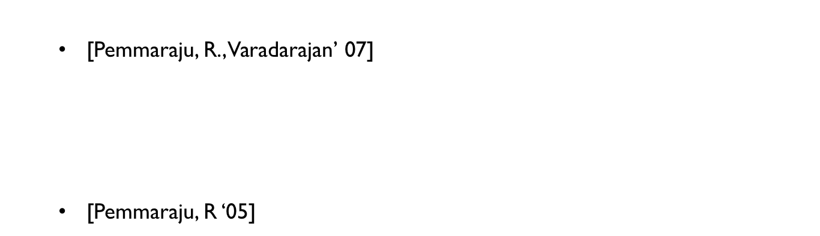
Our results
MAX-COLORING INTERVAL GRAPHS
b
1
5
c
1
a
3
d
3
NP-hard, and there exists a 2-approximation algorithm.
  [Pemmaraju, R., Varadarajan’ 07]
If $G$ has a $c$-approximation algorithm for coloring, then $G$ has an $e.c$-approximation
algorithm for Max-Coloring (where G is a hereditary class).
  8/7-approx. for bipartite graphs, and NP-hard to approximate beyond 8/7.
  PTAS, and O($n^{O(\log{n)}}$) exact algorithm for trees.
  [Pemmaraju, R ‘05]
A $\left(1+ε\right)$-approx. for interval graphs [Nonner ‘11]
O($n^{O(\log{n)}}$)-algorithm is optimal under ETH [Araujo, et. al.’14]

Slide 134

Our results
ONLINE-COLORING INTERVAL GRAPHS
b
c
a
d
2
2
2
First-fit uses at most $10k$-colors, via a column-construction method.
[Pemmaraju, R., Varadarajan, TALG’ 07]
40k. [Kierstead’88], improved to 27k [Kierstead, Qin’95].
Lower bound: 4.4k [Chrobak, Slusarek’88] (computer assisted)
$\left(5−ε\right)k$ [Kierstead, Smith, Trotter’16] (initially computer assisted).
Column Construction method: Used for proving several results on on-line partitioning of some partial orders.

